Slide 1
Connecting to Design | VALUE
Notes:
Goal: Set expectations: slides support teaching; textbook carries depth.
Commentary on Design: Follow the link to explore real-world examples of these concepts in graphic design, fashion design, industrial design, interior design, media arts and animation, game art and design, and film and video.

Slide 2
element | VALUE
Value is the relative degree of lightness or darkness in a given context.
We make judgments as to whether an object is light or dark
by comparing it to its surroundings.

Slide 3
VALUE AND CONTRAST
value scale
high-key, low-key
high contrast, low contrast

Slide 4
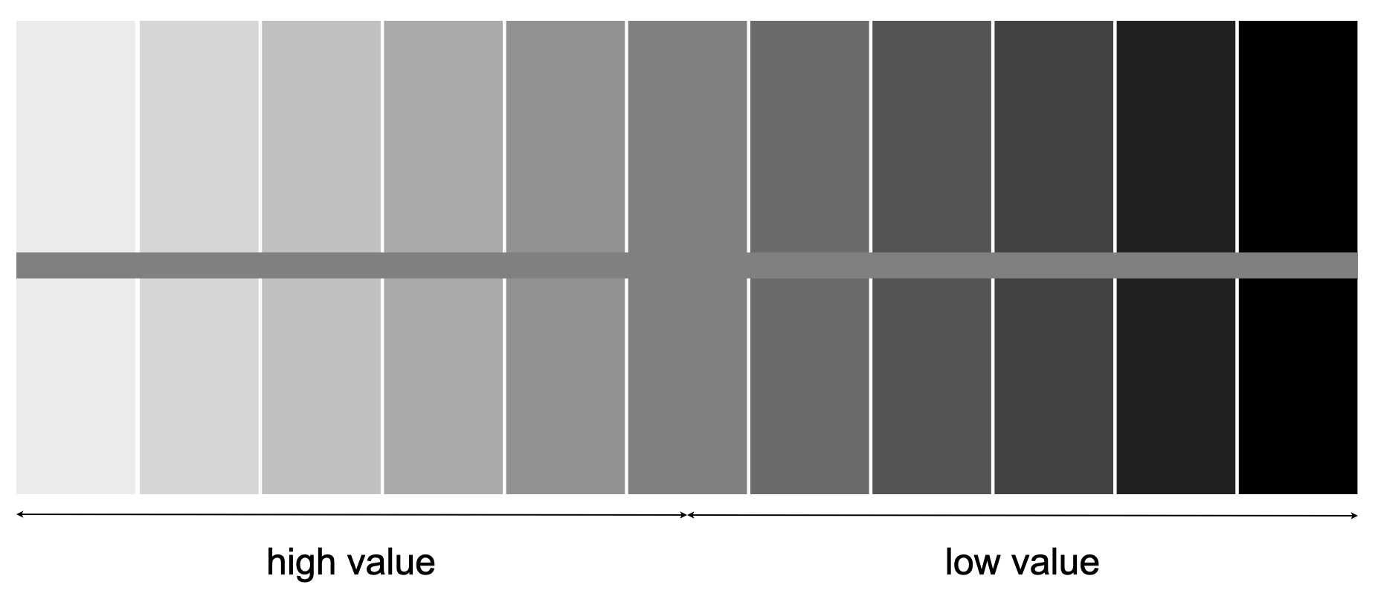
value scale
A value scale shows the gradation from light to dark in even-step intervals.
Notes:
A middle value can look darker near white, and lighter near black, because your eye compares.
Ask: How does a medium value change when placed next to light vs dark?
Ask: Why does this matter for logo design, UI readability, or drawing shadows?

Slide 5


high-key
FORM
Range of high to middle values
CONTENT
Peaceful / quiet
Airy / tranquil
Notes:
High-key scenes often feel open and peaceful because there’s less darkness and less heaviness.
Describe the mood in 3 words.
Ask: What about this scene feels calm, lightness, open space, or both?
Ask: Where do you see high-key lighting used (product ads, comedies, wellness branding)?

Slide 6

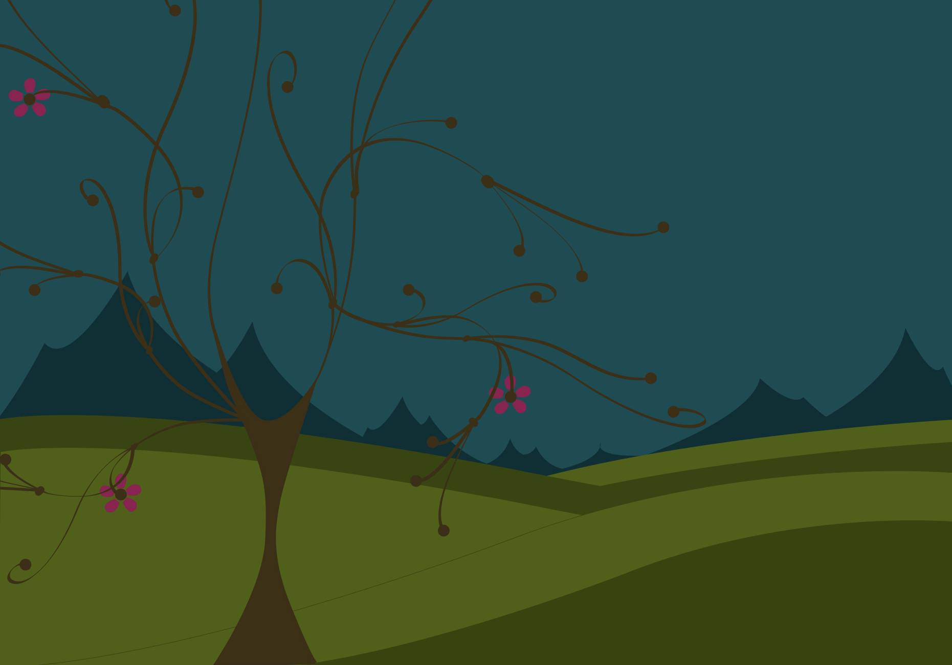
low-key
FORM
Range of middle to low values
CONTENT
Somber / serious
Gloomy / heavy
Notes:
Low-key value can make the same subject feel heavier, more intense, even unsettling.
Ask: What does the tree “feel like” now versus high-key?
Ask: What changes first, your mood, or where your eye goes?
Ask: What genres rely on low-key lighting (thriller, horror, prestige drama)?

Slide 7


high contrast
FORM
Values far apart on the value scale
Predominately high values
CONTENT
Energetic / lively
Notes:
High contrast grabs attention fast. Your eye snaps to the biggest value jump.
Ask: Where is the strongest contrast, and what does it make you notice first?
Ask: Why do posters and thumbnails often push contrast?

Slide 8

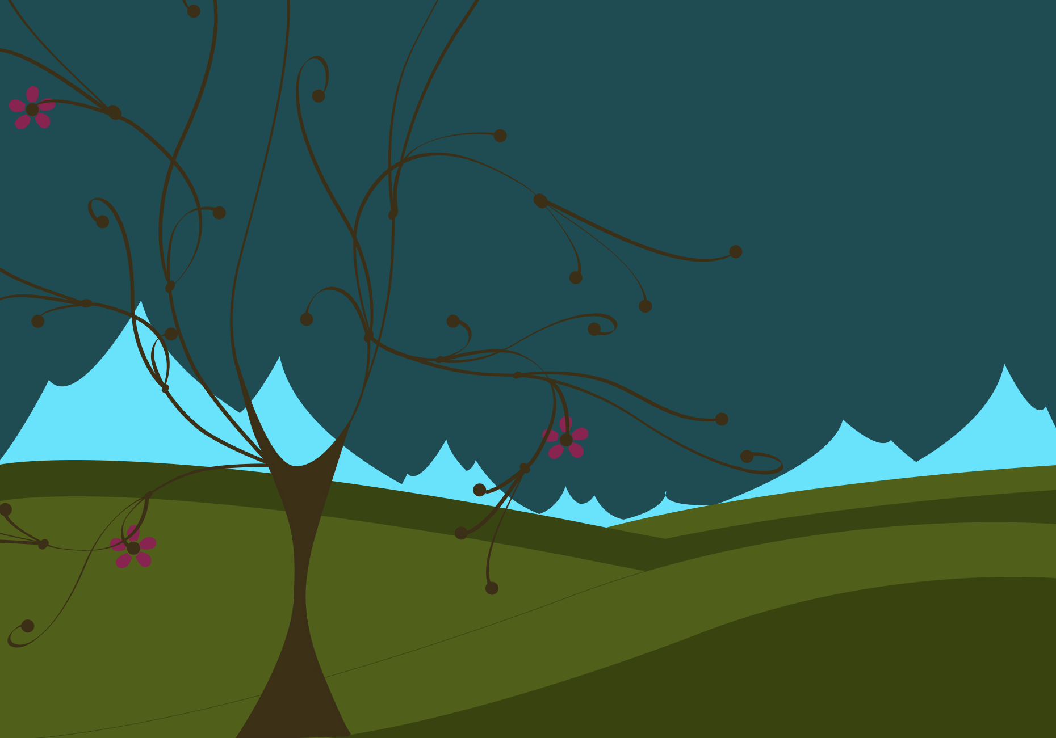
high contrast
FORM
Values far apart on the value scale
Predominately low values
CONTENT
Drama / mystery
Tension (questions the scene)
Heightened atmosphere
Notes:
When something glows bright against a heavy dark environment, it can feel unnatural and your brain asks “why?”
Create a one-sentence story for the image.
What story question does this contrast create?
Ask: How would reducing contrast change the story feeling?

Slide 9
low contrast | high value
FORM
Range of high to middle values
Small value jumps
CONTENT
Calm / quiet
Static / gentle
Airy / tranquil
Notes:
Low contrast often feels quieter because nothing “shouts” louder than the rest.
Squint test: what stays visible and what disappears.
Does your eye move slower in low contrast? Why?
Ask: Where is low contrast useful (backgrounds, subtle branding, calm interiors)?

Slide 10
low contrast | low value
FORM
Range of middle to low values
Small value jumps
CONTENT
Dense / heavy
Gloomy / subdued
Still calm/quiet (but weighted)
Notes:
Contrast is difference; key is overall lightness/darkness. You can be low contrast and still low-key.
Ask: How can something feel both calm and gloomy at the same time?
Ask: In film, what’s the difference between “soft lighting” and “dark lighting”?

Slide 11
VALUE COMPOSITIONAL STRATEGIES
value as visual weight
value and the illusion of space
value and the illusion of form

Slide 12

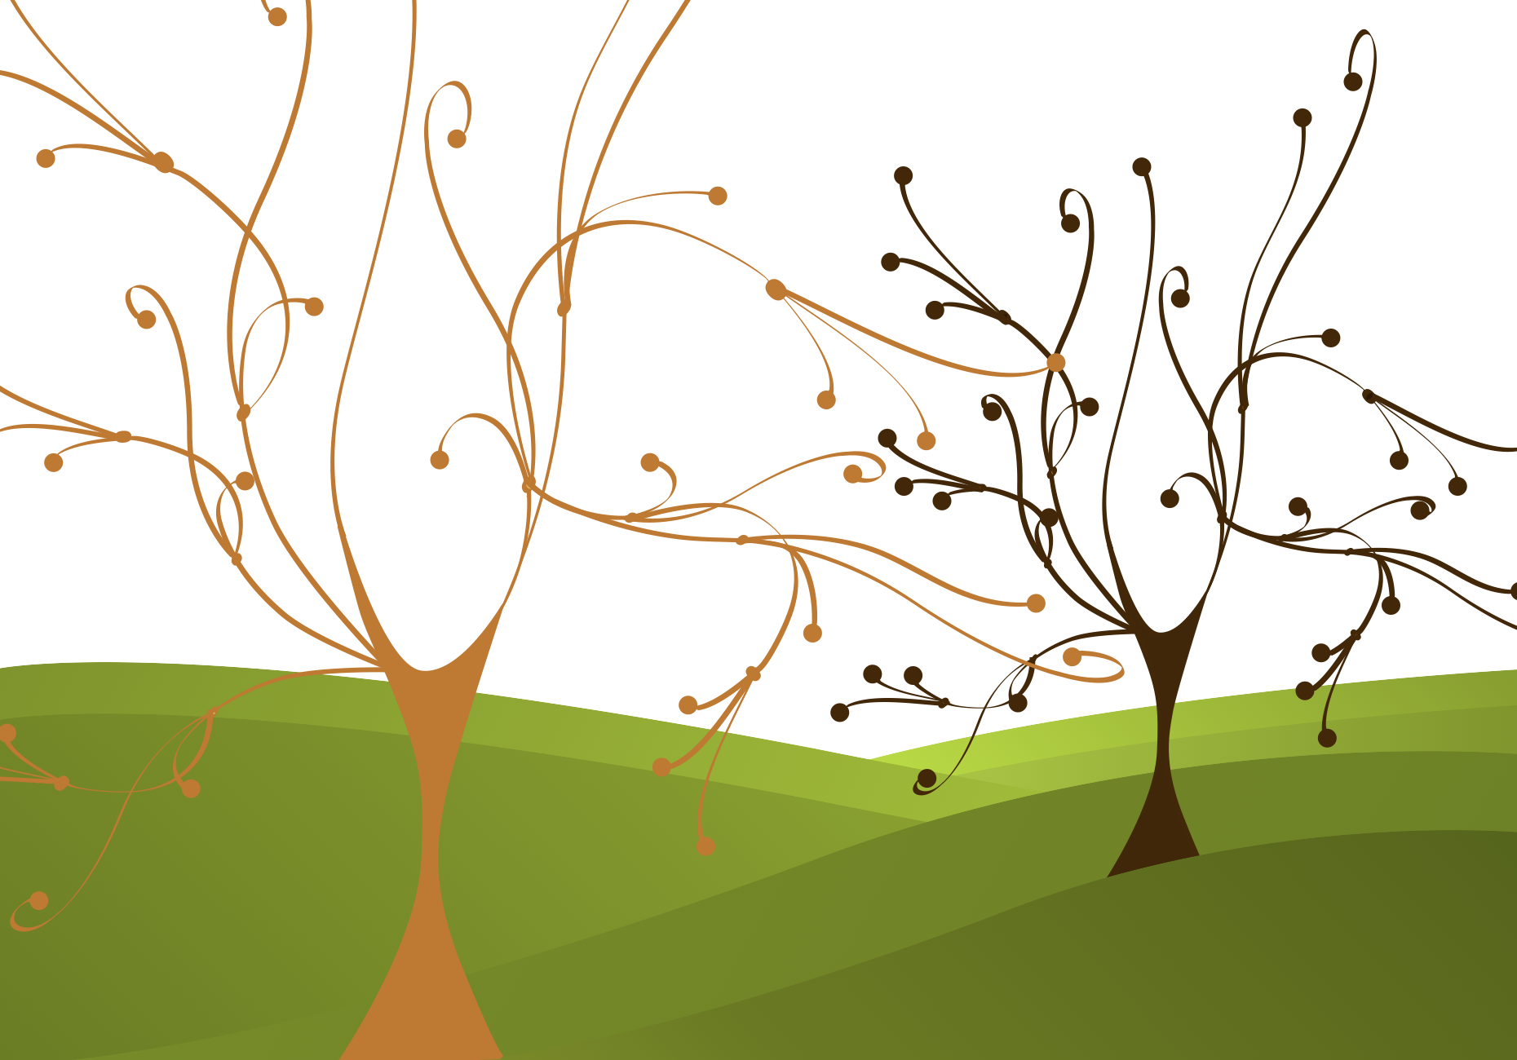
visual weight
FORM
Lower values feel heavier
Higher values feel lighter
CONTENT
Feels equally weighted
Feels comfortable / stable when balanced
Notes:
A small dark shape can balance a larger light one because darkness carries weight.
Cover one tree at a time: does the composition feel lopsided?
Which side feels heavier, and is it because of size, value, or both?
Ask: How does this show up in graphic design (text blocks), UI (buttons), or photography (silhouettes)?

Slide 13
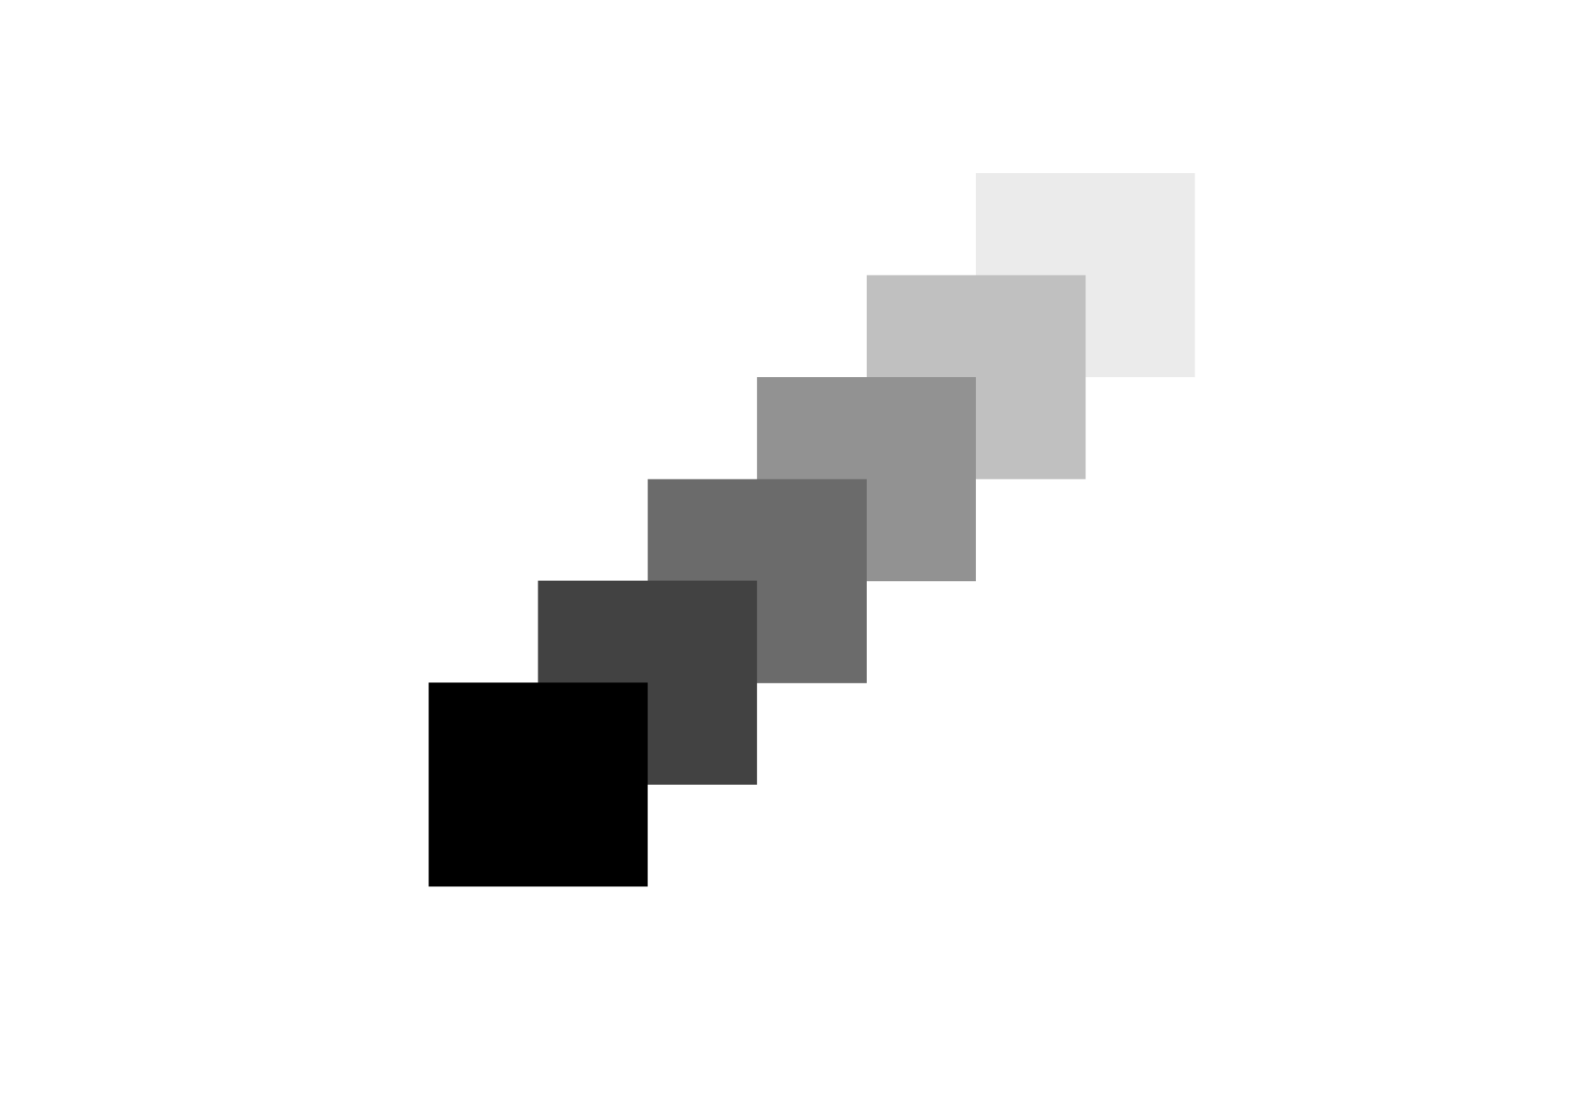

illusion of space
FORM
Gradual value shift creates “steps”
Lower values read as closer
Higher values read as farther
CONTENT
Pulls the eye back into the picture plane
Suggests distance between foreground and background
Notes:
“As things recede, they often appear lighter and less intense; value can simulate that.
Ask: What looks closest, and what value clues tell you that?
Ask: “Where do you see this in landscapes, games, or product renders?”

Slide 14
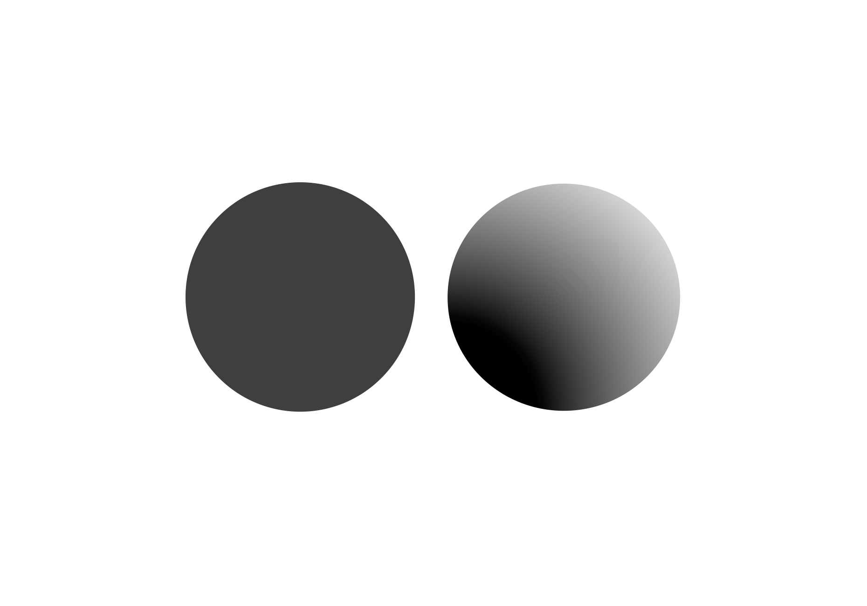

illusion of form
FORM
High values = light-facing planes
Low values = shadow planes
Value modeling suggests volume
CONTENT
Creates believable light source
Adds realism and dimensionality
Notes:
Without light and shadow, forms look flat. Value is what makes volume believable.
Ask: “How does this apply to 3D modeling, product photos, or character design?
Transition: Now we’ll apply these concepts to your own design field through Making the Connection and the Commentary on Design examples.

Slide 15
MAKING THE CONNECTION
You now have an understanding of how the element line feels and what it can communicate; now take it a step further, strengthen your comprehension by applying this knowledge to your area of design!
COMMENTARY ON DESIGN
Visit Commentary on Design for inspiration.
You will discover how designers in the real world are employing the elements and principles of design in a variety of design fields!
Notes:
Goal: Turn vocabulary into observation + analysis.
Your job is to spot value in the real world and describe it using our terms, key (high-key vs. low-key), contrast (high vs. low), and value structure (where the lightest lights and darkest darks sit, plus how values balance for visual weight, suggest space, and model form), then connect those choices to mood, emphasis, and meaning.

