Slide 1
Connecting to Design | ILLUSION OF MOTION
Notes:
Goal: Set expectations: slides support teaching; textbook carries depth.
Commentary on Design: Follow the link to explore real-world examples of these concepts in graphic design, fashion design, industrial design, interior design, media arts and animation, game art and design, and film and video.

Slide 2
principle | ILLUSION OF MOTION
The illusion of motion is the representation of an action,
or the process of moving.
The illusion of motion can be experienced as quite slow, to incredibly fast.

Slide 3
CREATING THE ILLUSION OF MOTION
kinesthetic empathy
multiple image
blurred outline

Slide 4
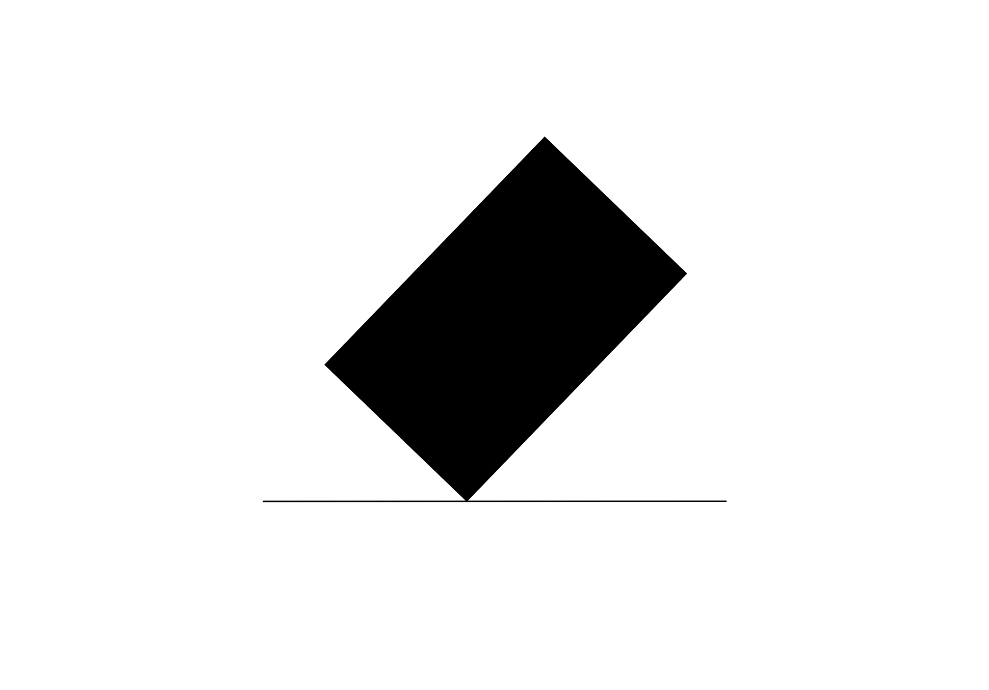

kinesthetic empathy
FORM
Body-based reaction: you feel the action
Gesture/pose triggers a physical memory
Often the strongest ‘human’ motion cue
CONTENT
Unstable / falling sensation
Immediate empathy (you know that feeling)
Can feel tense or unsettling
Notes:
You recognize the body mechanics and your brain simulates the feeling, balance, tension, impact.
Lean slightly back (safely) and notice the instinct to correct balance.
Ask: What do you feel in your body when you look at this pose?
Ask: How is this different from just “seeing” movement?

Slide 5

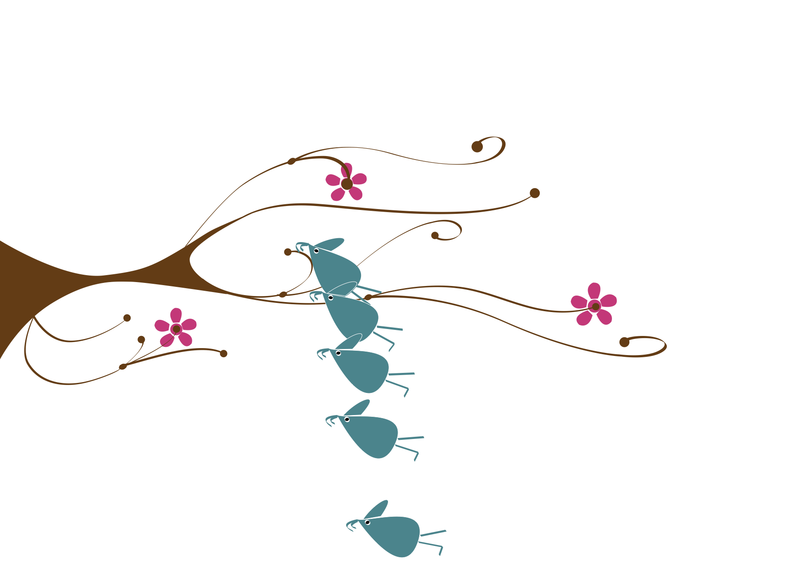
multiple image
FORM
Same object shown in multiple positions
Suggests time passing in steps
Creates a visible motion path
CONTENT
Slow-to-moderate movement
Inevitability / progression
Clear direction of travel
Notes:
Multiple positions act like a timeline, you see where the object was and where it’s going.
Ask: Does this feel controlled motion, or unavoidable motion? Why?

Slide 6


blurred outline
FORM
Blurred outline interpreted as movement
CONTENT
Speed / urgency
Chaos or intensity (depending on context)
Ambiguity (fluttering vs falling)
Notes:
Your eye reads blur as fast motion because the outline becomes less stable than the rest of the scene.
Ask: What reads faster, the blur itself or the contrast against still objects?
Ask: Is the motion happy (flutter) or dangerous (fall)? What pushes your interpretation?
Transition: Now we’ll apply these concepts to your own design field through Making the Connection and the Commentary on Design examples.

Slide 7
MAKING THE CONNECTION
You now have an understanding of how the element line feels and what it can communicate; now take it a step further, strengthen your comprehension by applying this knowledge to your area of design!
COMMENTARY ON DESIGN
Visit Commentary on Design for inspiration.
You will discover how designers in the real world are employing the elements and principles of design in a variety of design fields!
Notes:
Goal: Turn vocabulary into observation + analysis.
Your job is to spot the illusion of motion in the real world and describe it using our terms, how fast the action feels (slow → fast) and which strategy creates it: kinesthetic empathy (you “feel” the action), multiple image (repeated positions in space), or blurred outline (speed blur), then connect those choices to mood and meaning (tension, energy, instability, excitement) and why a designer would want the viewer to sense that movement.

