Slide 1
Connecting to Design | SCALE
Notes:
Goal: Set expectations: slides support teaching; textbook carries depth.
Commentary on Design: Follow the link to explore real-world examples of these concepts in graphic design, fashion design, industrial design, interior design, media arts and animation, game art and design, and film and video.

Slide 2
principle | SCALE
Scale is the relative size of an object.

Slide 3
TYPES OF SCALE
human scale
small scale
large scale
hierarchal scale

Slide 4


human scale
FORM
Human figure = scale reference
Without it, size can feel ambiguous
We lose a ‘known measuring stick’
CONTENT
Uncertainty / mystery of size
Can feel playful or surreal
Forces the viewer to guess
Notes:
Without a person, what clues are you using to estimate size?
Without the human figure, the most familiar reference, objects can feel hard to judge.
Ask: How big is the chick in the tree? Can you tell?
Ask: Why might a designer want ambiguity (fantasy, abstraction, product tease)?

Slide 5
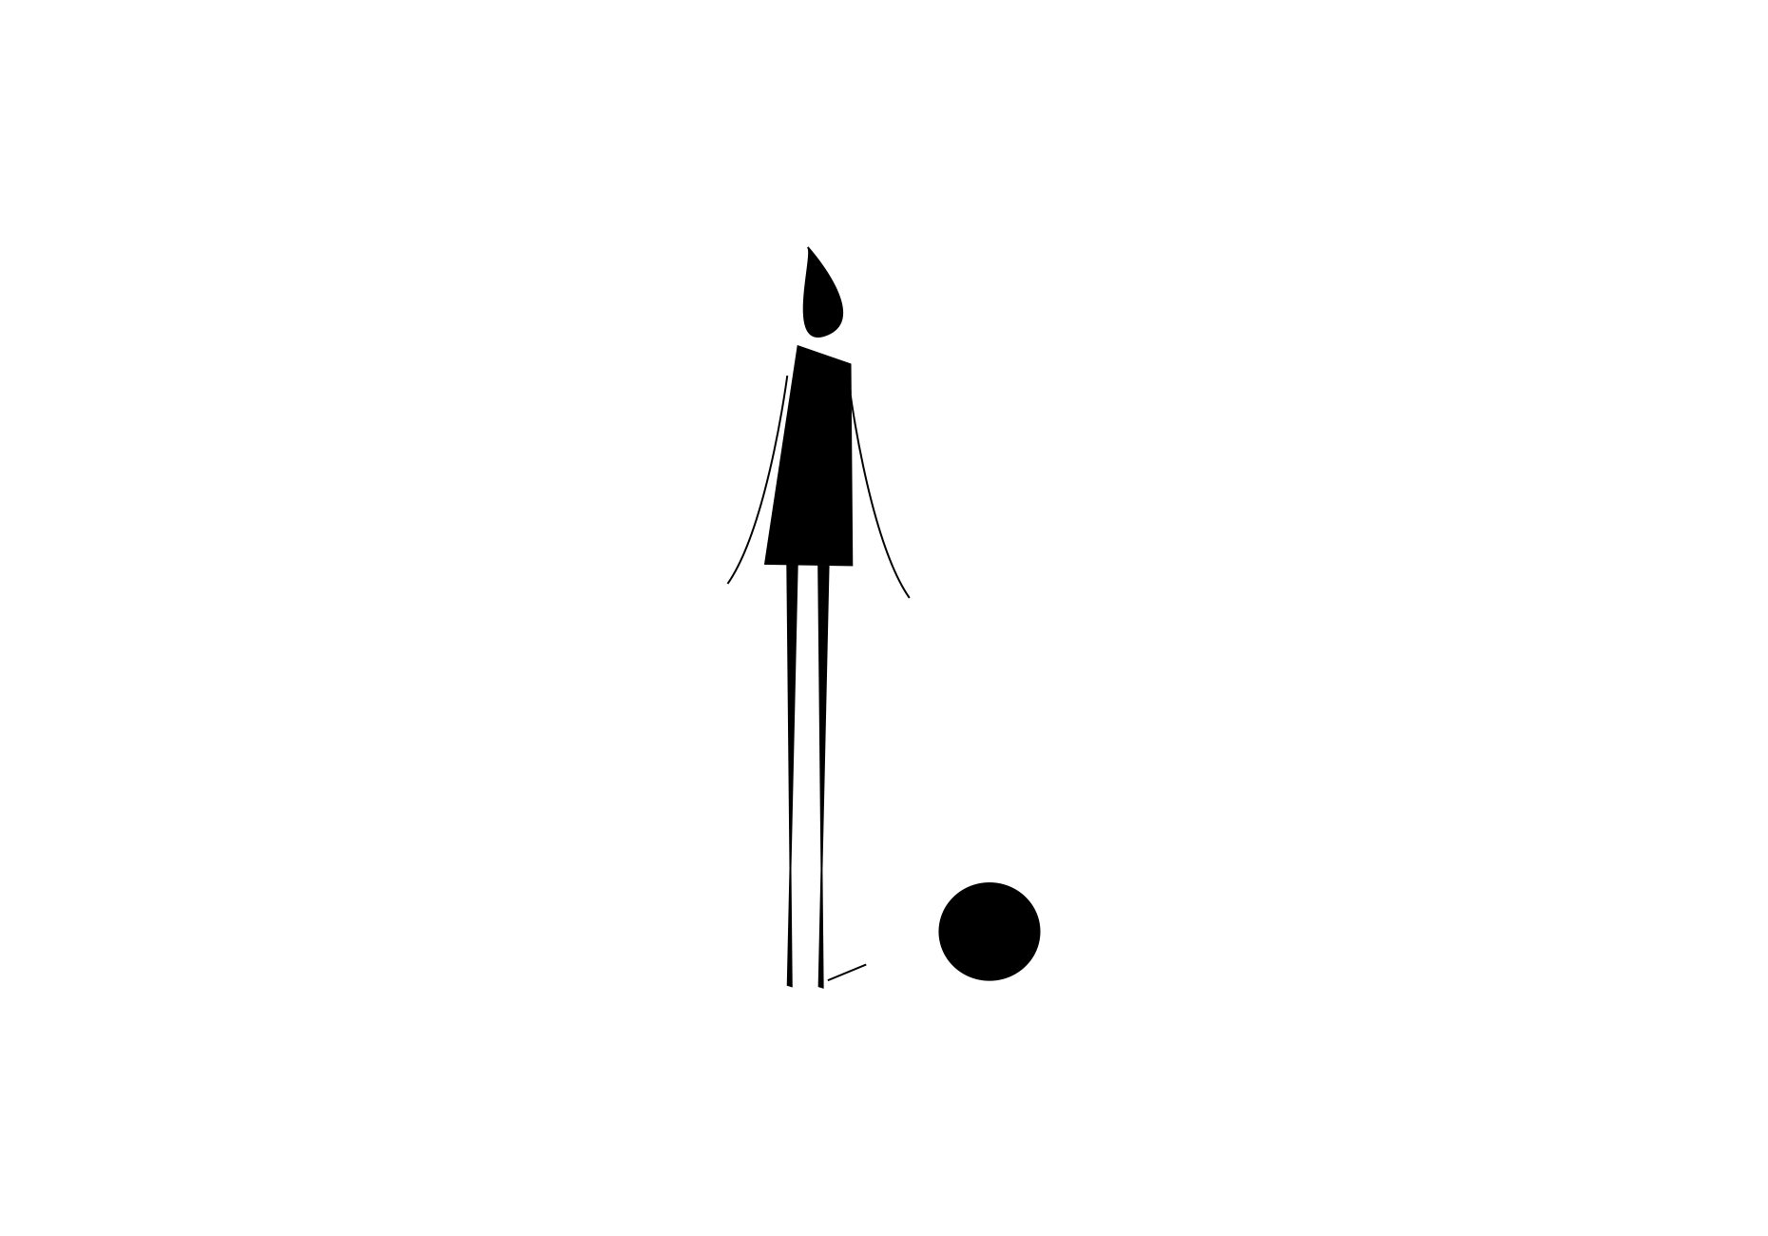

small scale
FORM
Human figure provides quick comparison
CONTENT
Delicate / fragile
Cute / vulnerable
Invites care or protection
Notes:
What emotion do you feel when the figure makes the object look tiny?
As soon as you see the person, the object’s small scale becomes obvious, and it starts to feel fragile.
Describe the object in 3 words (tiny, delicate, harmless, etc.).
Ask: Where do you see small scale used persuasively (toy ads, character design)?

Slide 6

large scale
FORM
Human figure provides quick comparison
CONTENT
Powerful / majestic
Awe / grandeur
Can feel overwhelming
Notes:
Large scale often creates a ‘wow’ feeling, because the human figure proves how enormous the subject is.
Describe how this change in scale feels.
Ask: In film, how do wide shots use large scale to shape story mood?

Slide 7

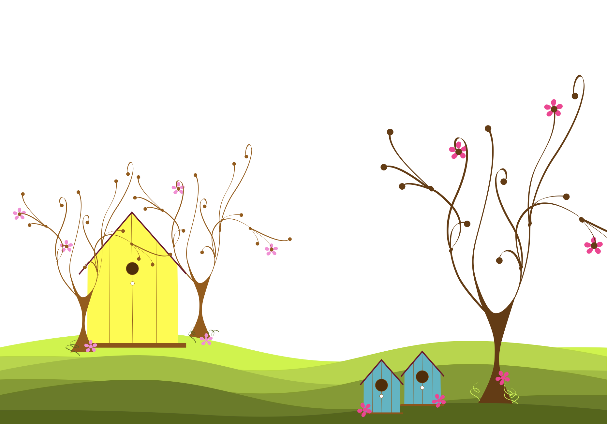
hierarchal scale
FORM
Size used to show importance
Most important thing appears largest
Can override realistic depth/space
CONTENT
Dominance / priority
Visual ‘ranking’ of elements
Notes:
What do you assume is most important, and why?
Hierarchal scale is when size becomes a message, the biggest thing is what you’re meant to notice first.
Ask: Where do you see this in design (ads, political cartoons, icons)?
Transition: Now we’ll apply these concepts to your own design field through Making the Connection and the Commentary on Design examples.

Slide 8
MAKING THE CONNECTION
You now have an understanding of how the element line feels and what it can communicate; now take it a step further, strengthen your comprehension by applying this knowledge to your area of design!
COMMENTARY ON DESIGN
Visit Commentary on Design for inspiration.
You will discover how designers in the real world are employing the elements and principles of design in a variety of design fields!
Notes:
Goal: Turn vocabulary into observation + analysis.
Your job is to spot scale in the real world and describe it using our terms, human scale (reference figure), small scale, large scale, and hierarchal scale (size = importance), then connect those choices to mood, meaning, and what the designer wants you to notice first.

