Slide 1
Connecting to Design | ILLUSION OF SPACE
Notes:
Goal: Set expectations: slides support teaching; textbook carries depth.
Commentary on Design: Follow the link to explore real-world examples of these concepts in graphic design, fashion design, industrial design, interior design, media arts and animation, game art and design, and film and video.

Slide 2
principle | ILLUSION OF SPACE
The illusion of space is the representation of depth on a 2-dimensional surface.
Though we mostly think of space as the distance between objects that are far apart from one another, the illusion of space can also feel very shallow.

Slide 3
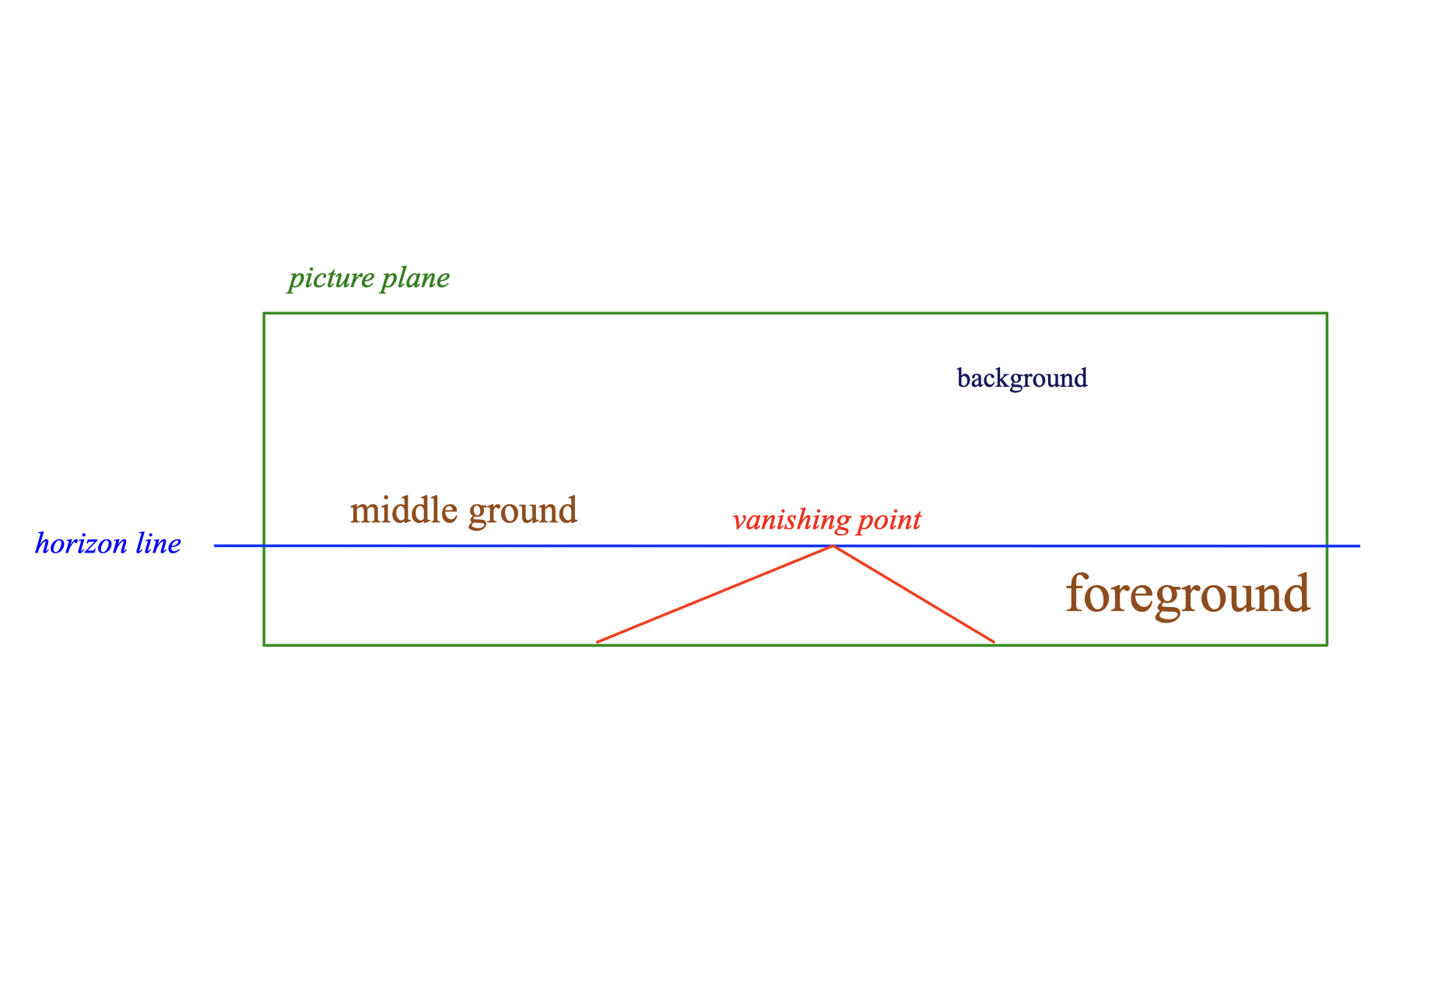
illusion of space
We use the terms picture plane, horizon line, vanishing point, foreground, middle ground and background when referring to space.
Notes:
These concepts help us describe where objects sit within a composition, explain how a sense of depth is created, and predict how the viewer’s eye will travel through the image.

Slide 4
VIEWPOINTS
internal view
external view
eye-level view
worm’s eye view
bird’s eye view

Slide 5
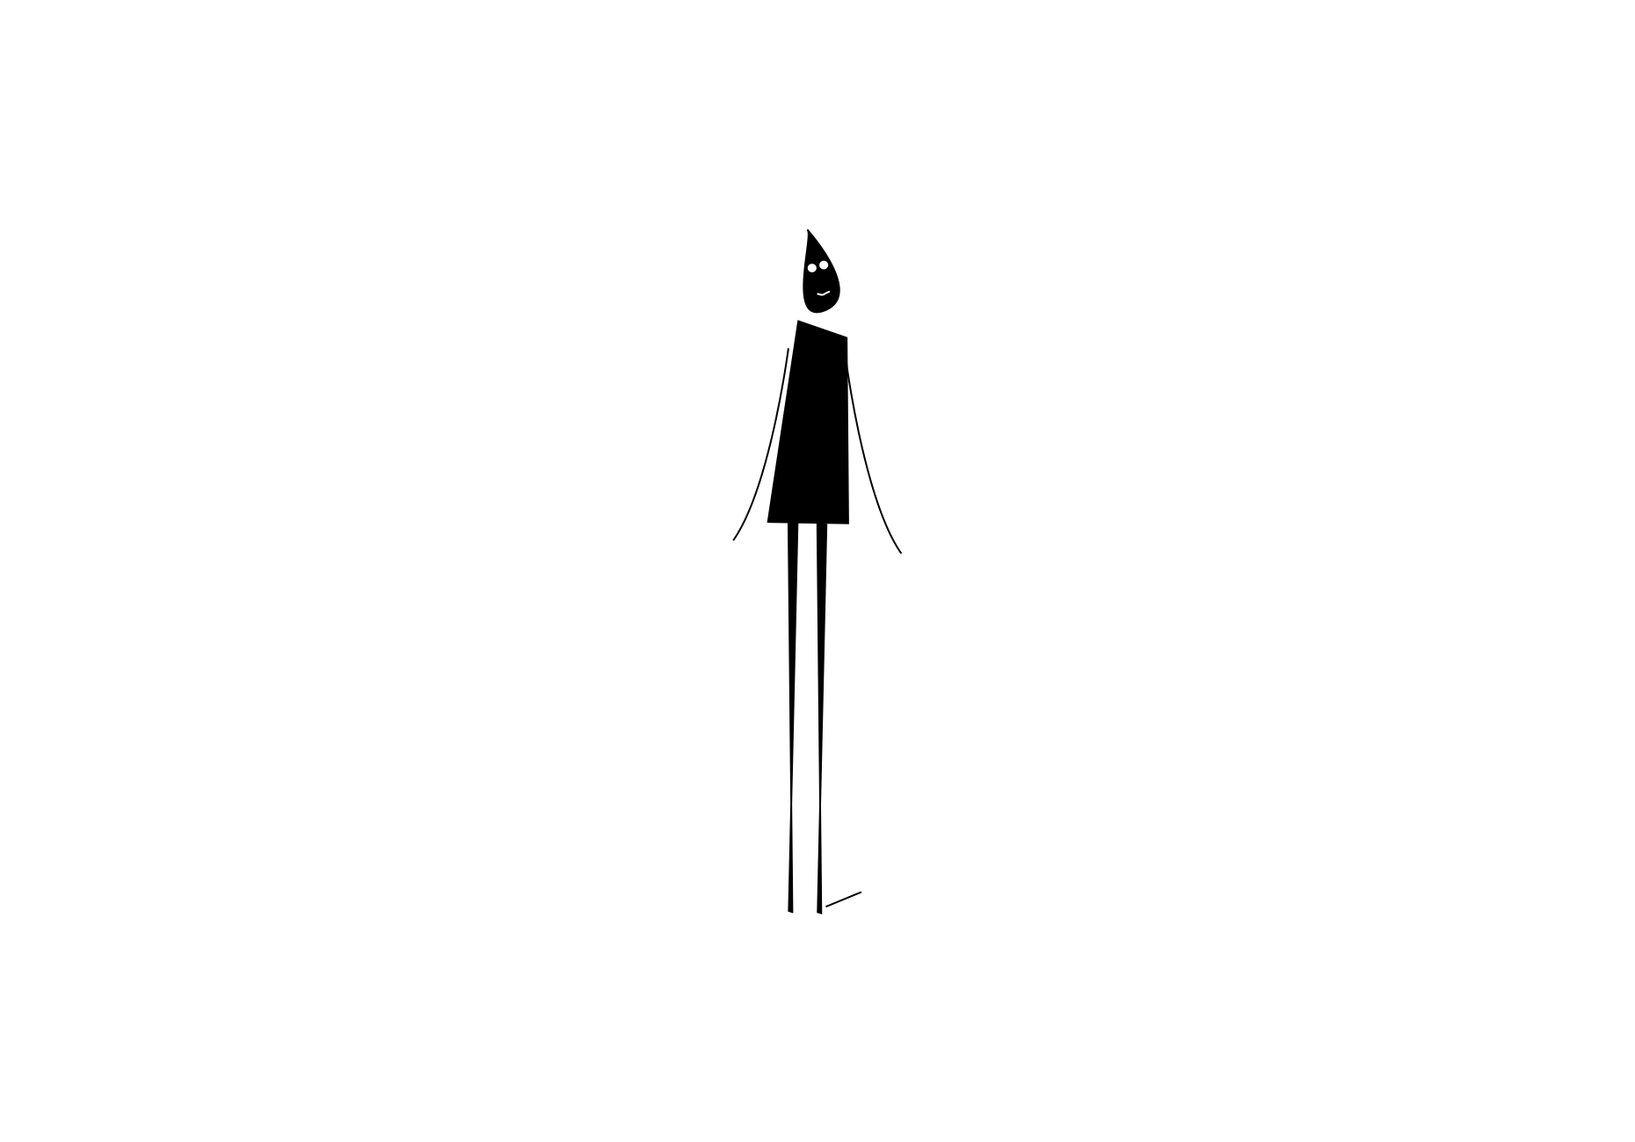

internal view
FORM
Viewer feels included / involved
Often created by a psychic line (gaze/attention connection)
CONTENT
Closeness / engagement
Personal connection
Higher emotional impact
Notes:
When the subject’s gaze connects to us, our brain creates a psychic line, and we feel included.
Ask: Do you feel like the bird ‘connects’ with you? What creates that connection?
Ask: Where do you see internal view used (ads, portraits, social media, film close-ups)?

Slide 6
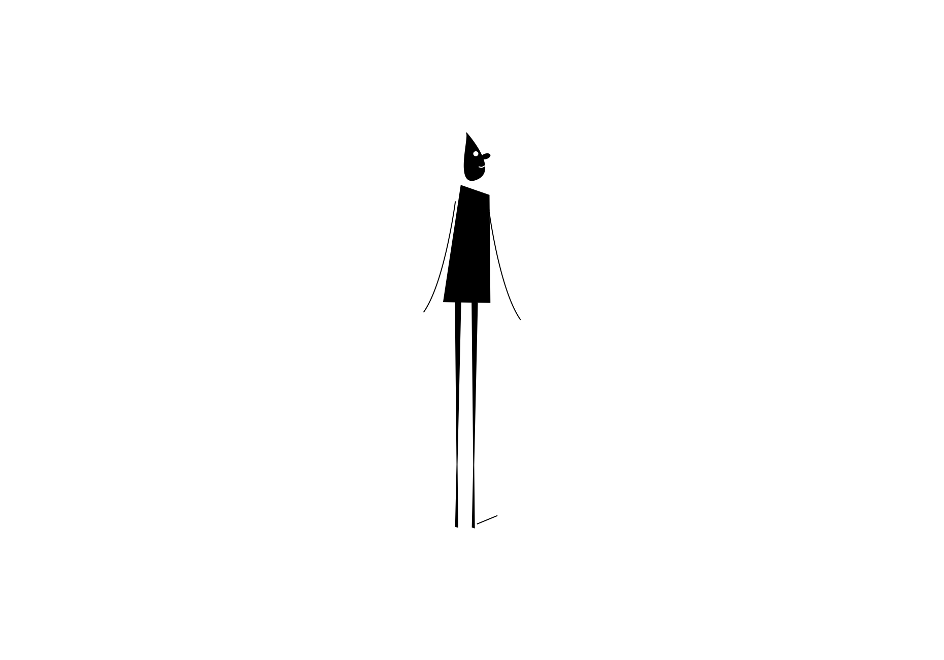

external view
FORM
Viewer feels excluded / observing
No psychic line connection
CONTENT
Distance / detachment
Feels like you’re watching from outside
Can feel safer or colder
Notes:
Without a connection back to us, we are simply looking at the composition, not participating in it.
Describe the mood shift in 2–3 words.
How does the lack of eye contact change the mood?
Ask: When is external view useful (establishing shots, product context, storytelling distance)?

Slide 7
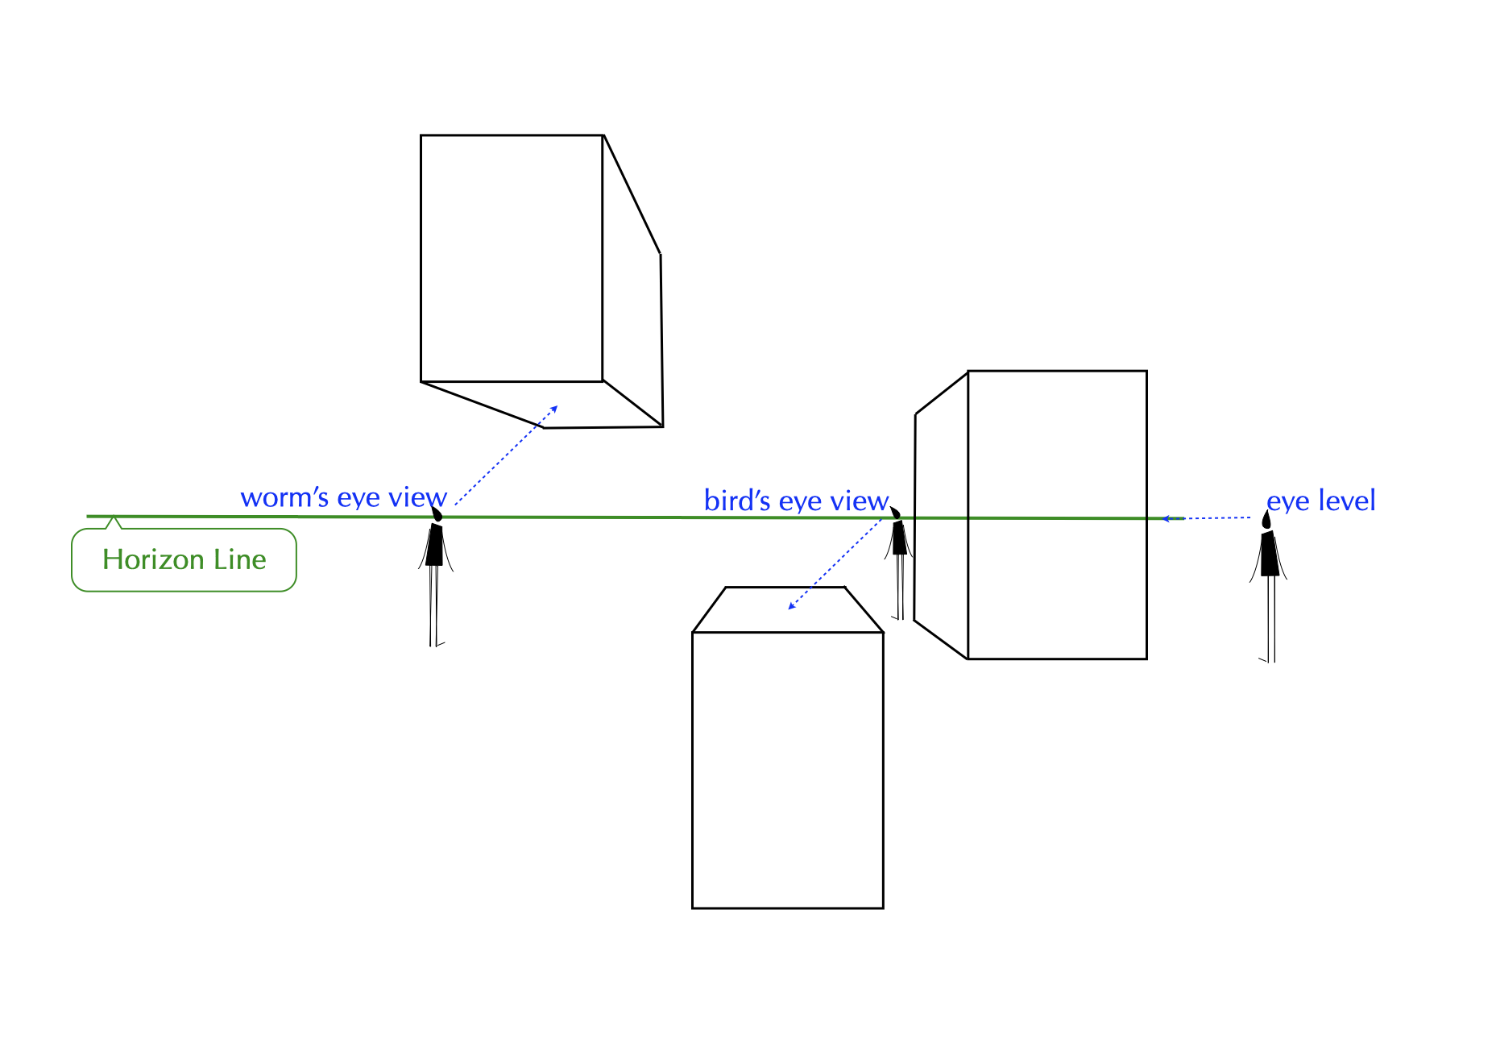
viewpoints
The placement of an object in relation to the horizon line establishes our point of view.
Notes:
If you can find the horizon line, you can tell where the viewer is standing, even if it’s not drawn.

Slide 8
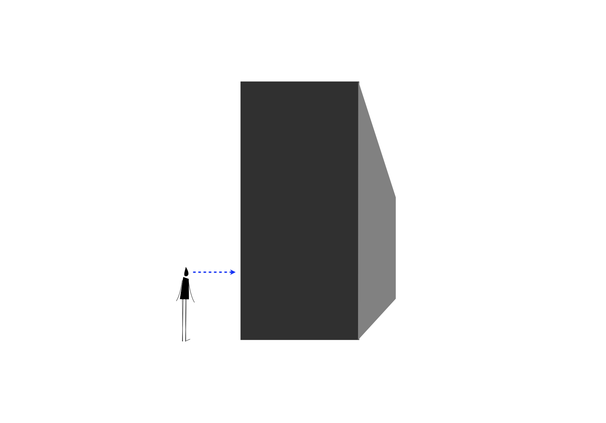

eye-level view
FORM
Looking straight on at the object
Eyes level with the horizon line
CONTENT
Feels natural and familiar
Less dramatic than extreme viewpoints
Notes:
Eye-level usually feels the least stylized, like normal human viewing and emotional neutrality.
Ask: Where is the horizon line? Do you feel like the viewer is sitting or standing?
Ask: Where do you see eye-level used most (interviews, product demos, everyday photography)?

Slide 9
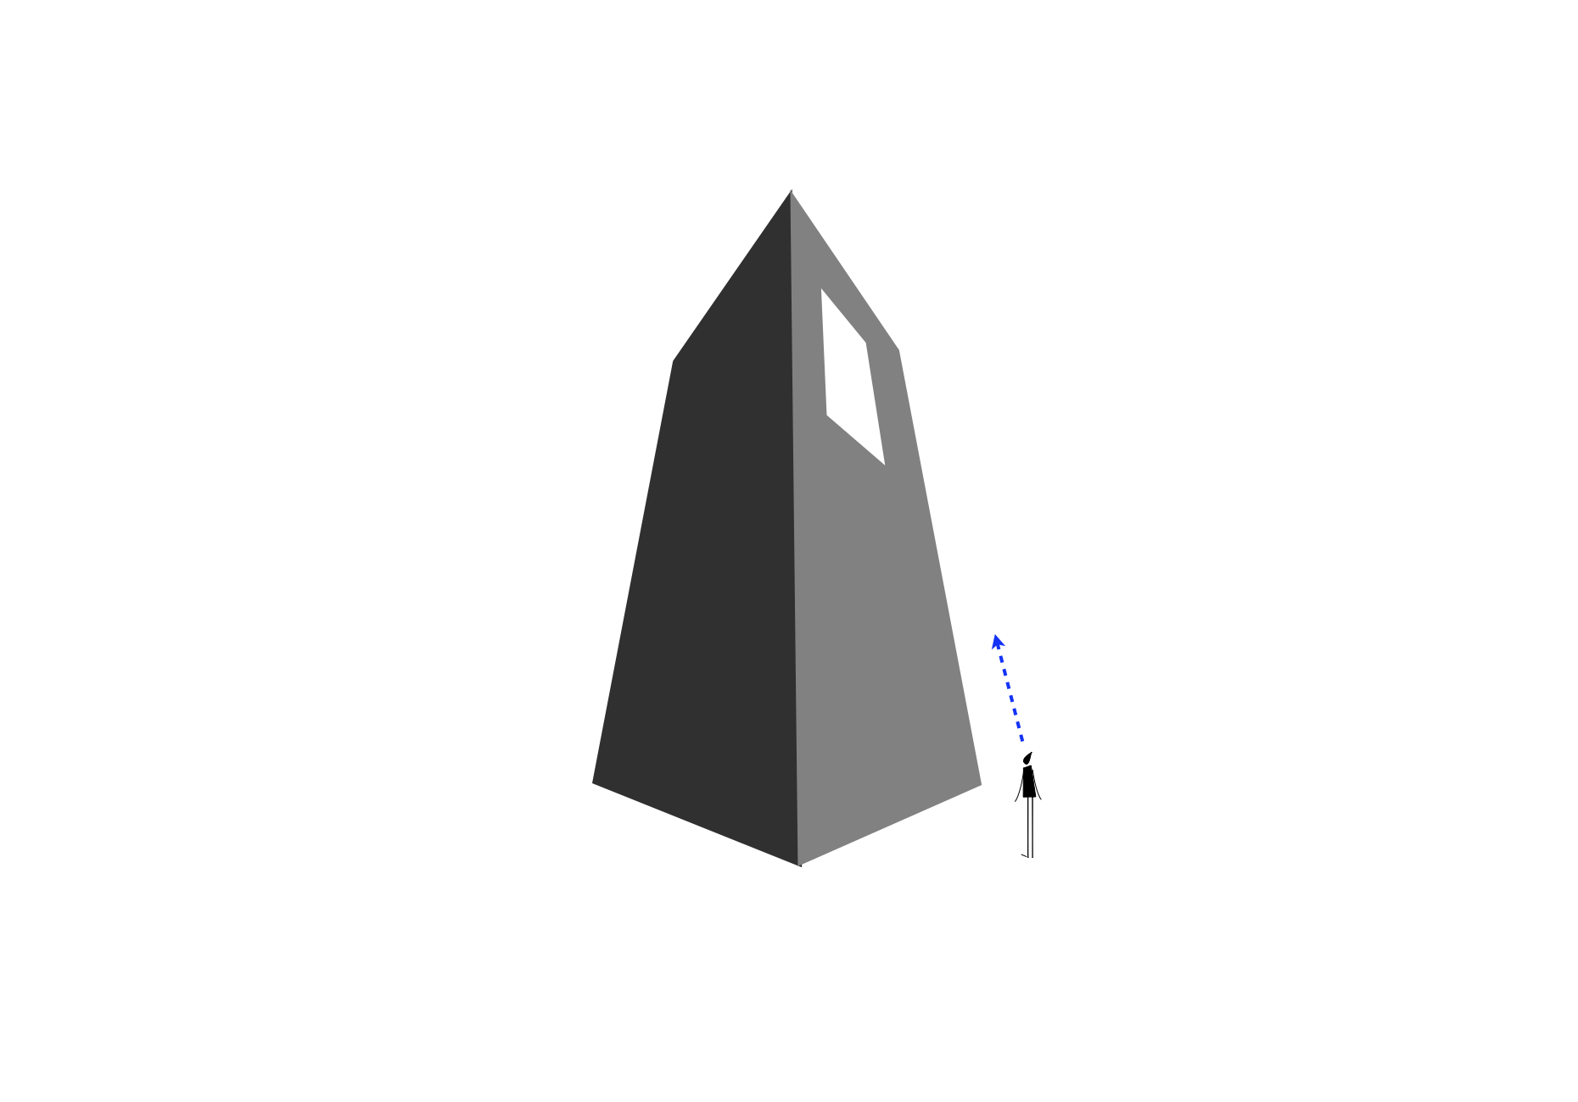

worm’s eye view
CONTENT
Power / dominance
Drama / intensity
Can create internal space
Extreme worm’s eye can feel immersive
FORM
Looking up at the subject
Viewer positioned below the subject
Notes:
This extreme worm’s eye view makes the tree big and powerful, perhaps threatening.
Ask: Do you feel included, or intimidated? Why?
Ask: Where is worm’s eye used intentionally (architecture shots, heroes, ads, horror)?

Slide 10
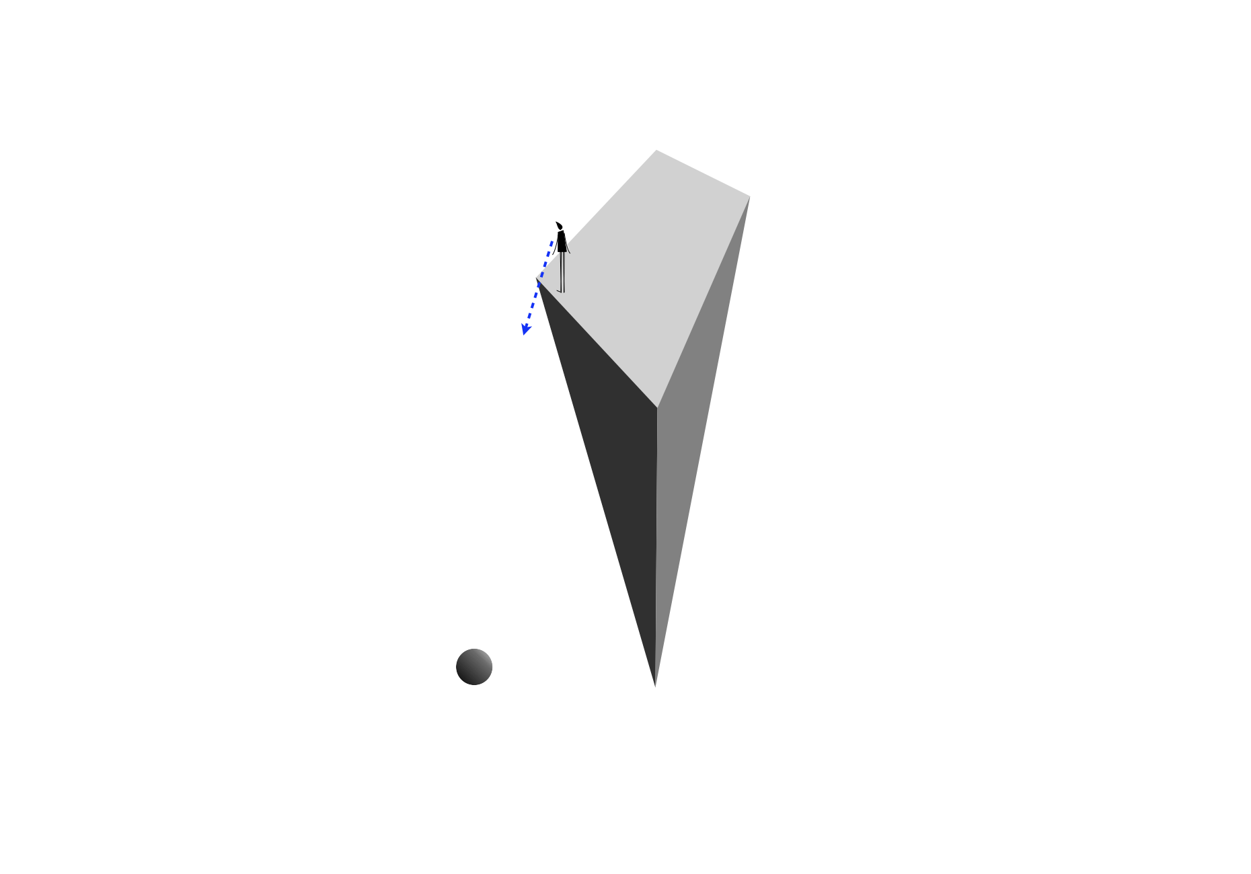
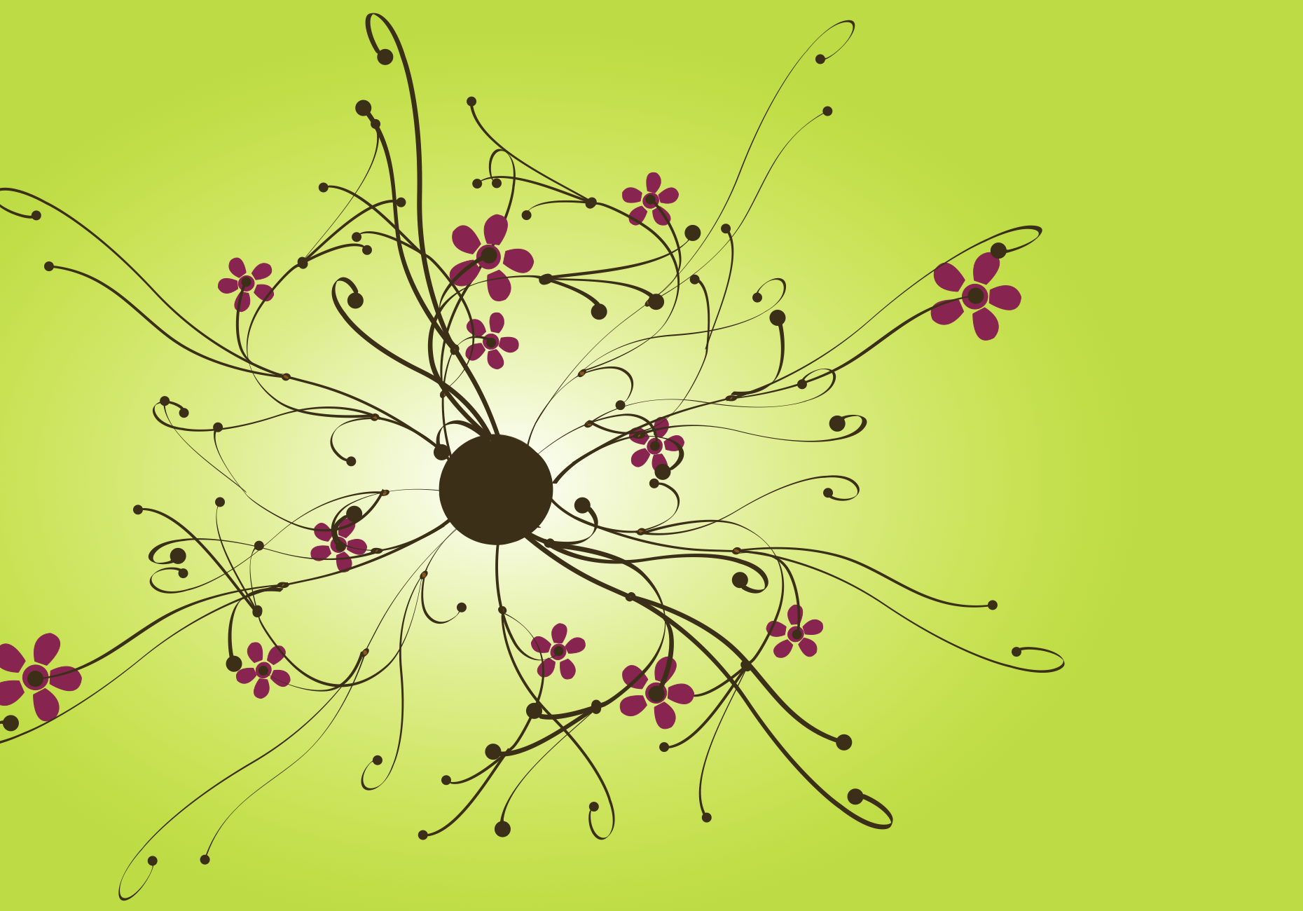
bird’s eye view
FORM
Looking down at the subject
Viewer positioned above the subject
CONTENT
Control / overview / distance
Can create internal space
Extreme bird’s eye can feel immersive
Notes:
A bird’s eye point of view occurs when we are looking down at an object
An internal space can also be established in an extreme bird’s eye view.
Ask: Do you feel included in the composition? Do you feel that you are looking down at the tree?
Ask: Where do you see bird’s eye used (games, choreography shots)?

Slide 11
CREATING THE ILLUSION OF SPACE
deep space
shallow space
vertical location
gradients
overlapping

Slide 12
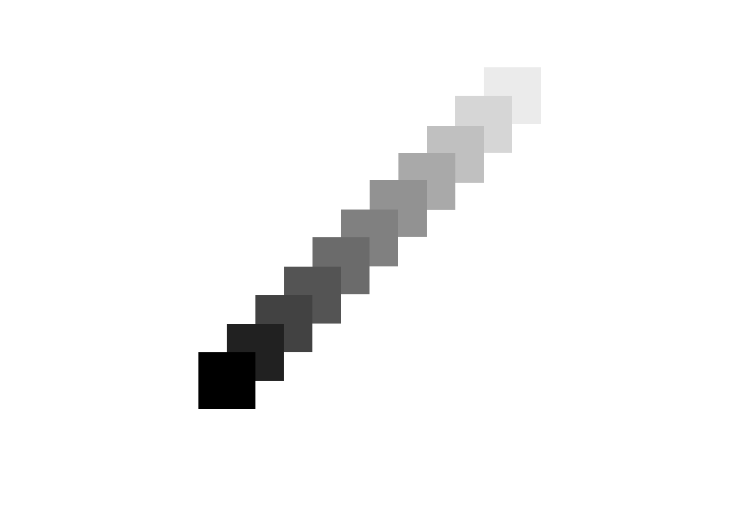
deep space
The illusion of deep space is created when the distance between foreground and background appears to be far apart from one another.
Notes:
Deep space can create the sense that the world continues beyond the picture.
Ask: Where is deep space useful (world-building, environment design)?

Slide 13

shallow space
The illusion of shallow space is created when the distance between foreground and background appears to be closer together.
Notes:
Shallow space brings everything closer to you, great for detail and emotion, but it can also create pressure.
Ask: What feels “closest” to the picture plane?
Ask: Where is shallow space common (portraits, product shots, graphic layouts, close interiors)?

Slide 14
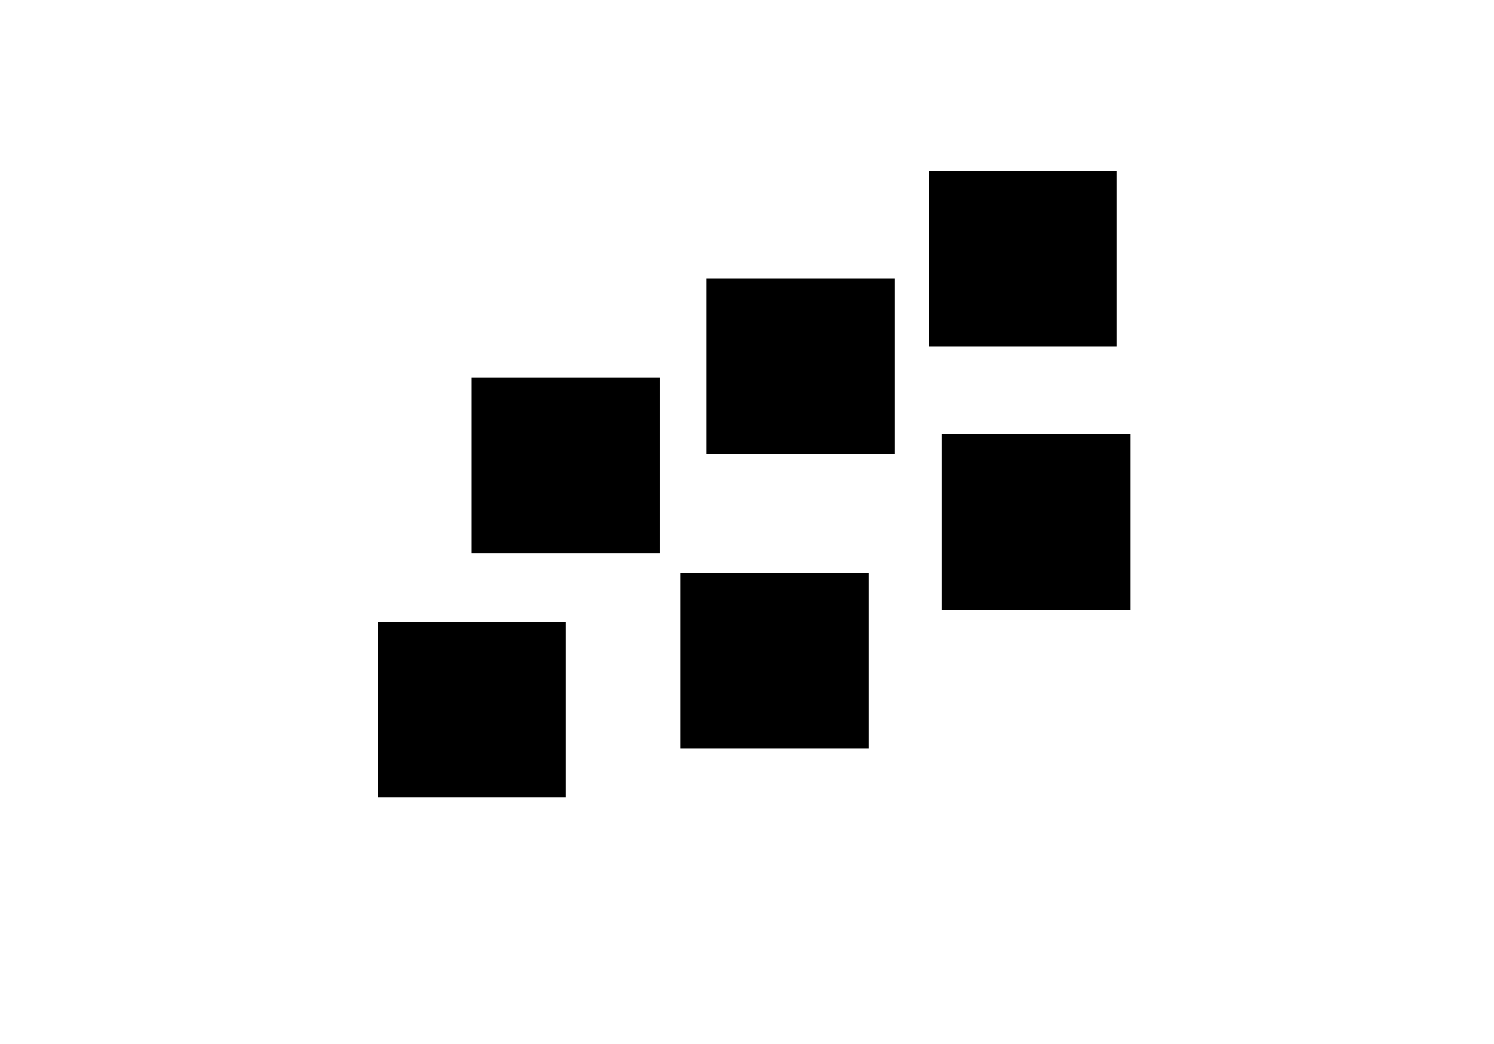
vertical location
Creating the illusion of space by vertical location is achieved by placing the objects in the background higher up than those in the foreground.
Notes:
Your brain often interprets higher placement as farther away.
Rank objects from closest to farthest.
Ask: Where do you see vertical location used?

Slide 15

gradients
Creating the illusion of space by gradients is achieved by the gradual change in value and gradual decreasing size of the objects.
Notes:
Gradients mimic how things look in real life as they recede, less contrast, lighter value, smaller scale.
Point to the most distant “step”.

Slide 16

overlapping
Creating the illusion of space by overlapping is achieved by representing objects in the foreground as overlapping the objects in the background.
Notes:
Overlapping is a go-to strategy. If one object blocks another, our brain immediately places it in front of the other object.

Slide 17
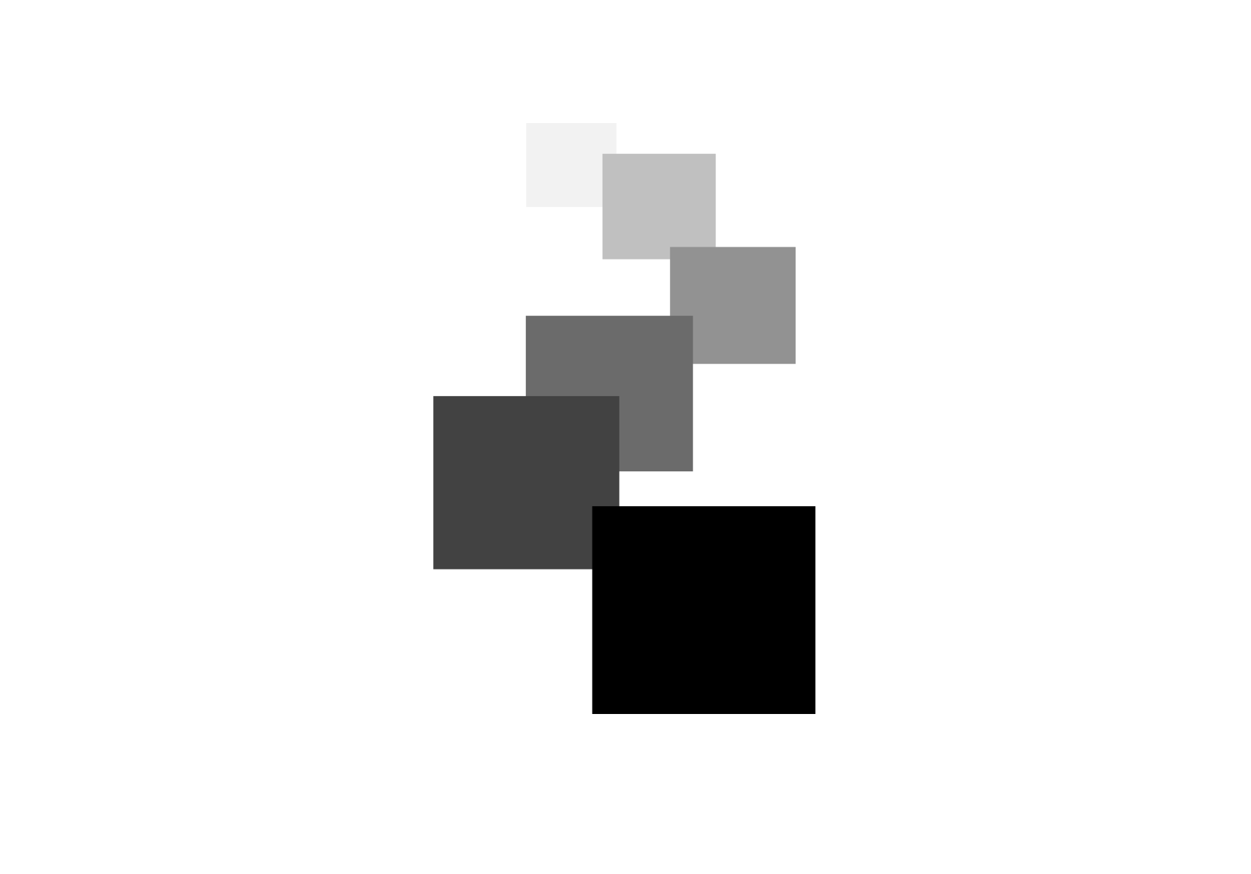

combination
FORM
Vertical location + gradients + overlapping
More value steps = deeper space
Foreground clarity establishes ‘closest’
CONTENT
Natural progression into distance
More realistic depth
Stronger visual navigation through the scene
Notes:
Which visual cue is doing the most work, overlap, placement, or gradient?
The composition feels more spatial when with multiple visual cues; our brain gets consistent evidence.
Ask: If you removed one cue, which would hurt depth the most?

Slide 18
LINER PERSPECTIVE
one-point perspective
two-point perspective
three-point perspective

Slide 19
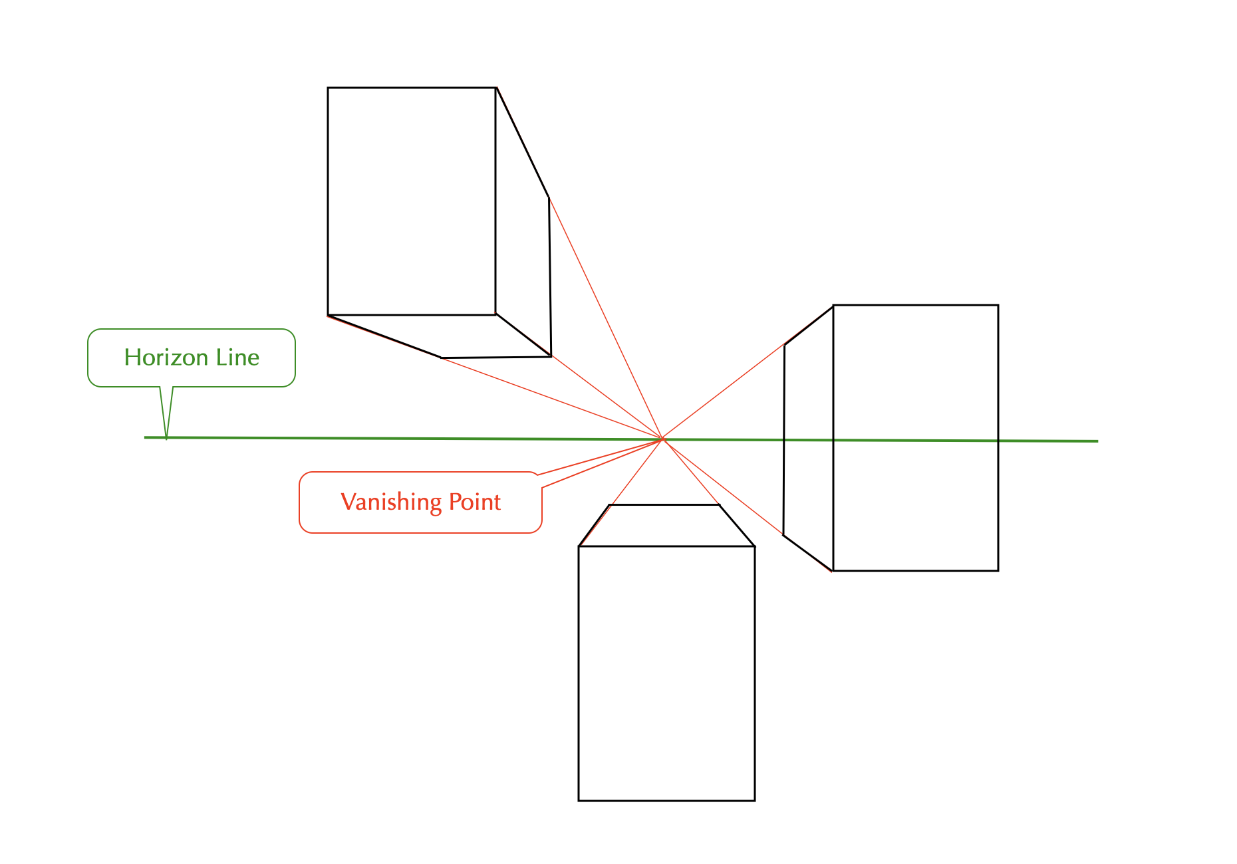
kinesthetic empathy
one-point perspective
A one-point perspective is a method for creating the illusion of space on a 2-dimensional surface by showing parallel lines as converging on one vanishing point on the horizon line, while the objects are parallel to the picture plane.
Notes:
A one-point perspective can feel like you’re being pulled straight into the composition.
Ask: Why might a designer want that “tunnel’ pull”?

Slide 20
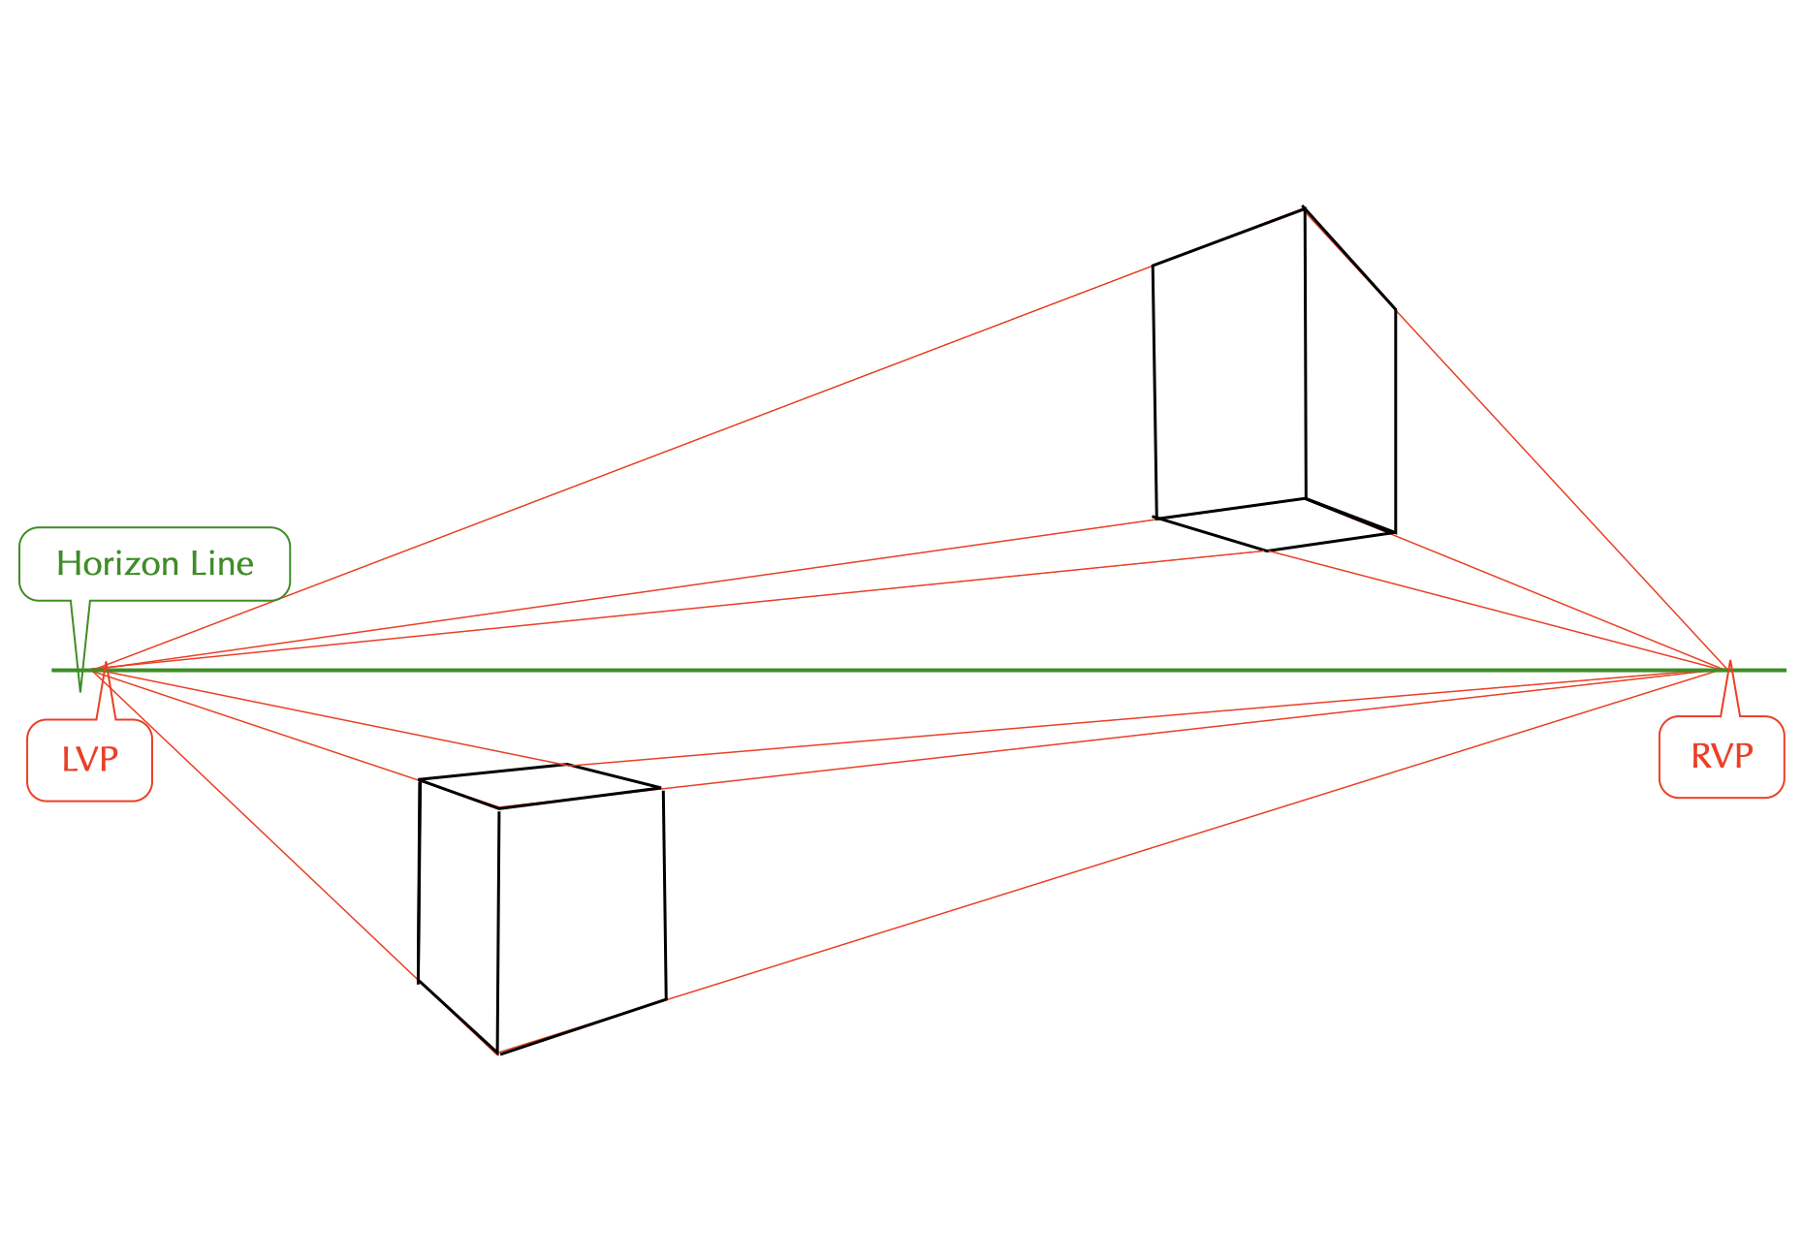
kinesthetic empathy
two-point perspective
A two-point perspective is a method for creating the illusion of space on a 2-dimensional surface by showing parallel lines as converging on two vanishing points on the horizon line, while the objects are seen at an angle to the picture plane.
Notes:
A two-point perspective is the common “street corner” view; edges recede left and right.
Ask: Where is two-point essential (product sketching, interiors)?

Slide 21
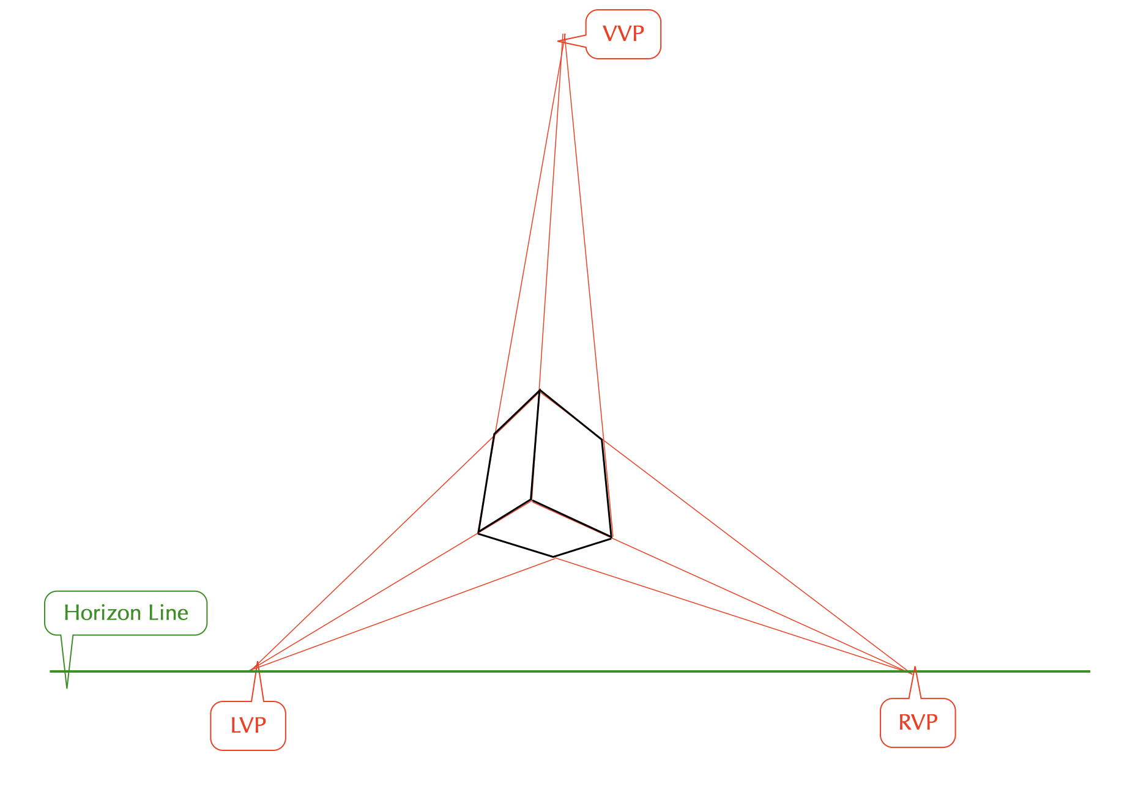
three-point perspective
A three-point perspective is a method for creating the illusion of space on a 2-dimensional surface by showing parallel lines as converging on two vanishing points on the horizon line, plus a third vanishing point placed above or below the eye level.
Notes:
The third point creates an exaggerated sense of height or depth, producing a dramatic “towering” or “plunging” feeling.
Ask: Where do you see 3-point used (superhero shots, skyscrapers, dynamic game scenes)?
Transition: Now we’ll apply these concepts to your own design field through Making the Connection and the Commentary on Design examples.

Slide 22
MAKING THE CONNECTION
You now have an understanding of how the element line feels and what it can communicate; now take it a step further, strengthen your comprehension by applying this knowledge to your area of design!
COMMENTARY ON DESIGN
Visit Commentary on Design for inspiration.
You will discover how designers in the real world are employing the elements and principles of design in a variety of design fields!
Notes:
Goal: Turn vocabulary into observation + analysis.
Your job is to spot the illusion of space in the real world and describe it using our terms, picture plane, horizon line, vanishing point, and foreground / middle ground / background, plus the viewpoint (internal vs. external; eye-level, worm’s eye, bird’s eye) and the space-building strategies (deep vs. shallow space, vertical location, gradients, overlapping, and linear perspective: one-, two-, or three-point), then connect those choices to how the scene feels (included vs. excluded, close vs. expansive) and what it communicates.

