Slide 1
Connecting to Design | COLOR
Notes:
Goal: Set expectations: slides support teaching; textbook carries depth.

Slide 2
Designing with Color
The elements and principles of design operate independently of color as a design can be understood and evaluated in grayscale.
Here we focus on strategic application of hue, value, saturation, and temperature to reinforce a message, evoke emotion, and shape the viewer’s experience of a composition.

Slide 3
PROPERTIES OF COLOR
hue
value
saturation
temperature

Slide 4

hue
Hue =
the color family/name
yellow
yellow-orange
orange
red-orange
red
red-violet
violet
blue-violet
blue, blue-green
green
yellow-green
Notes:
Goal: Hue = identity (what we call the color).
Hue changes the message quickly—often the first thing we notice.
Ask: Name the hue families you see most in your field (branding, interiors, etc.).

Slide 5
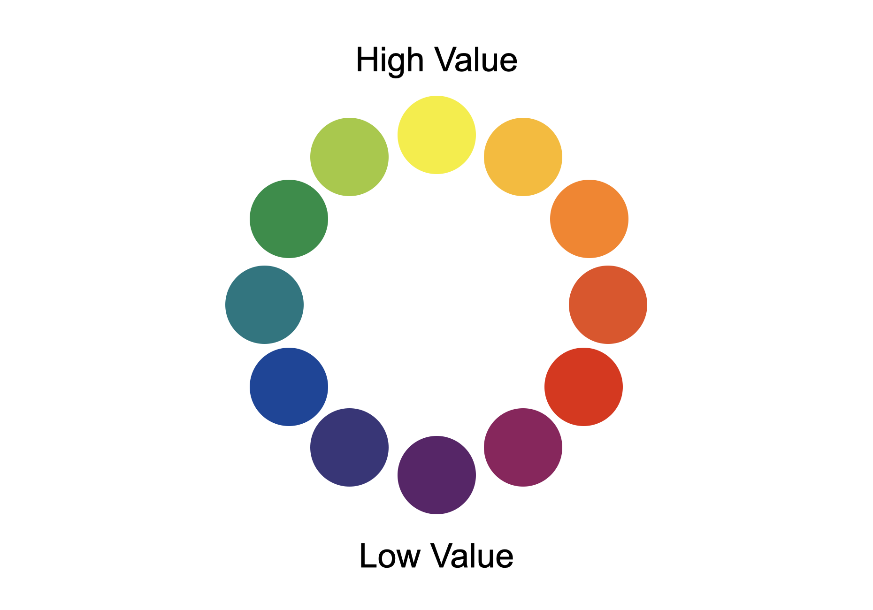
value
Value =
lightness/darkness
High value / Low Value
Notes:
Goal: Value drives contrast + readability.
If the values are too similar, designs can flatten and information may get lost.
Ask: If we converted your favorite app screen to grayscale—would it still work?

Slide 6
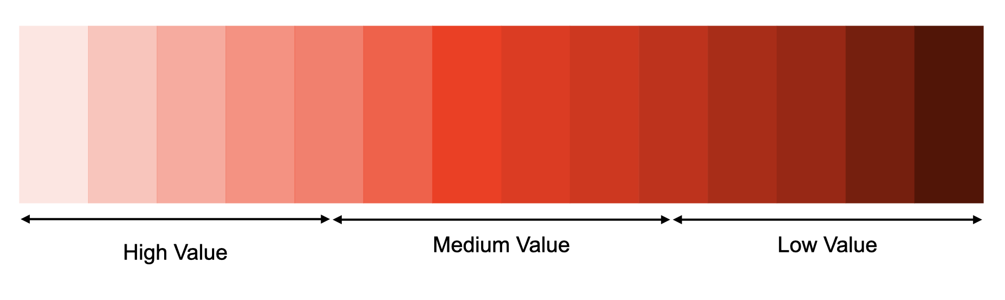
monochromatic value scale
One hue, stepped from light to dark
Pure hues have different inherent values (yellow lighter, violet darker)
Notes:
Goal: Teach inherent value + stepping.
Two colors can be different hues but similar value, so they may ‘disappear’ together in grayscale.
Ask: Why might yellow ‘pop’ even when it’s not more saturated?

Slide 7



monochromatic value
Monochromatic High Value
Monochromatic Middle Value
Monochromatic Low Value
Notes:
Goal: Quick identification practice.
Ask: How does each one feel, and why?

Slide 8
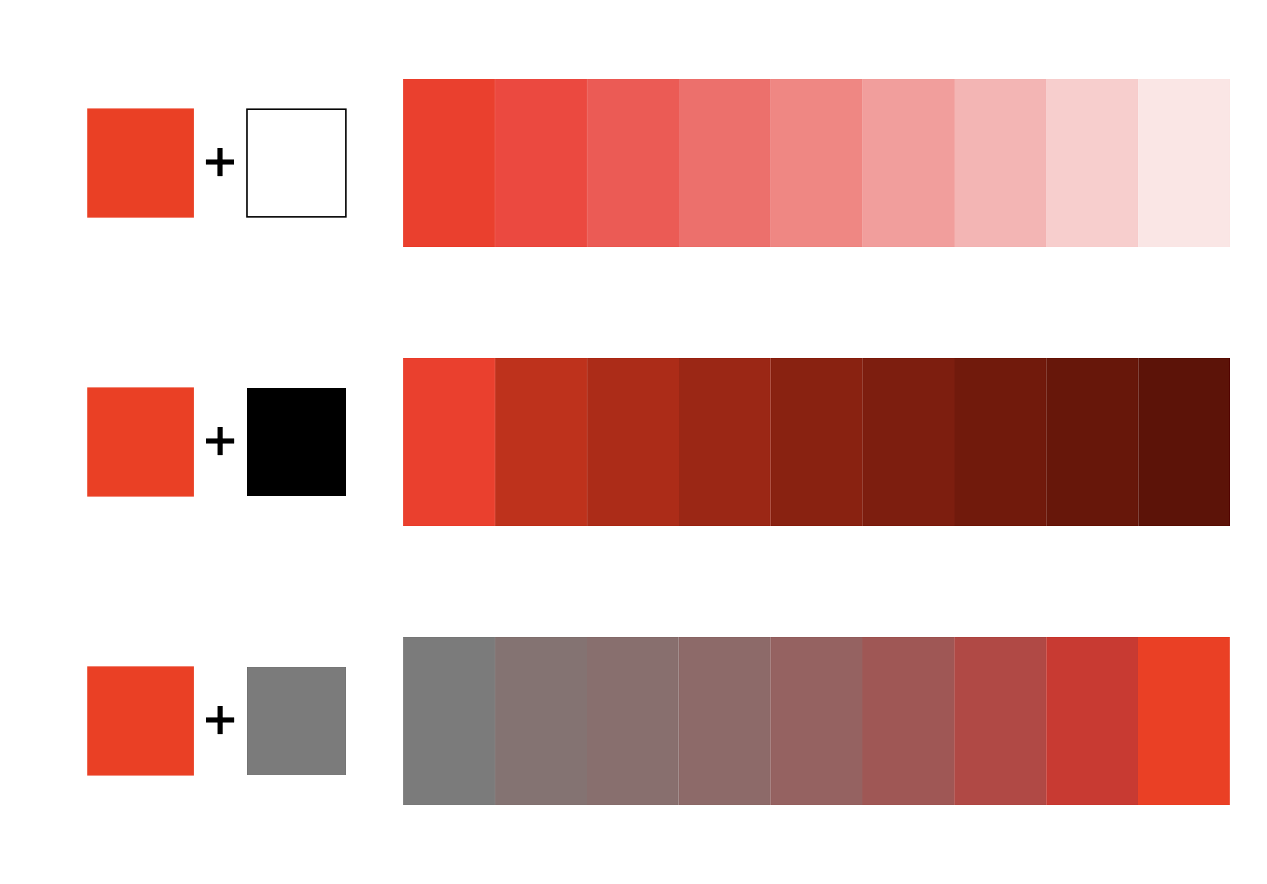
value: tints, shades, and tones
Tint = hue + white (higher value, less saturation)
Shade = hue + black (lower value, less saturation)
Tone = hue + gray (value depends; saturation reduces)
Notes:
Goal: Separate value change from saturation change.
Tint/shade/tone often change both value and saturation, watch what your color is doing.
Ask: When would you choose a tone instead of a tint/shade (e.g., professional, subdued, editorial)?

Slide 9


saturation
Saturation refers to the intensity or purity of a color.
High saturation: vivid/energetic
Low saturation: muted/subdued
Notes:
Goal: Saturation = intensity/purity.
Saturation can create urgency or quiet, often more than hue does.

Slide 10
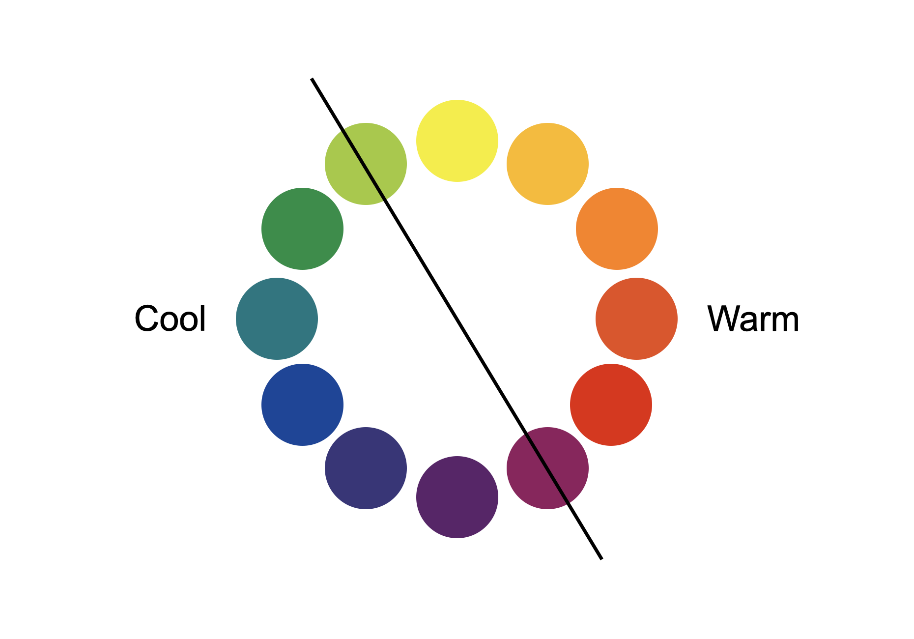
temperature
Temperature = perceived warm/cool
Warm: reds/oranges/yellow
Cool: blues/greens/violets
Notes:
Goal: Temperature influences depth + emotion.
Warm often feels nearer; cool often feels farther, but context can flip it.
Ask: Where do you see warm/cool used for wayfinding or emphasis?

Slide 11

warm color temperature
Notes:
Goal: Connect warm temperature to emotional/physical associations (without overclaiming).
Ask: Can you feel the warmth in the image dominated by reds?
Ask: What words come to mind: heat, energy, comfort, urgency?

Slide 12

cool color temperature
Notes:
Goal: Contrast cool temperature associations.
Ask: Do you notice your body’s subtle shift when viewing the image with dominated by blues?
Ask: What words come to mind: calm, distance, clarity, restraint?

Slide 13
COLOR INTERACTION
simultaneous contrast
complementary contrast
after-image
ground subtraction

Slide 14

simultaneous contrast
A color shifts depending on surrounding colors
The eye ‘seeks’ the complement
Neutrals can appear tinted by their surroundings
Notes:
Goal: Make the phenomenon observable, not theoretical.
Keep your gaze on the white space between areas to notice the shift.
Ask: Do the two ‘same’ grays look identical? What changed?
Ask: Where might this cause problems (product photos, branding)?

Slide 15

simultaneous contrast
Notes:
Keep your gaze on the white space between areas to notice the shift.
Ask: Do the two ‘same’ grays look identical? What changed?

Slide 16

simultaneous contrast
Notes:
Keep your gaze on the white space between areas to notice the shift.
Ask: Do the two ‘same’ grays look identical? What changed?

Slide 17

complementary contrast
Visual intensification
Complements intensify each other when adjacent
Notes:
Ask: Which area feels most intense? Where does your eye go first?

Slide 18

after-image
After-image = lingering complementary impression
Happens after staring at strong saturation.
Notes:
Notice what happens when you fix your gaze on the black dot at the center of the red star (for about 30 seconds, then shift your gaze to the black dot on the right. The luminous blue-green shape that appears “drawn out of” the white is an after-image. (If anyone feels discomfort, stop, no need to push the demo)
Ask: What color appears? Is it the complement you’d predict?
This is one reason intense color can cause fatigue over time.”

Slide 19

ground subtraction by hue
Background subtracts shared qualities (hue/value/saturation)
Differences become more pronounced
Same color can look different on different grounds
Notes:
Goal: Make the ‘shared quality gets reduced’ idea stick.
Ask: Does the color look greener or bluer here, why?
Name what the ground ‘takes away’ (the shared component).

Slide 20

ground subtraction by value
Medium value looks darker on light grounds
Medium value looks lighter on dark grounds
Notes:
Ask: Which looks lighter/darker, even if they’re the same value?

Slide 21

ground subtraction 2 values as 1
Different colors can appear identical on different grounds
Grounds are chosen to cancel shared qualities
Notes:
Ask: Which two areas look the same? Are they actually the same?

Slide 22
EXPRESSIVE COLOR
color psychology
color symbolism

Slide 23
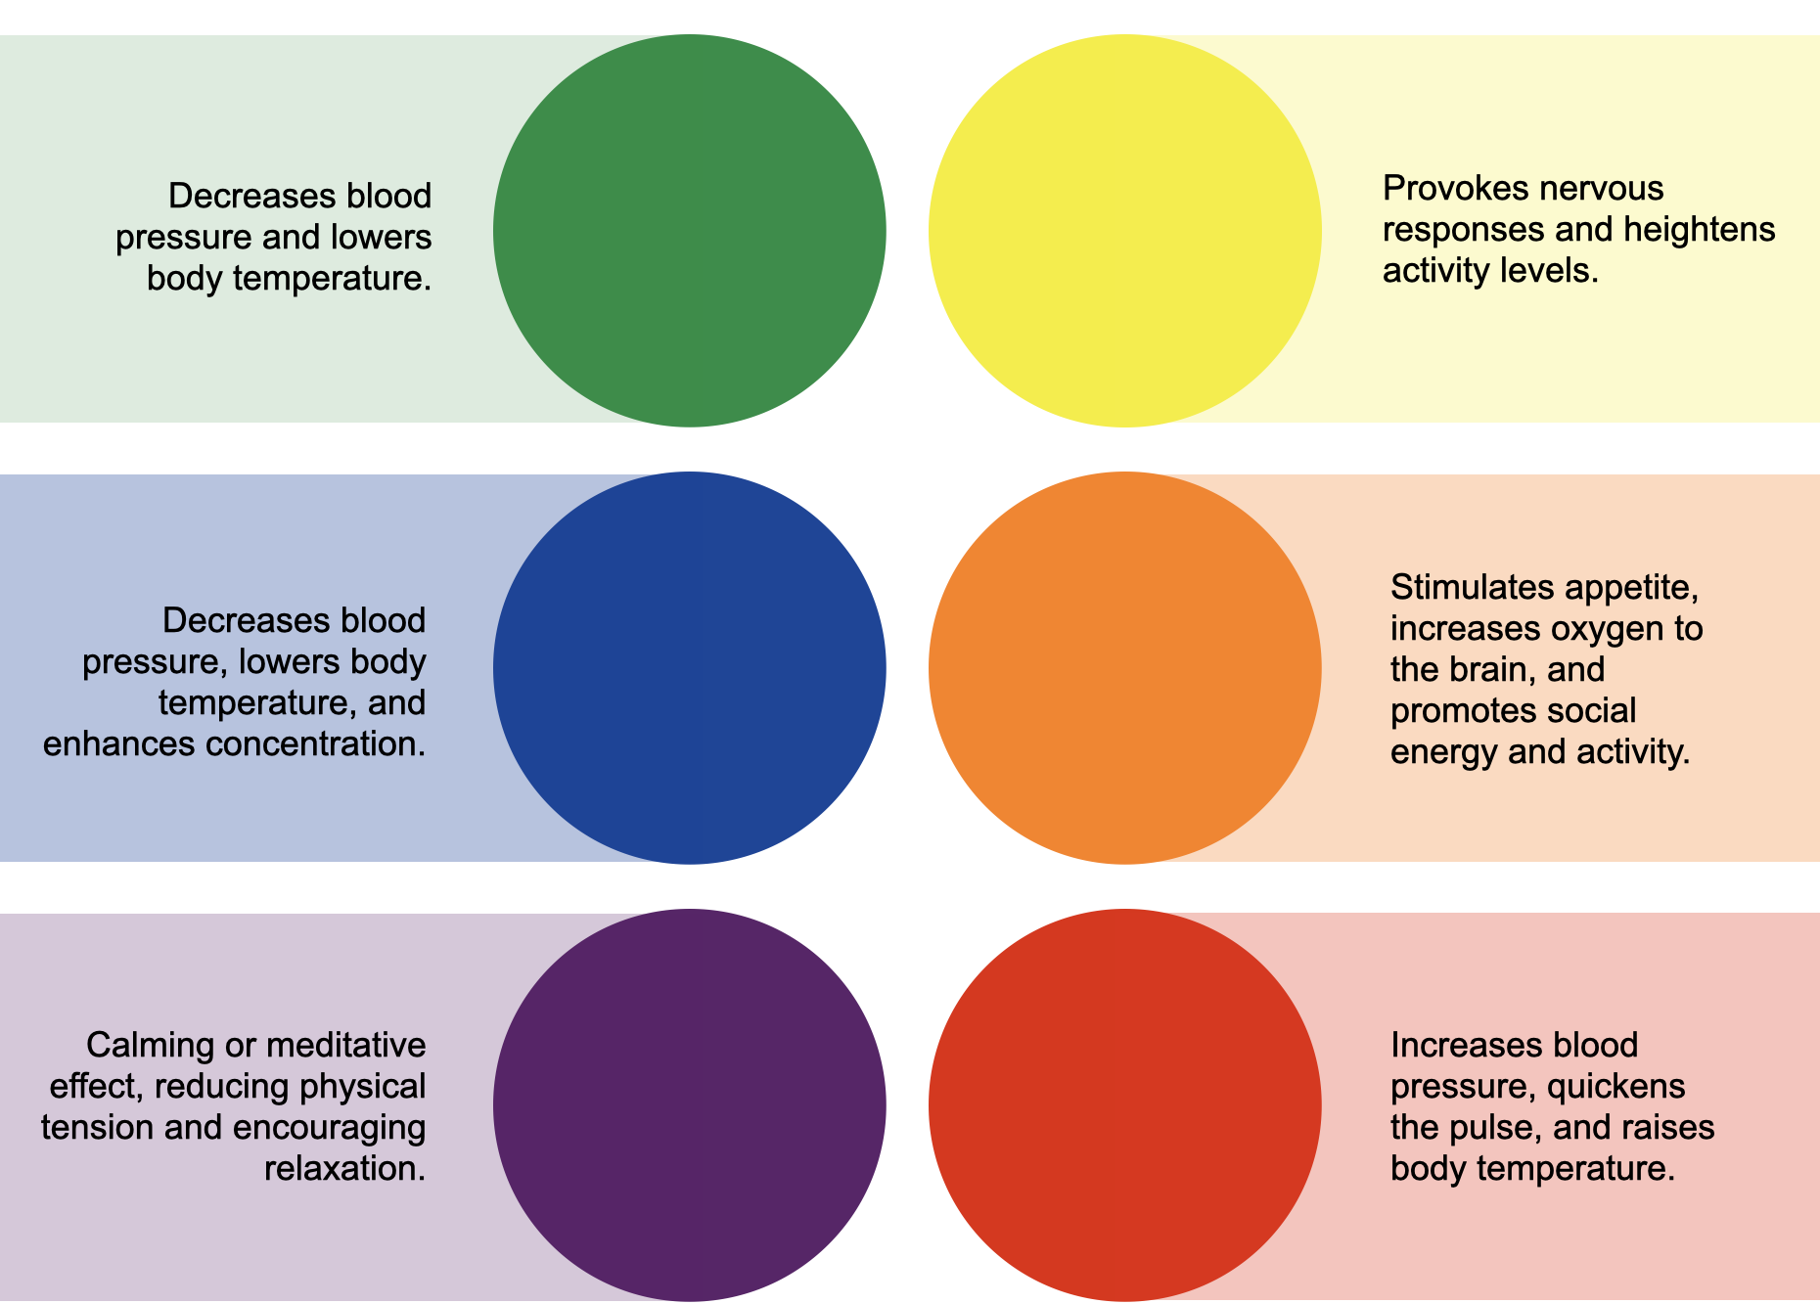
color psychology
Physical Effects of Color
Color can influence attention/arousal (context-dependent)
Reported physical responses vary; treat as tendencies, not rules
Emotional Effects of Color
Warm: active/energizing
Cool: calm/soothing
Context + culture can override defaults
Physical Effects of Color
Notes:
Goal: Encourage critical thinking (not rigid claims).
These are commonly reported associations
Physical Effects of Color
Where have you seen color used to speed people up or calm them down?
Emotional Effects of Color
Give one example where warm feels unsafe vs warm feels welcoming.

Slide 24
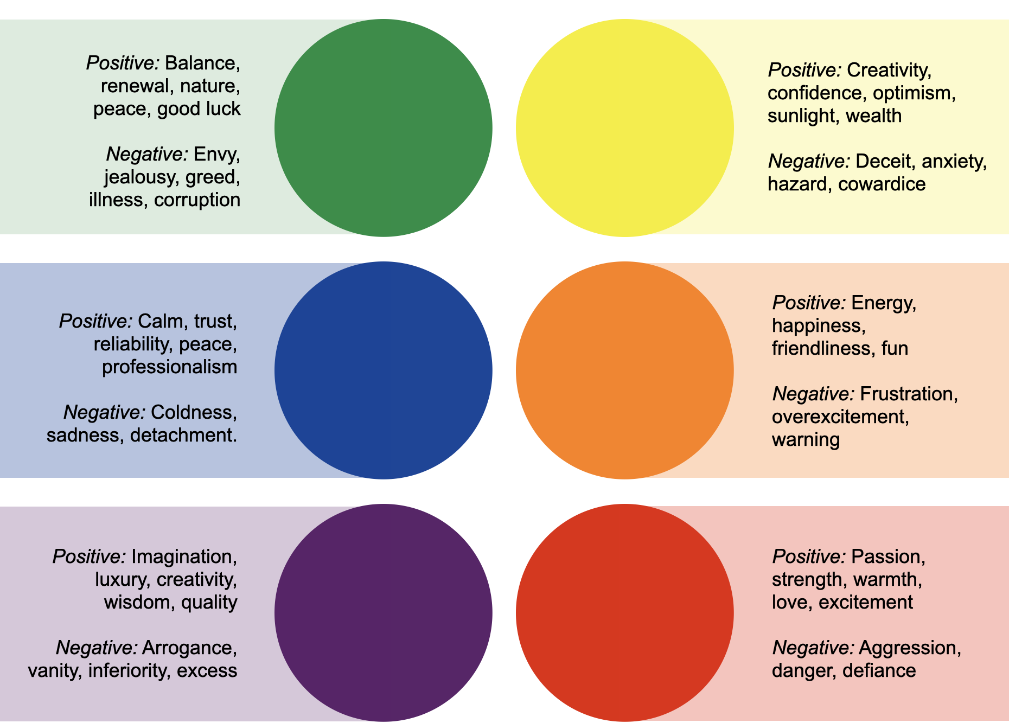
color symbolism
Color symbols are color associations that represent ideas or convey meaning both culturally and universally.
Colors can carry both positive and negative associations
Notes:
Goal: Prevent overgeneralizing.
Ask: Where do color meanings change across cultures or subcultures?
Treat symbolism as a design hypothesis, verify, don’t assume.

Slide 25
COLOR STRATEGIES
spatial effects
balance
focal point
unity

Slide 26
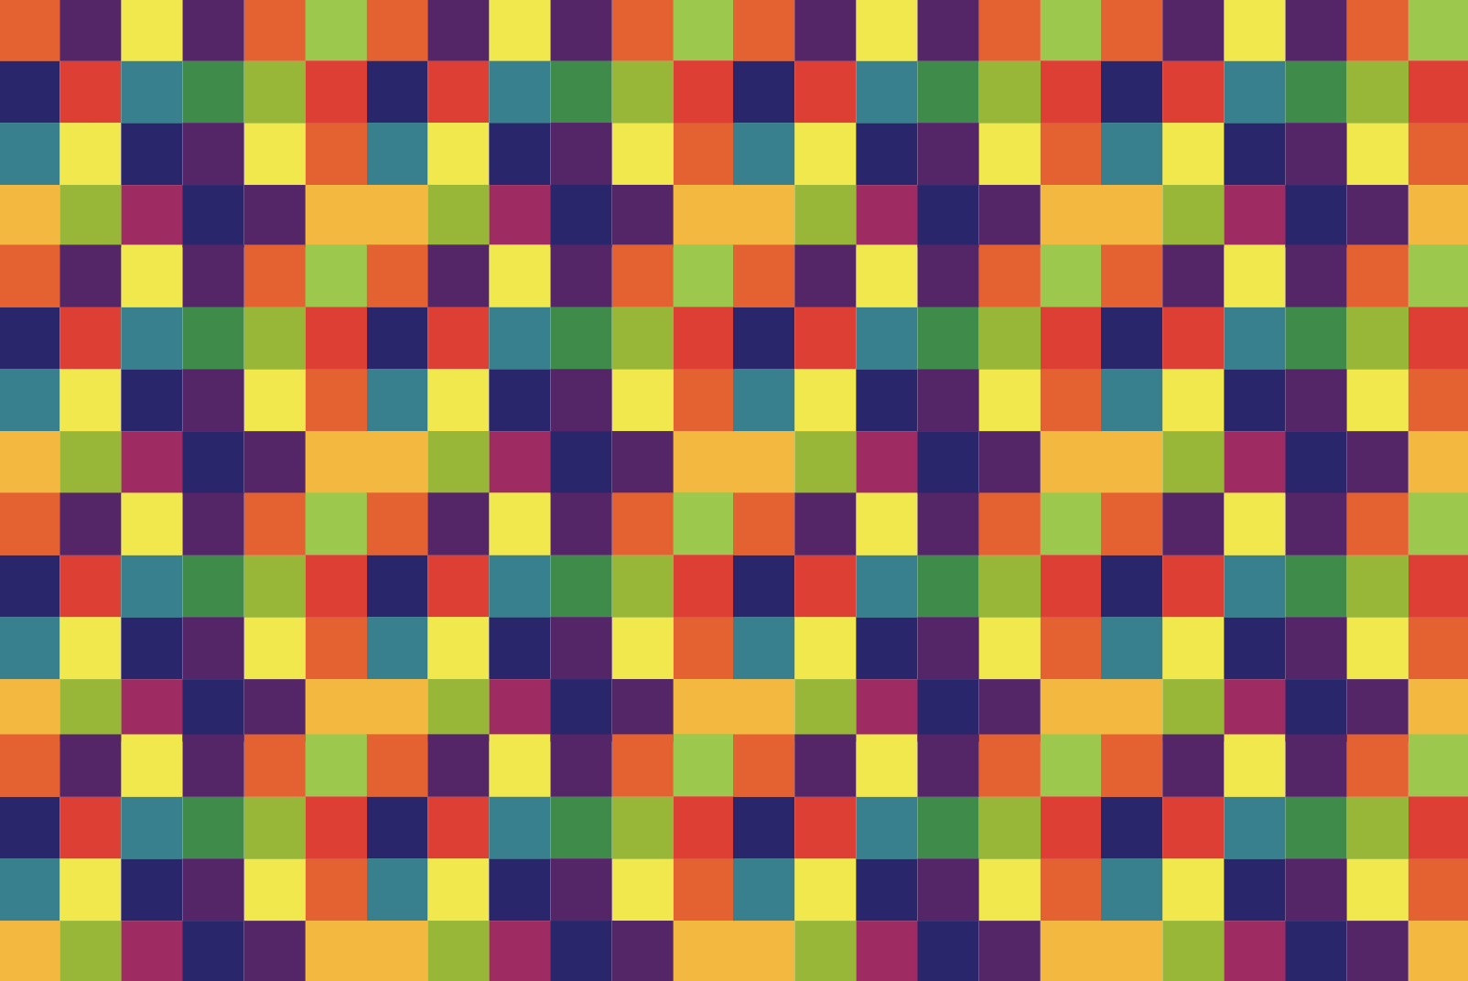
spatial effects
Saturation and Value
Higher value + stronger saturation can feel larger/more forward
Lower value can feel denser/heavier
Observe inherent value differences (yellow vs violet)
Notes:
Ask: Which squares feel larger, what property is doing that?

Slide 27
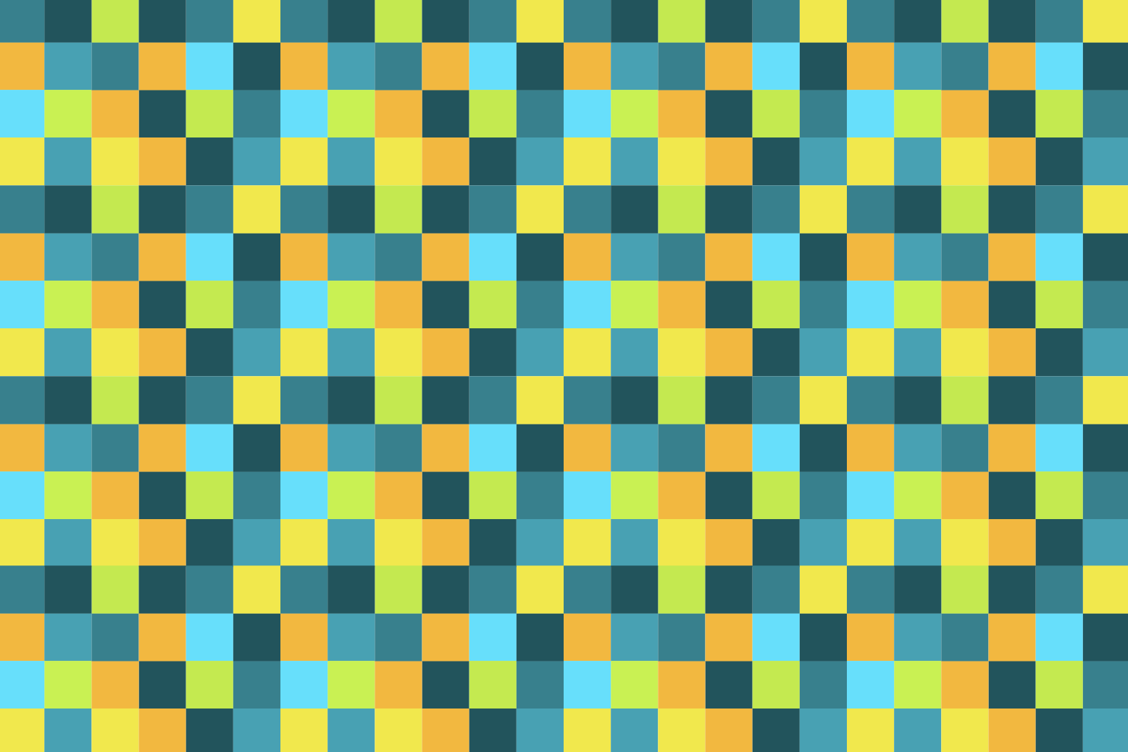
spatial effects
Warm and Cool Colors
Warm advances; cool recedes
Notes:
Ask: Where do you see this used to create depth without perspective lines?

Slide 28

spatial effects
Creating Space – Daytime
Background higher value than foreground = daytime depth
Value shift suggests distance
Notes:
Ask: What happens if the background becomes darker than the foreground?

Slide 29

spatial effects
Creating Space - Nighttime
Background darker than foreground = nighttime depth
Saturation/value shifts reinforce distance
Notes:
Ask: Which shift sells the illusion more here—value or saturation?

Slide 30

balance
Compositional Weight
Balance is the distribute visual weight
Saturation/contrast/detail add weight
Notes:
Ask: What carries more weight here, scale, complexity, or color?

Slide 31

balance
Color change redistributes weight and balances the composition.
Notes:
Ask: Where do your eyes go first now, and why?

Slide 32

focal point
Unique Color
The goal is to allow one area of color to stand out or contrast with the rest
Before use of unique color: our eye circulates
Notes:
Ask: Do you ‘land’ anywhere, or do you keep scanning?

Slide 33

focal point
When color is introduced notice the change—the single hue contrasts sharply with the surrounding forms, immediately drawing our attention to that one flower.
Notes:
Ask: Why does that single color feel important?

Slide 34

unity
What makes this feel unified, rather than random parts?
Notes:
Unity is often a palette decision before it’s a layout decision. Two common methods: limited palette and repetition.

Slide 35
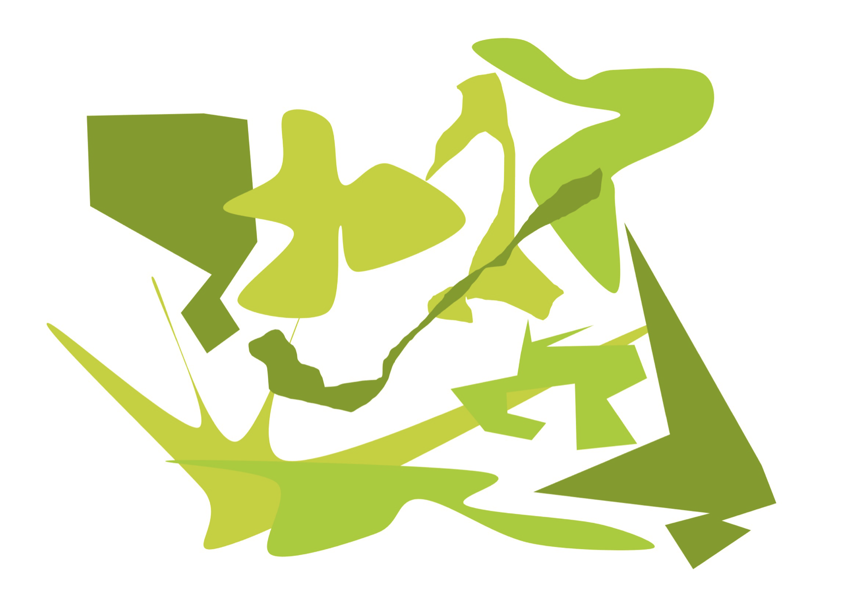
unity
Limited Palette
1 hue (with tints/shades/tones) or 2–3 adjacent hues.
Notes:
Ask: What mood does a limited palette create in your discipline?

Slide 36
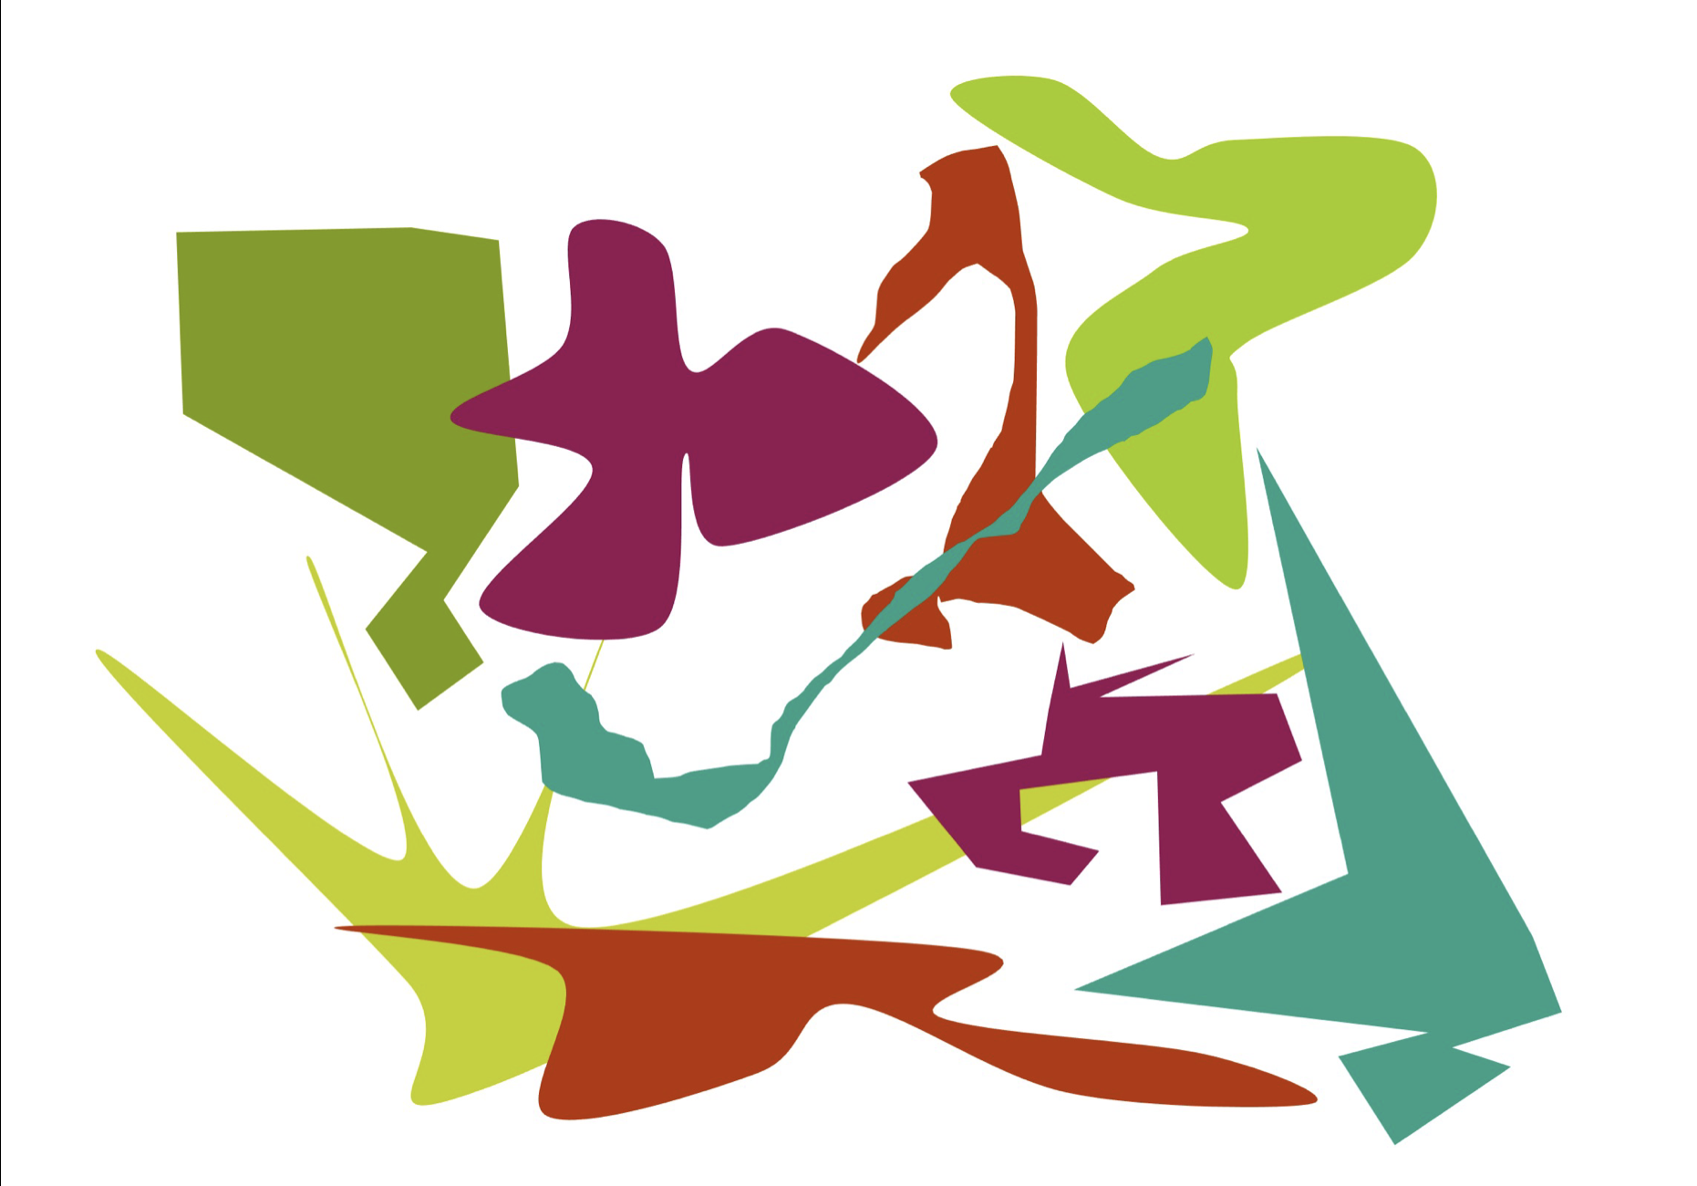
unity
Color Repetition
Repetition guides the eye and unifies
Notes:
Ask: The eye naturally moves through the design, linking separate objects into a cohesive whole, no matter how diverse their shapes or subjects may be.

Slide 37
COLOR SCHEMES
monochromatic
analogous
complementary
split complementary
double complementary (tetradic)
triadic

Slide 38

color scheme
Monochromatic
One hue + its tints/shades/tones
Calm/unified; watch contrast
Notes:
Ask: How do you prevent monotony? Value contrast or texture/detail?

Slide 39
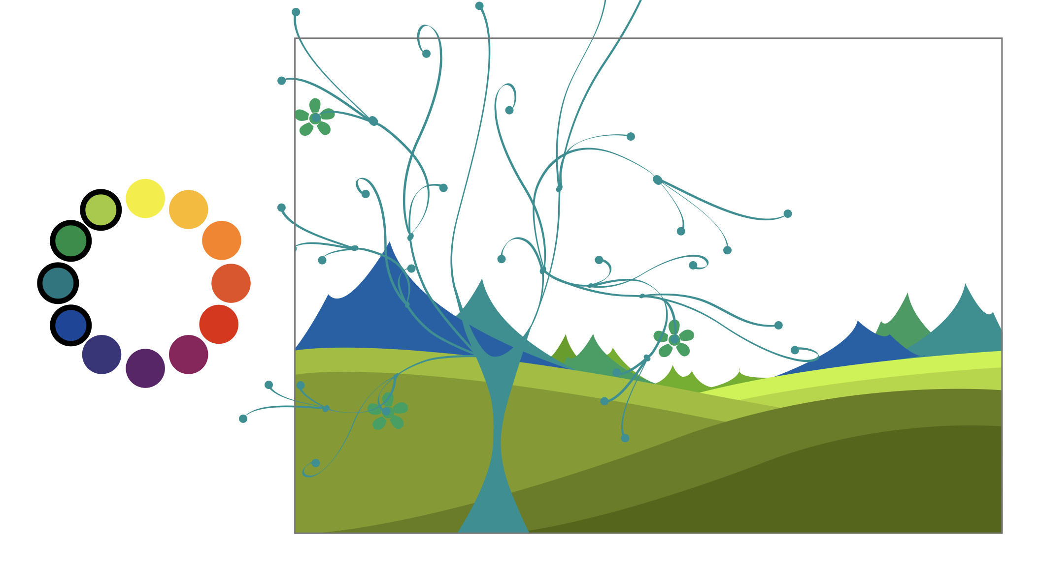
color scheme
Analogous
3–5 adjacent hues
Cohesive; moderate energy
Notes:
Ask: Where would you add contrast? Value shift, complementary accent, or saturation change?

Slide 40
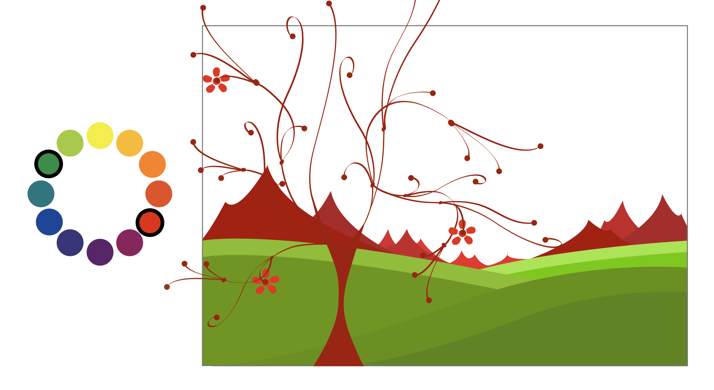
color scheme
Complementary
Opposites on the wheel
High energy/contrast; manage proportions
Notes:
Ask: Which hue should dominate to reduce high energy?

Slide 41
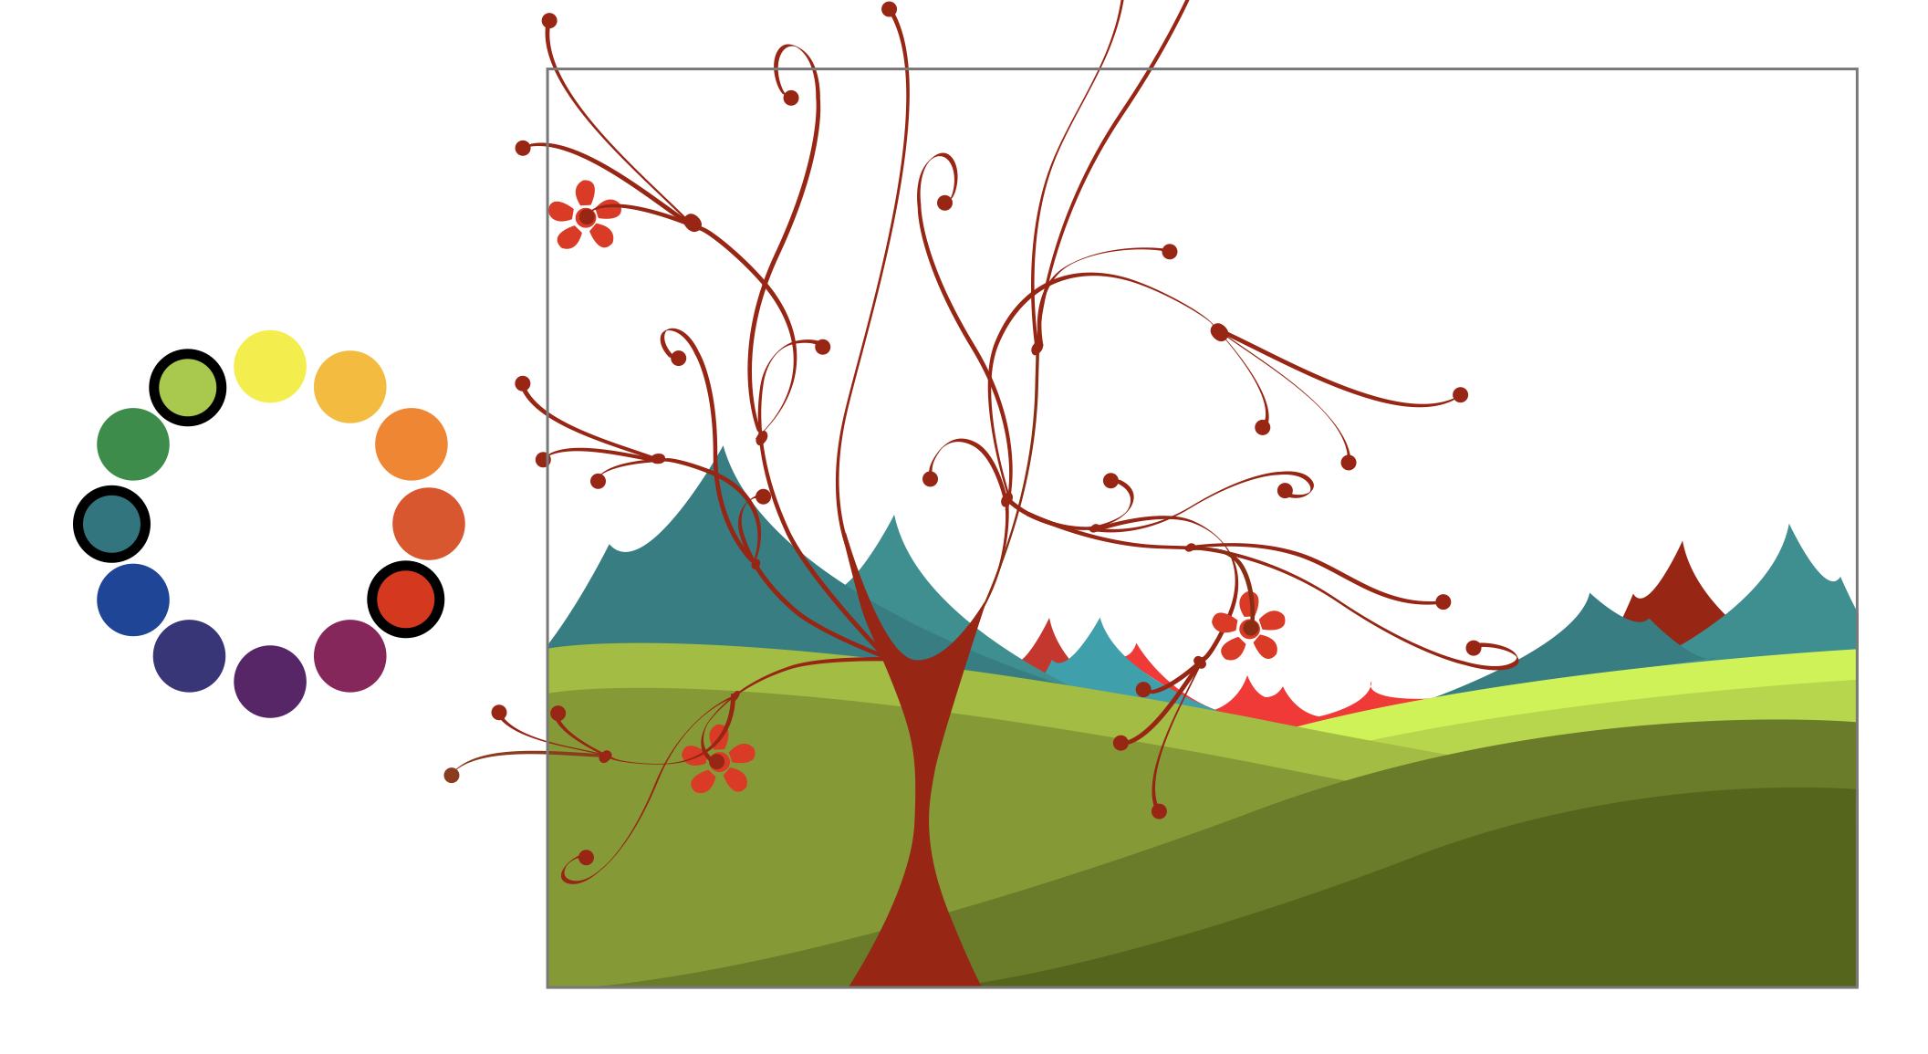
color scheme
Split-complementary
One hue + two neighbors of its complement
Vivid, but softer than direct complements
Notes:
Ask: How would you make this feel sophisticated (hint: distribution of saturation, values)?

Slide 42
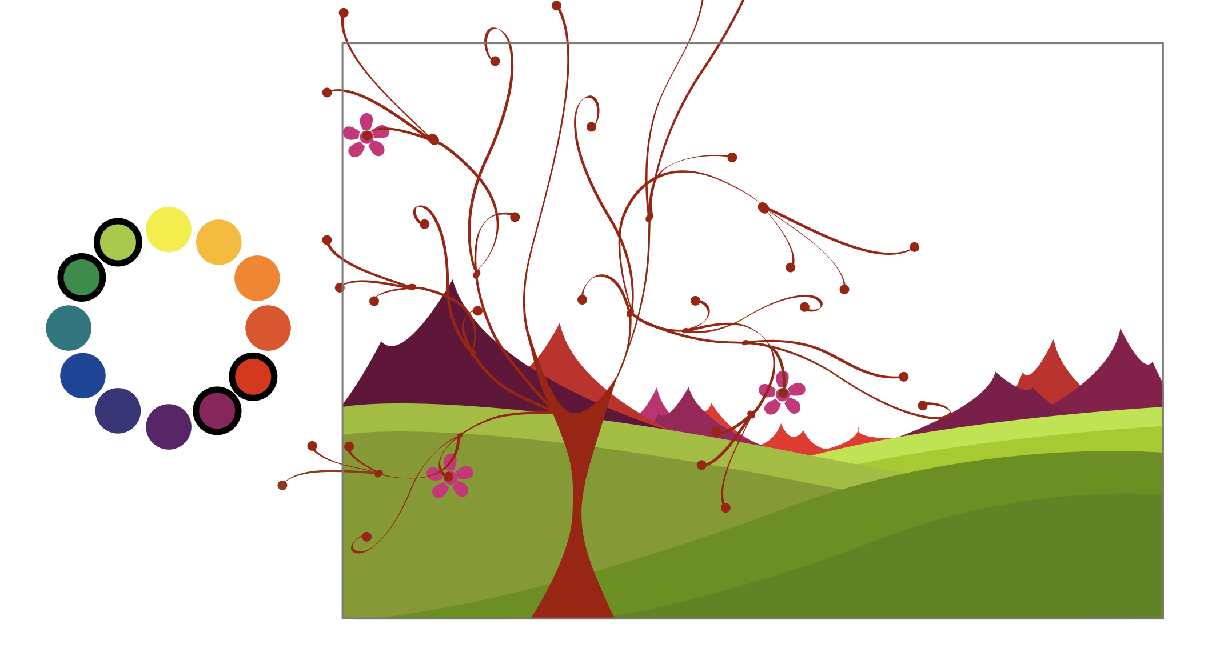
color scheme
Double-complementary
Two complementary pairs
Rich range; pick a dominant pair
Notes:
Ask: What is the result if all four hues fight for attention?

Slide 43
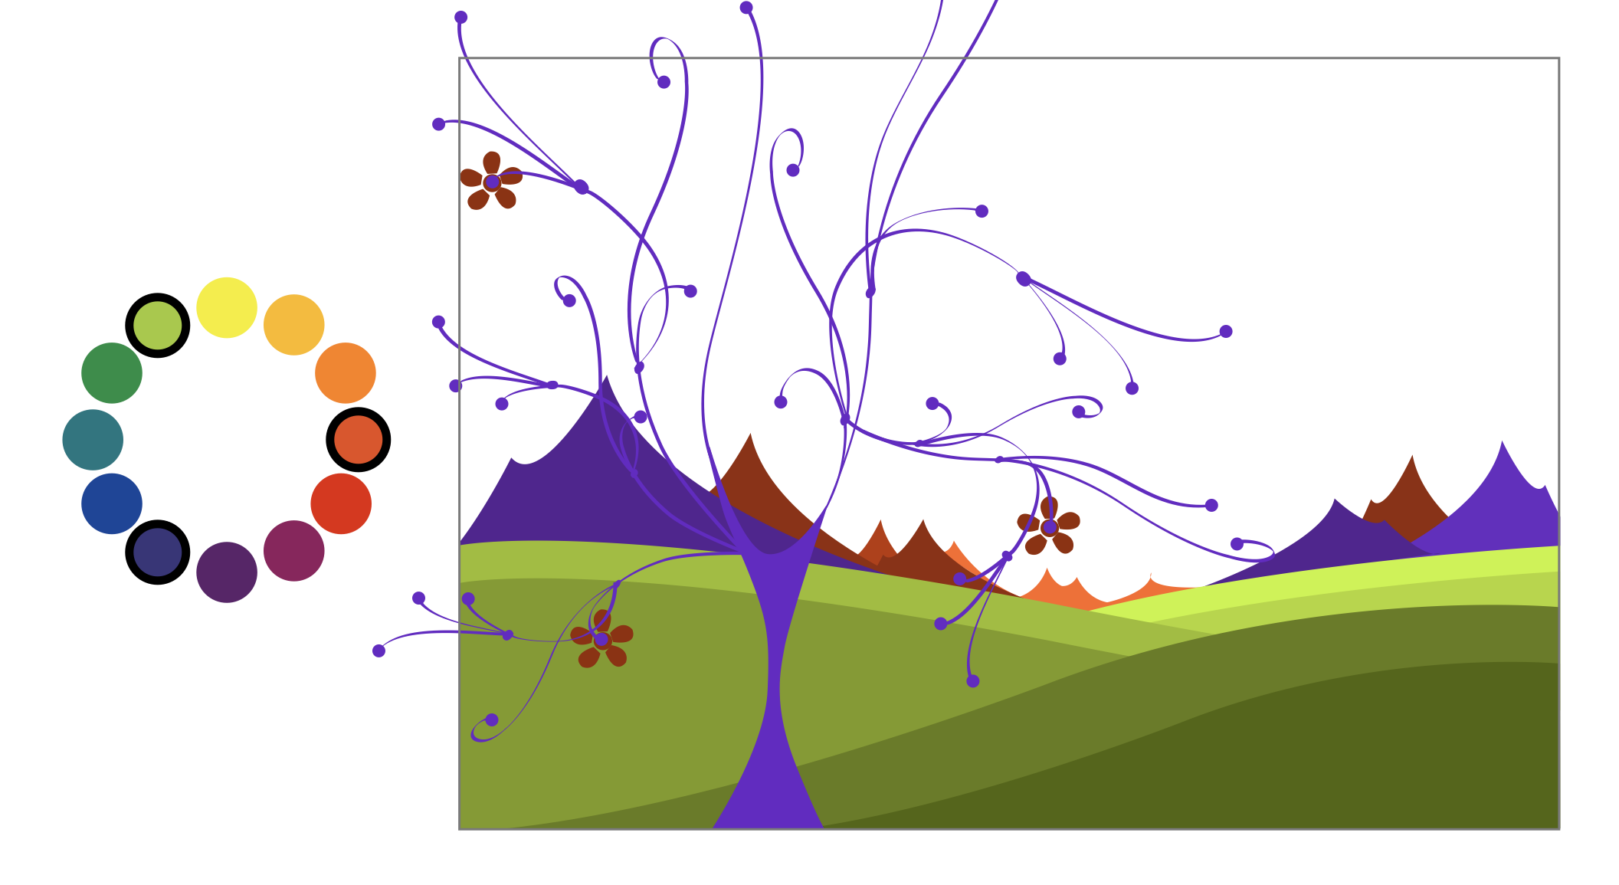
color scheme
Triadic
Three evenly spaced hues
Lively but stable; control saturation/value
Notes:
Ask: Why might this feel easier to balance than complementary?

Slide 44
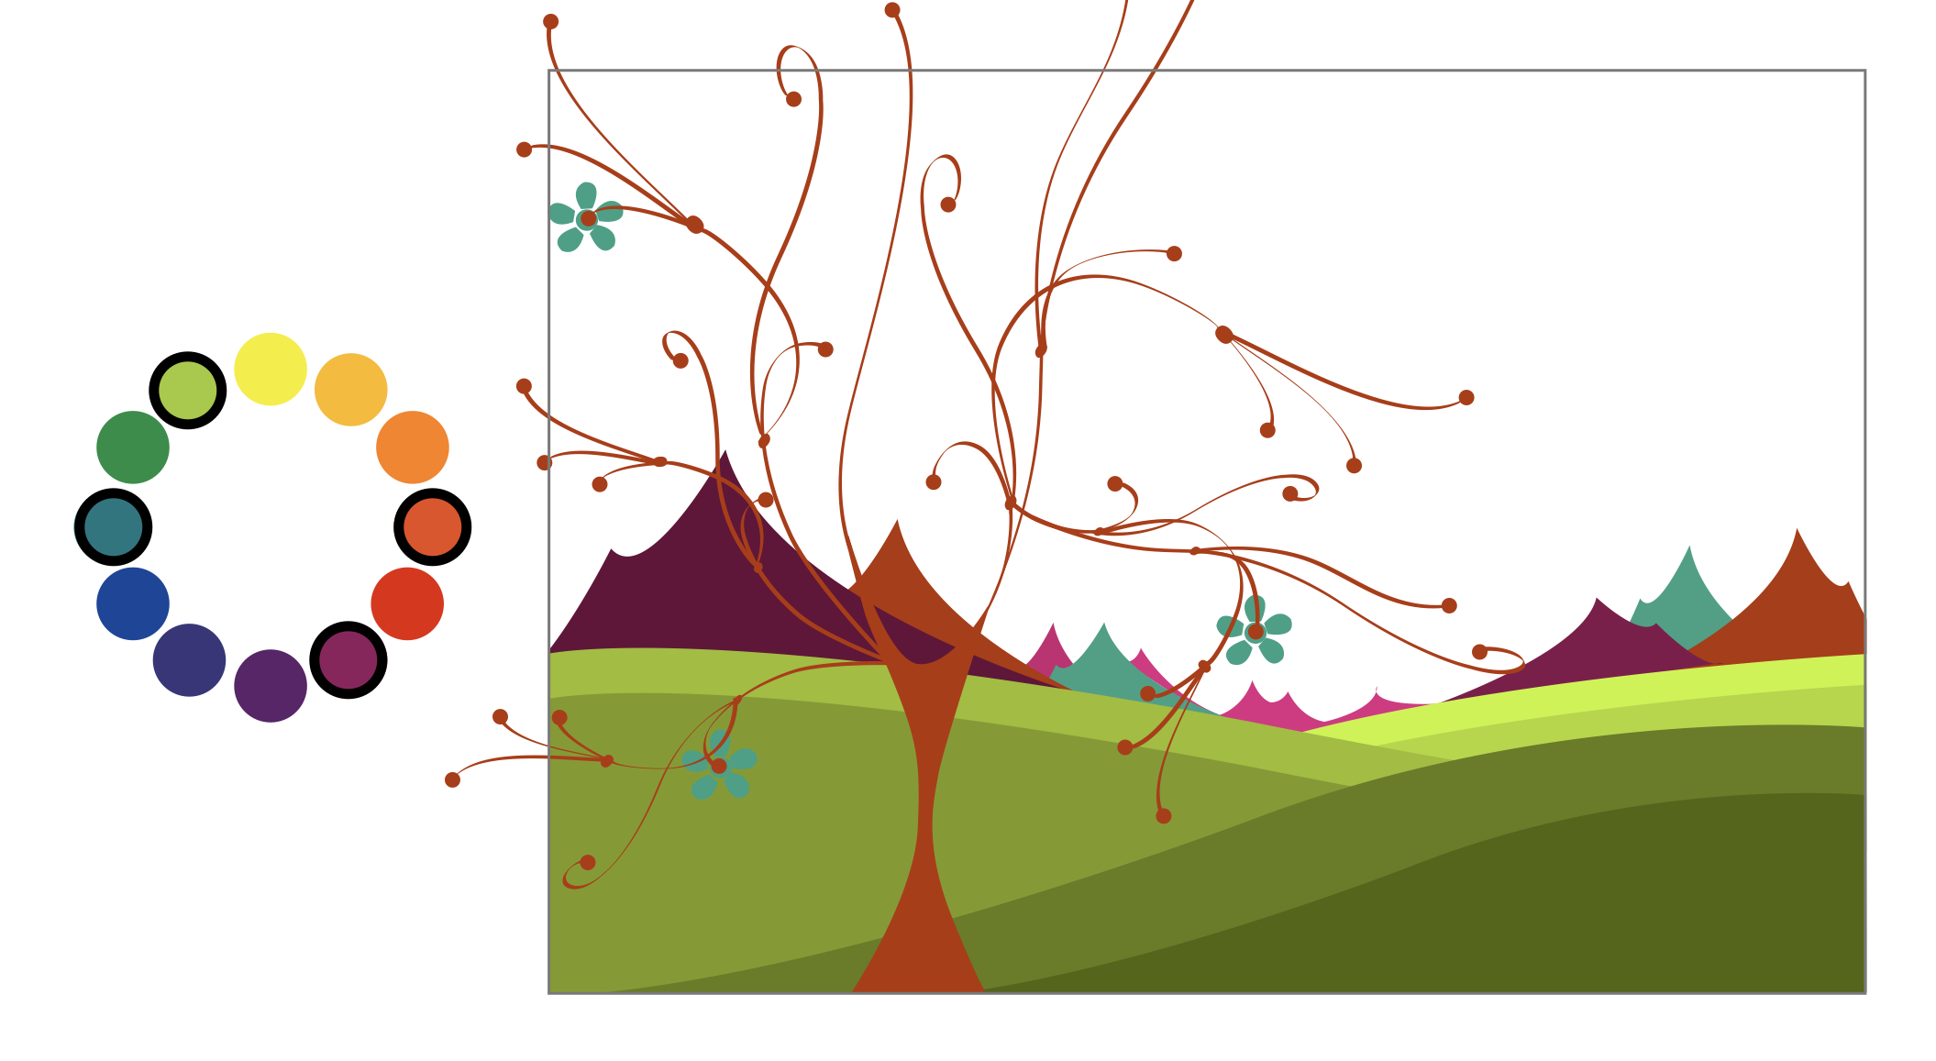
color scheme
Tetradic
Four hues arranged as square or rectangle
Variety and flexibility

