Slide 1
Connecting to Design | FOCAL POINT
Notes:
Goal: Set expectations: slides support teaching; textbook carries depth.
Commentary on Design: Follow the link to explore real-world examples of these concepts in graphic design, fashion design, industrial design, interior design, media arts and animation, game art and design, and film and video.

Slide 2
principle | FOCAL POINT
A focal point is the center of interest;
it is what catches our eye and holds our attention.

Slide 3
CREATING A FOCAL POINT
focal point by contrast
focal point by isolation
focal point by placement
absence of focal point

Slide 4
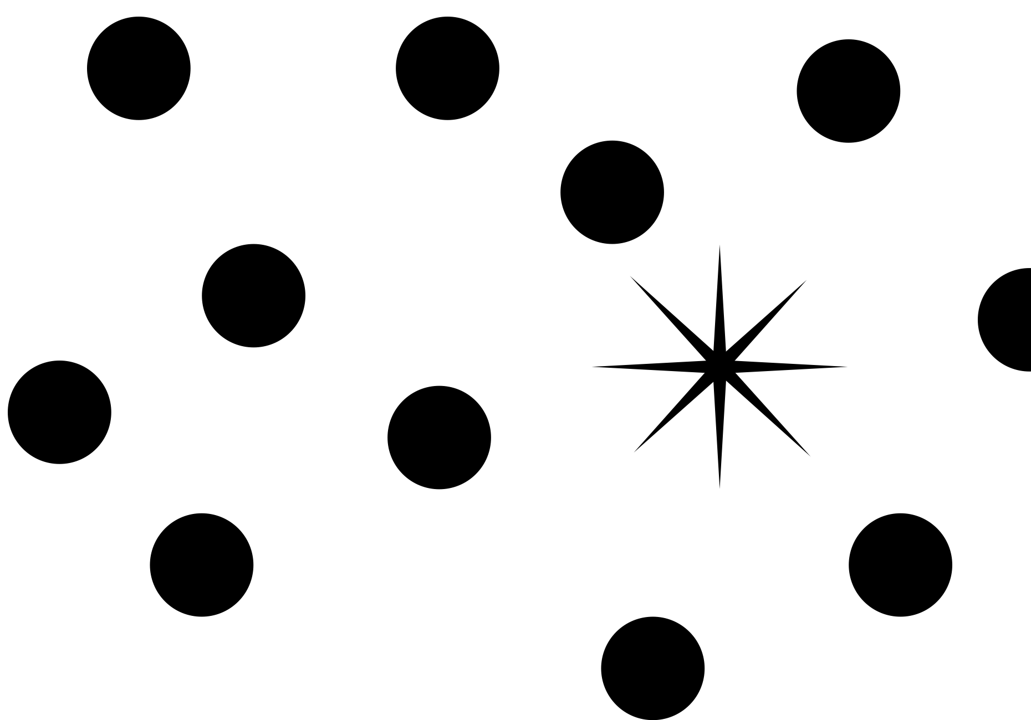
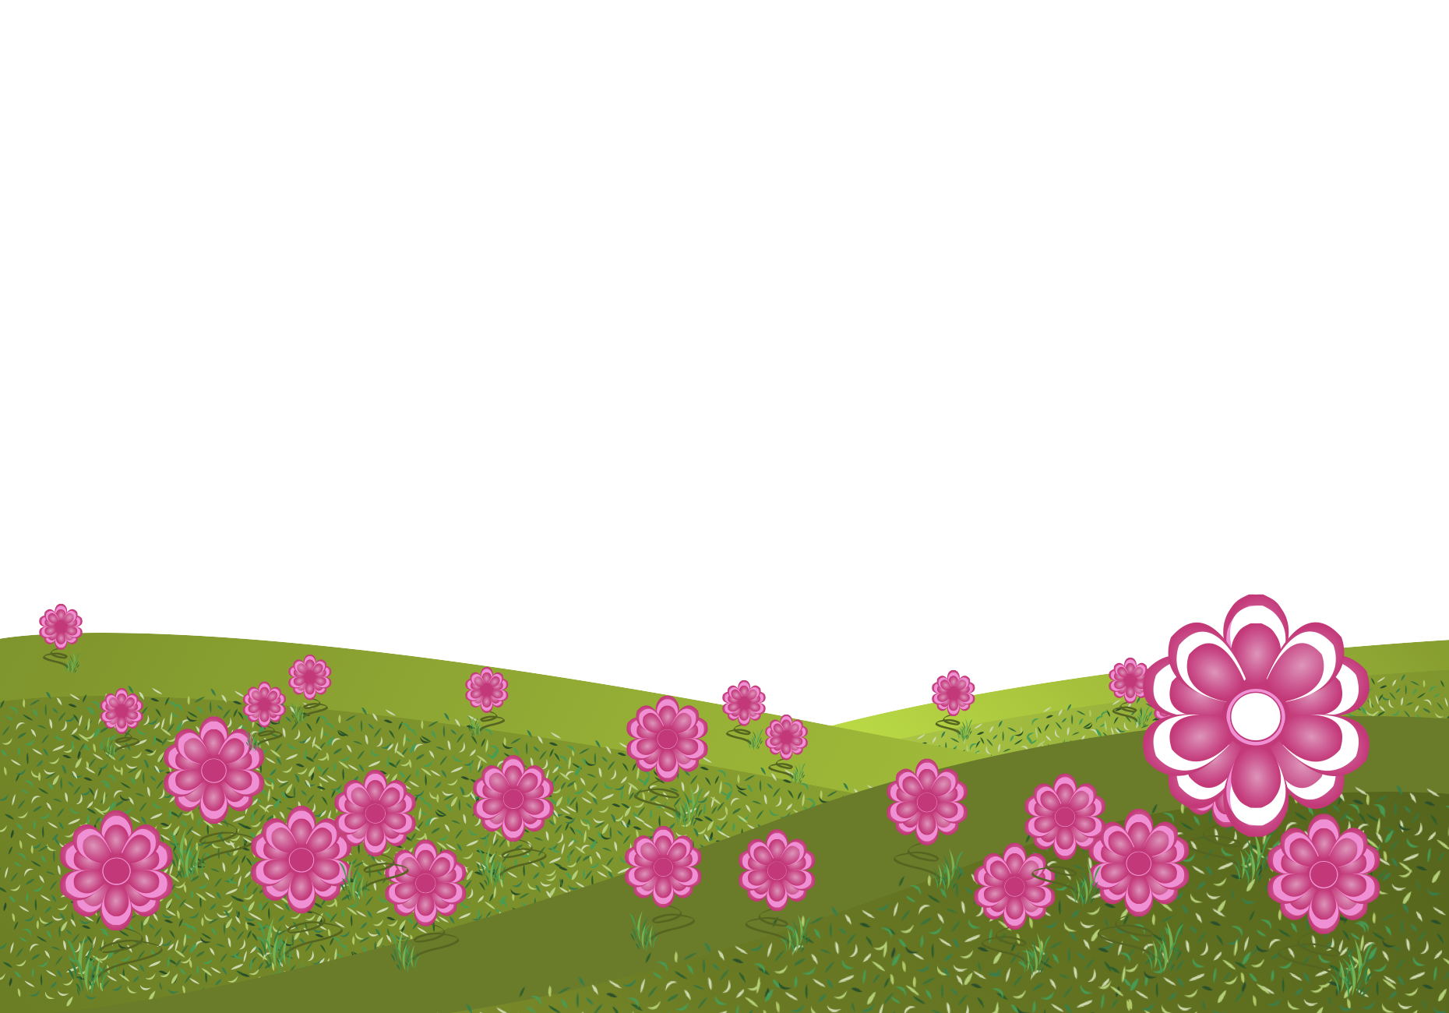
focal point by contrast
FORM
One area/object differs from the rest
Difference creates emphasis (value/color/shape/size/detail)
CONTENT
Immediate attention
Feels singled-out (creates a question: why that one?)
Builds drama or curiosity
Notes:
When something breaks the pattern, your brain flags it as important; “difference” call attention and narrative curiosity.
Ask: What is contrasting? What story question does it create?
Ask: What kinds of contrast are possible besides color (value, size, texture, direction)?

Slide 5
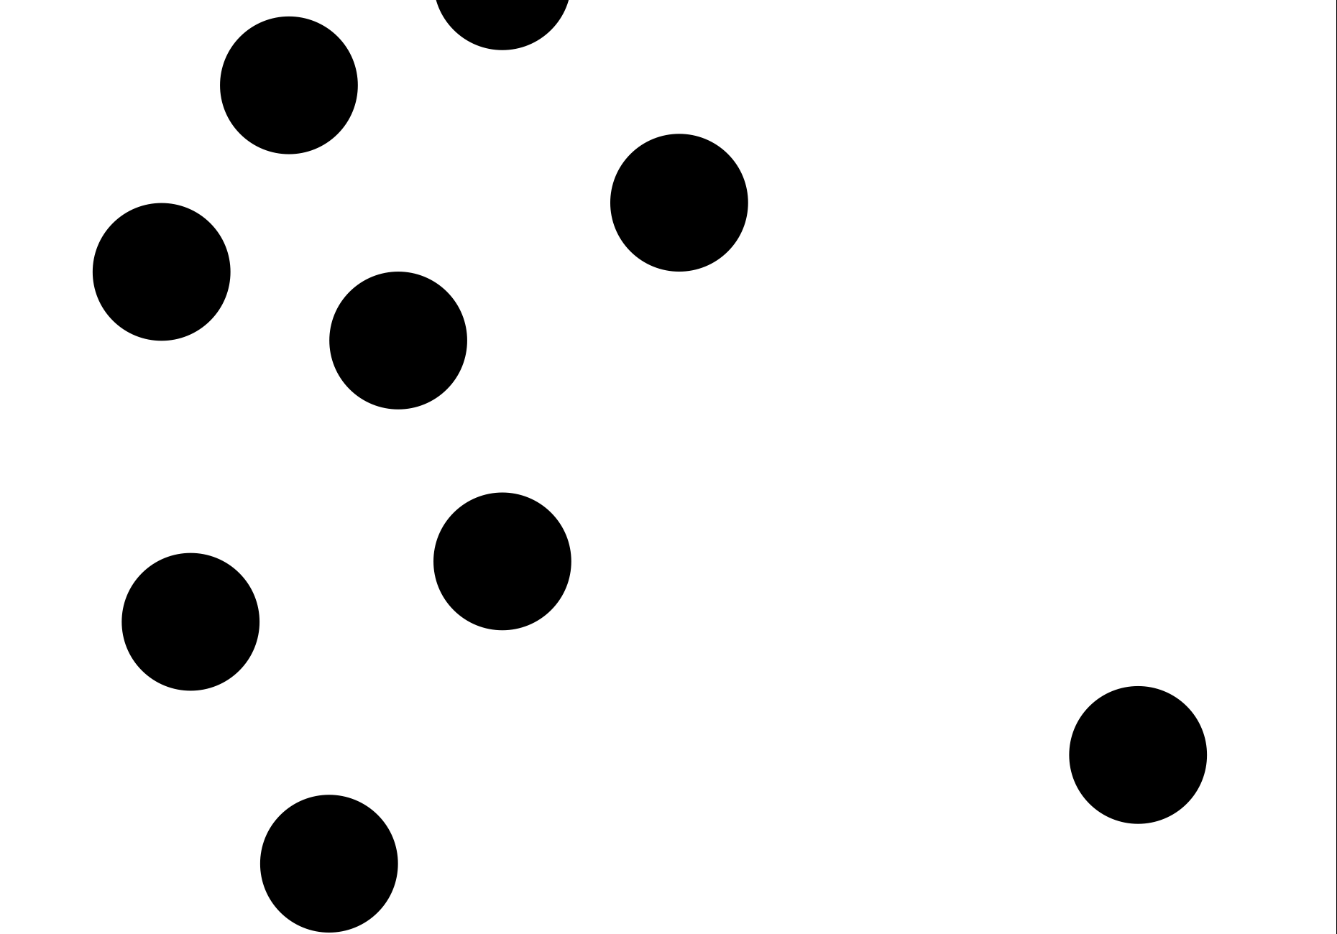
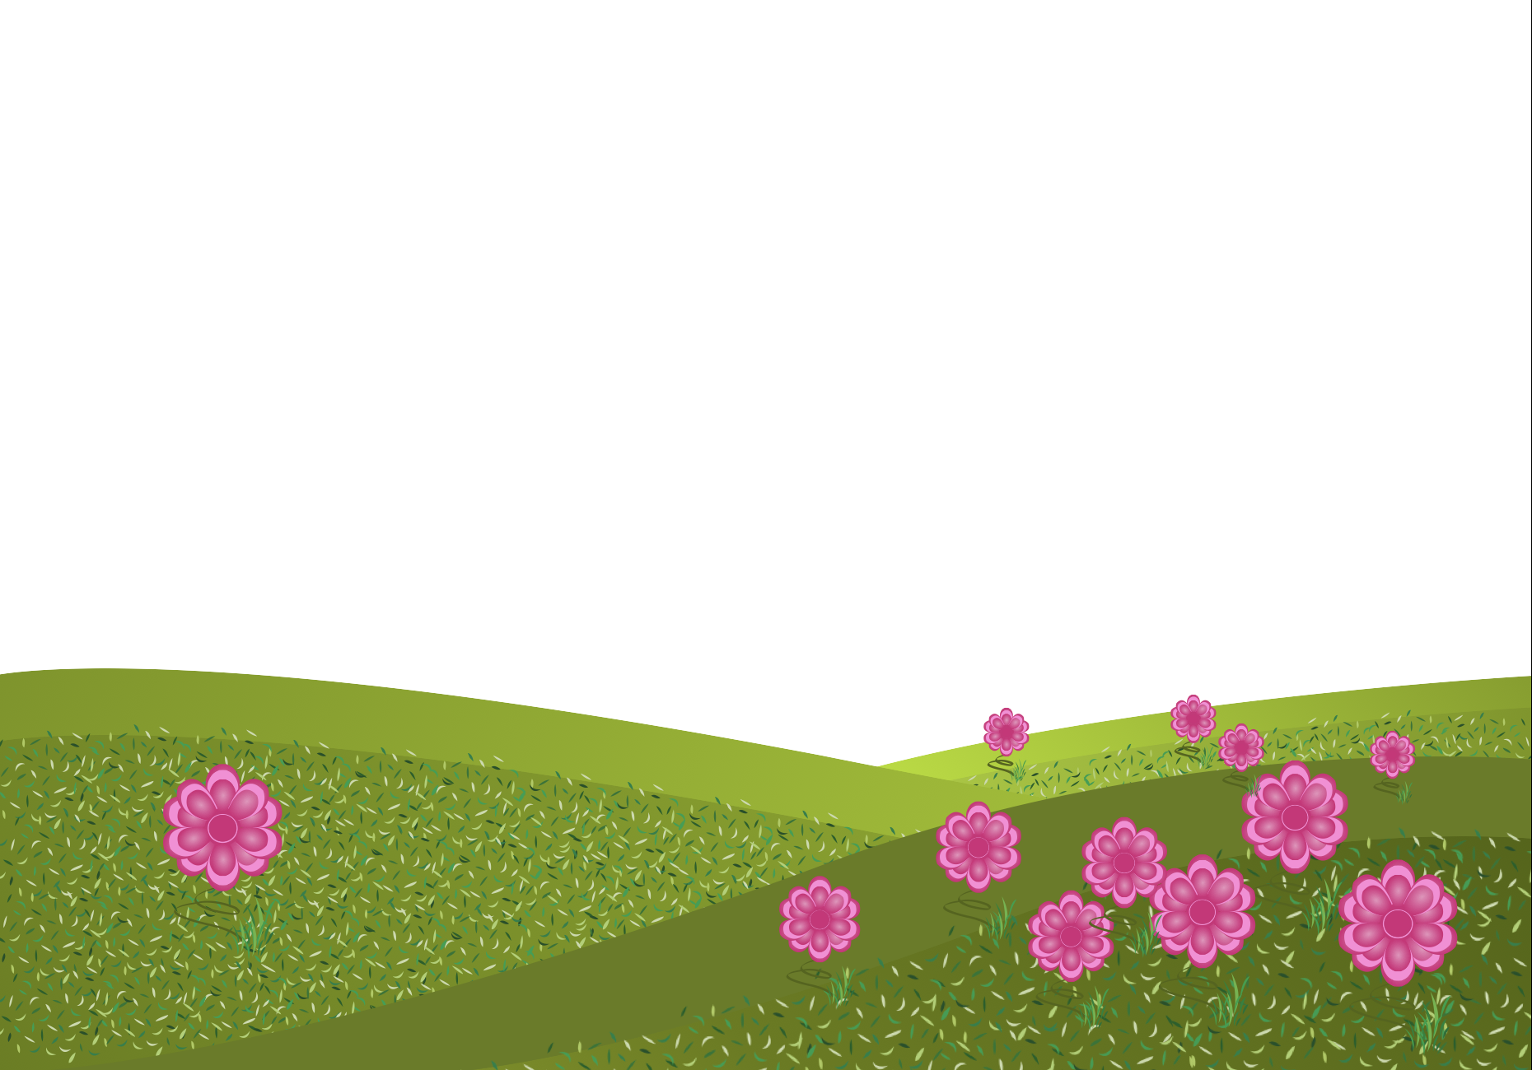
focal point by isolation
FORM
One object/area separated from the group
Space around it increases emphasis
CONTENT
Lone / special / important
Can feel quiet, mysterious, or intentional
Encourages “why is it alone?” thinking
Notes:
Isolation works because your eye notices the one thing that isn’t part of the cluster.
How does isolation increase attention here?
Ask: Where is isolation used in design (minimal posters, luxury branding, UI onboarding screens)?

Slide 6
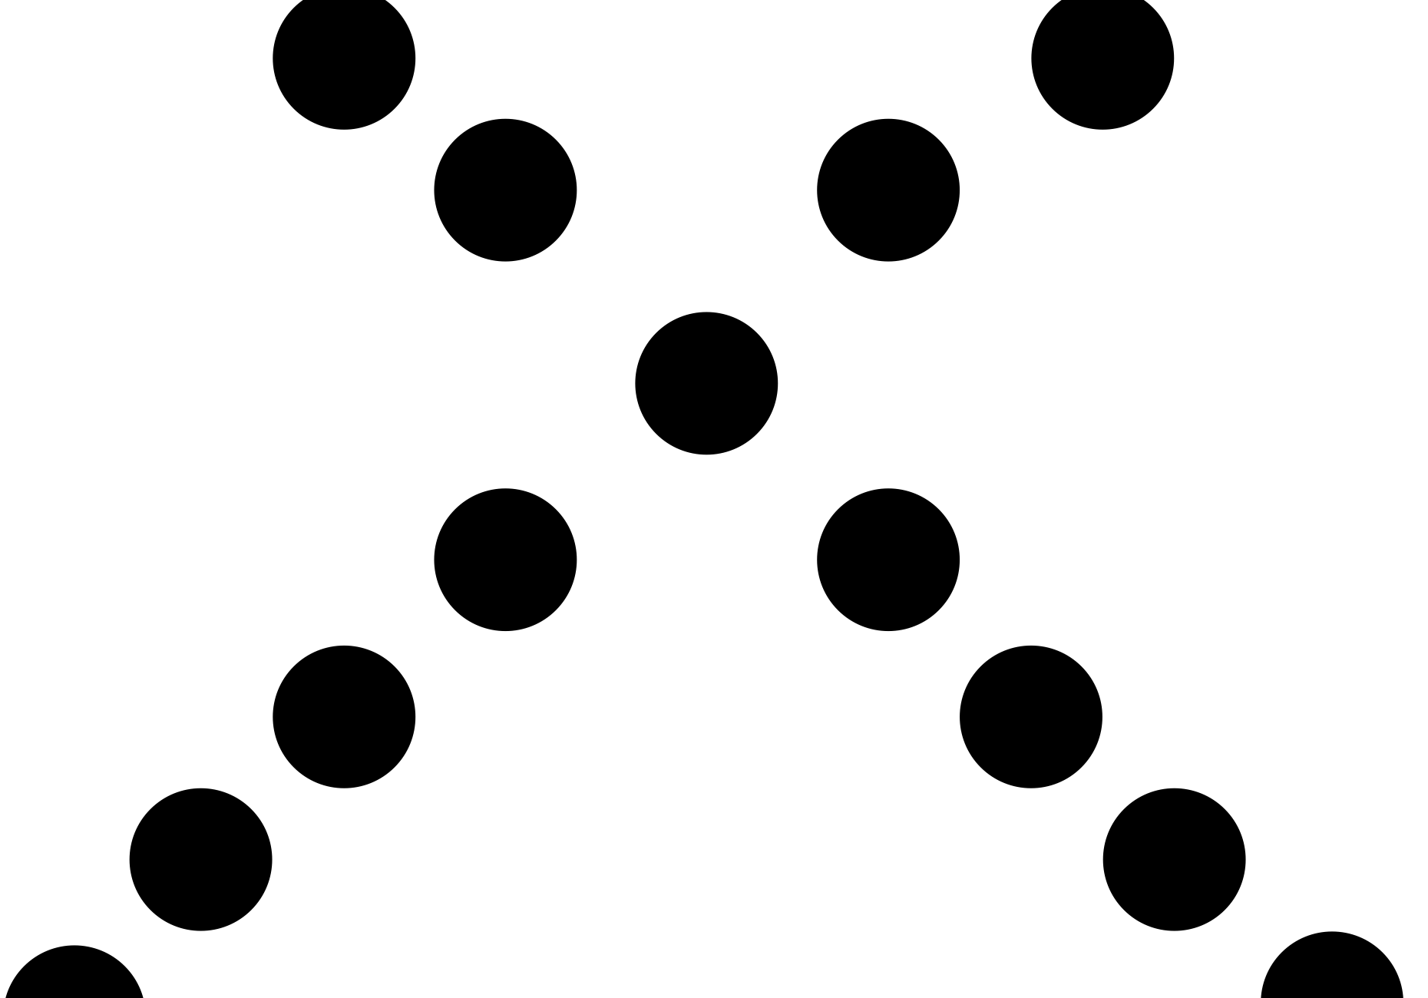
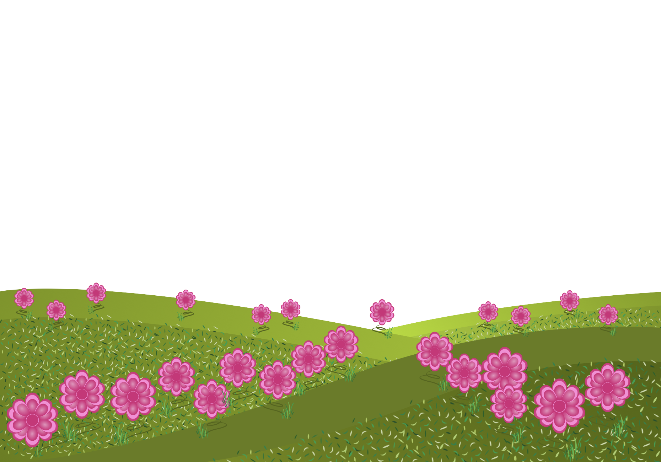
focal point by placement
FORM
Placement of objects leads the eye to one area
CONTENT
Controlled viewing path
Feels designed / intentional
Strong composition structure
Notes:
When the placement of objects leads our eye to one object or area, a focal point by placement is created.
Ask: What implied lines lead you and where do they land?
Ask: Where do filmmakers place subjects for focus (center, rule of thirds, leading lines)?

Slide 7
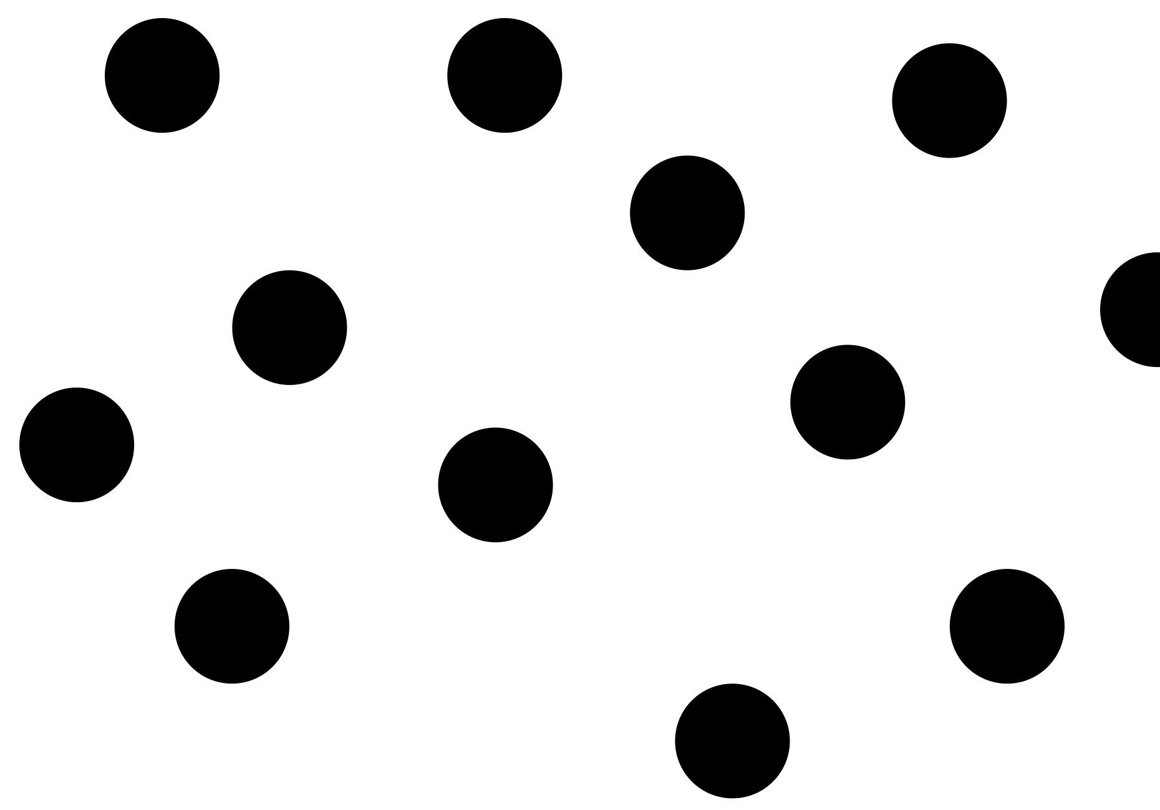
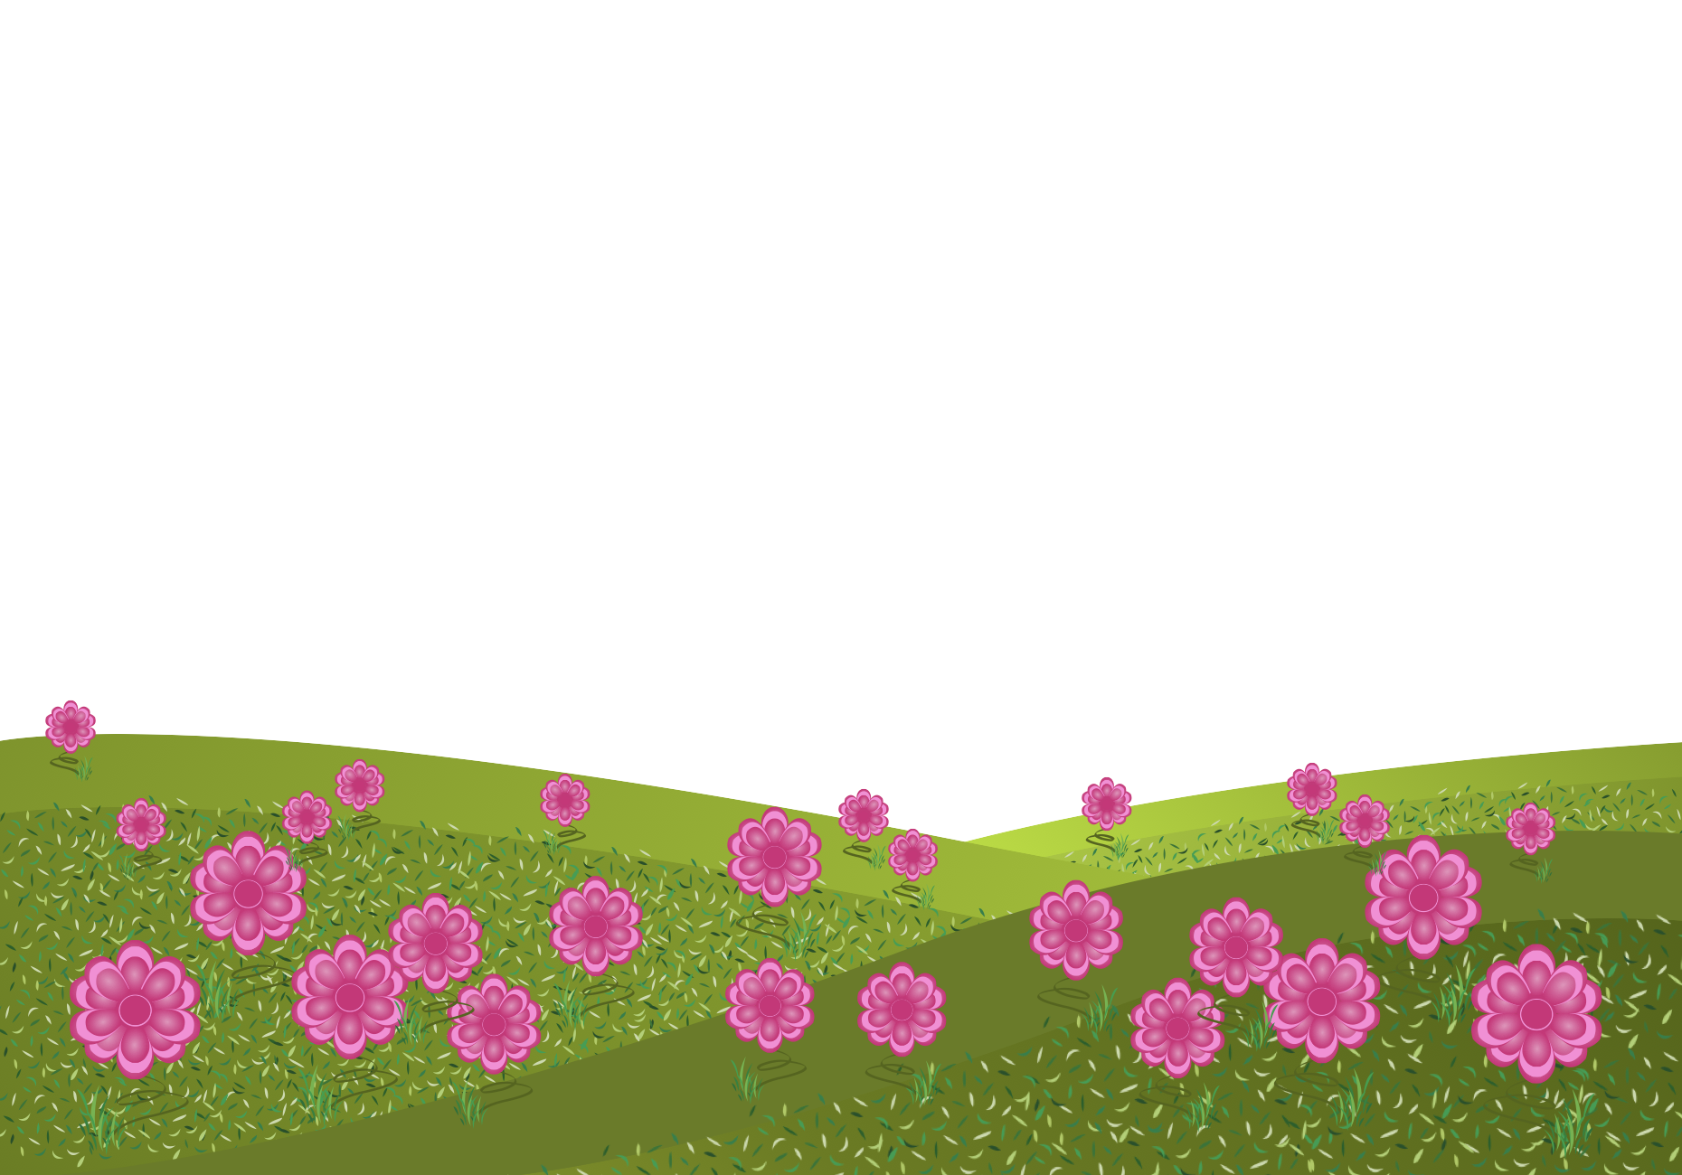
absence of focal point
FORM
Many areas emphasized equally
No single attention anchor
CONTENT
Dispersed attention
Eye moves freely across the whole composition
Can feel busy, pattern-like, or democratic
Notes:
Without a focal point, your attention spreads, sometimes that’s peaceful, sometimes it’s overwhelming.
Ask: Where did your eye go first?’ (Compare answer--do they differ?)
Ask: When is absence useful (textures/patterns, backgrounds, all-over designs, environments)?
Transition: Now we’ll apply these concepts to your own design field through Making the Connection and the Commentary on Design examples.

Slide 8
MAKING THE CONNECTION
You now have an understanding of how the element line feels and what it can communicate; now take it a step further, strengthen your comprehension by applying this knowledge to your area of design!
COMMENTARY ON DESIGN
Visit Commentary on Design for inspiration.
You will discover how designers in the real world are employing the elements and principles of design in a variety of design fields!
Notes:
Goal: Turn vocabulary into observation + analysis.
Your job is to spot focal point in the real world and describe it using our terms, focal point by contrast, isolation, or placement, or the absence of focal point, then connect that choice to hierarchy (what matters most), mood (curiosity, tension, calm), and what the designer wants the viewer to notice and remember.

