Slide 1
Connecting to Design | PROPORTION
Notes:
Goal: Set expectations: slides support teaching; textbook carries depth.
Commentary on Design: Follow the link to explore real-world examples of these concepts in graphic design, fashion design, industrial design, interior design, media arts and animation, game art and design, and film and video.

Slide 2
principle | PROPORTION
Proportion is the size relationship of different part(s) to the whole.

Slide 3
PROPORTION
notions of the ideal
the golden rectangle

Slide 4
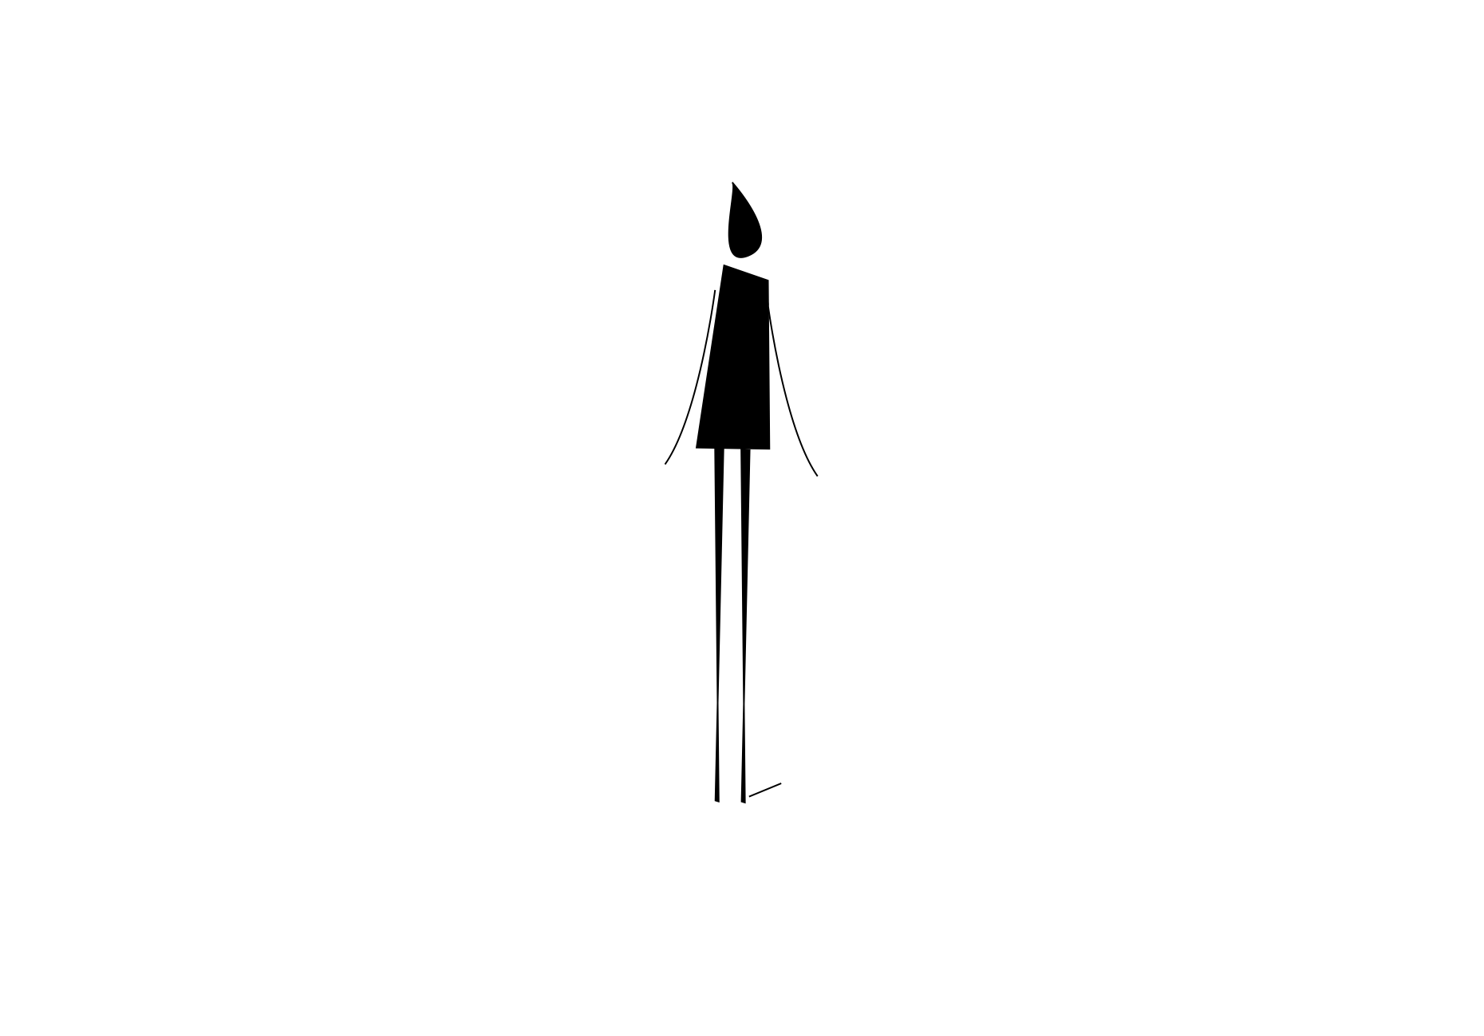

notions of the ideal
FORM
Based on our own personal perception
CONTENT
Normal / believable
Stable / familiar
Realistic character design
Notes:
We carry an internal template for what bodies “should” look like, so proportion feels correct when it matches that template.
Ask: How does “normal proportion” help in design (clarity, trust, relatability)?

Slide 5

notions of the ideal
FORM
A body part is exaggerated
Relationship no longer matches the expected standard
Reads as out of proportion
CONTENT
Whimsical / playful
Stylized / cartoon-like
Can signal personality or humor
Notes:
What feeling does exaggeration create?
Exaggerated proportion is a storytelling tool, it can make a figure feel funny, strange, cute, or dramatic.
Ask: What does exaggerated proportion tell here?
Ask: Where do you see proportion exaggeration used on purpose (animation, caricature, fashion)?

Slide 6
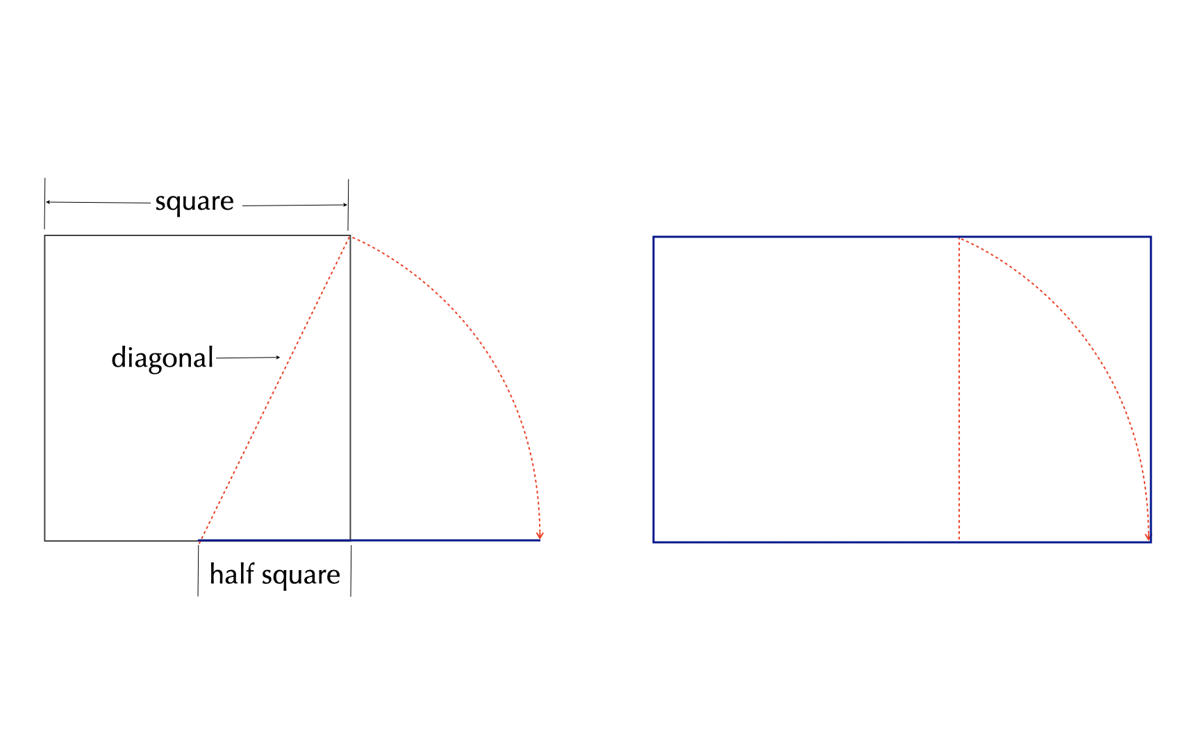
the golden rectangle
FORM
Golden rectangle = shape based on the golden ratio
Can be constructed from a square + extended rectangle
Repeatable / expandable proportion system
CONTENT
Often associated with harmony and balance
Used as a guide for pleasing composition
A historical ‘ideal proportion’ idea
Notes:
Treat golden rectangle as a design tool (not magic). The golden rectangle is one approach designers use when they want proportions that feel orderly and consistent.
Ask: Do you think “ideal proportion” is universal, or context-dependent?

Slide 7
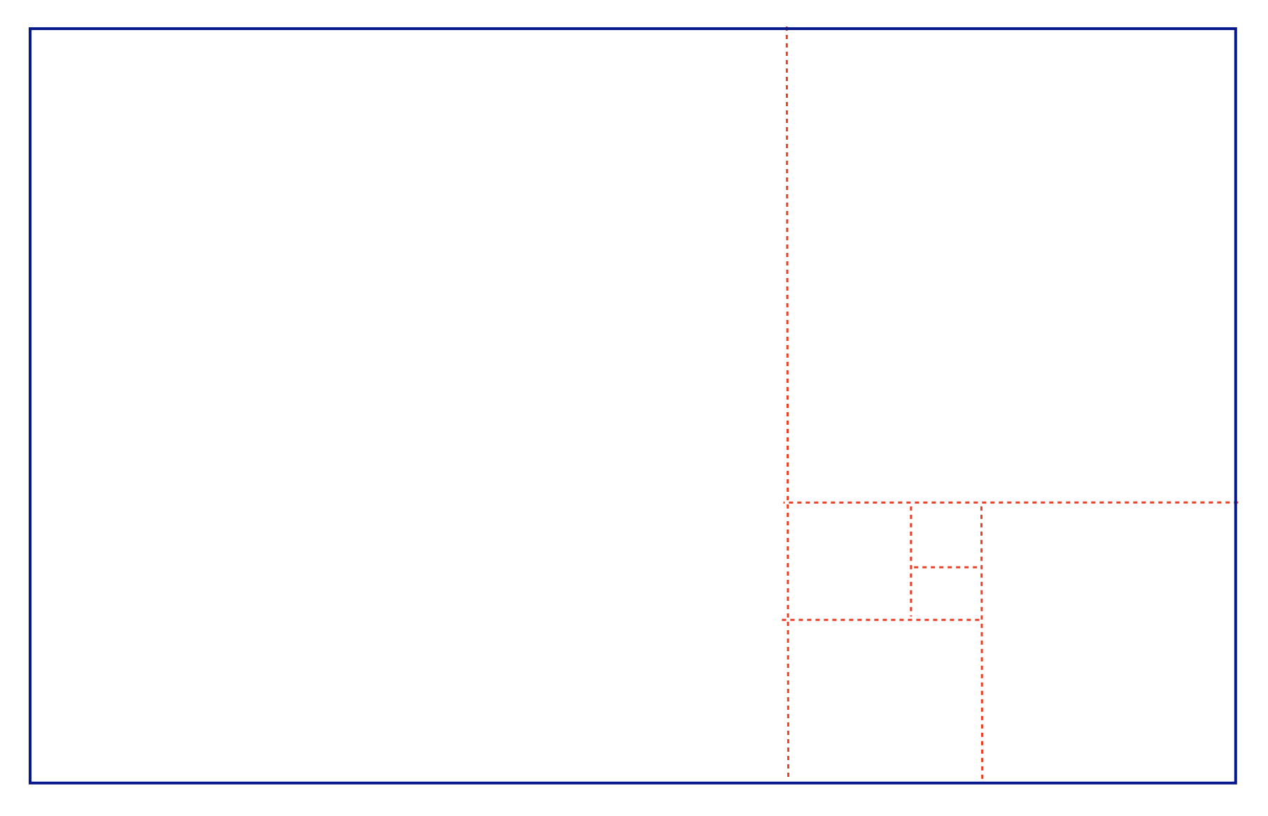
the golden rectangle
FORM
Golden rectangle can be subdivided repeatedly
Creates a consistent proportion family
CONTENT
Recognizable balance / structure
Encourages ‘pleasant’ spacing relationships
Notes:
Do you recognize proportion systems in formats you use constantly?
Even if you don’t calculate anything, you can start noticing repeated rectangle formats: photos, posters, screens.
Name 3 rectangles you see daily (phone, laptop, notebook, TV) that follow the golden rectangle.
Ask: Do you think designers choose these formats for function, aesthetics, or both?

Slide 8
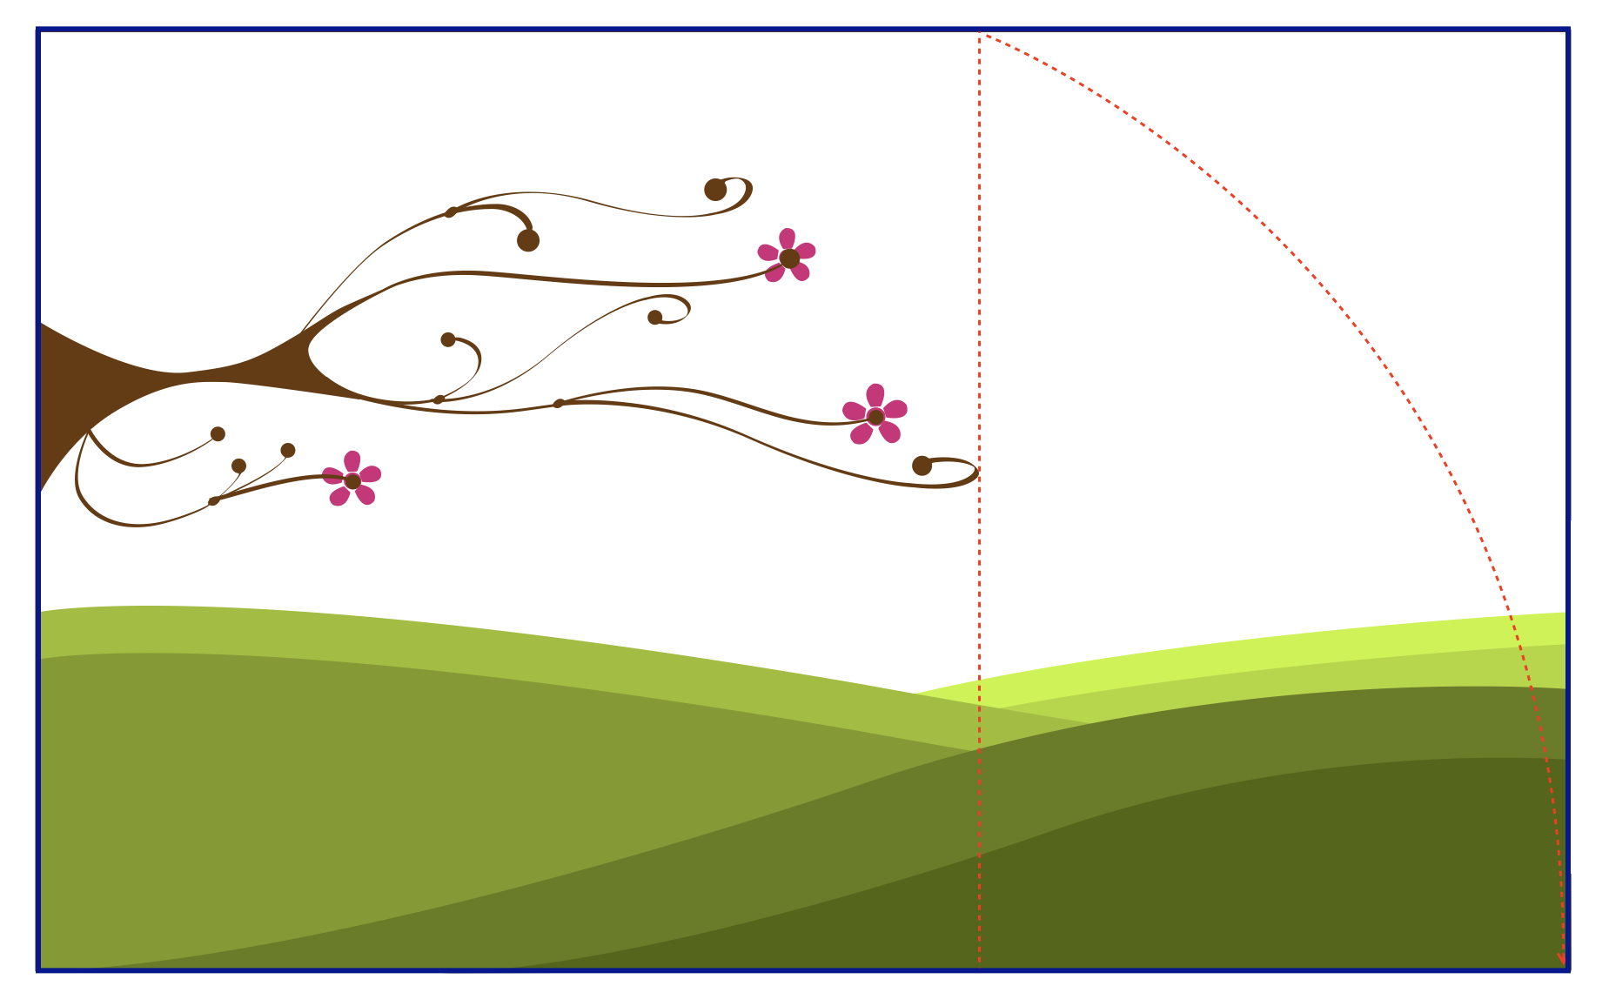
the golden rectangle
FORM
Golden rectangle can be subdivided repeatedly
Creates a consistent proportion family
CONTENT
Recognizable balance / structure
Encourages ‘pleasant’ spacing relationships
Notes:
Proportion guides where things feel “right” in a frame.
Ask: If the horizon or focal element shifted, would the composition feel more tense or less stable?
Transition: Now we’ll apply these concepts to your own design field through Making the Connection and the Commentary on Design examples.

Slide 9
MAKING THE CONNECTION
You now have an understanding of how the element line feels and what it can communicate; now take it a step further, strengthen your comprehension by applying this knowledge to your area of design!
COMMENTARY ON DESIGN
Visit Commentary on Design for inspiration.
You will discover how designers in the real world are employing the elements and principles of design in a variety of design fields!
Notes:
Goal: Turn vocabulary into observation + analysis.
Your job is to spot proportion in the real world and describe it using our terms, part-to-whole relationships, what reads in proportion versus out of proportion (exaggeration), and when a designer is aiming for harmonious proportion (like the golden rectangle), then connect those choices to mood, meaning, and the message the design is trying to send.

