Slide 1
Connecting to Design | UNITY
Notes:
Goal: Set expectations: slides support teaching; textbook carries depth.
Commentary on Design: Follow the link to explore real-world examples of these concepts in graphic design, fashion design, industrial design, interior design, media arts and animation, game art and design, and film and video.

Slide 2
principle | UNITY
Unity is the aesthetic arrangement of elements;
the elements look as if they belong together.
An important aspect of visual unity is that you see the design as a whole
before you notice the individual elements.
A unified design can have a pleasing interaction and therefore
be considered harmonious, or an unpleasing interaction creating dissonance.

Slide 3
unity | THE GESTALT THEORY
The Gestalt Theory states that objects are first perceived as a unified whole before they are perceived as individual units.

Slide 4
THE GESTALT THEORY
closure
continuation
repetition
proximity

Slide 5
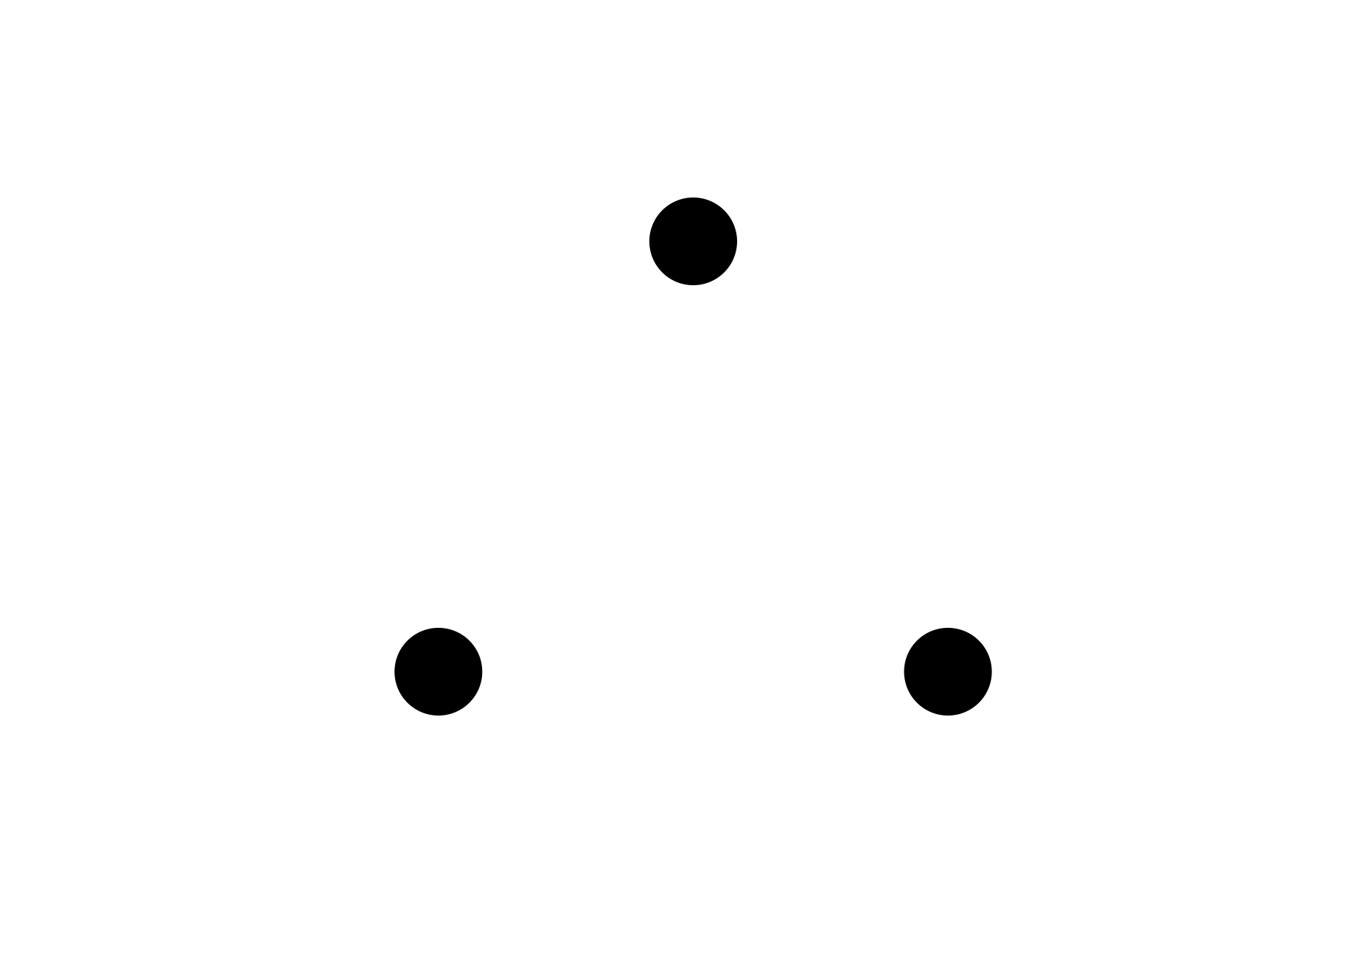
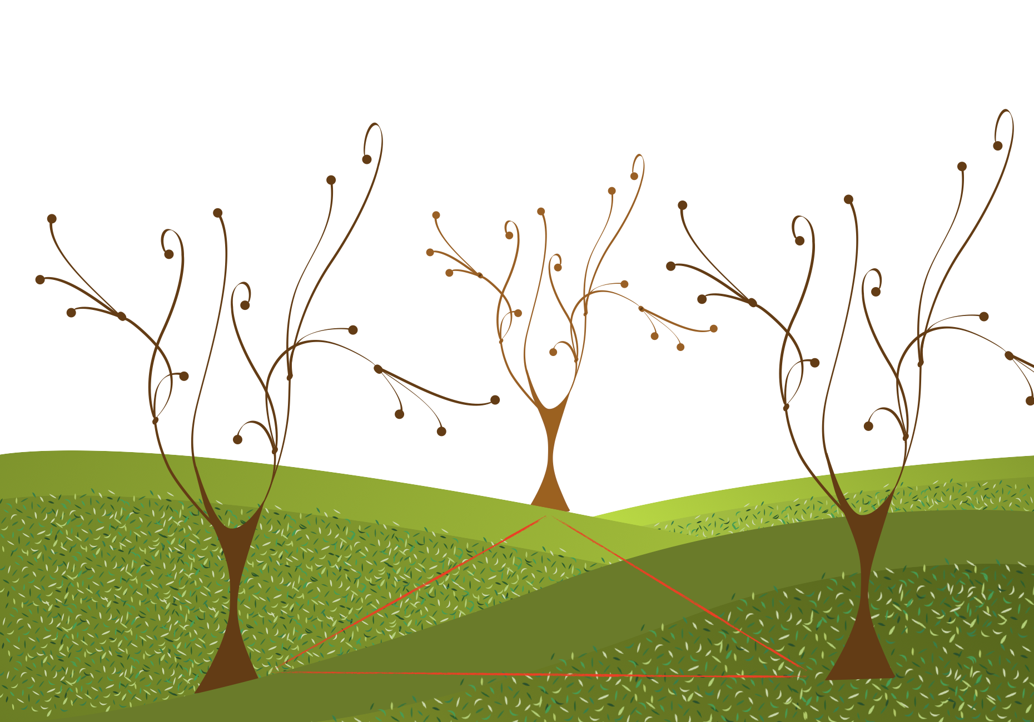
internal view
FORM
Separate objects placed so the brain forms an additional shape
The mind “connects the dots”
CONTENT
Strong organization (hidden structure)
Can feel stable if the implied shape is stable (triangle)
Unity created through implied shape
Notes:
Closure happens when your brain completes a shape that isn’t actually outlined, like forming a triangle from separate points.
Ask: Why does a triangle feel stable as a base?

Slide 6
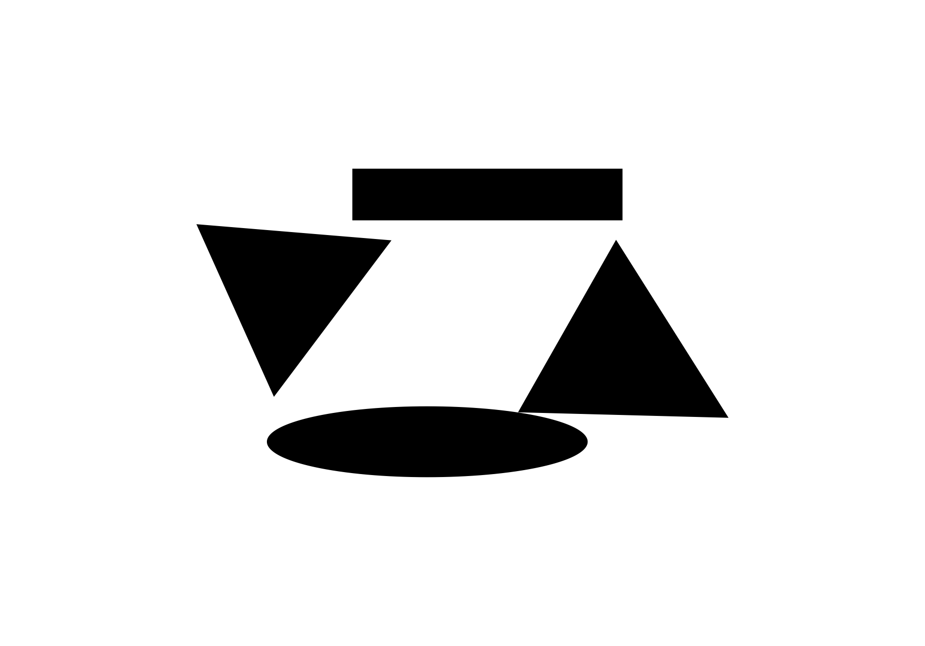
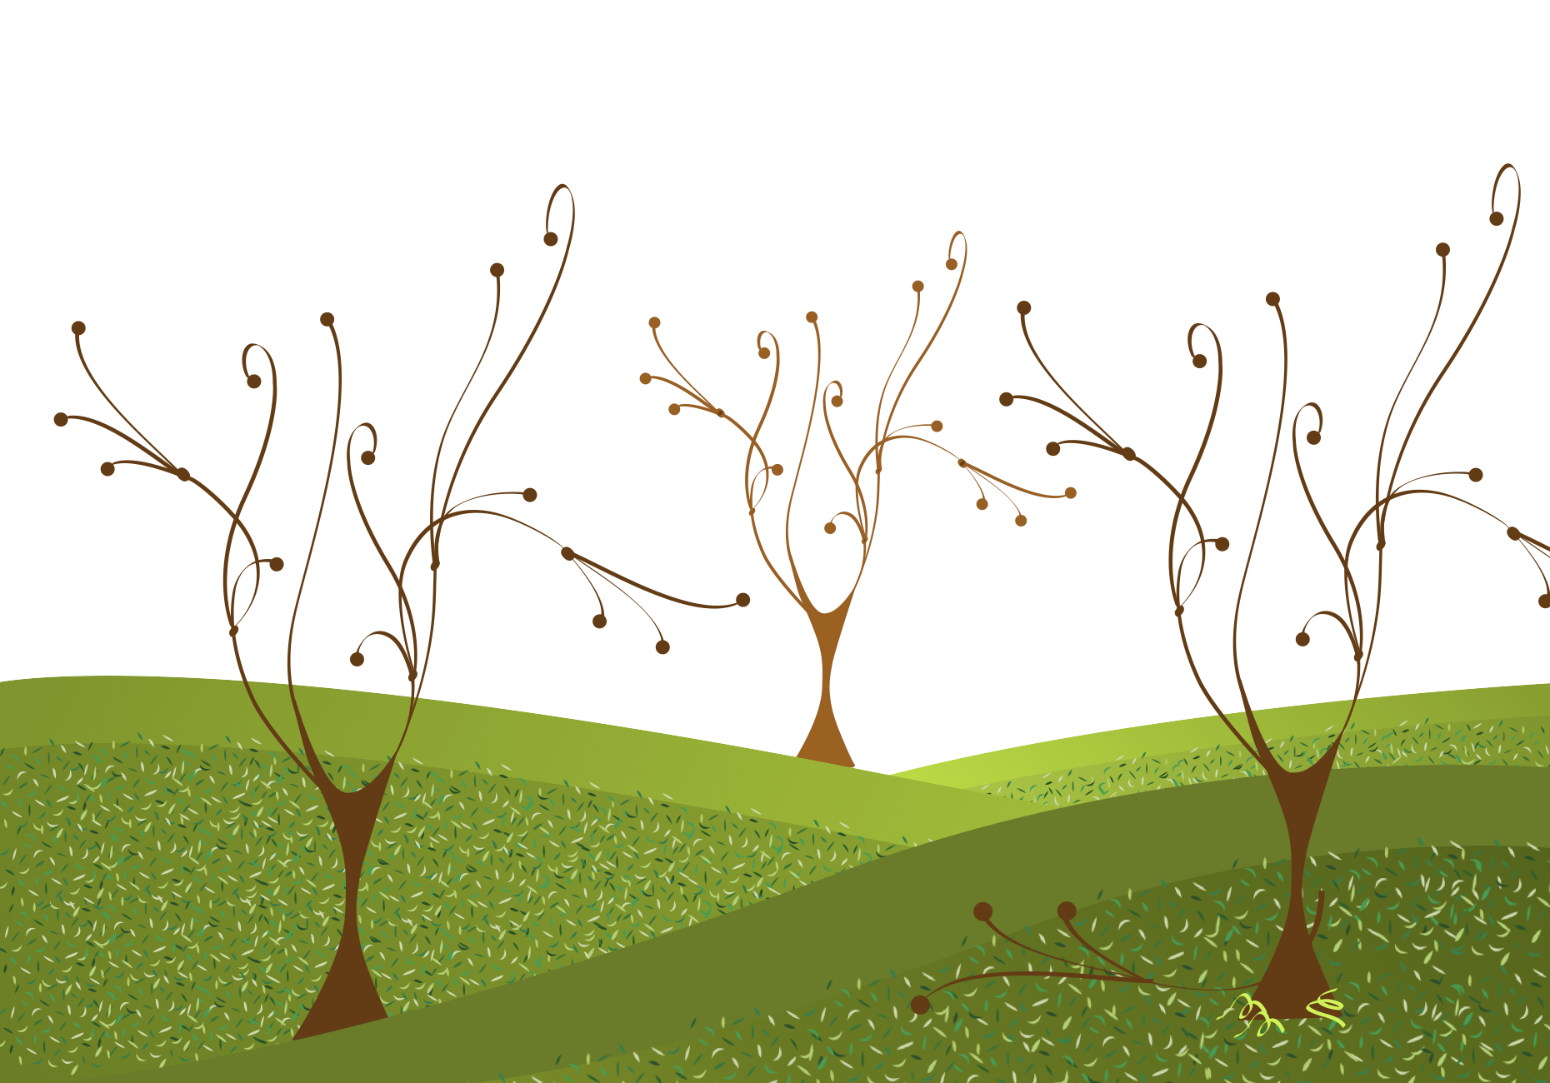
continuation
FORM
A line/edge/direction continues from one object to another
Creates a visual path
Leads the eye through the composition
CONTENT
Flow and connectedness
Cluster/group is perceived before individual units
Smooth visual navigation
Notes:
Continuation is when your eye keeps moving because the design gives it a path, branches, edges, or direction that “hands off” from one object to another.
Ask: What line or direction is connecting these elements?

Slide 7
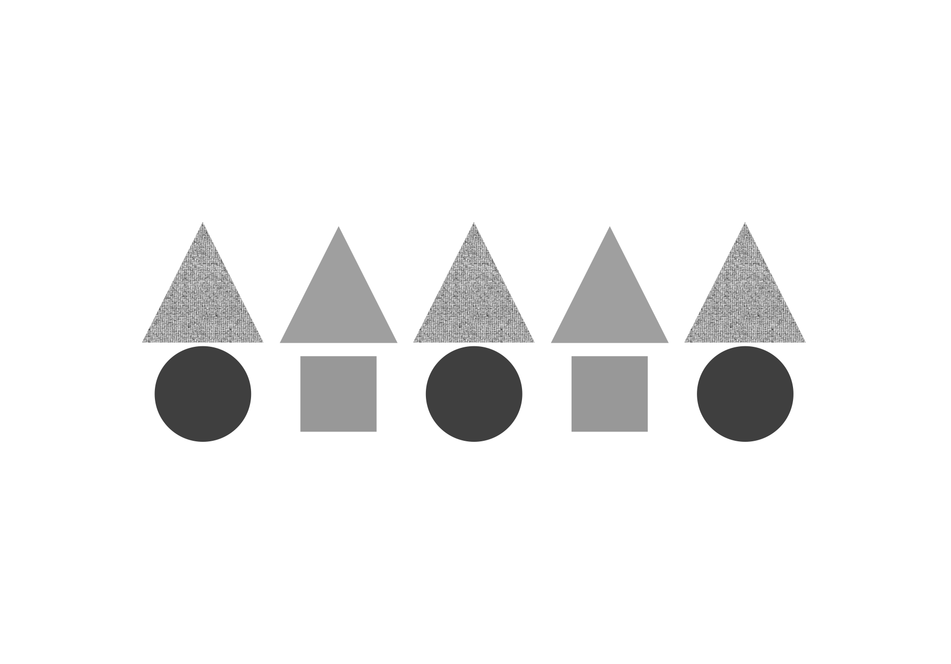
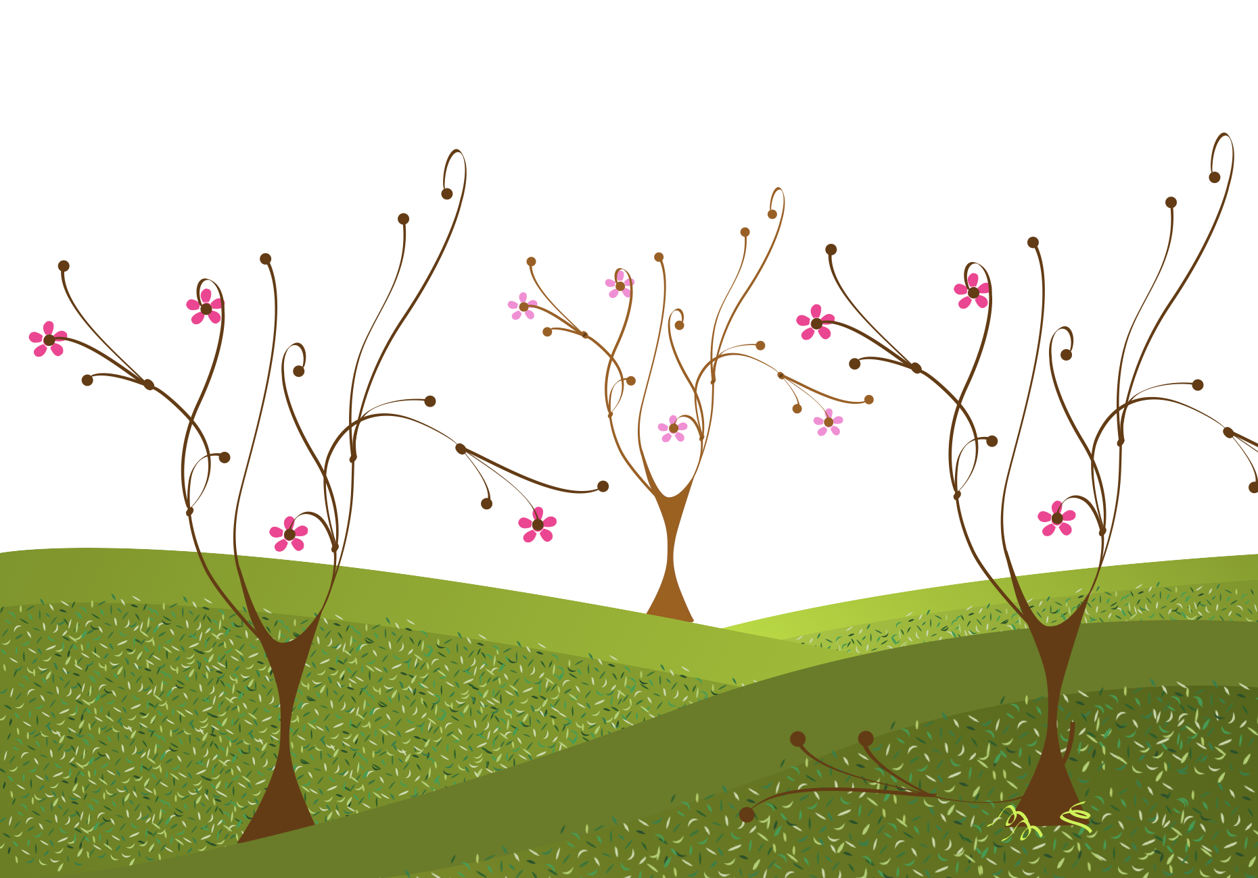
repetition
FORM
Similar elements repeated (line, shape, value, texture, color)
Repetition makes parts appear related
CONTENT
Strong unity (elements ‘belong’)
Clear identity/style
Readable, organized composition
Notes:
Repetition relates to “relatedness” and cohesive style. When features repeat, your brain groups them, repetition becomes a glue that holds the design together.
Ask: What is repeating and which repeated feature unifies it most?

Slide 8
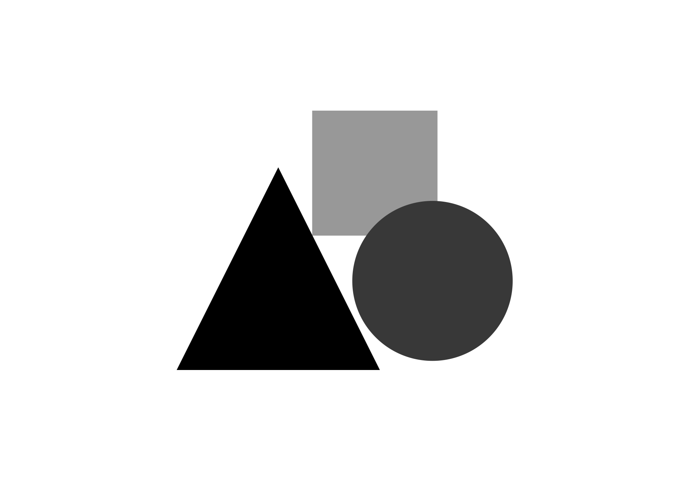
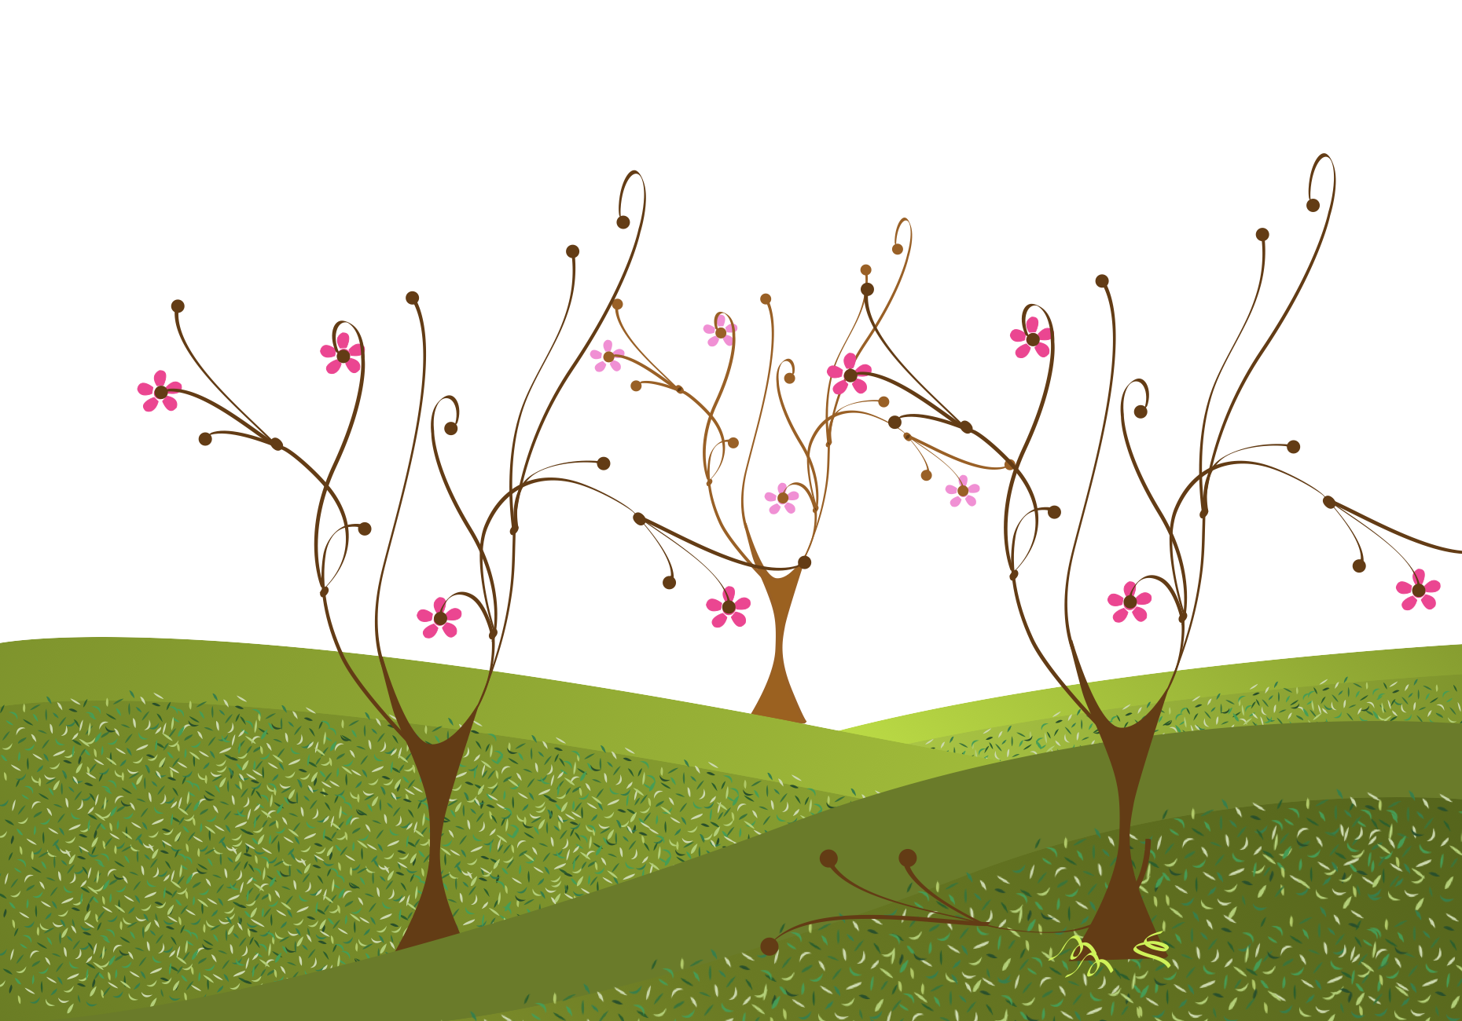
proximity
FORM
Separate objects appear related because they’re close together by
close-edge, touching, overlapping
CONTENT
Strong unity through clustering
The brain reads ‘group’ first
Eye explores parts after group is established
Notes:
Proximity as the fastest grouping mechanism, if things are close, we assume they belong together.
Ask: What is being grouped by closeness and how does that change what you notice first?
Ask: Where is proximity critical (menus, posters, slides, infographics)?

Slide 9
UNITY WITH VARIETY
variety
excessive unity
excessive variety

Slide 10
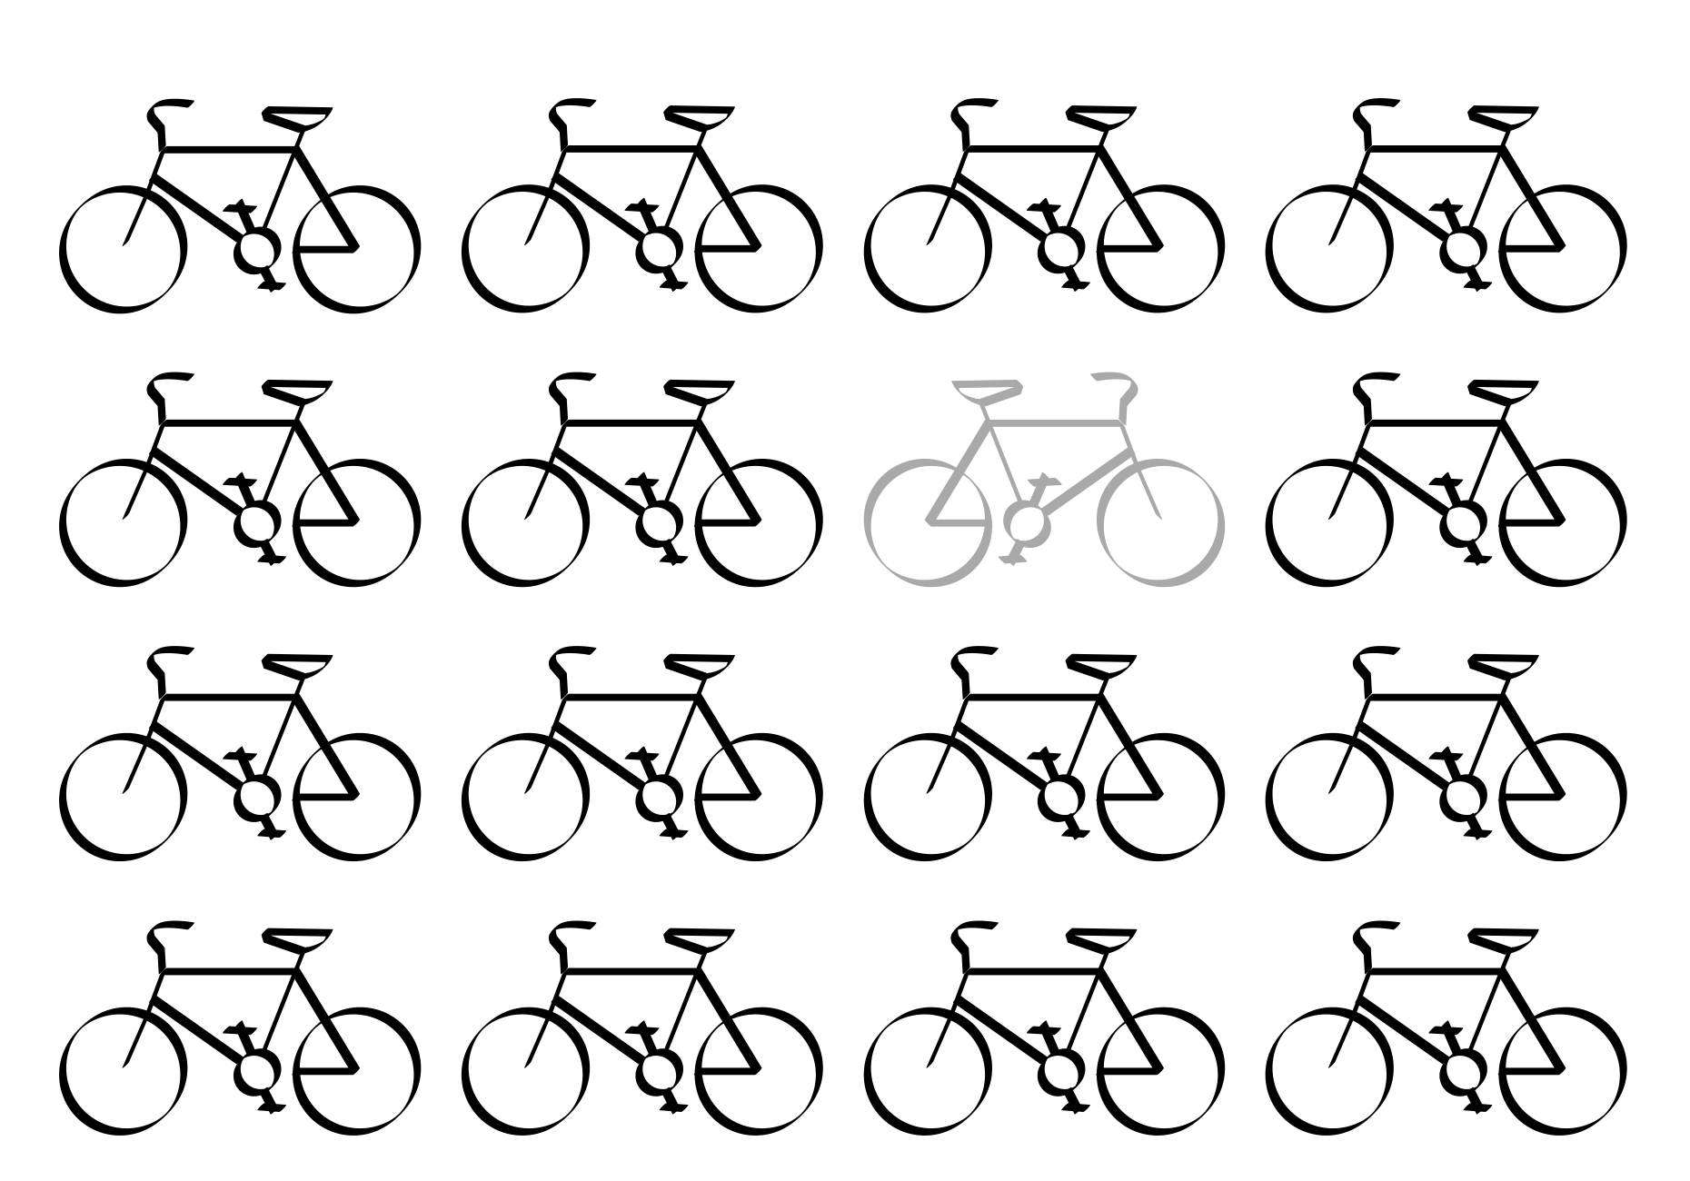
variety
FORM
Differences introduced into the design
Diversifying elements (shape, value, texture, color, size, direction)
CONTENT
Interest and energy
Prevents monotony
Helps emphasize key areas
Notes:
What kind of variety feels most effective here, subtle or bold?

Slide 11
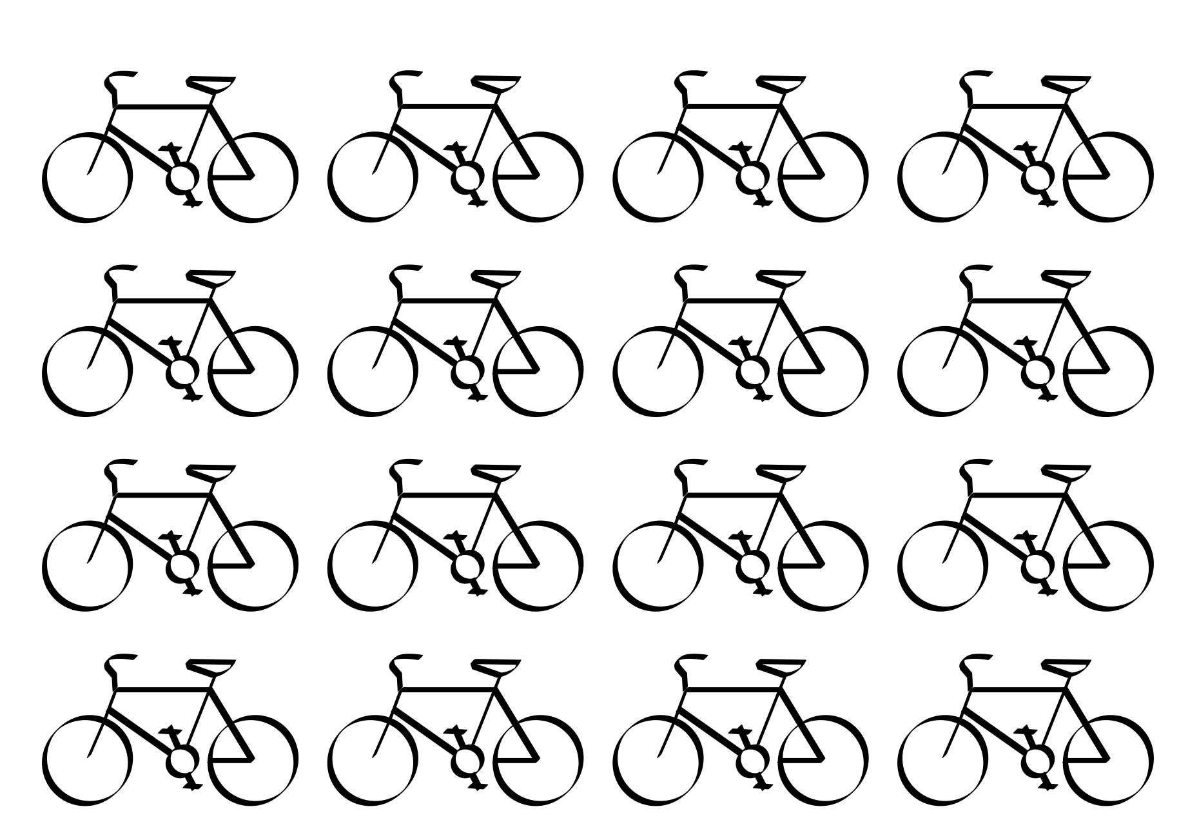
excessive unity
FORM
Too little variety
Repetition dominates with minimal change
CONTENT
Monotonous
Static
Uninteresting / predictable
Notes:
Excessive unity is when everything matches so closely that nothing feels important.
Ask: What would you change first to add interest without losing unity?
Ask: Where might a designer intentionally want monotony (minimalism, calm environments)?

Slide 12
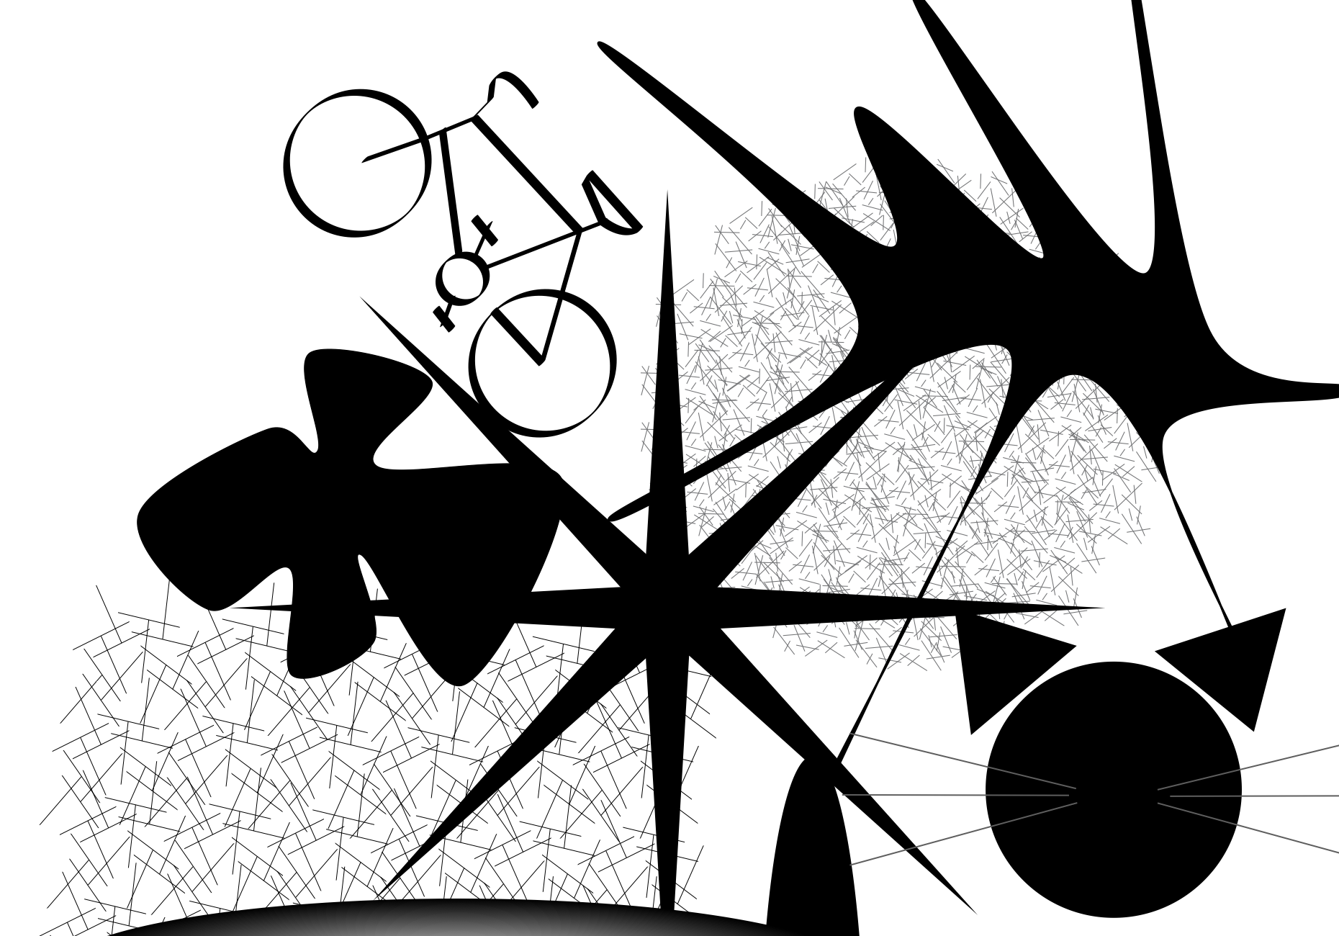
excessive variety
FORM
Too many competing differences
No consistent visual language
CONTENT
Chaos
Dissonance
Difficulty knowing where to look
Notes:
Excessive variety happens when everything demands attention, your eye can’t settle.
Ask: What’s the first sign that variety has become chaos?
Ask: Is this composition unified?
Ask: How does chaos affect readability in UI or advertising?
Transition: Now we’ll apply these concepts to your own design field through Making the Connection and the Commentary on Design examples.

Slide 13
MAKING THE CONNECTION
You now have an understanding of how the element line feels and what it can communicate; now take it a step further, strengthen your comprehension by applying this knowledge to your area of design!
COMMENTARY ON DESIGN
Visit Commentary on Design for inspiration.
You will discover how designers in the real world are employing the elements and principles of design in a variety of design fields!
Notes:
Goal: Turn vocabulary into observation + analysis.
Your job is to spot unity in the real world and describe it using our terms, identify which Gestalt strategy is creating unity (closure, continuation, repetition, or proximity), then evaluate the balance of unity with variety (enough interest without excessive sameness or chaos), and connect those choices to whether the design feels harmonious or dissonant, and what that feeling communicates.

