Slide 1
Connecting to Design | TEXTURE
Notes:
Goal: Set expectations: slides support teaching; textbook carries depth.
Commentary on Design: Follow the link to explore real-world examples of these concepts in graphic design, fashion design, industrial design, interior design, media arts and animation, game art and design, and film and video.

Slide 2
element | TEXTURE
Texture is the surface variation we experience through sight or touch.
We refer to texture experienced through sight as visual texture,
and texture experienced through touch as tactile texture.
Texture can be experienced as soft and delicate, rough and hard,
and everything in between.

Slide 3
EMOTIONAL ASPECTS OF TEXTURE
even/hard, even/soft
uneven/hard, uneven/soft

Slide 4
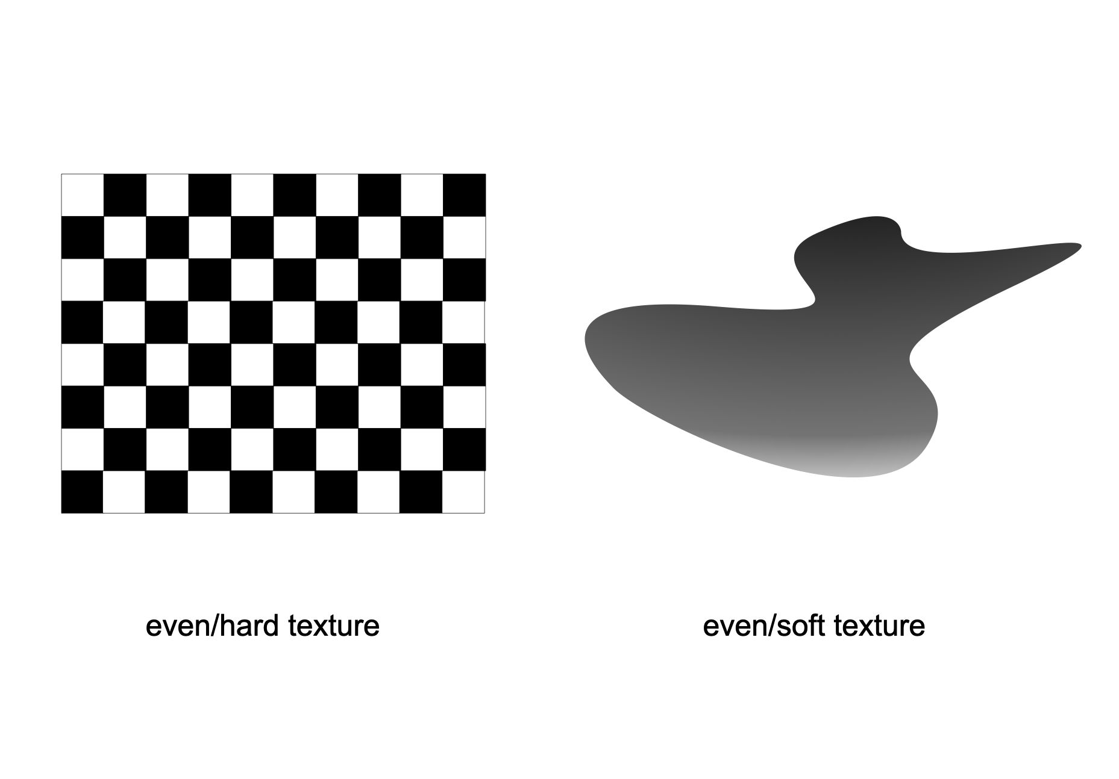
even texture
FORM
Consistent surface
Regular, predictable structure
Little variation
CONTENT
Even/hard: cold / sterile
Even/soft: smooth / fluid
Controlled / clean
Notes:
Even textures feel organized. “Hard” can feel clinical; “soft” and it can feel sleek.
Ask: What feels more “human”, even/soft or even/hard? Why?
Ask: Where do you see even/hard (tiles, grids) vs even/soft (silk, gradients)?
Ask: What brands lean into sterile/clean on purpose?

Slide 5
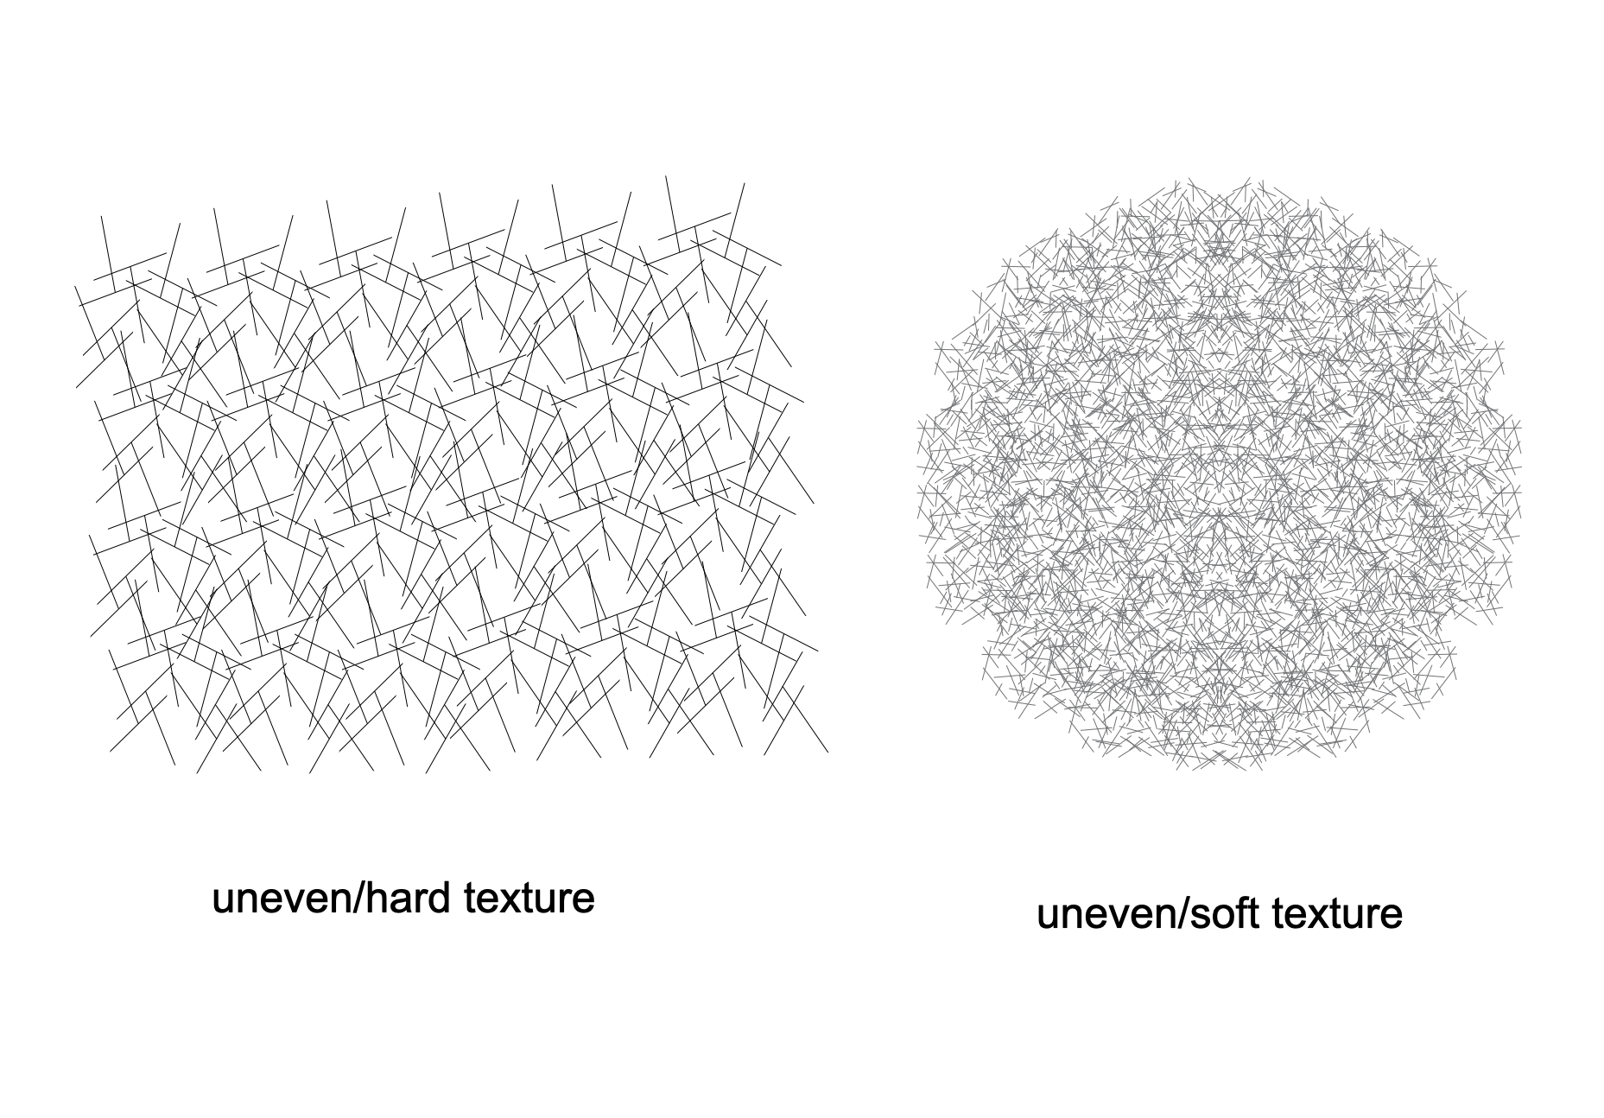
uneven texture
FORM
Irregular surface
Varied marks and
Spacing
Unpredictable detail
CONTENT
Uneven/hard: rough / abrasive / threatening
Uneven/soft: warm / welcoming
Organic / expressive
Notes:
Unevenness reads as organic or chaotic; hardness changes it to danger.
Uneven textures feel more natural and alive, but if they’re sharp/hard, they can feel hostile.
Ask: Which would you want to touch?’
Ask: How does irregularity change your emotional response?
Ask: Where do you see uneven/hard used intentionally?

Slide 6

texture variation
FORM
Multiple textures in one composition
Different surfaces suggest
Different touch sensations
CONTENT
Grass: uneven + soft (comfortable)
Bark: uneven + hard (rough)
Petals: smooth + soft (delicate)
Eggs: smooth + hard (firm)
Notes:
Even when it’s just an image, we “feel” textures because of experience and association.
Ask: Which texture feels most inviting, and which feels least?
Ask: How could changing one texture change the story of the scene?

Slide 7
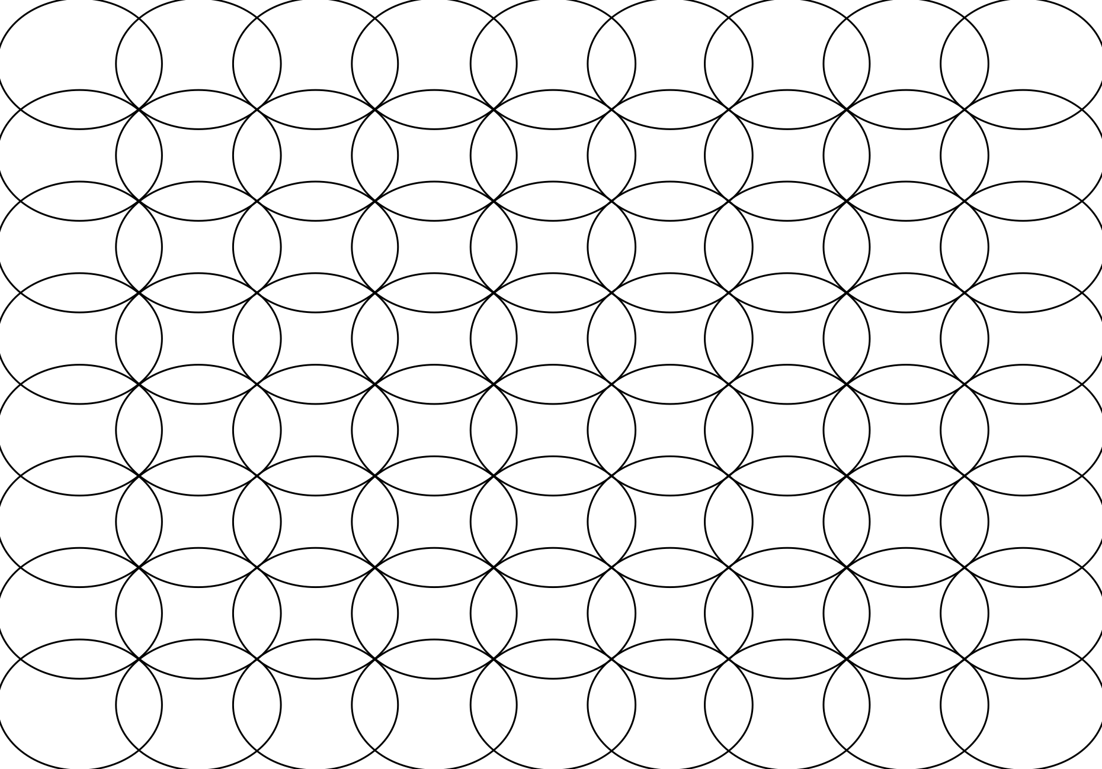

texture and pattern
FORM
Pattern = repeated motif in a regular sequence
Texture can include repetition, but doesn’t have to regular repetition creates rhythm
CONTENT
Pattern can be subtle → loud/busy
Grass shows texture + pattern (regular blades)
Bark shows texture without clear pattern (random repetition)
Notes:
Pattern is repetition you can count or predict. Texture is the surface quality, predictable or random.
Identity one patterned area and one purely textural area.
Ask: In your field, when does pattern become distracting instead of helpful?
Transition: Now we’ll apply these concepts to your own design field through Making the Connection and the Commentary on Design examples.

Slide 8
MAKING THE CONNECTION
You now have an understanding of how the element line feels and what it can communicate; now take it a step further, strengthen your comprehension by applying this knowledge to your area of design!
COMMENTARY ON DESIGN
Visit Commentary on Design for inspiration.
You will discover how designers in the real world are employing the elements and principles of design in a variety of design fields!
Notes:
Goal: Turn vocabulary into observation + analysis.
Your job is to spot texture in the real world and describe it using our terms, type (visual vs. tactile), surface quality (even vs. uneven, hard vs. soft), and pattern vs. texture (repetition/rhythm vs. surface variation,) then connect those choices to emotion, atmosphere, and what the designer wants the viewer to feel.

