Slide 1
Connecting to Design | BALANCE
Notes:
Goal: Set expectations: slides support teaching; textbook carries depth.
Commentary on Design: Follow the link to explore real-world examples of these concepts in graphic design, fashion design, industrial design, interior design, media arts and animation, game art and design, and film and video.

Slide 2
principle | BALANCE
Balance refers to an even distribution of visual weight.
Symmetrical balance can feel strong and stable,
while asymmetrical balance can feel quite spontaneous.

Slide 3
TYPES OF BALANCE
symmetrical balance
approximate symmetrical balance
asymmetrical balance
asymmetrical balance by value
asymmetrical balance by shape
asymmetrical balance by texture
radial balance

Slide 4
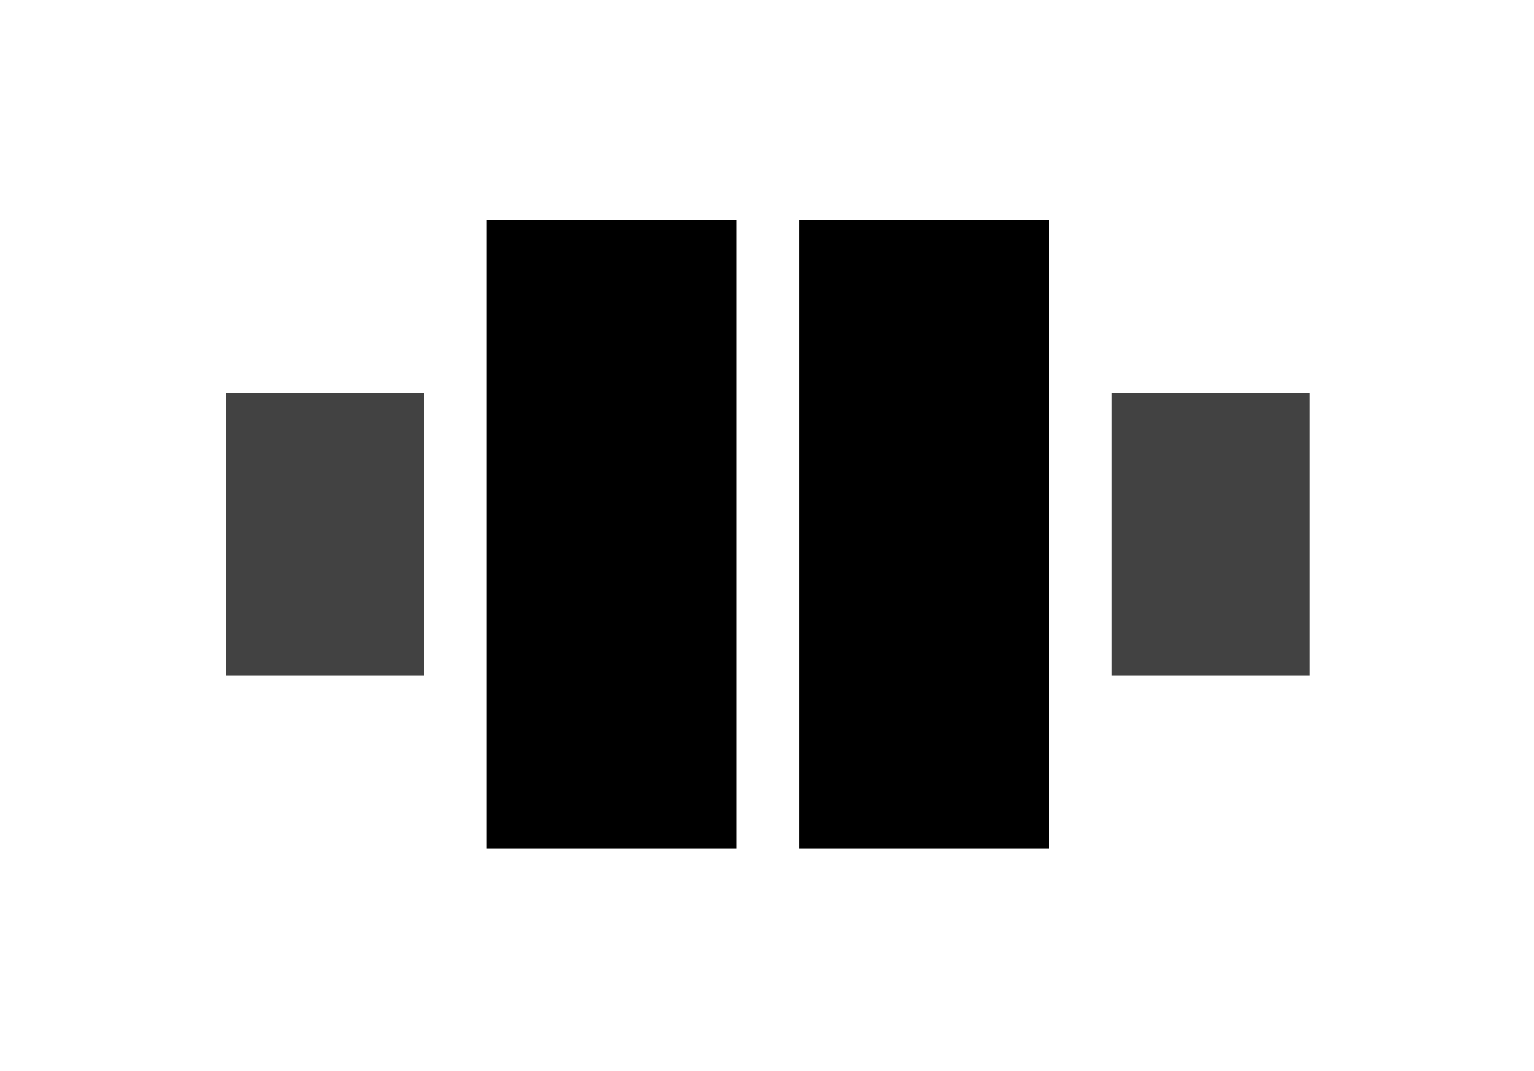
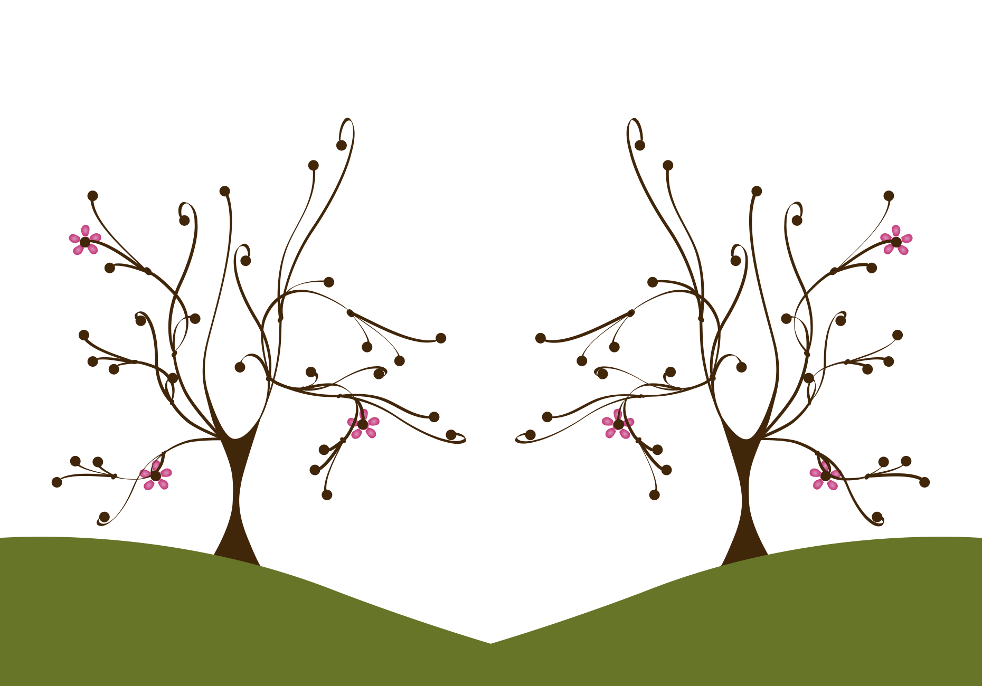
symmetrical balance
FORM
Left and right of a vertical axis match
Mirror image in visual weight (line, shape, value, texture, color)
“Formal” balance
CONTENT
Organized / calm
Strong / stable
Predictable (“no surprises”)
Notes:
Symmetry reads as stable because both sides behave the same visually.
Have students trace the vertical center line in the example.
What is the axis, and what feels mirrored?
Ask: Why might a designer want “no surprises” (banks, government, luxury, rituals)?

Slide 5
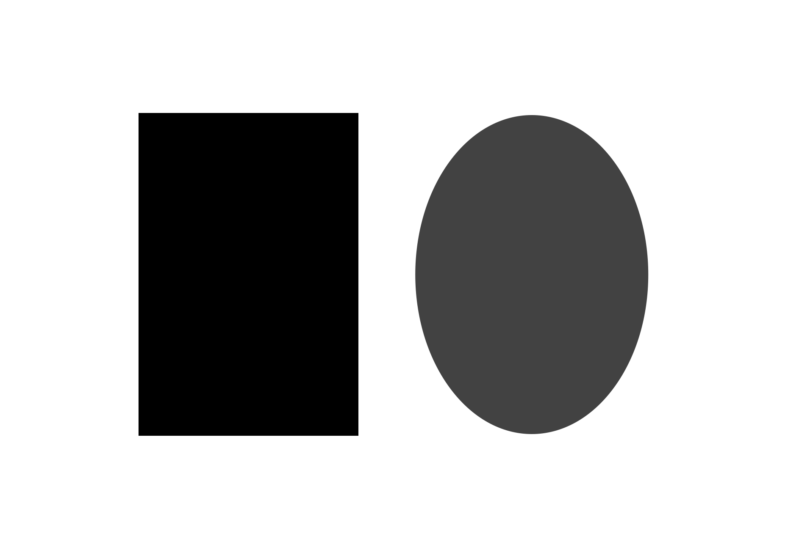
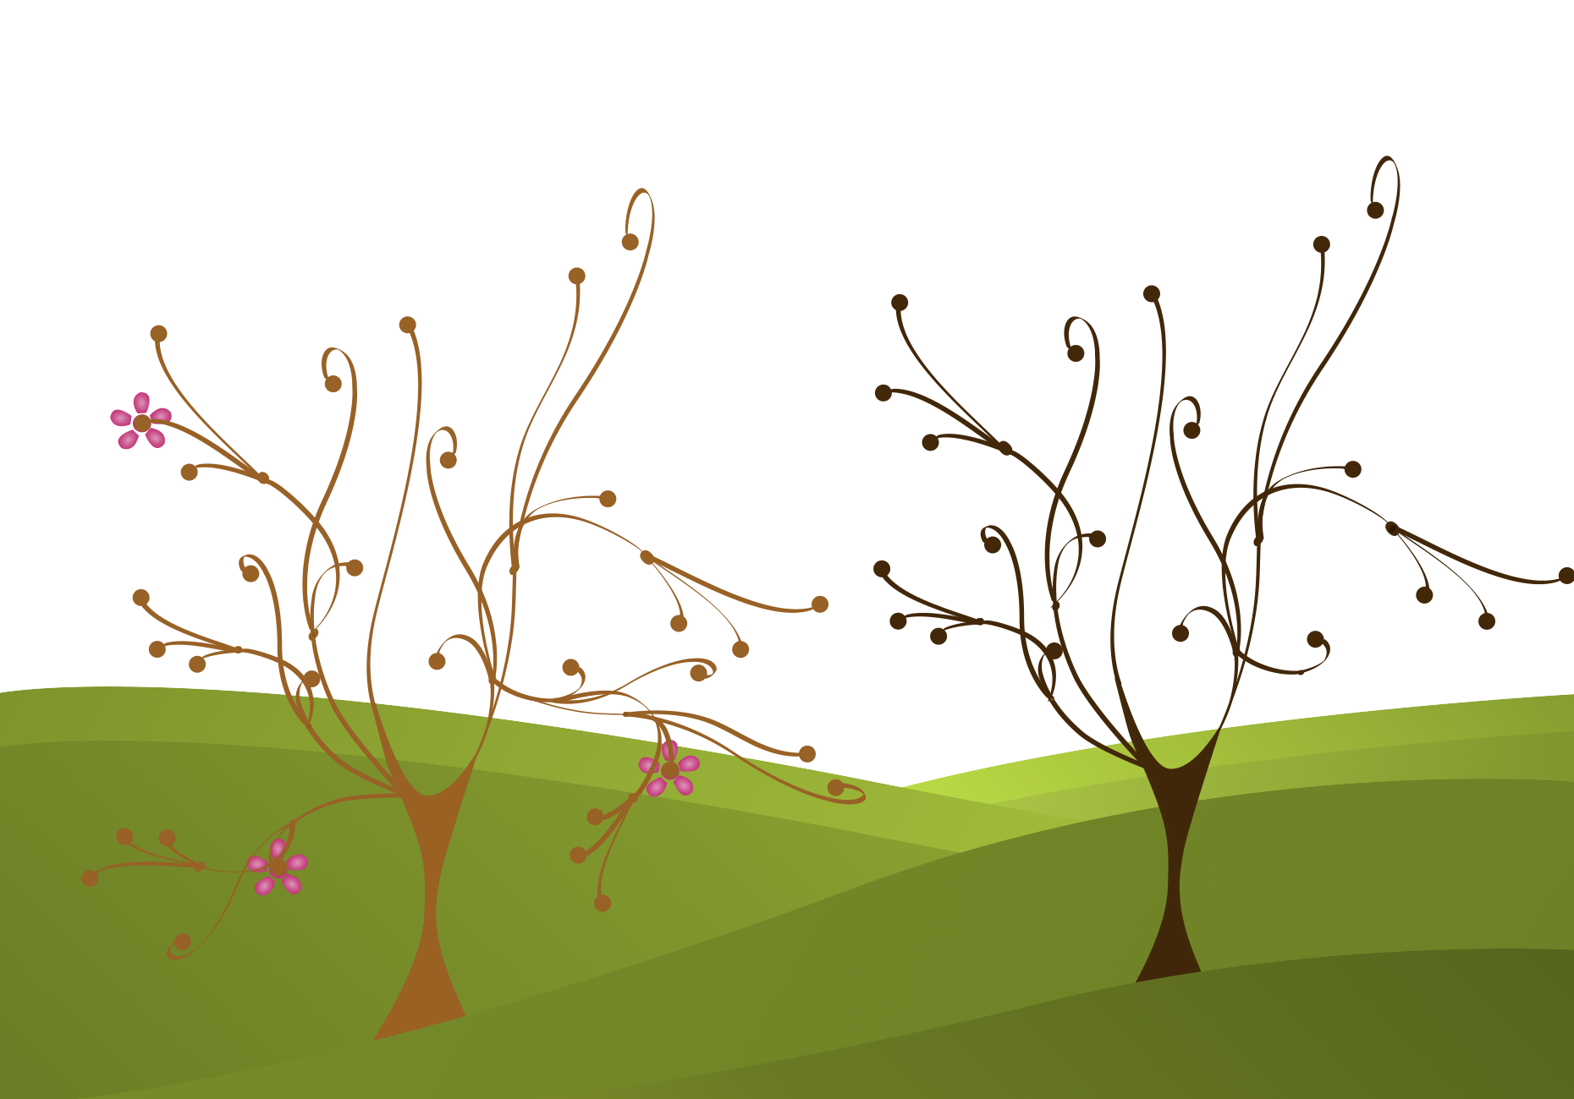
approximate symmetrical balance
FORM
Left/right sides are similar, not identical
Near-mirror balance in weight
Still organized, but less rigid
CONTENT
Structured (symmetry vibe)
Slightly more natural
Mild variety without losing stability
Notes:
What differences keep it from being perfectly symmetrical?
Approximate symmetry keeps the calm structure but adds small differences so it feels less stiff.
Ask: When would you prefer approximate symmetry over perfect symmetry?

Slide 6
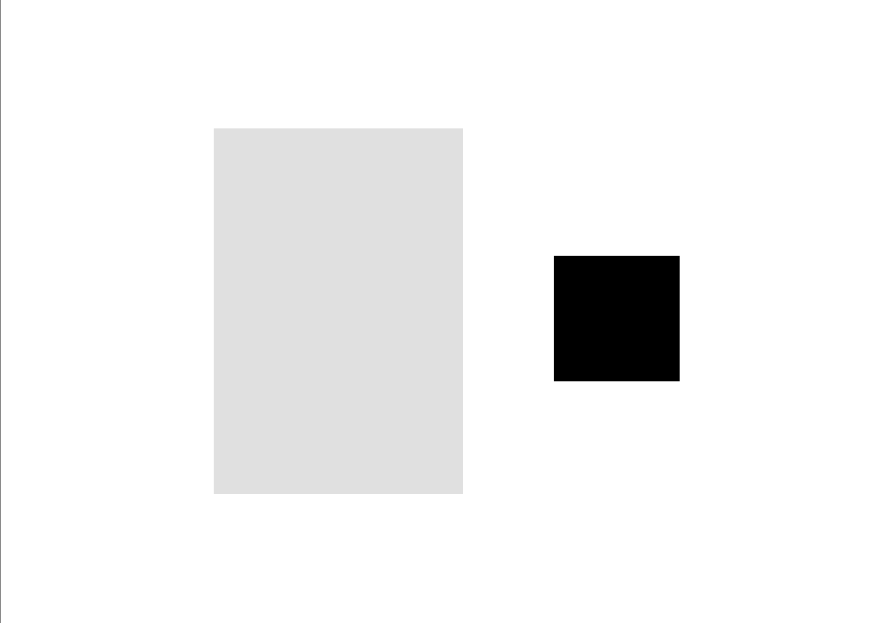
asymmetrical balance
FORM
Uneven distribution of visual weights
Still feels balanced overall
“Informal” balance
CONTENT
Natural / casual
Spontaneous
More energy and variety than symmetry
Notes:
Balance does not require “matching”.
Asymmetry is balanced by equivalence, not equality; different things can weigh the same visually.
Ask: Why does asymmetry often feel more realistic or modern?

Slide 7
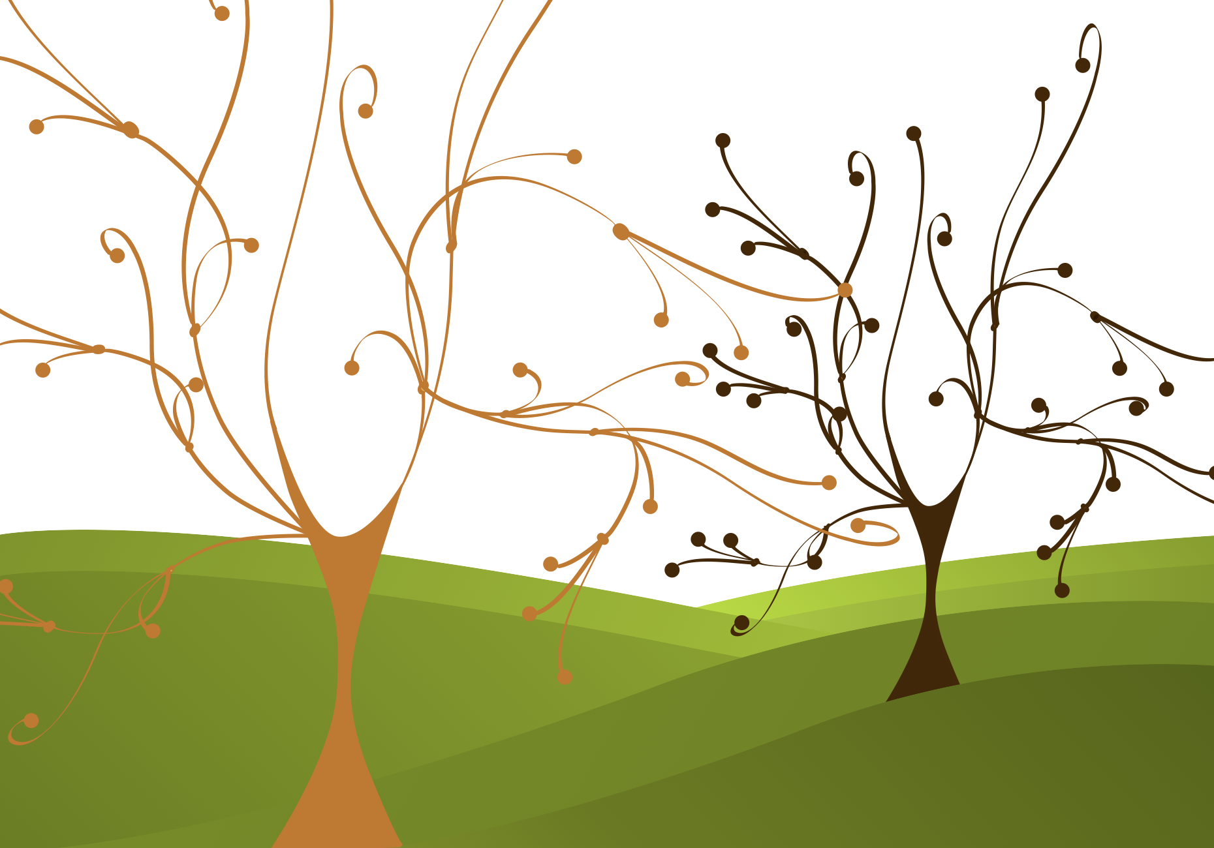
asymmetrical balance by value
FORM
Lower values carry more weight
CONTENT
Variety + spontaneity
Comfortable balance without symmetry
Notes:
“Dark = heavy” as a balance tool.
A smaller dark shape can balance a much larger light shape because darkness carries visual weight.
Squint test: what still ‘holds’ the composition?
Which area feels heavier, and how much of that is value?
Ask: Where do you see this in layouts (small bold text balancing big whitespace)?

Slide 8
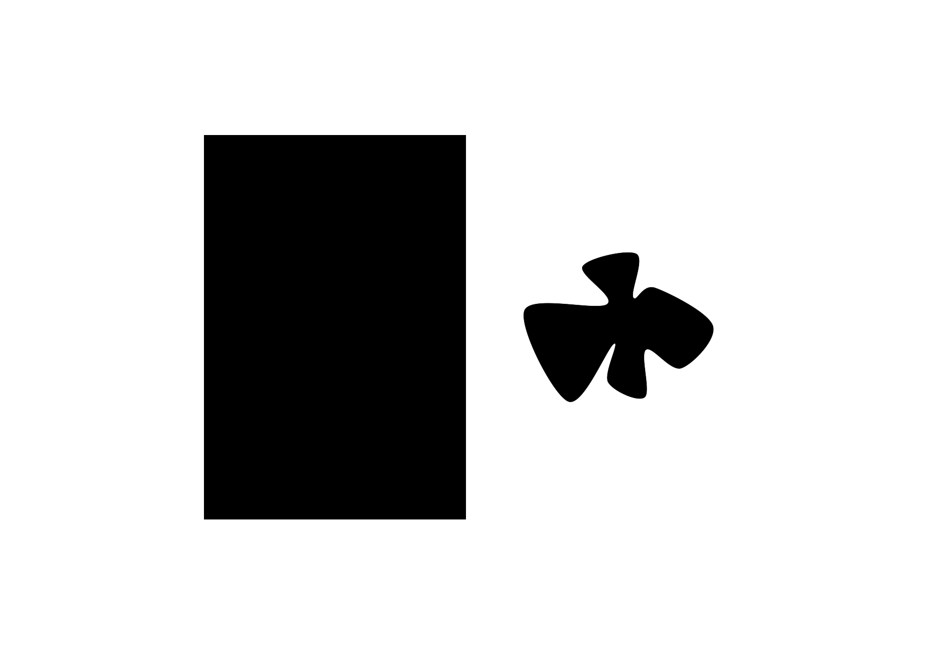
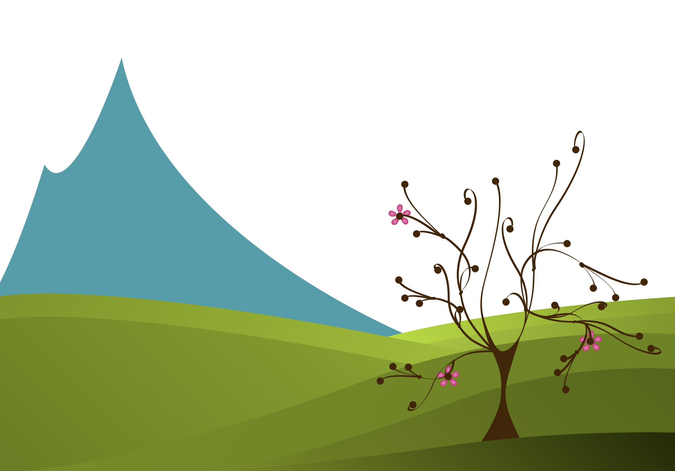
asymmetrical balance by shape
FORM
Complex shapes carry more weight than simple shapes
CONTENT
Less structured than symmetry
Still comfortable / stable
Adds visual interest without chaos
Notes:
What’s “complex” here, and why does it feel heavier?
Complexity grabs attention. More edges and irregularity often feel heavier than a simple silhouette.
Ask: What side has more detail/edges?
Ask: How do designers “add weight” without increasing size (detail, pattern, complexity)?

Slide 9
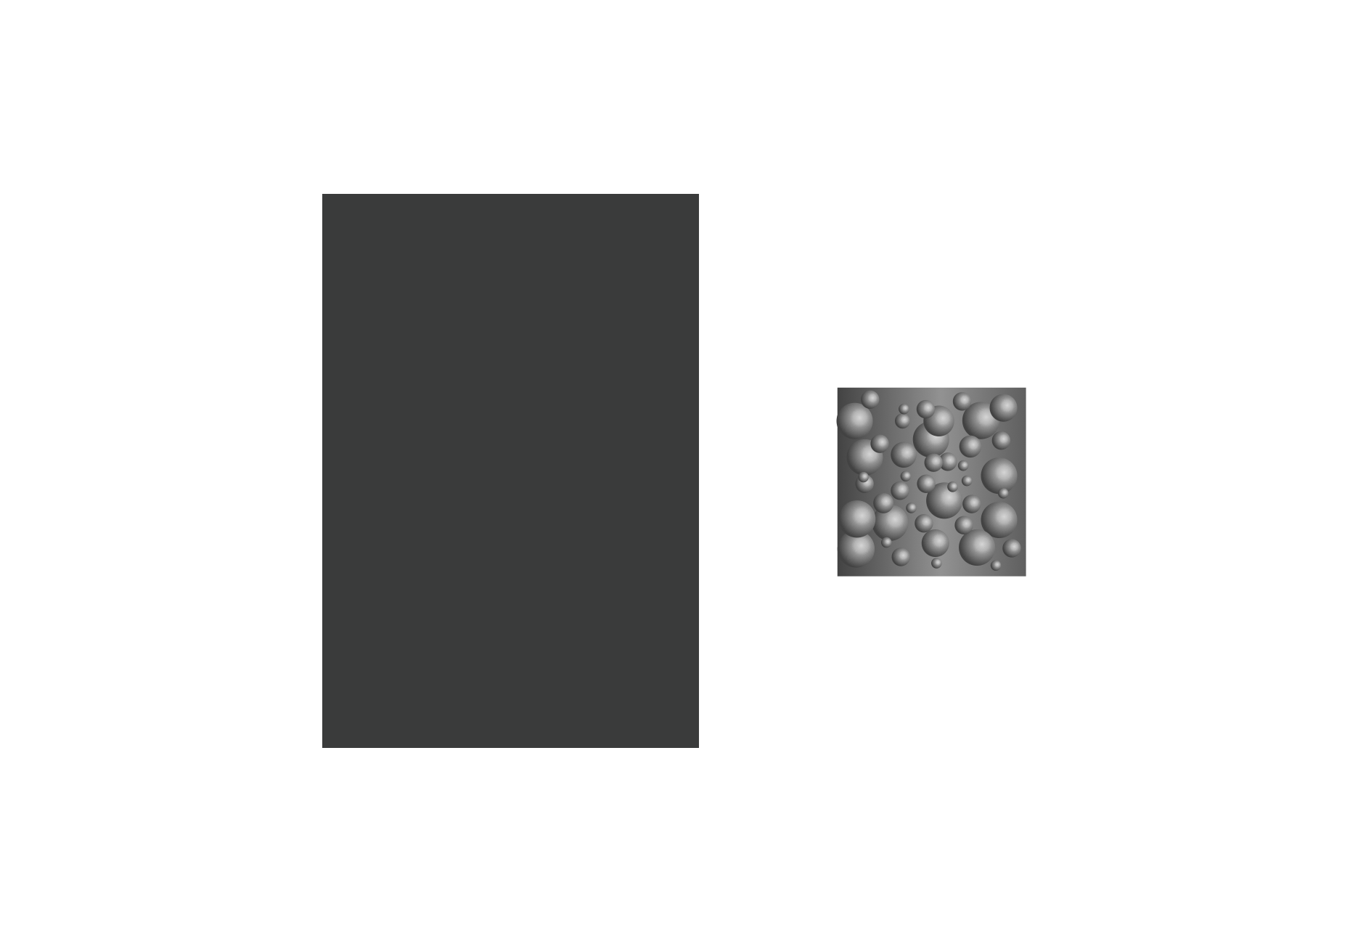
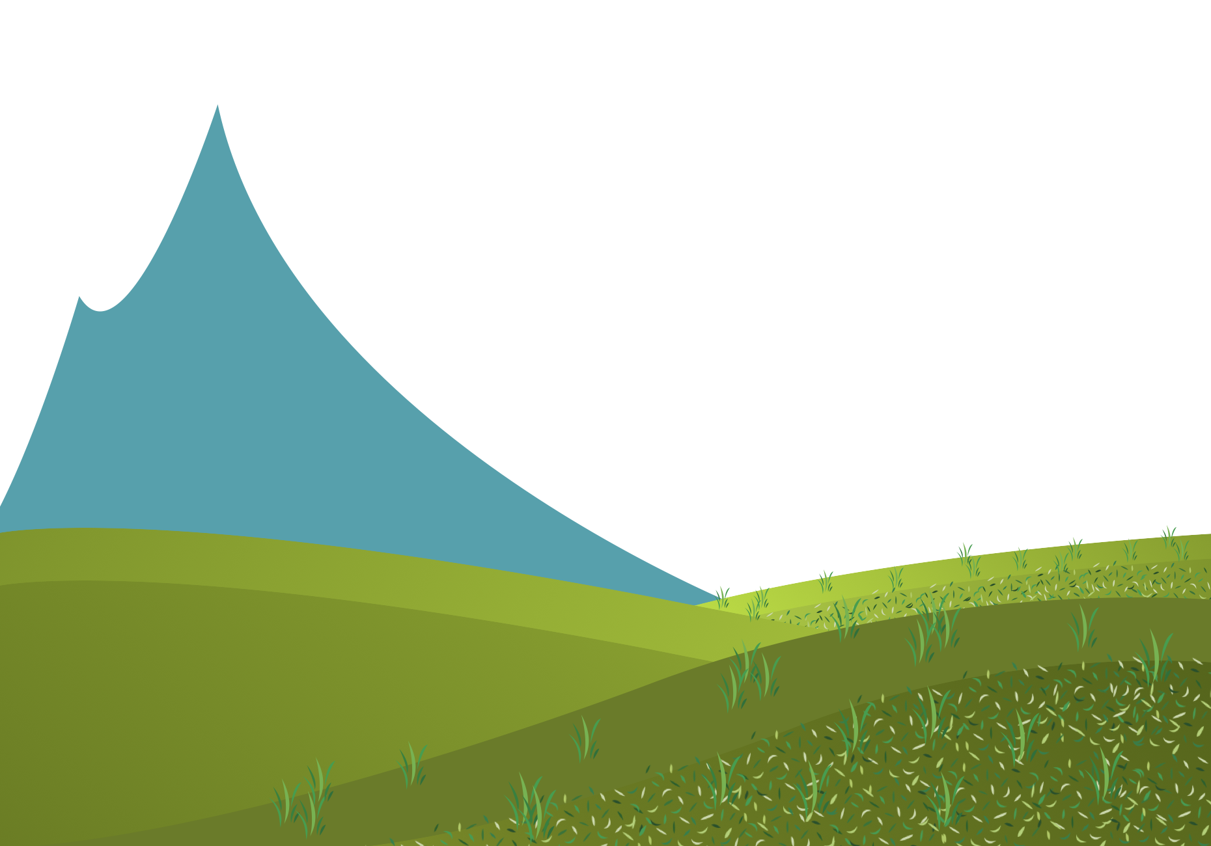
asymmetrical balance by texture
FORM
Uneven textures carry more weight than even textures
CONTENT
Comfortable balance without symmetry
Adds interest and richness
Natural / organic feeling
Notes:
Uneven texture is visually ‘louder’, it attracts attention like detail does.
Ask: How is texture doing the balancing composition?
Ask: Where do you see this in design (fashion fabrics, product materials, flim)?

Slide 10
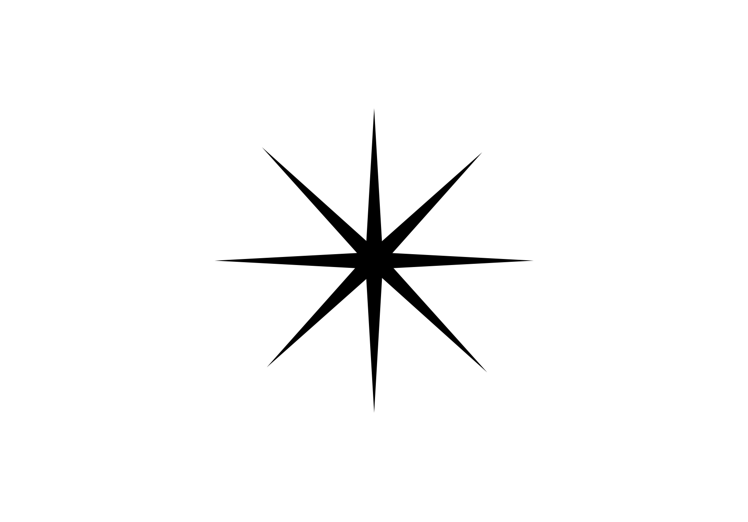
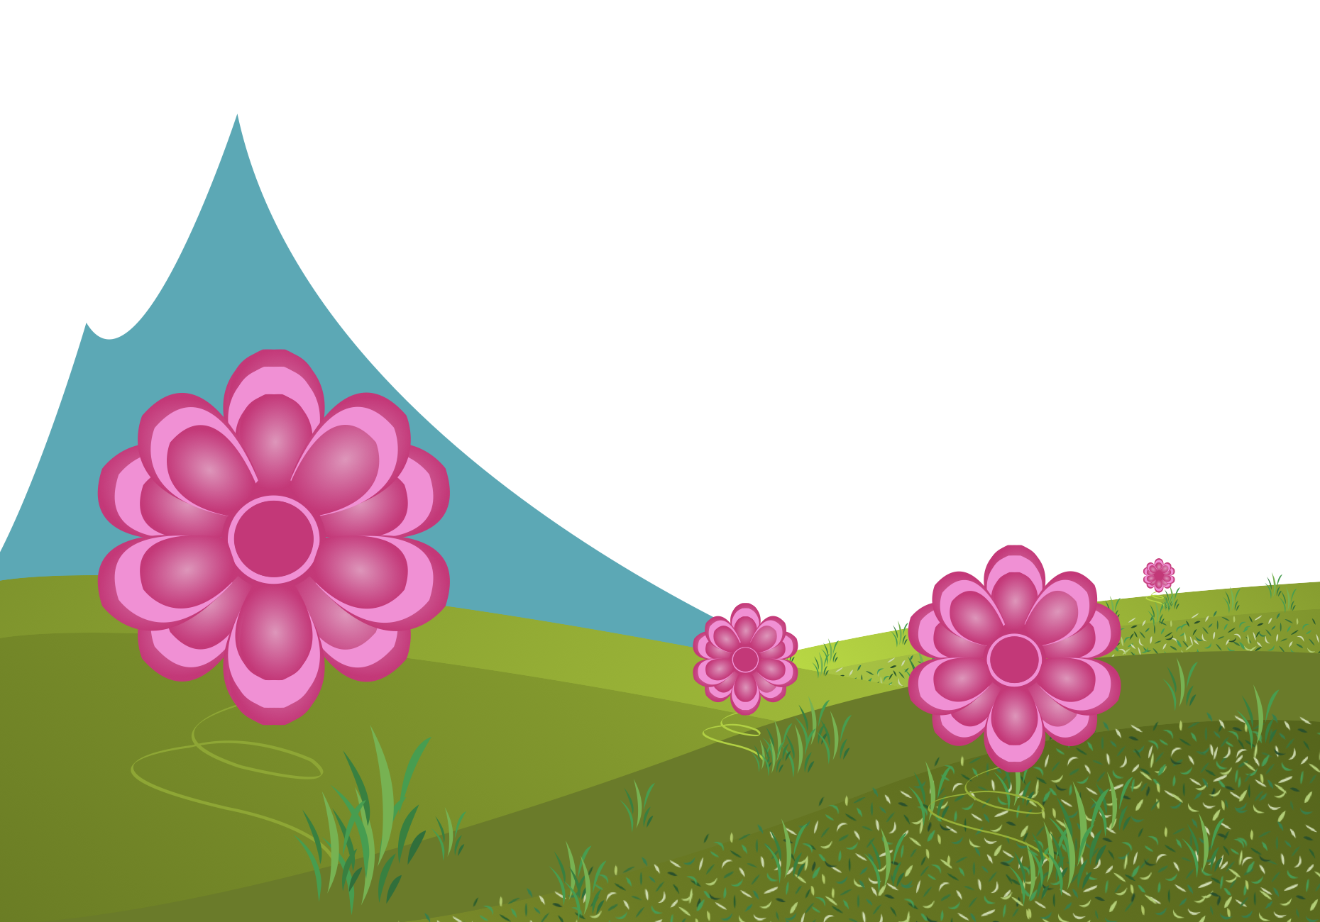
radial balance
FORM
Visual weights mirrored around a central point
Can be symmetrical radially (or approximate radial)
CONTENT
Strong / organized
Predictable / structured
Notes:
Radial balance feels organized because everything relates to one center, like a wheel or a flower.
What is the center point, and how do elements repeat around it?
Ask: Where is radial balance common (logos, mandalas, interfaces, architecture domes)?
Transition: Now we’ll apply these concepts to your own design field through Making the Connection and the Commentary on Design examples.

Slide 11
MAKING THE CONNECTION
You now have an understanding of how the element line feels and what it can communicate; now take it a step further, strengthen your comprehension by applying this knowledge to your area of design!
COMMENTARY ON DESIGN
Visit Commentary on Design for inspiration.
You will discover how designers in the real world are employing the elements and principles of design in a variety of design fields!
Notes:
Goal: Turn vocabulary into observation + analysis.
Your job is to spot balance in the real world and describe it using our terms, symmetrical, approximate symmetrical, asymmetrical (including balance by value, shape, or texture), and radial balance, then connect those choices to mood (stable vs spontaneous) and what the designer wants to feel “weighted” or “important.”

