Slide 1
Connecting to Design | RHYTHM
Notes:
Goal: Set expectations: slides support teaching; textbook carries depth.
Commentary on Design: Follow the link to explore real-world examples of these concepts in graphic design, fashion design, industrial design, interior design, media arts and animation, game art and design, and film and video.

Slide 2
principle | RHYTHM
Rhythm refers to a clear repetition of elements.
A strong rhythm produces the look and feel of movement,
allowing our eye to jump or travel easily from one object to the next.

Slide 3
TYPES OF RHYTHM
regular repetition
alternating repetition
progressive rhythm

Slide 4
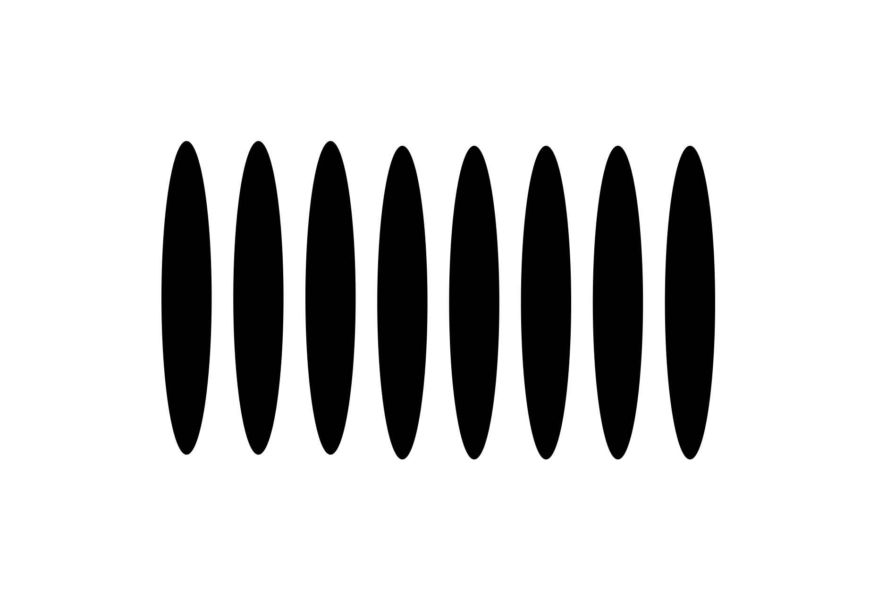
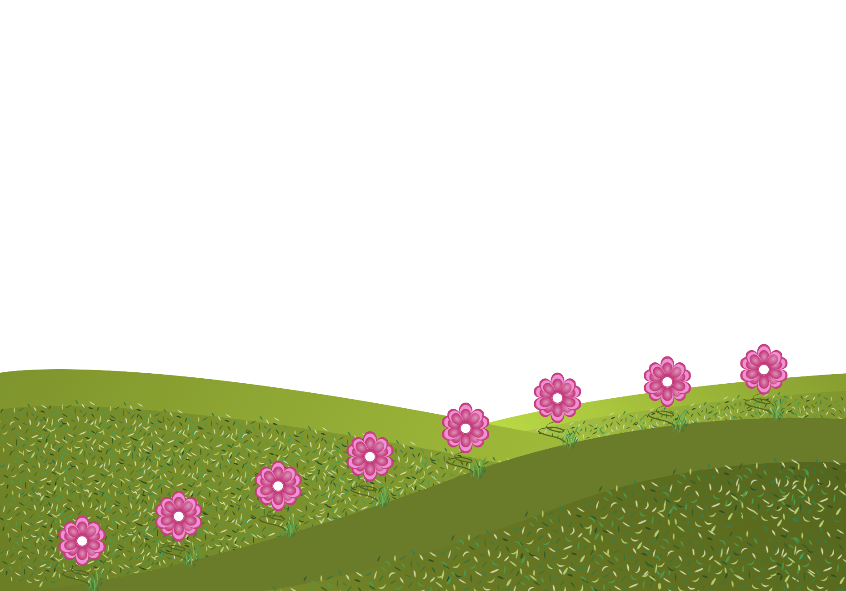
regular repetition
FORM
Similar elements repeated in a clear, consistent pattern
Even spacing or consistent placement
CONTENT
Direct eye movement across the design
Can feel static, orderly, structured
Calm, controlled rhythm
Repetition is predictable (steady ‘beat’)
Notes:
What repeats here and how does that repetition move your eye?
Regular repetition feels steady because the repetition doesn’t surprise you, your eye moves in a regular, predictable way.
Ask: When is a “static/direct” rhythm useful (instructional design, grids, clean branding)?

Slide 5
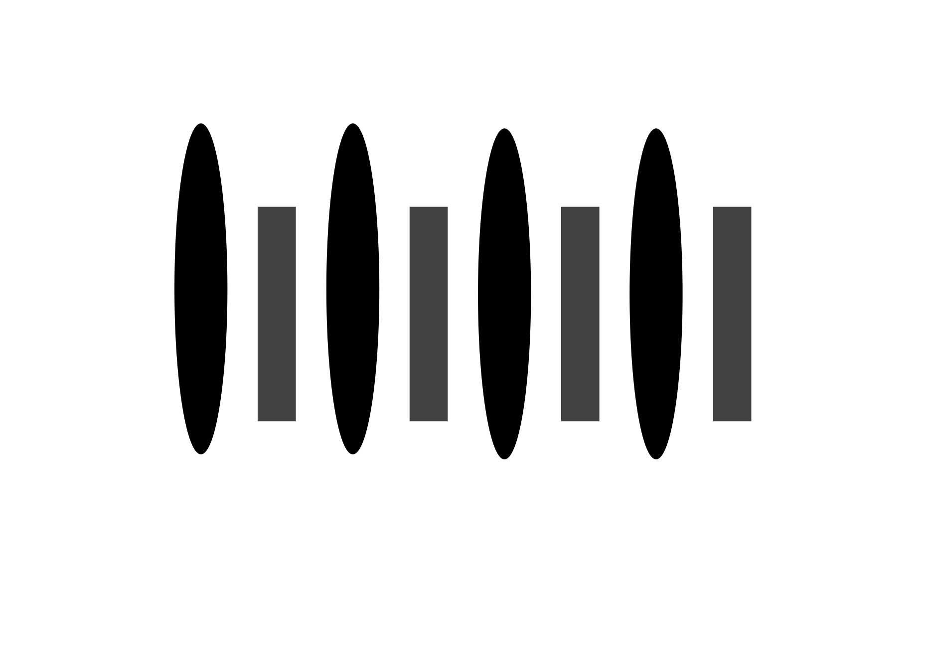
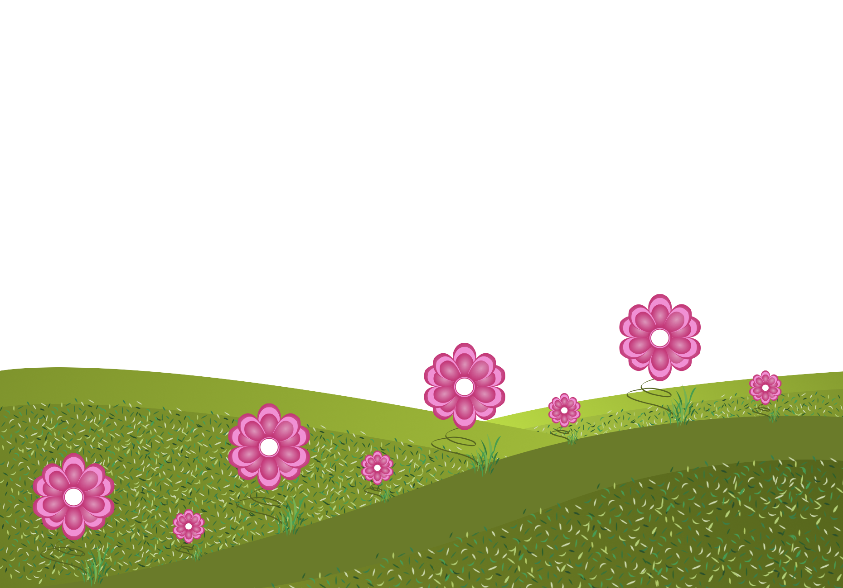
alternating repetition
FORM
Similar elements repeated in an alternating pattern
Alternation can be size, value, color, shape, spacing
CONTENT
Softer flow than strict regular repetition
More variety, less “marching”
Often feels gentler / less jarring
Creates a back-and-forth visual beat
Notes:
Alternating repetition adds variation without chaos, your eye still follows the pattern, but it feels softer and more natural.
Ask: How does it change the rhythm?
Ask: Where do you see alternating rhythm in your field?

Slide 6
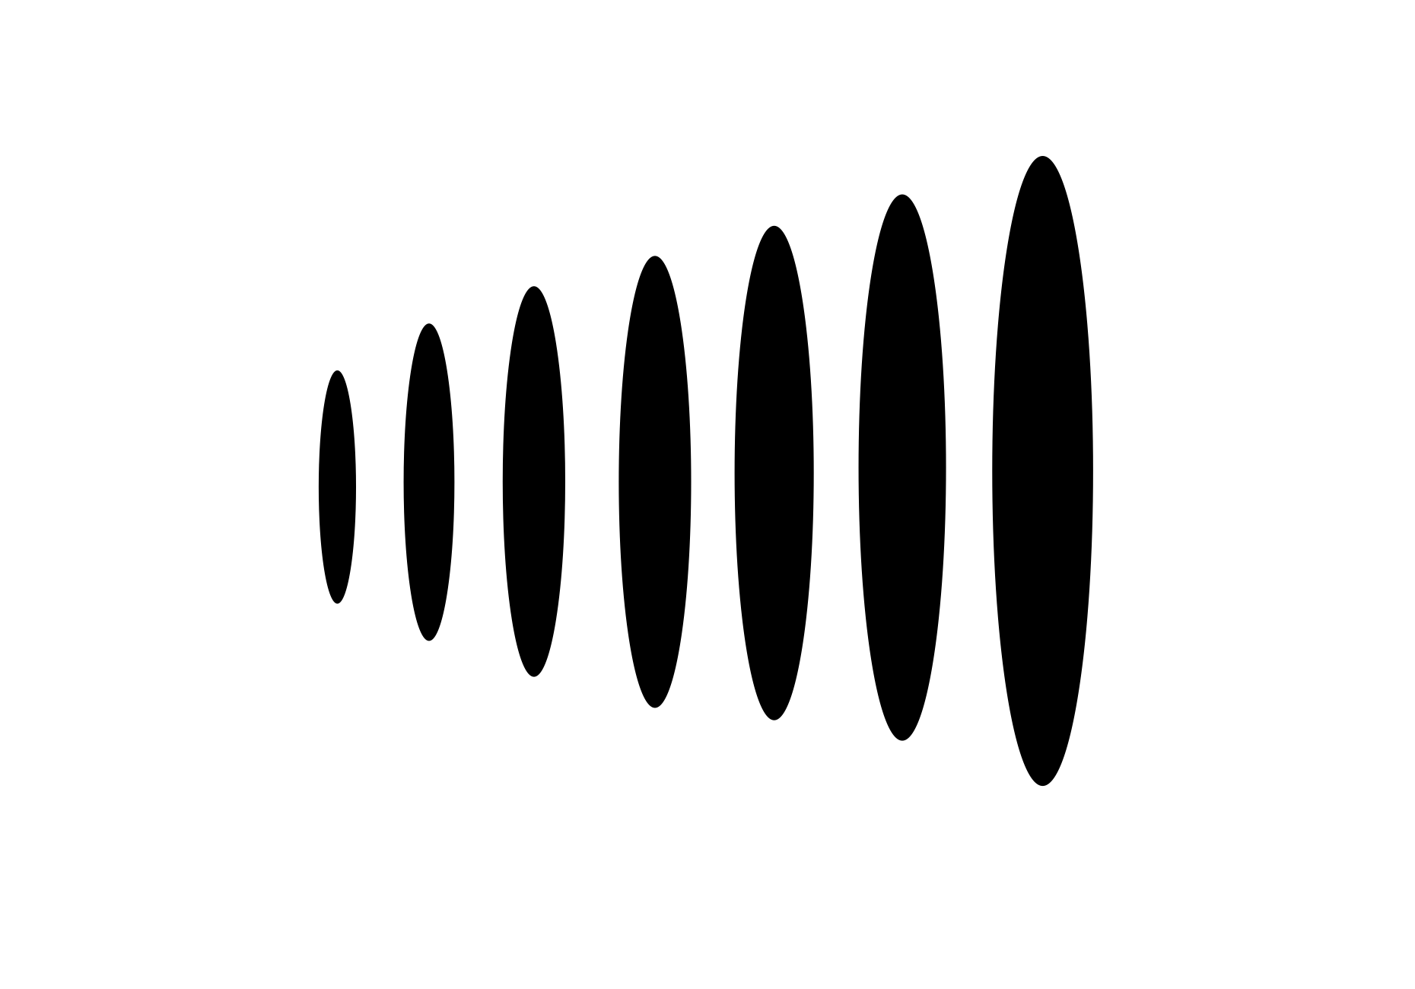
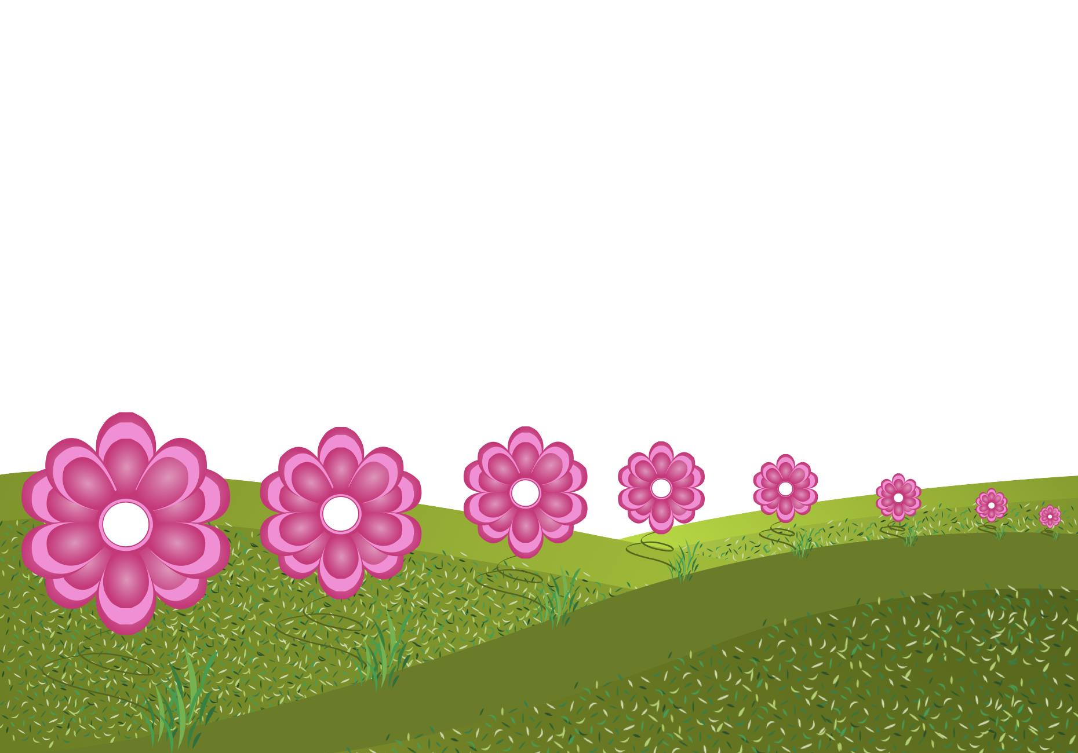
progressive rhythm
FORM
Similar elements repeated with a gradual change
Change can be size, spacing, value, direction, density
CONTENT
Gentle movement from one element to the next
Often feels smooth, natural, flowing
Can suggest distance, growth, fading, or motion
Notes:
Progressive rhythm is repetition with a gradual shift, your eye glides because each step changes just a little.
Ask: What changes progressively, and what does that imply (movement, depth, time)?
Ask: Why does gradual change feel smoother than sudden change?
Transition: Now we’ll apply these concepts to your own design field through Making the Connection and the Commentary on Design examples.

Slide 7
MAKING THE CONNECTION
You now have an understanding of how the element line feels and what it can communicate; now take it a step further, strengthen your comprehension by applying this knowledge to your area of design!
COMMENTARY ON DESIGN
Visit Commentary on Design for inspiration.
You will discover how designers in the real world are employing the elements and principles of design in a variety of design fields!
Notes:
Goal: Turn vocabulary into observation + analysis.
Your job is to spot rhythm in the real world and describe it using our terms, identify the repeating unit and label the rhythm type (regular repetition, alternating repetition, or progressive rhythm), then connect that repetition to how the design feels (static, gentle, energetic) and what it communicates (flow, direction, movement, emphasis).

