Slide 1
Connecting to Design | SHAPE
Notes:
Goal: Set expectations: slides support teaching; textbook carries depth.
Commentary on Design: Follow the link to explore real-world examples of these concepts in graphic design, fashion design, industrial design, interior design, media arts and animation, game art and design, and film and video.

Slide 2
element | SHAPE
A shape is a distinct area defined by an actual or implied outline.
Shapes can feel cold and intimidating as well as warm and inviting.

Slide 3
TYPES OF SHAPE
simple
rectilinear
implied
complex
geometric
abstract
curvilinear
organic
non-objective

Slide 4
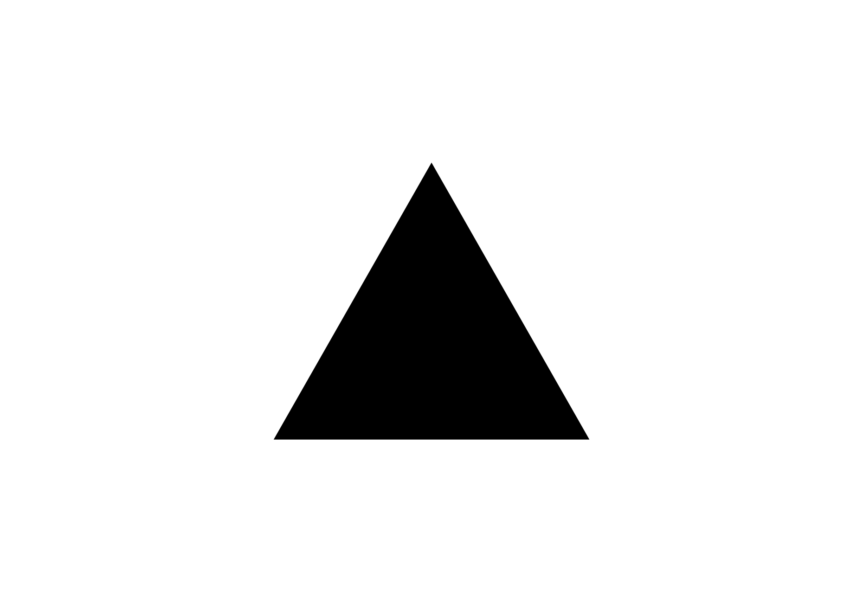
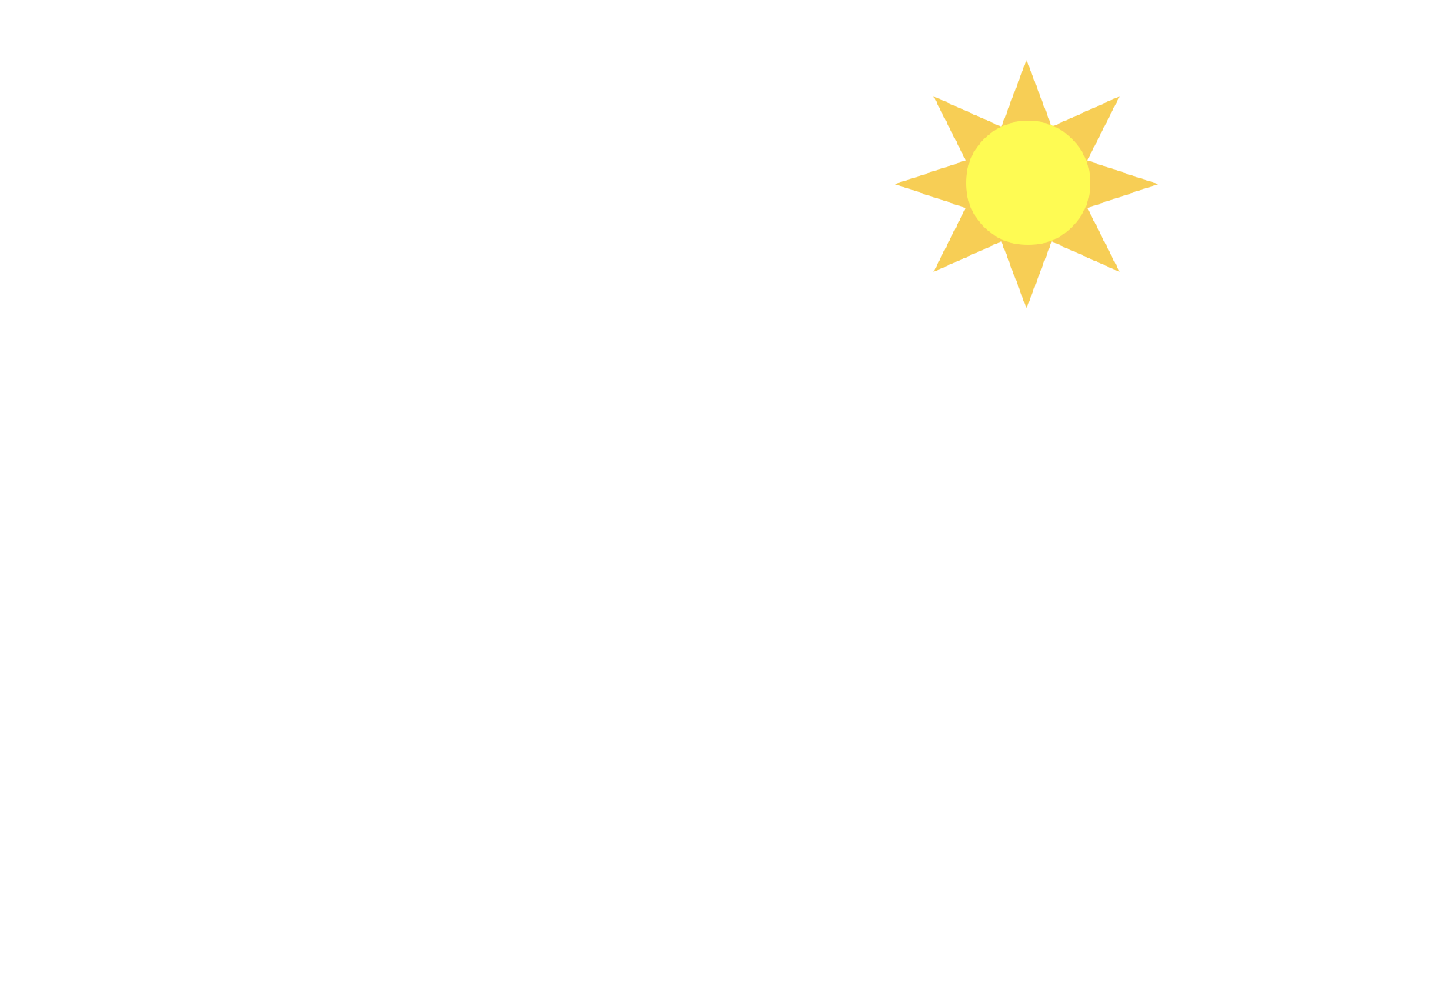
simple shape
FORM
Basic, geometric structure
Instantly recognizable
Easy to recall from memory
CONTENT
Familiar / approachable
Predictable / stable
Comfortable / “safe”
Notes:
Simple shapes have a structure that’s easy to remember. A quick glance is usually enough to recall it. That memorability often creates a sense of familiarity and predictability. Most people feel more comfortable with what they recognize quickly.
Look at the triangle for 3 seconds.
Now look away—can you sketch it from memory?
(That’s why simple shapes work so well for icons, signs, and logos.)
Ask: What makes this feel “predictable”, the shape itself, or how it’s used?
Ask: Where do you see simple shapes used to make something feel clear or trustworthy?

Slide 5
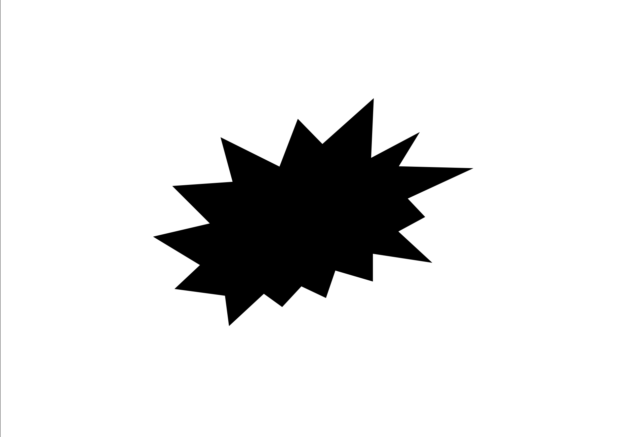
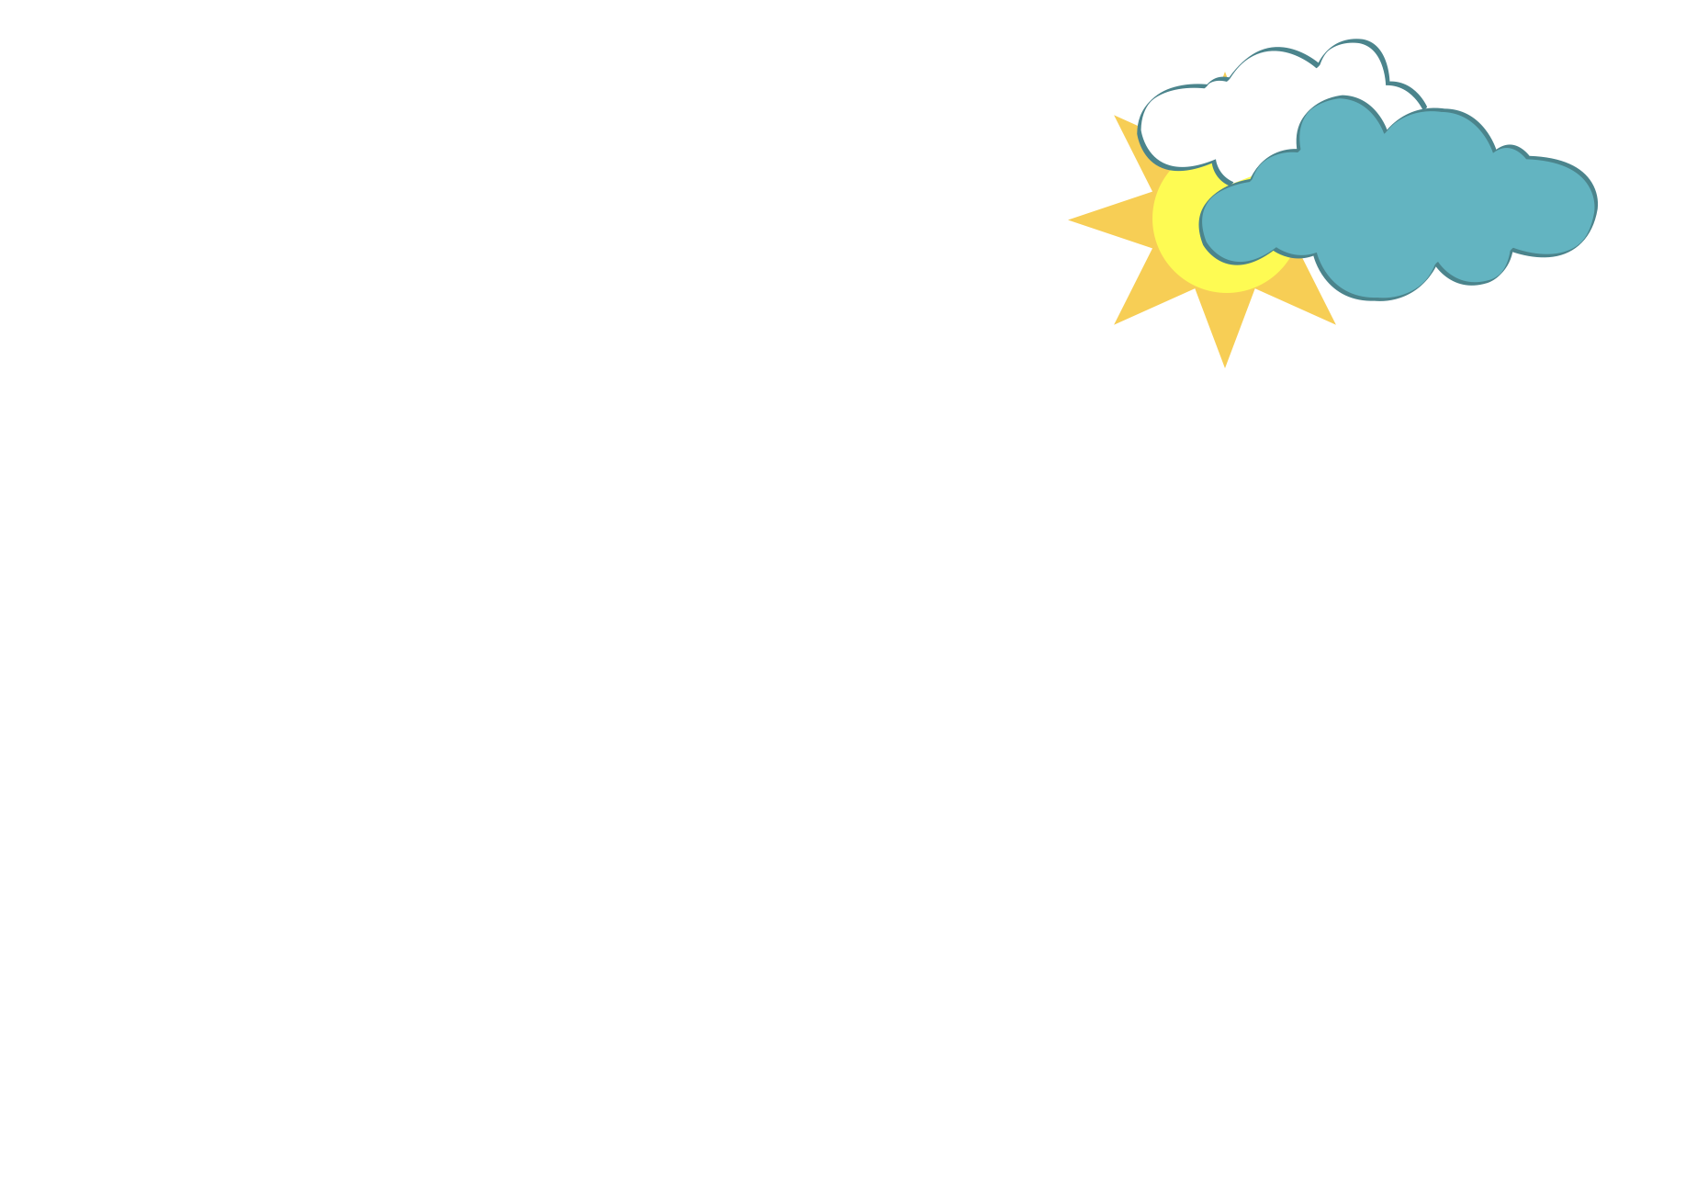
complex shape
FORM
Irregular / detailed structure
Harder to recall quickly
Takes longer to interpret
CONTENT
Unpredictable
Intriguing
Adds mystery / interest
Notes:
We spend more time interpreting complex shapes, so they tend to feel less predictable. That extra interpretation time often adds intrigue.
Quick test—look for 2 seconds, then describe the shape from memory.
Ask: Which feels more “interesting”, the sun or the cloud? Why?
Ask: Where do you see complex shapes used to create drama or curiosity?

Slide 6
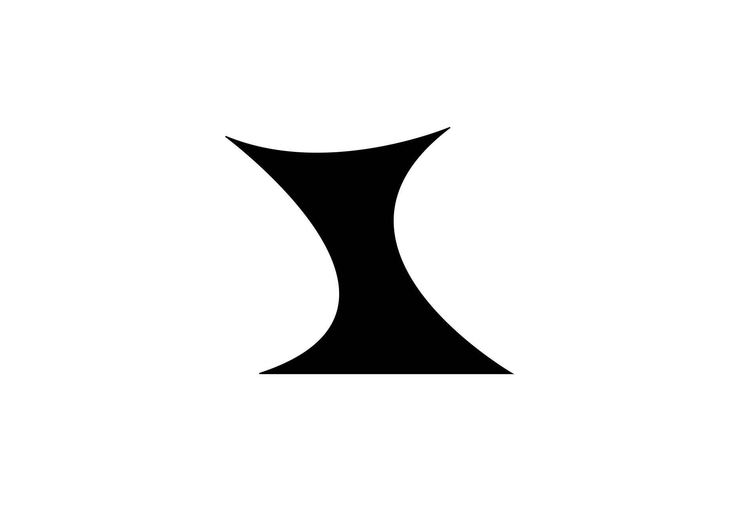
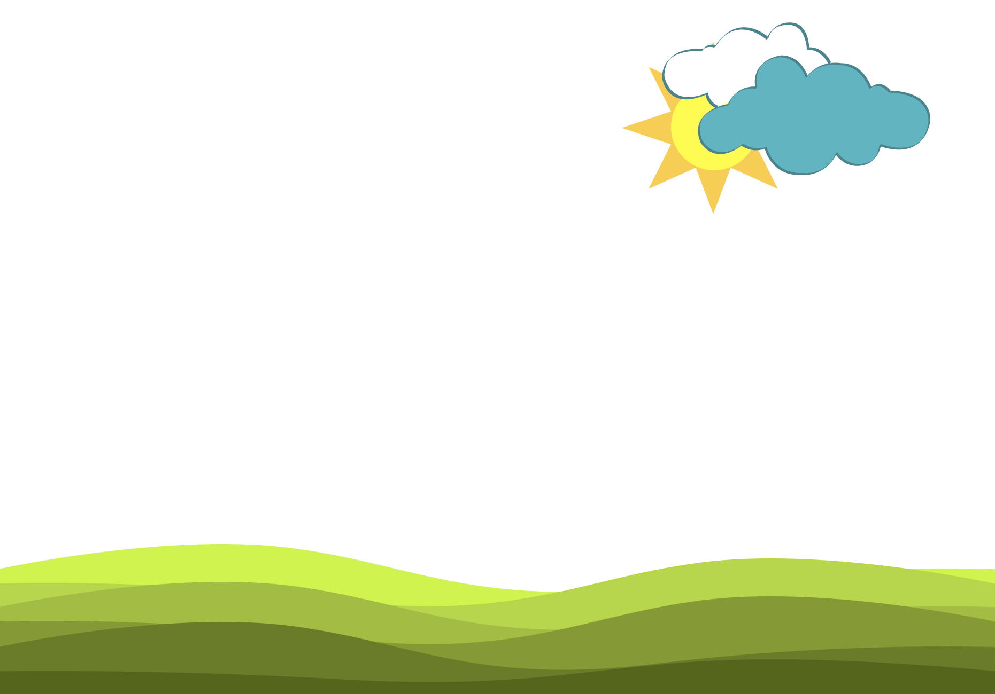
curvilinear shape
FORM
Boundaries made of curving lines
Rounded edges
Flowing contour
CONTENT
Free / soft / flowing
Graceful
Gentle / sensual
Notes:
Curvilinear shapes feel fluid and natural in motion. Curved boundaries often read as soft and graceful.
Ask: What would change emotionally if the grass bands were straight?
Ask: Where do you see curvilinear shapes in branding or product design?

Slide 7
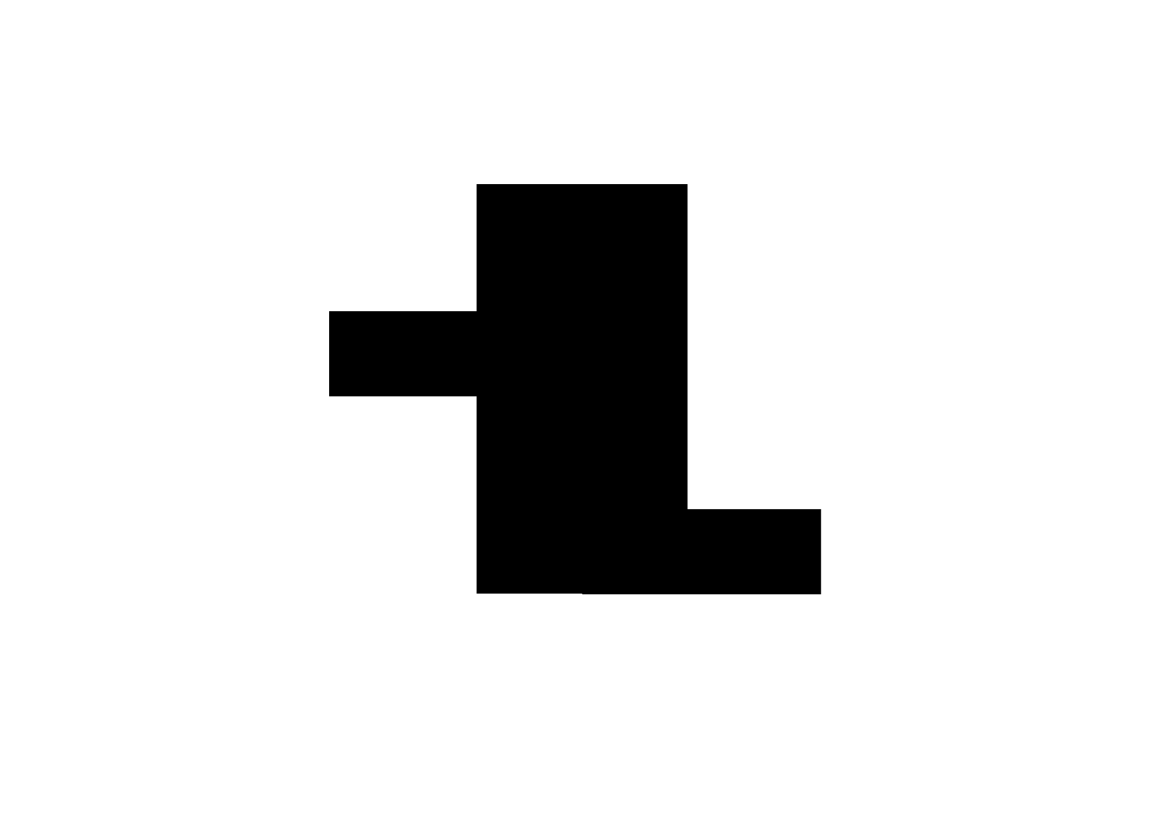
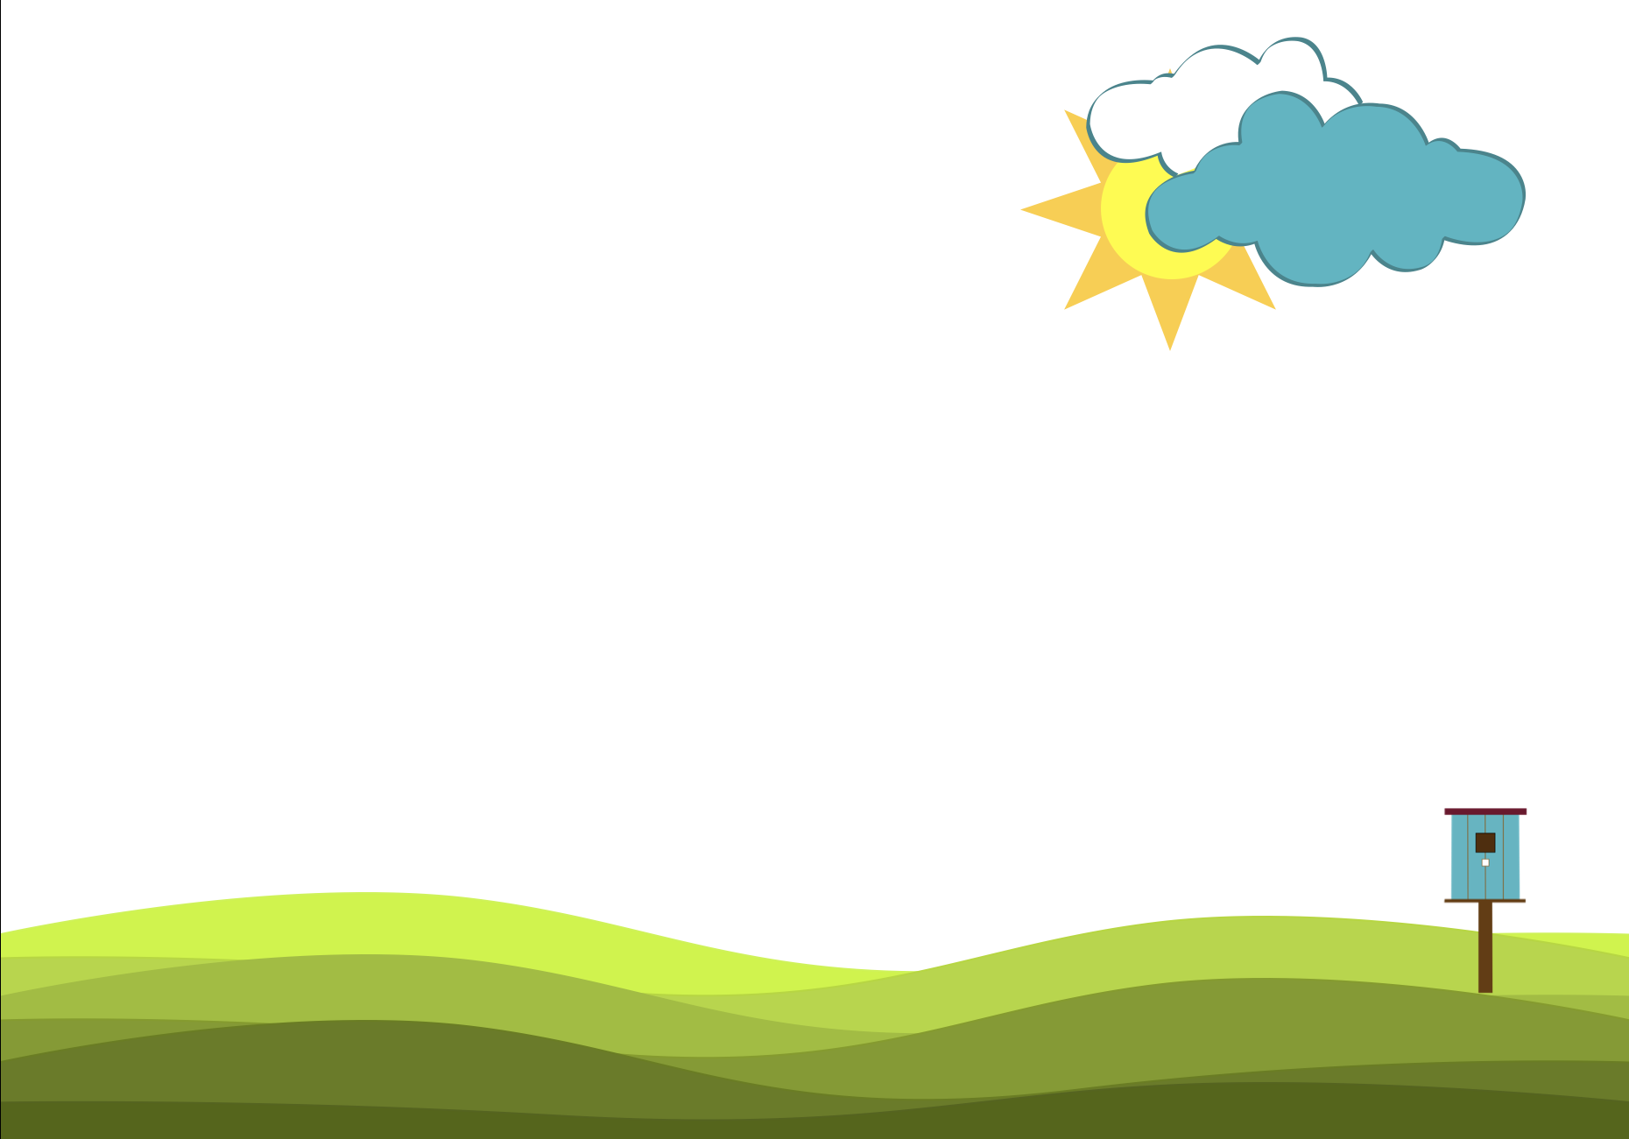
rectilinear shape
FORM
Straight edges
Angular corners
Hard-edged boundary
CONTENT
Precise / sharp
Artificial / man-made
Structured
Notes:
Rectilinear shapes read as sharp and precise. In the scene, the birdhouse feels manufactured compared to the softer grass and clouds.
Ask: Which feels more “human-made”, the birdhouse or the hills?
Ask: When is “sharp and precise” a benefit in design?

Slide 8

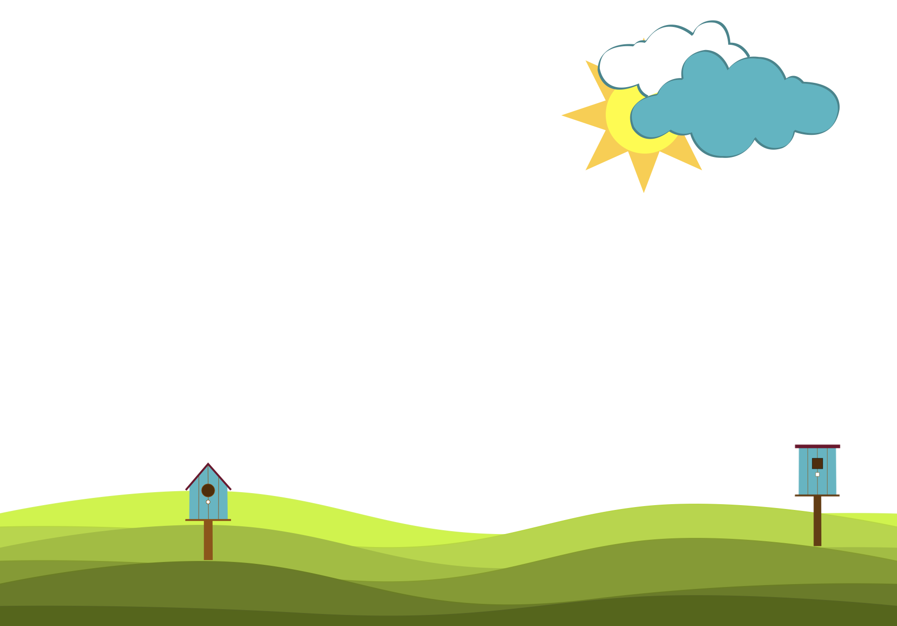
geometric shape
FORM
Basic shapes (circle, triangle, rectangle, etc.)
Precise edges / angles / curves
Clean, measurable structure
CONTENT
Strong
Cold / mechanical
Man-made
Notes:
Geometric shapes feel intentional and mechanical because their edges and angles are precise. They often signal control, structure, and man-made order.
Ask: Which elements here feel geometric vs organic?
Ask: What industries rely on geometric shapes for credibility?

Slide 9
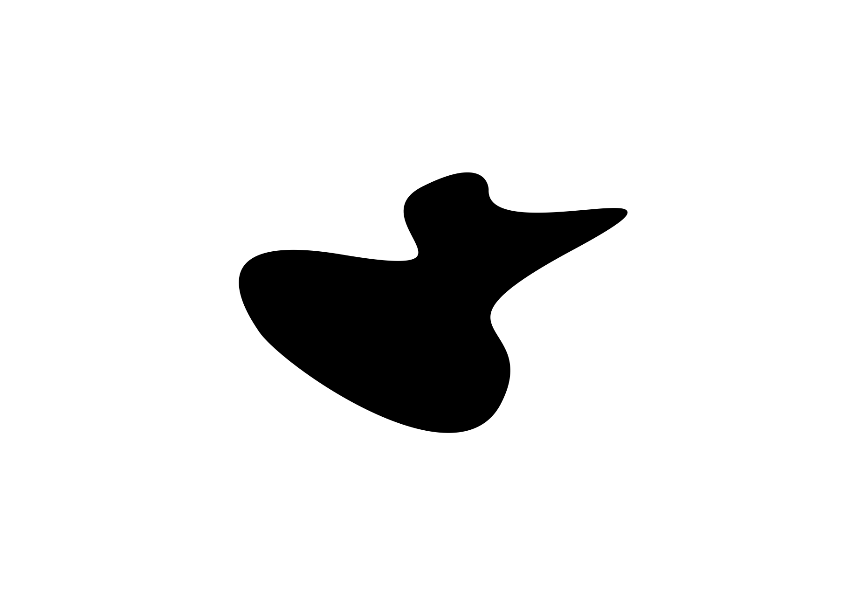
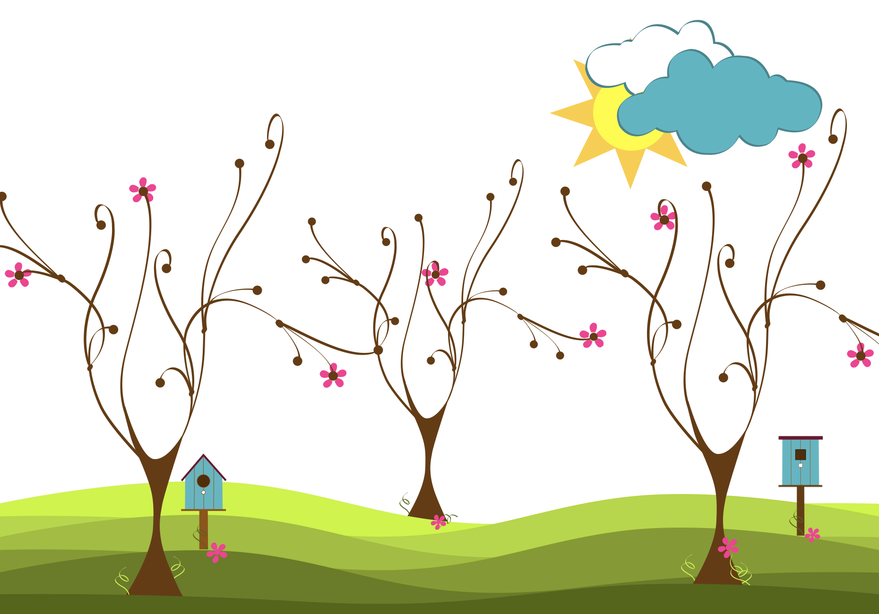
organic shape
FORM
Fluid / curving edges
Not perfectly straight
Biomorphic = looks alive
CONTENT
Natural / living
Life energy
Human / approachable
Notes:
Organic shapes feel natural because they aren’t perfectly uniform or mechanically precise. We tend to associate them with living things.
Ask: What makes the trees feel ‘alive’?
Ask: When do designers choose organic shapes to build trust or warmth?

Slide 10
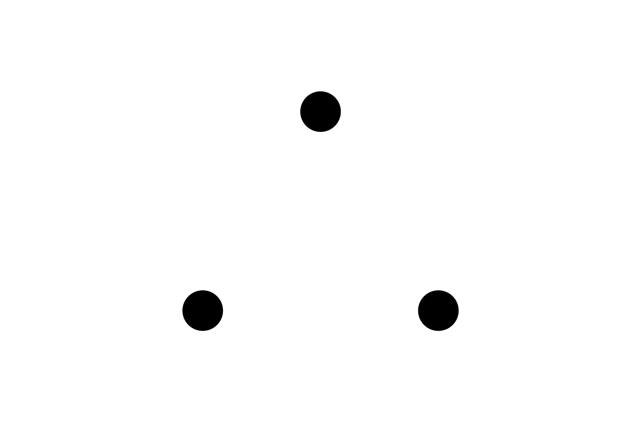
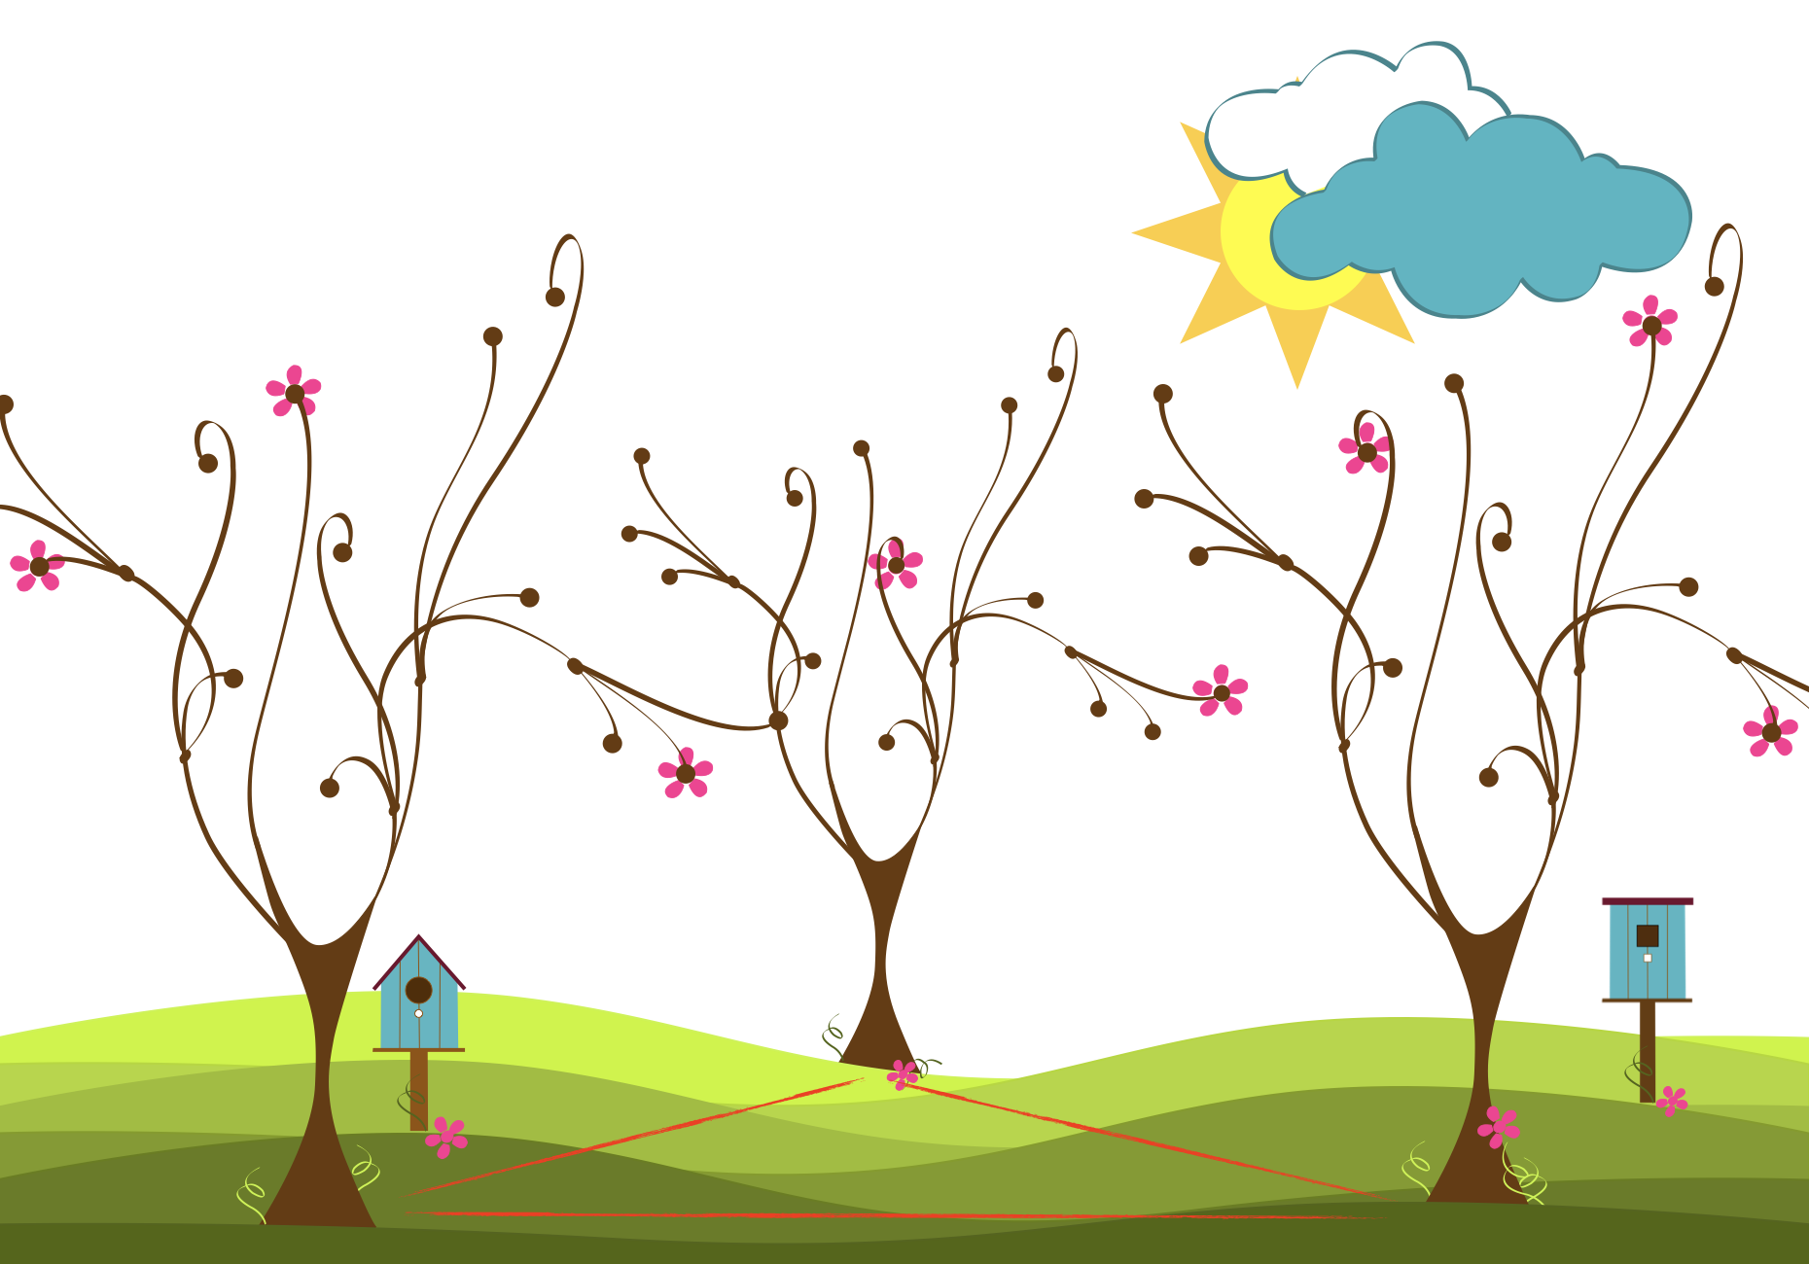
implied shape
FORM
Shape suggested by gaps/placement
Boundary is not drawn
Brain completes the shape
CONTENT
Creates unity
Organizes scattered elements
Can add stability (base)
Notes:
Implied shapes happen when our mind connects separate parts into a familiar whole. That implied triangle not only unifies the piece, but it also creates a stable base.
Ask: Where do you see implied shapes used in logos?

Slide 11
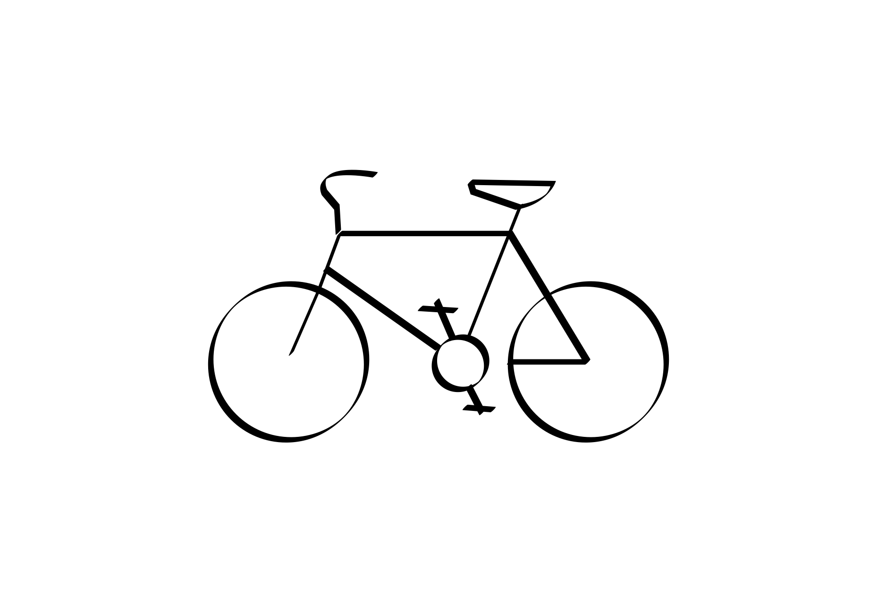
abstract shape
FORM
Simplified / distorted form
Still recognizable
Reduced detail
CONTENT
Can feel playful
Can feel tense/uneasy
Can feel calm/energized
Notes:
Abstract shapes come from real objects that are simplified or altered, but still readable. Designers abstract to shift mood, playful, calm, excited, or uneasy.
Ask: What details were removed and what stayed?
Ask: What mood does this abstraction create and what caused it?
Ask: How does simplification change meaning?

Slide 12
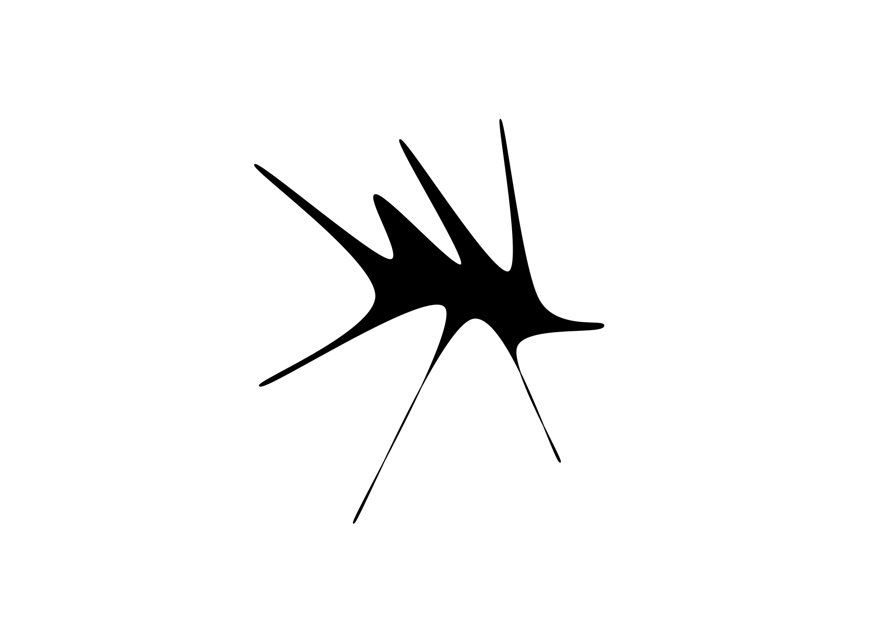
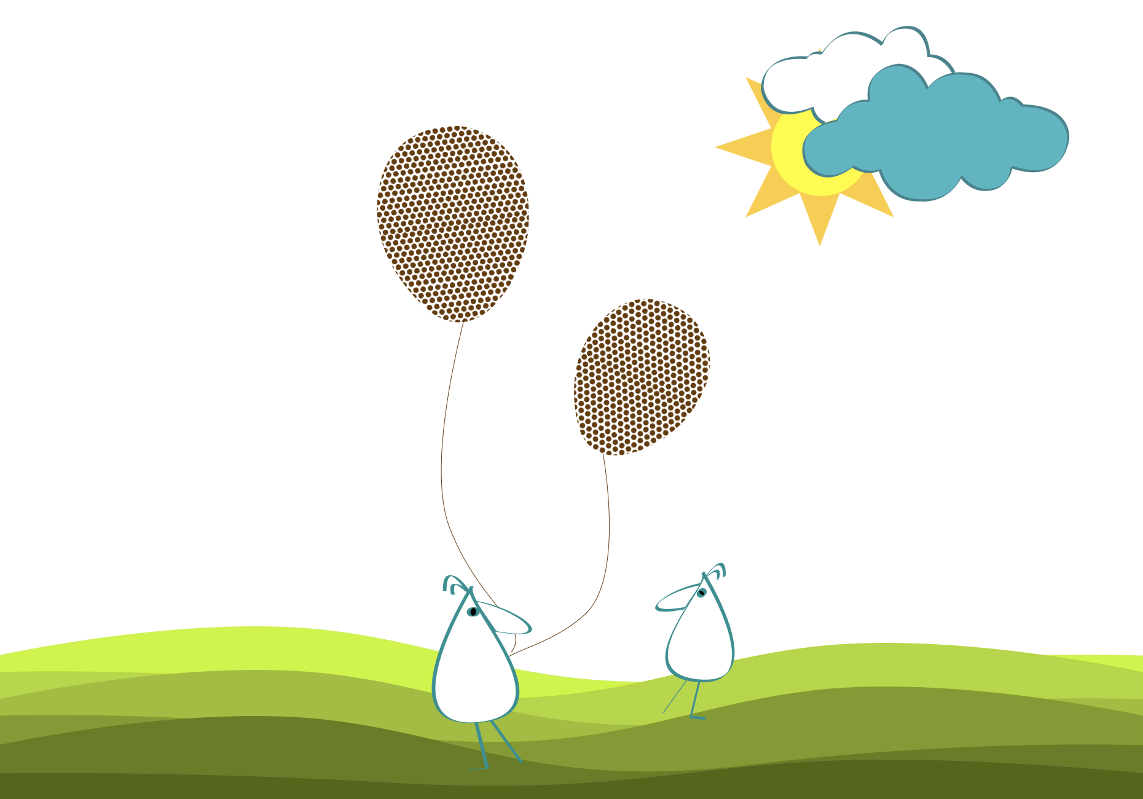
non-objective shape
FORM
Does not represent an object
Pure pattern / form
Non-referential
CONTENT
Emotion-driven
Can feel sterile/cool
Can feel warm/inviting
Notes:
Even when we recognize an object the composition, a non-objective pattern doesn’t “stand for” anything. It’s mainly expressive; patterns can feel sterile or warm depending on their character.
Describe the pattern using only adjectives.
Ask: What does the pattern communicate? Why?
Ask: Where do you see non-objective shapes used?

Slide 13
POSITIVE / NEGATIVE SHAPE
positive/negative shape
positive dominate
negative dominate
equal dominance

Slide 14
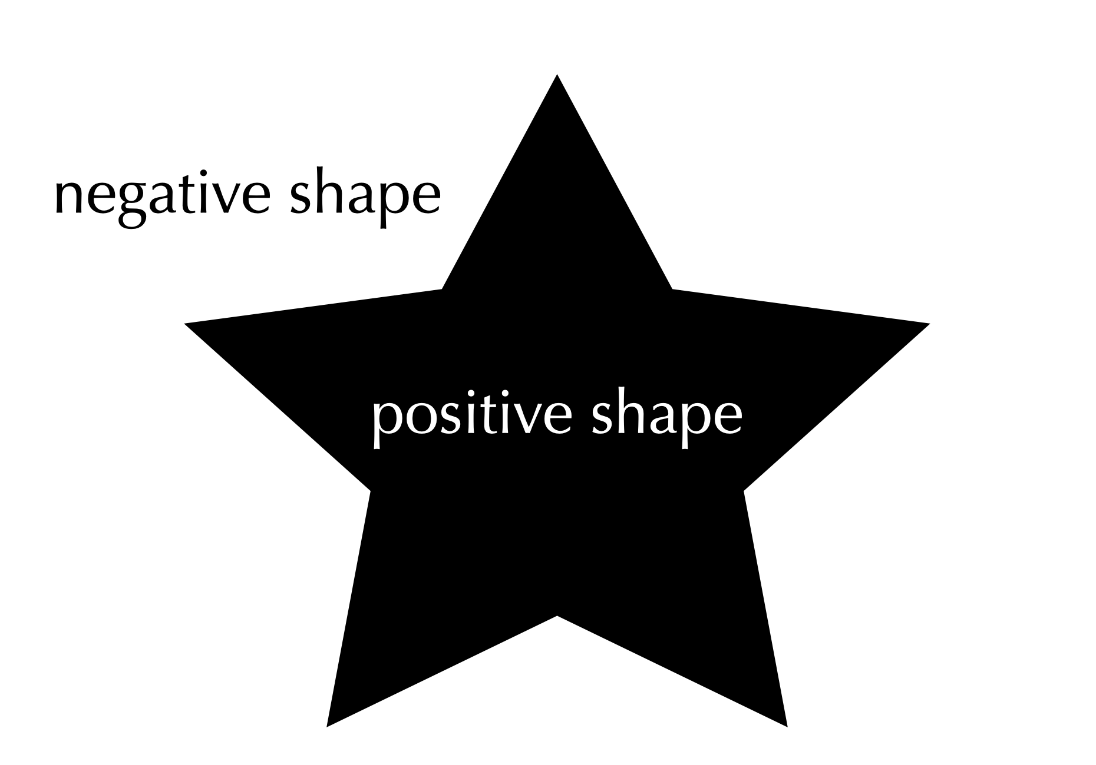
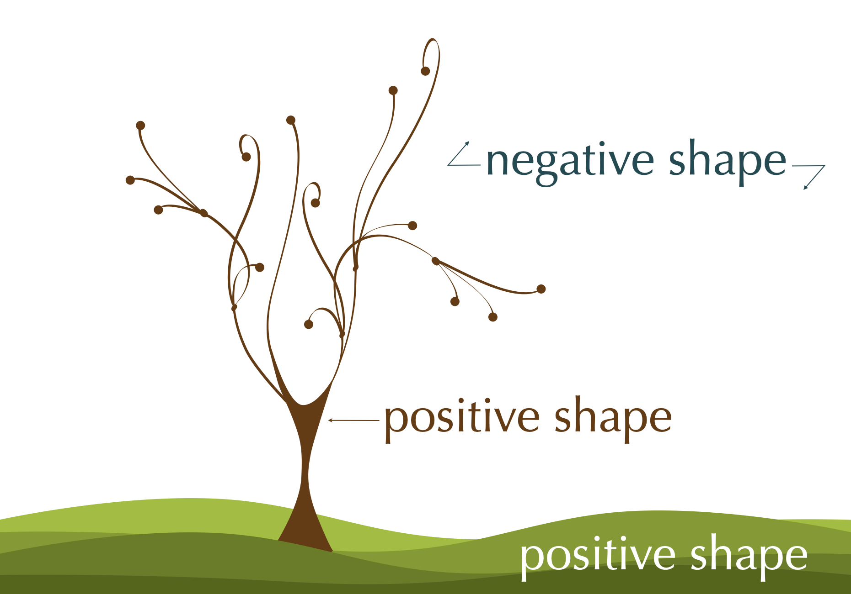
positive/negative
FORM
Positive = object(s)
Negative = surrounding area
Figure / ground (aka positive/negative space)
CONTENT
Clarifies subject
Shapes the background as active design
Creates figure-ground relationship
Notes:
Positive shape is the subject; negative shape surrounds it. Both are shapes, and both influence what we notice first.
Ask: Where have you seen a logo that uses negative space cleverly?

Slide 15

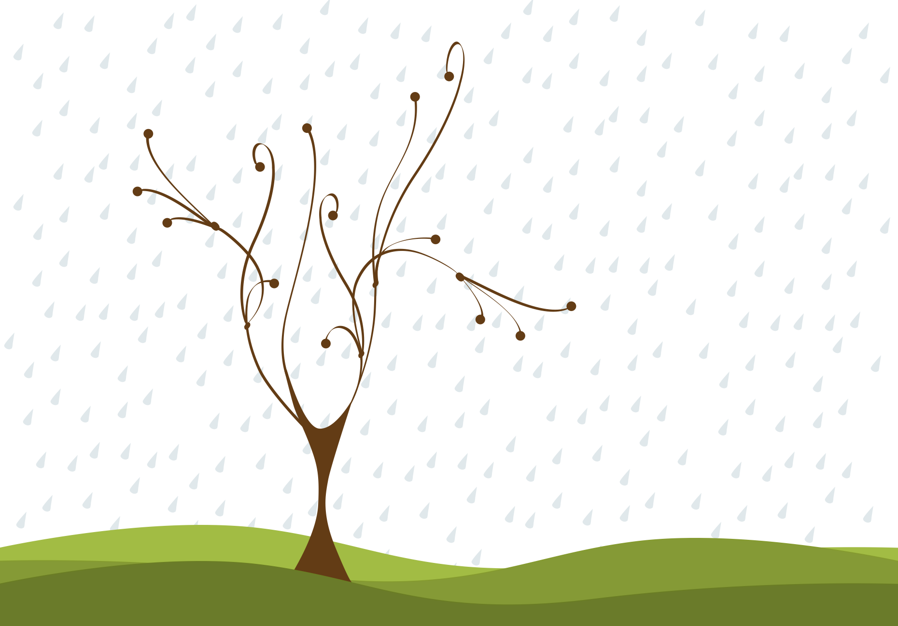
positive dominate
FORM
Positive shapes carry more weight
Viewer notices subject first
Negative recedes
CONTENT
Positive is lower in value (darker)
Higher visual weight
Subject leads attention
Notes:
In a positive-dominant design, we’re most aware of the positive shapes. Here, the tree/grass read heavier, so they pull attention more than the raindrops.
Ask: What’s making the positive dominate, value, size, or detail?
Ask: How could you make the negative more dominant?

Slide 16
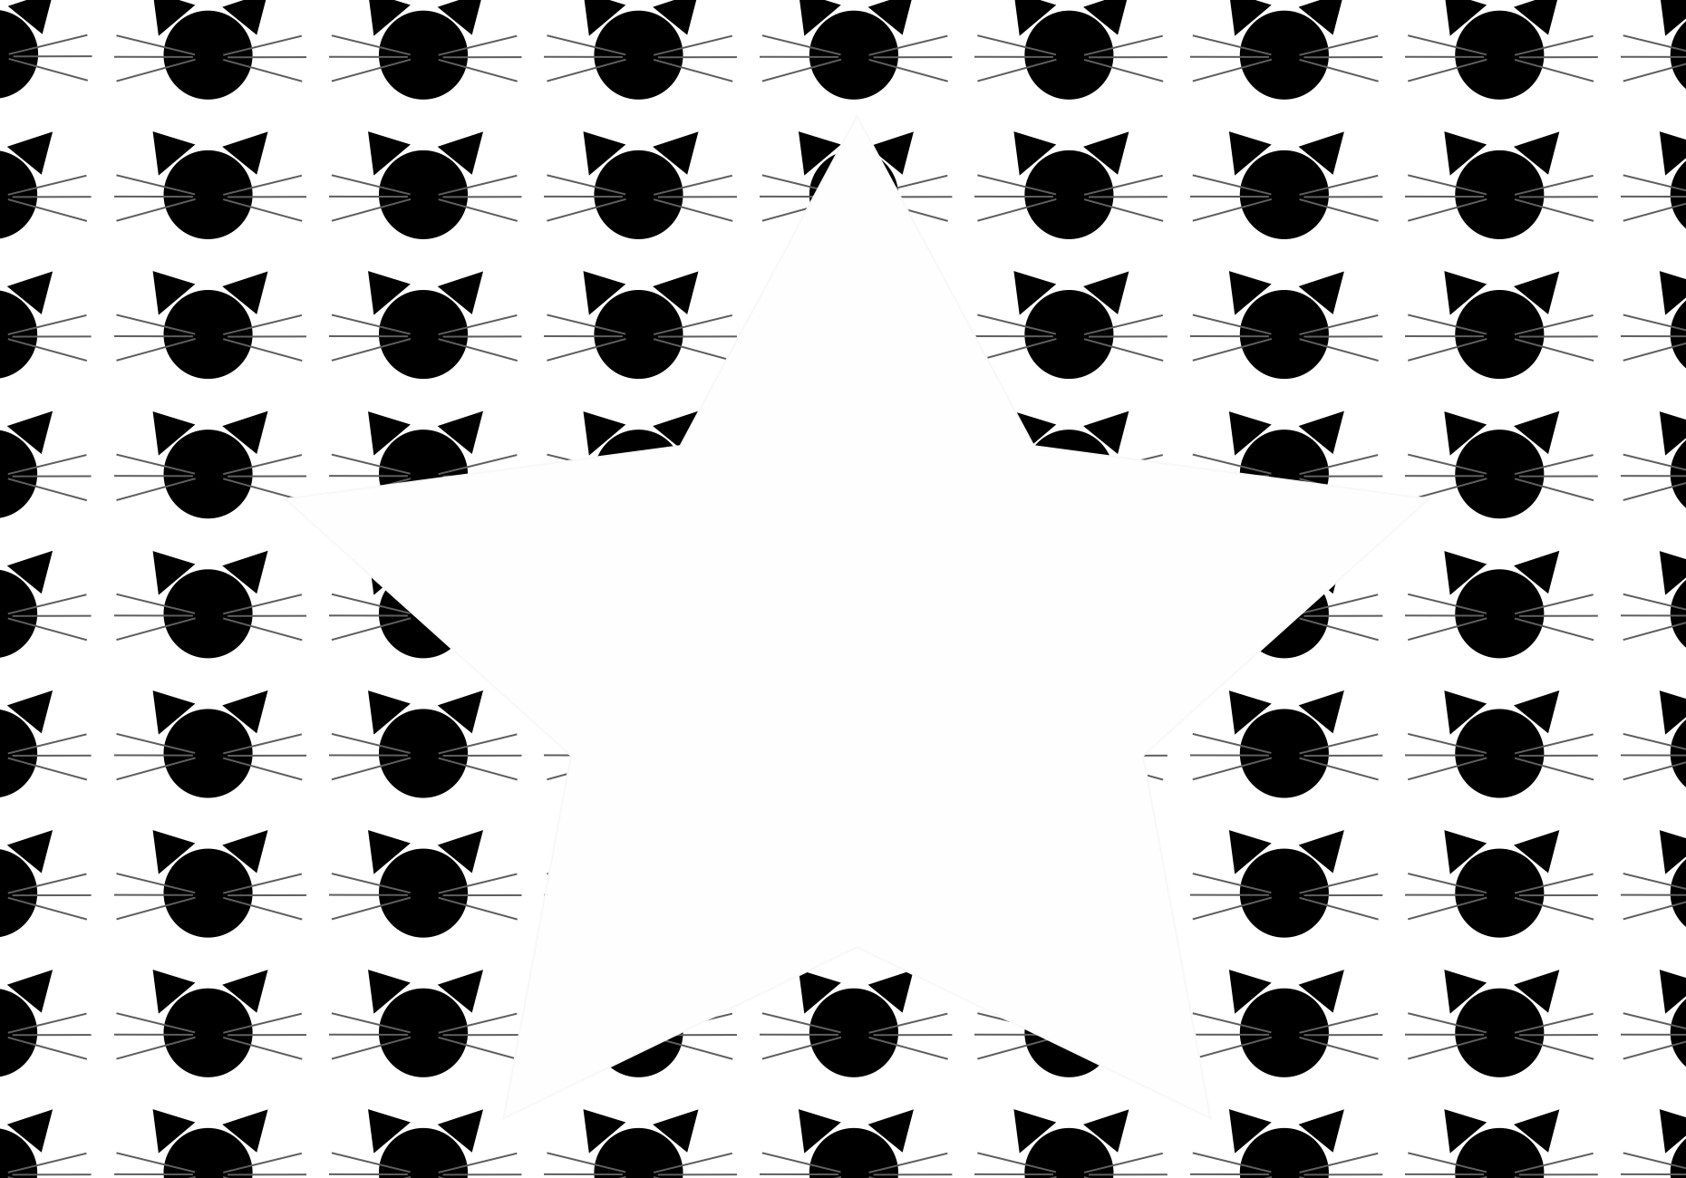
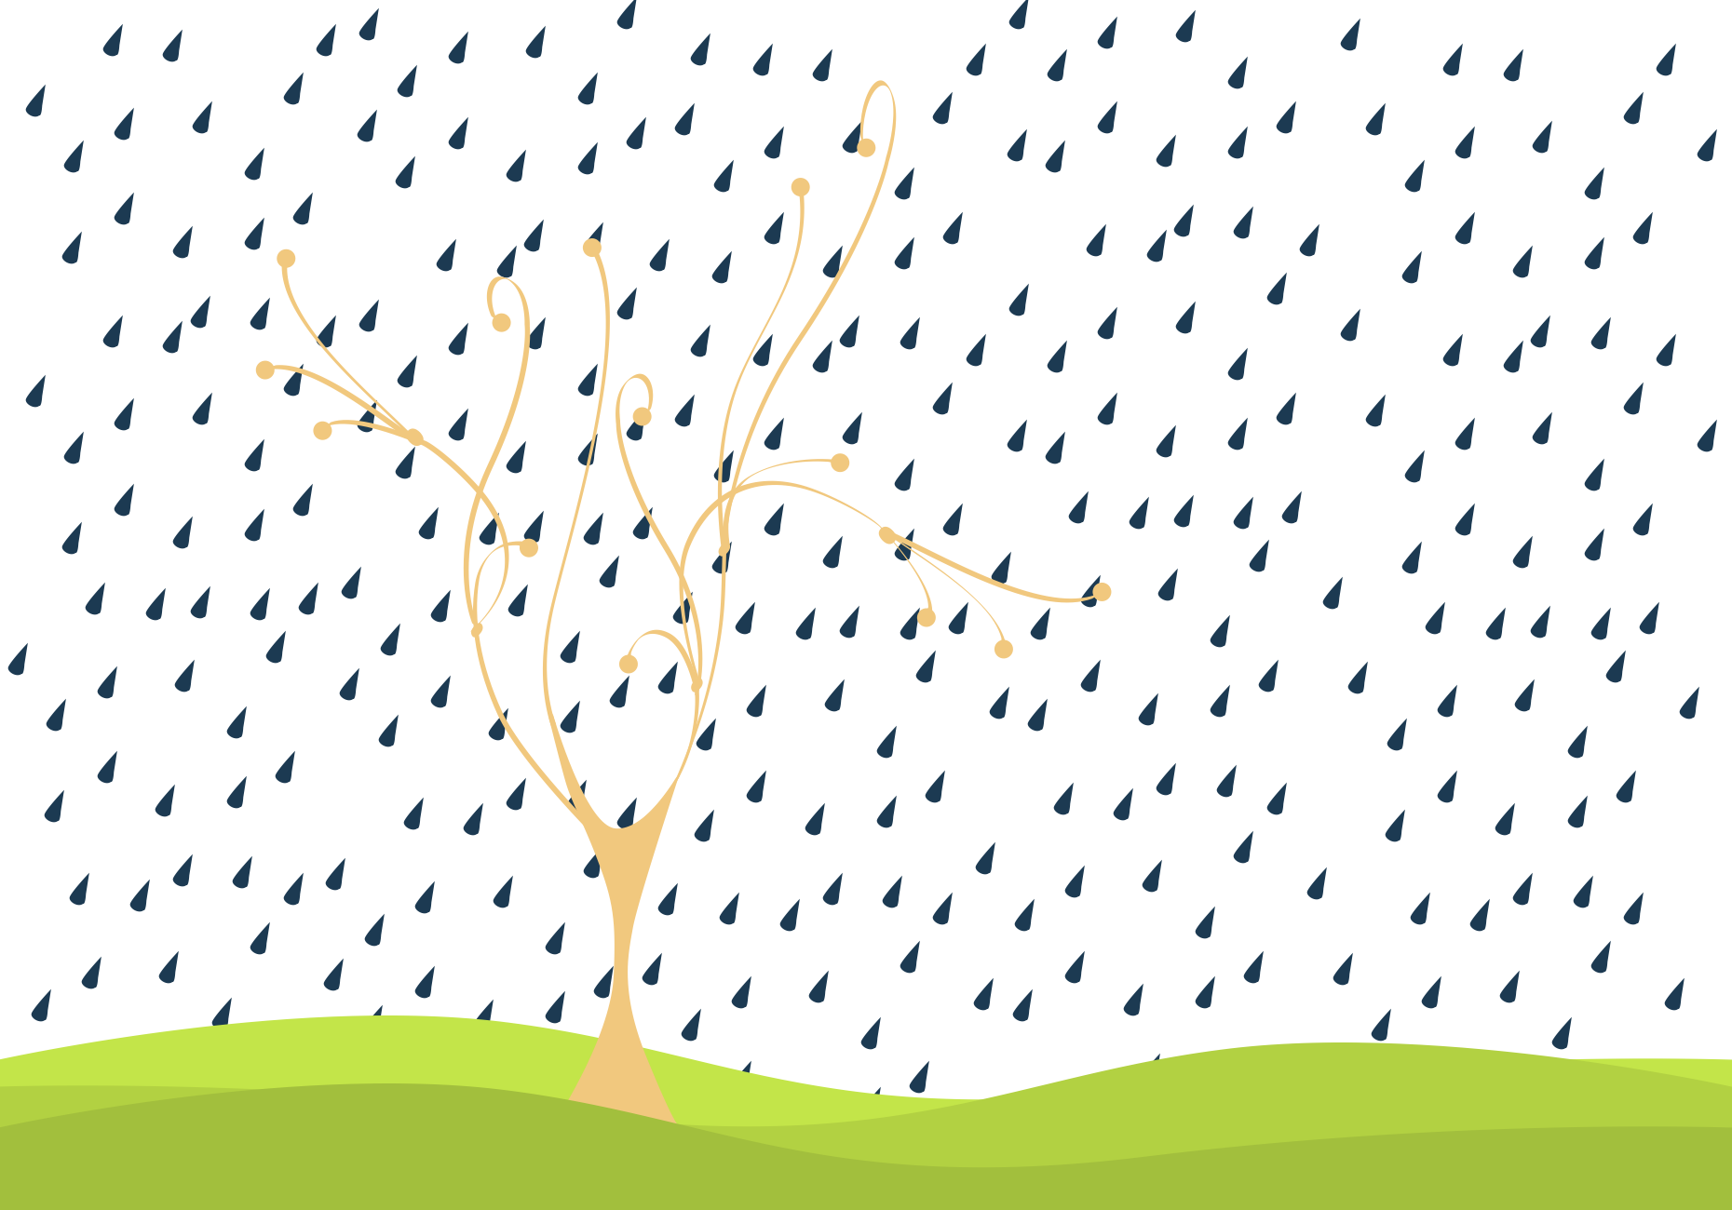
negative dominate
FORM
Negative shape carries more weight
Viewer notices background/pattern first
Positive feels quieter
CONTENT
Negative is lower in value (darker)
Strong repetition/pattern
Background becomes the focus
Notes:
In a negative-dominant design, we notice the negative shape first. Here the raindrops have strong visual weight, so the background becomes the main event.
Ask: Where does your eye go first, and what caused that?
Ask: When would you want negative dominance?

Slide 17
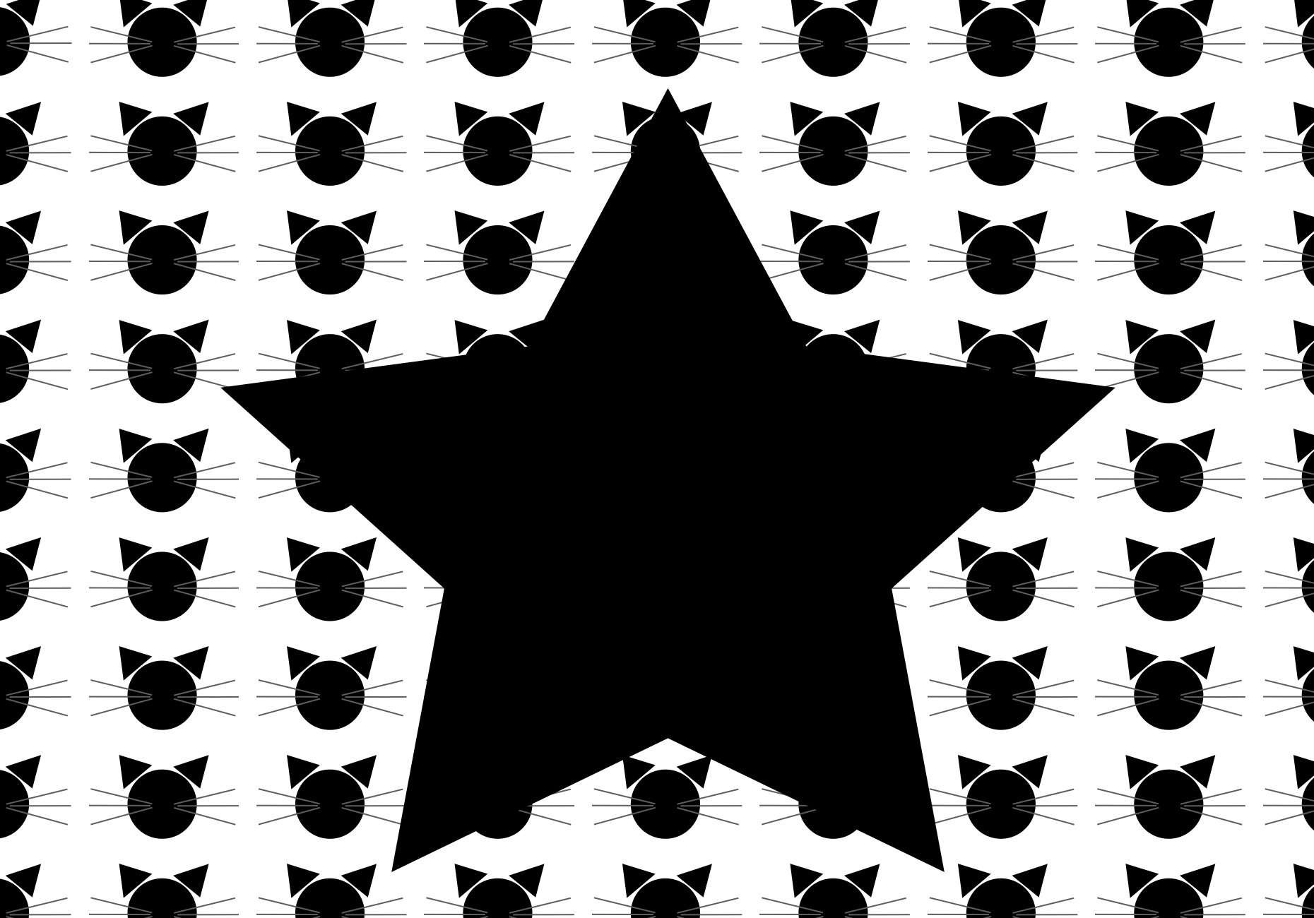
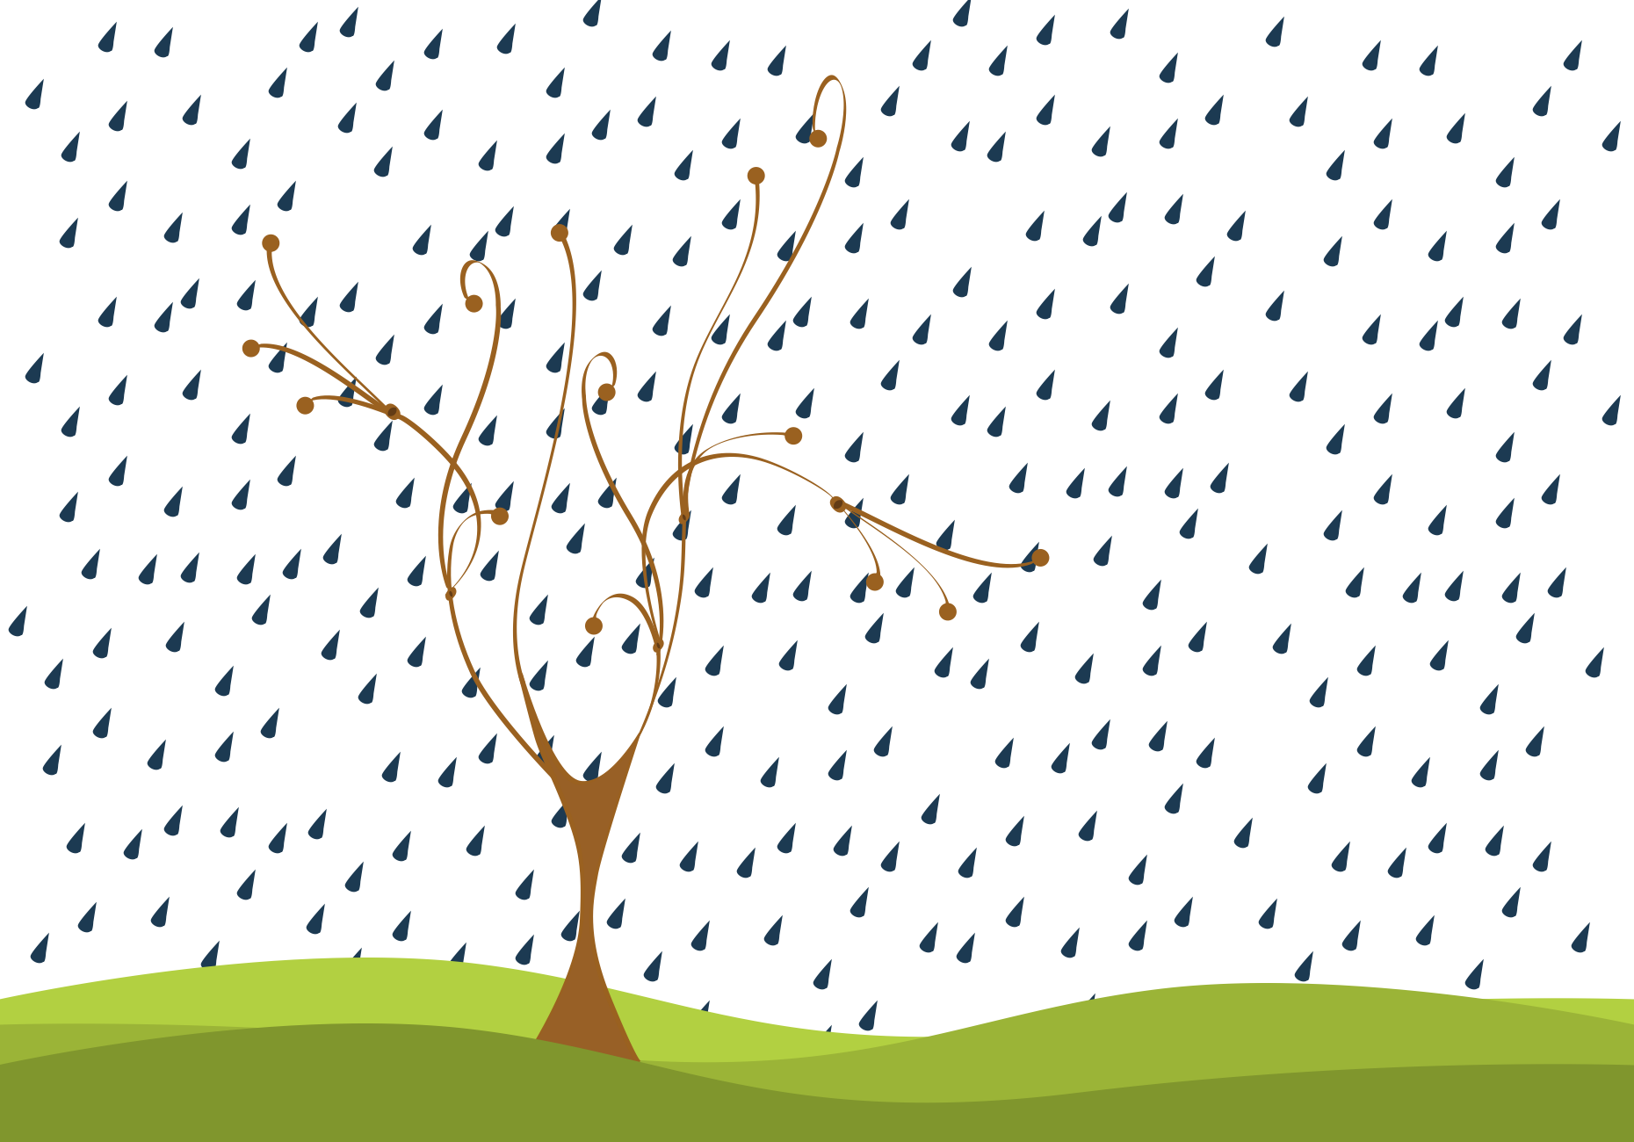
equal dominance
FORM
Values are closer
Positive and negative compete
Neither clearly leads
CONTENT
Busy negative detail competes
Both spaces pull focus
Notes:
When values get closer, and the negative has detail, it can compete with the positive. The result is equal dominance, your attention bounces between both.
Ask: What single change would make one side dominate again?
Ask: Is equal dominance ever desirable?
Transition: Now we’ll apply these concepts to your own design field through Making the Connection and the Commentary on Design examples.

Slide 18
MAKING THE CONNECTION
You now have an understanding of how the element line feels and what it can communicate; now take it a step further, strengthen your comprehension by applying this knowledge to your area of design!
COMMENTARY ON DESIGN
Visit Commentary on Design for inspiration.
You will discover how designers in the real world are employing the elements and principles of design in a variety of design fields!
Notes:
Goal: Turn vocabulary into observation + analysis.
Your job is to spot shape in the real world and describe it using our terms, shape type (geometric, organic, abstract, non-objective), complexity (simple vs. complex), and figure/ground (positive vs. negative, dominance), then connect those choices to mood and meaning.

