Slide 1
Connecting to Design | LINE
Notes:
Goal: Set expectations: slides support teaching; textbook carries depth.
Commentary on Design: Follow the link to explore real-world examples of these concepts in graphic design, fashion design, industrial design, interior design, media arts and animation, game art and design, and film and video.

Slide 2
element | LINE
A line is a stroke or mark that has length and width.
Lines are so simple, yet they can communicate
personality, movement, structure, meaning and emotion.

Slide 3
TYPES OF LINE
actual line
psychic line
implied line

Slide 4
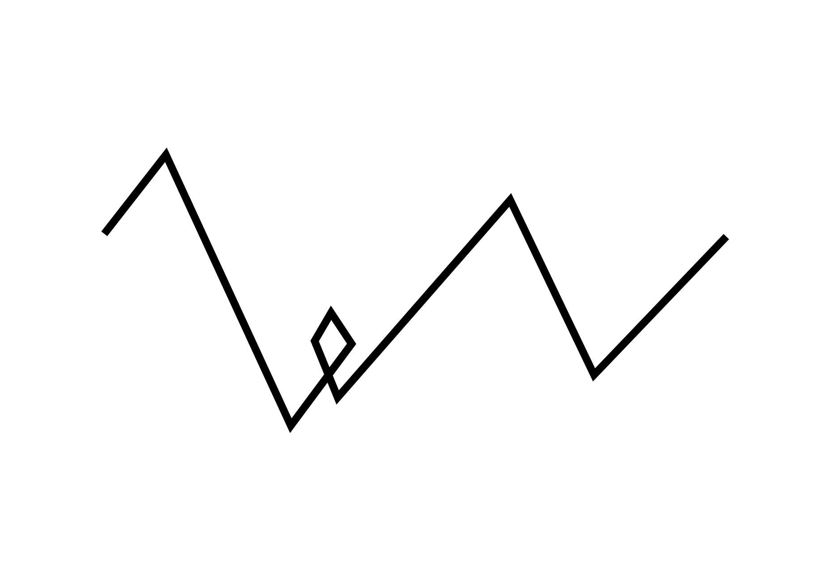

actual line
FORM
A drawn mark
Has length and width
Physically visible
CONTENT
Defines forms
Creates clear structure
Notes:
We think of line as thin, but anything with length and width can function as line, like the trunk and bands of grass.
Ask: What else in this image functions like a line besides the branches?
Ask: Where do you see actual lines most often—illustrations, architecture, fashion seams?

Slide 5
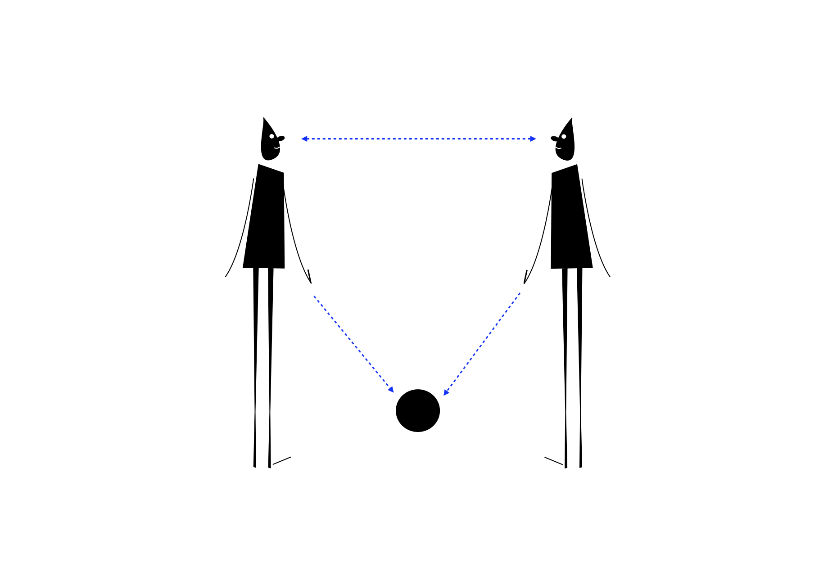
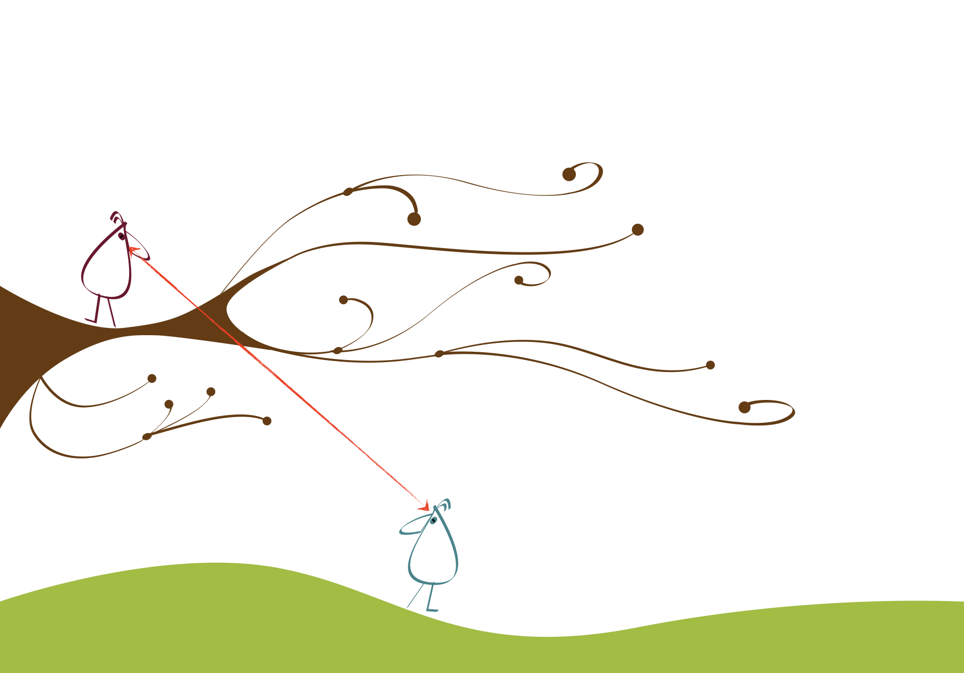
psychic line
FORM
A mental connection
Created by looking/pointing
Not physically drawn
CONTENT
Connects the birds
Creates unity
Makes the relationship feel intentional
Notes:
When one object looks at or points toward another, your brain draws a connection. That connection acts like a line.
Ask: Where do you see psychic line used in photography, film, or advertising?

Slide 6
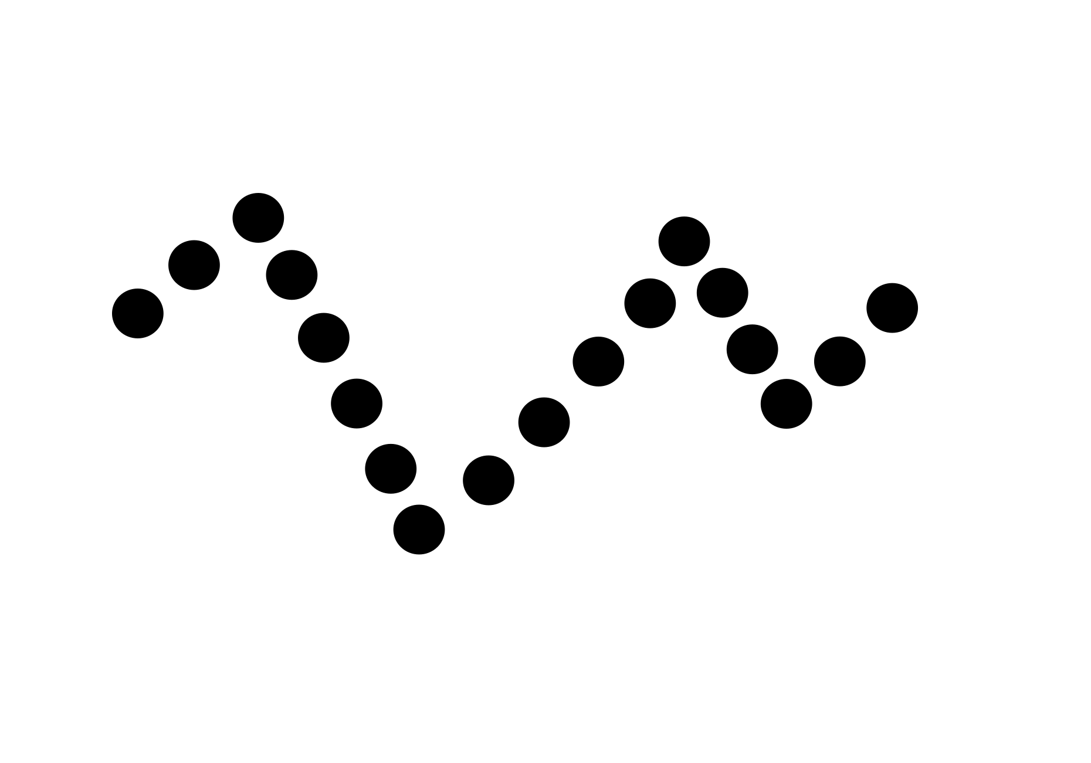
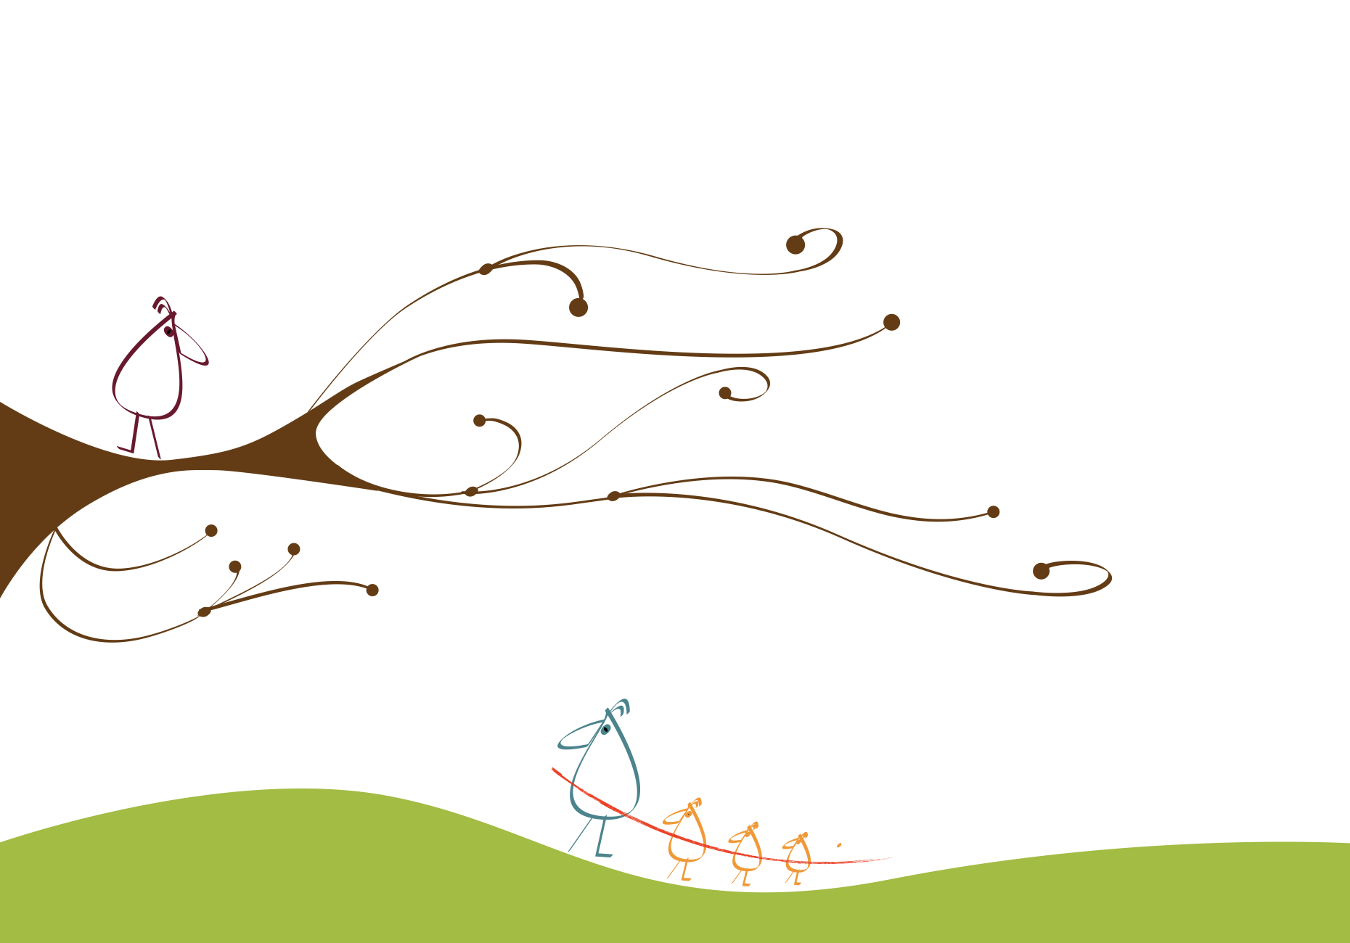
implied line
FORM
Suggested by a series
Points/objects align
Brain completes the line
CONTENT
Reads as a group first
Connects elements visually
Creates belonging/unity
Notes:
Implied line forms when separate parts are arranged so your mind connects them. You often see the group before the individuals.
Ask: Do you notice the “line of birds” before individual birds?
Ask: Where do you see implied line used in wayfinding, or pattern design?

Slide 7
LINE DIRECTION
horizontal line
vertical line
diagonal line

Slide 8
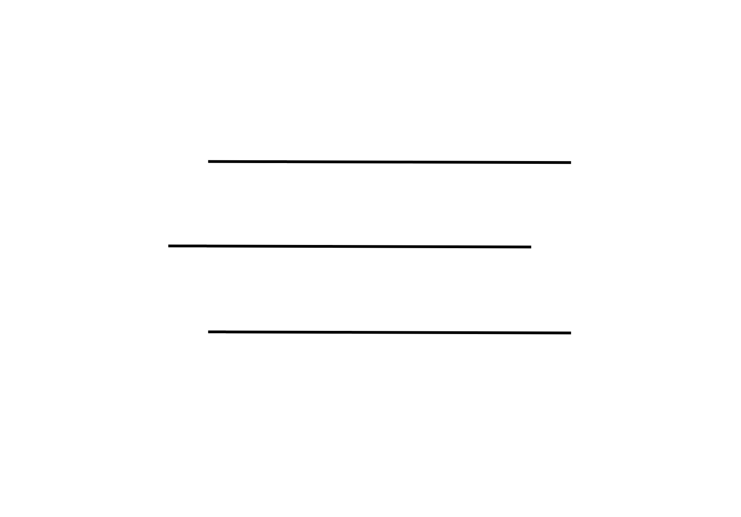
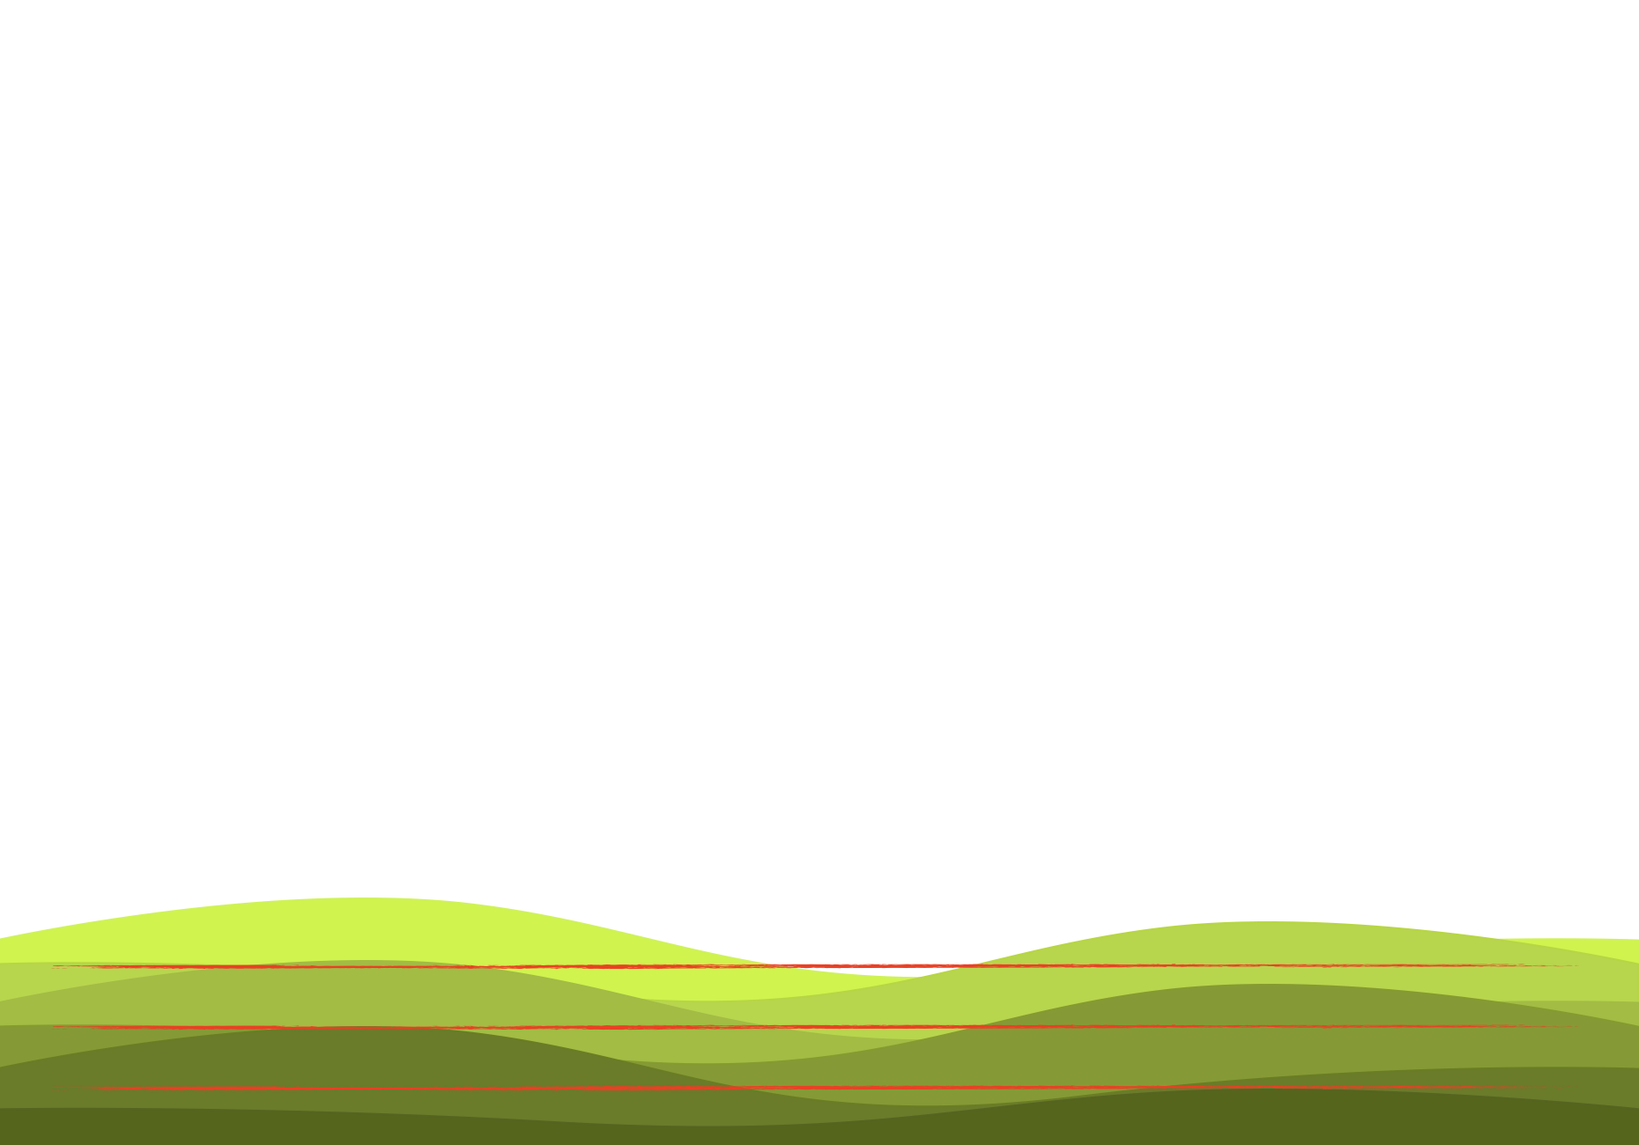
horizontal line
FORM
Parallel to the horizon
Moves left to right
Level orientation
CONTENT
Calm and quiet
Low motion / restful
Grounds the composition
Notes:
Because horizontal suggests little motion, it often feels calm and stable. The repeated bands also reinforce that calm.”
Ask: What makes the grass feel calm, direction, repetition, or both?
Ask: Where do designers use horizontal lines to create calm (interiors, branding, websites)?

Slide 9
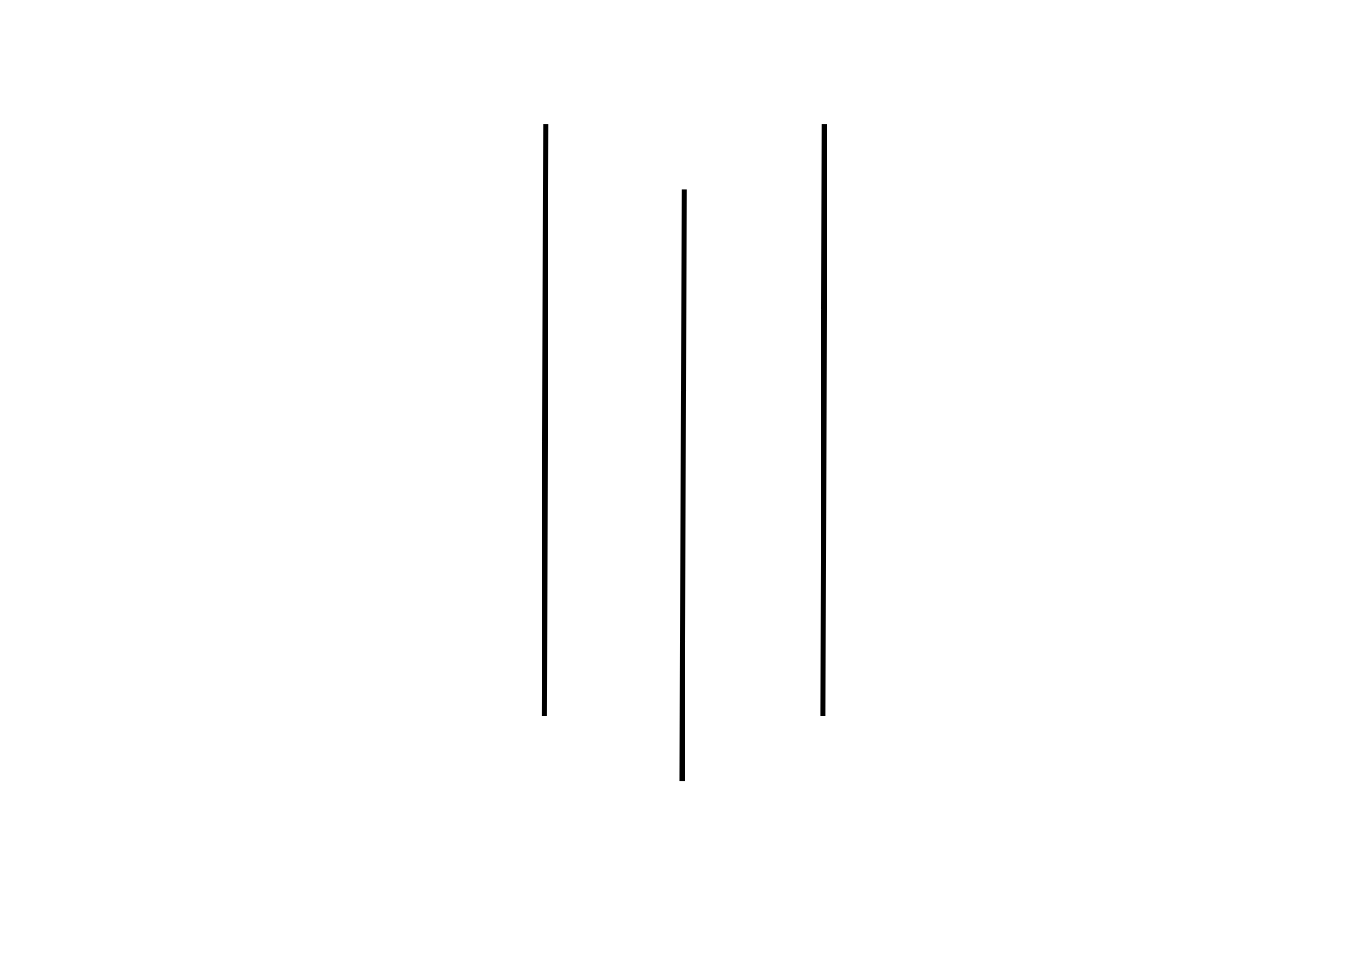
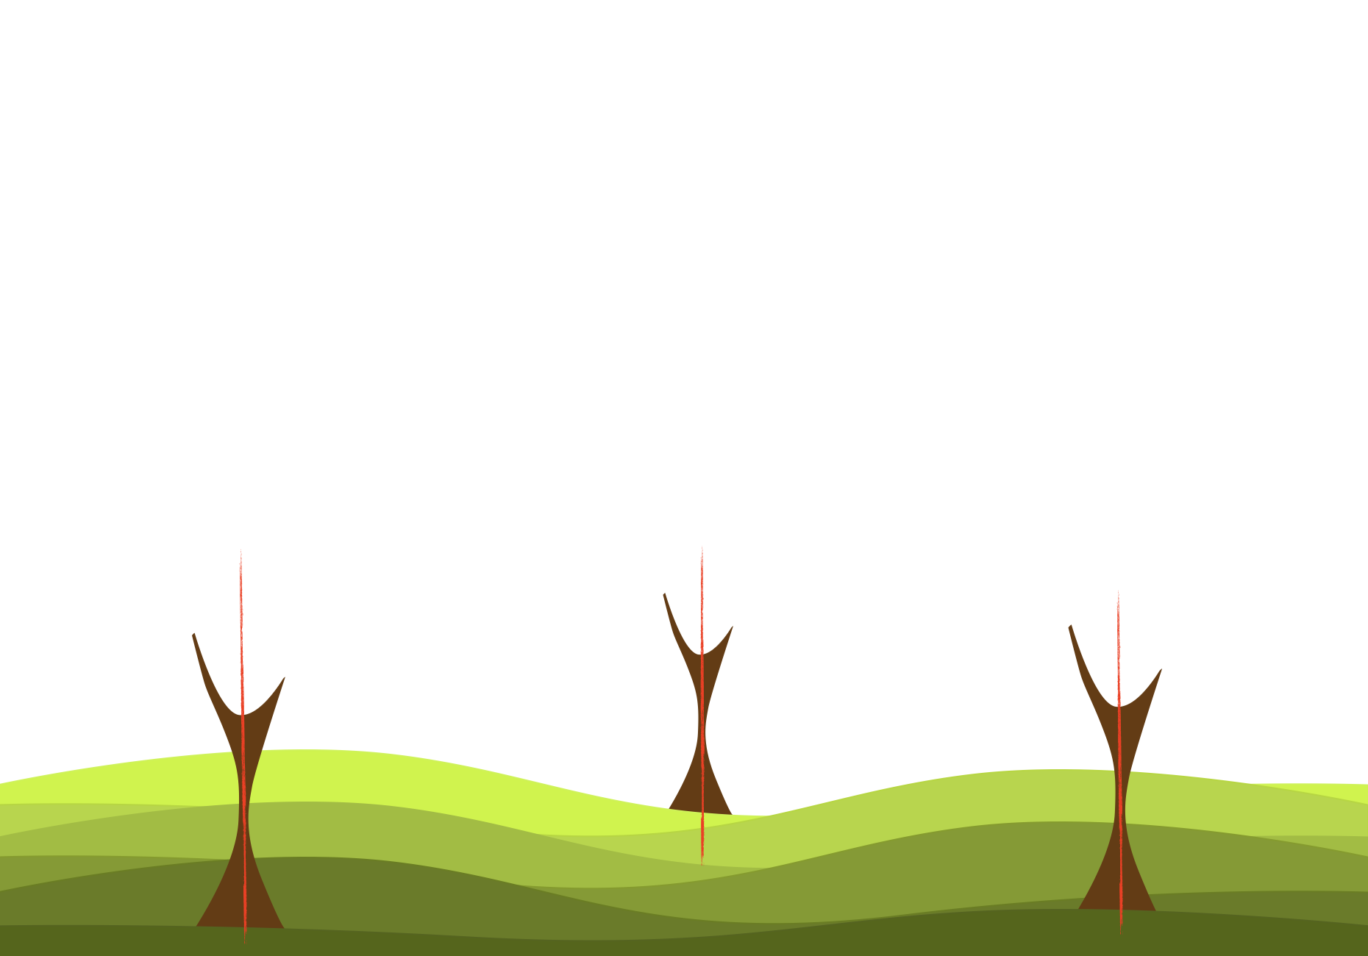
vertical line
FORM
Upright orientation
Moves up and down
Right angle to horizontal
CONTENT
Stable
Dignified
Alert / “Standing at Attention”
Notes:
Vertical lines feel stable, but they can also feel alert, like posture. The tree trunks read like they’re standing.
Have students mimic posture: slouch vs stand tall. Compare the feeling.
Ask: Where do you see vertical lines used to signal strength or formality?

Slide 10
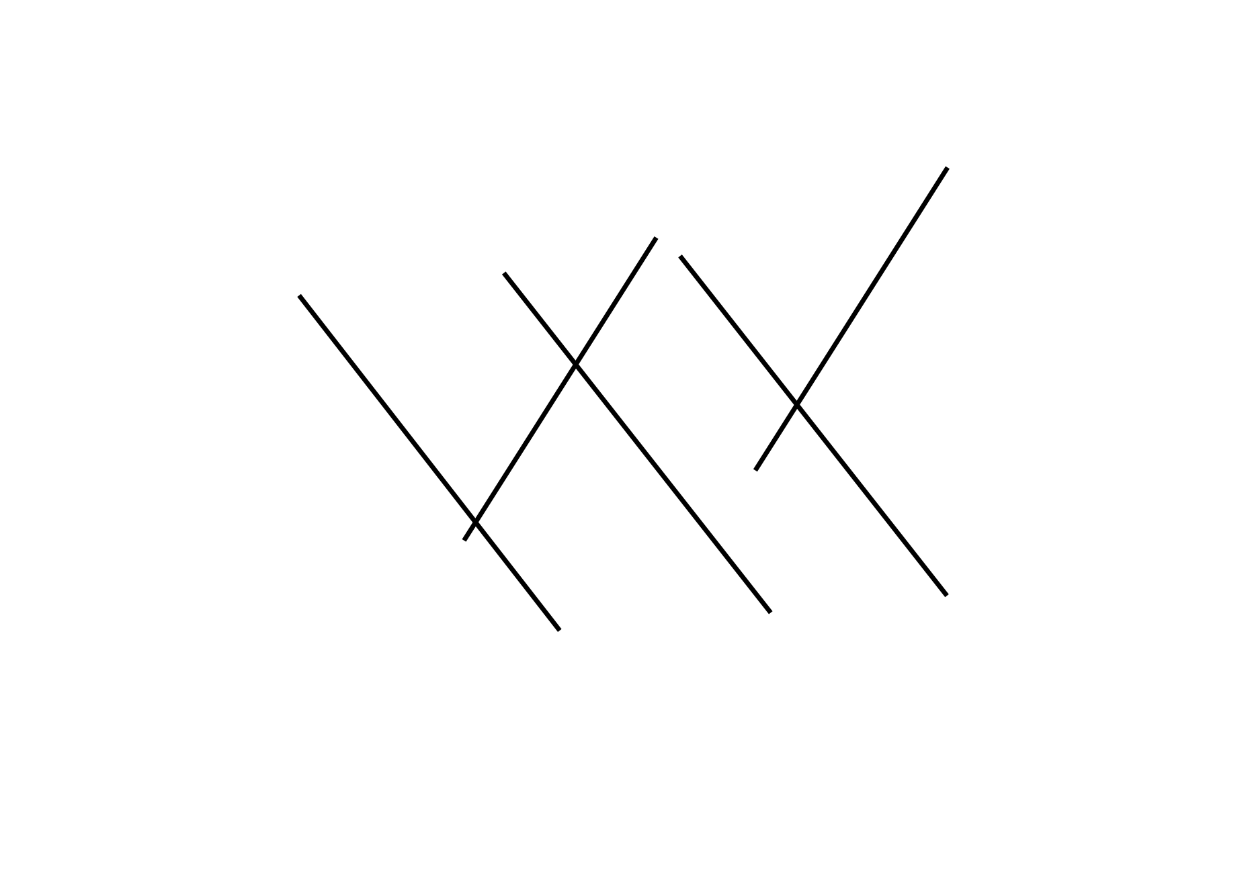
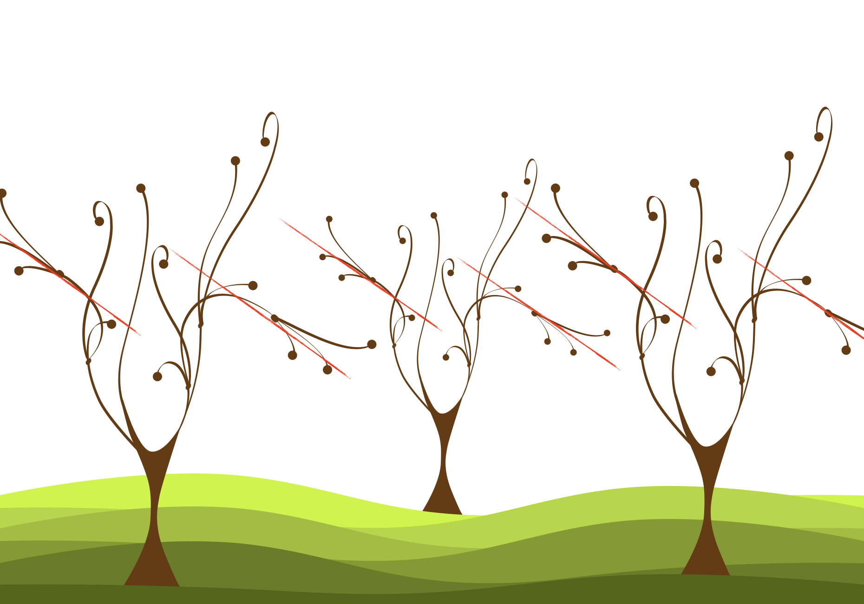
diagonal line
FORM
Slanted direction
Moves up/down and left/right
Varied angles
CONTENT
Motion and energy
Dynamic
Free / active
Notes:
Diagonal lines imply movement because they feel unstable compared to horizontal and vertical. They add energy and action.
Ask: Can you feel the difference between trunks (vertical) and branches (diagonal)?
Ask: Where do you see diagonals used for action (sports ads, film posters, game art)?

Slide 11
LINE CLASSIFICATION
even weight line
thick-to-thin line
light-to-dark line
broken line

Slide 12
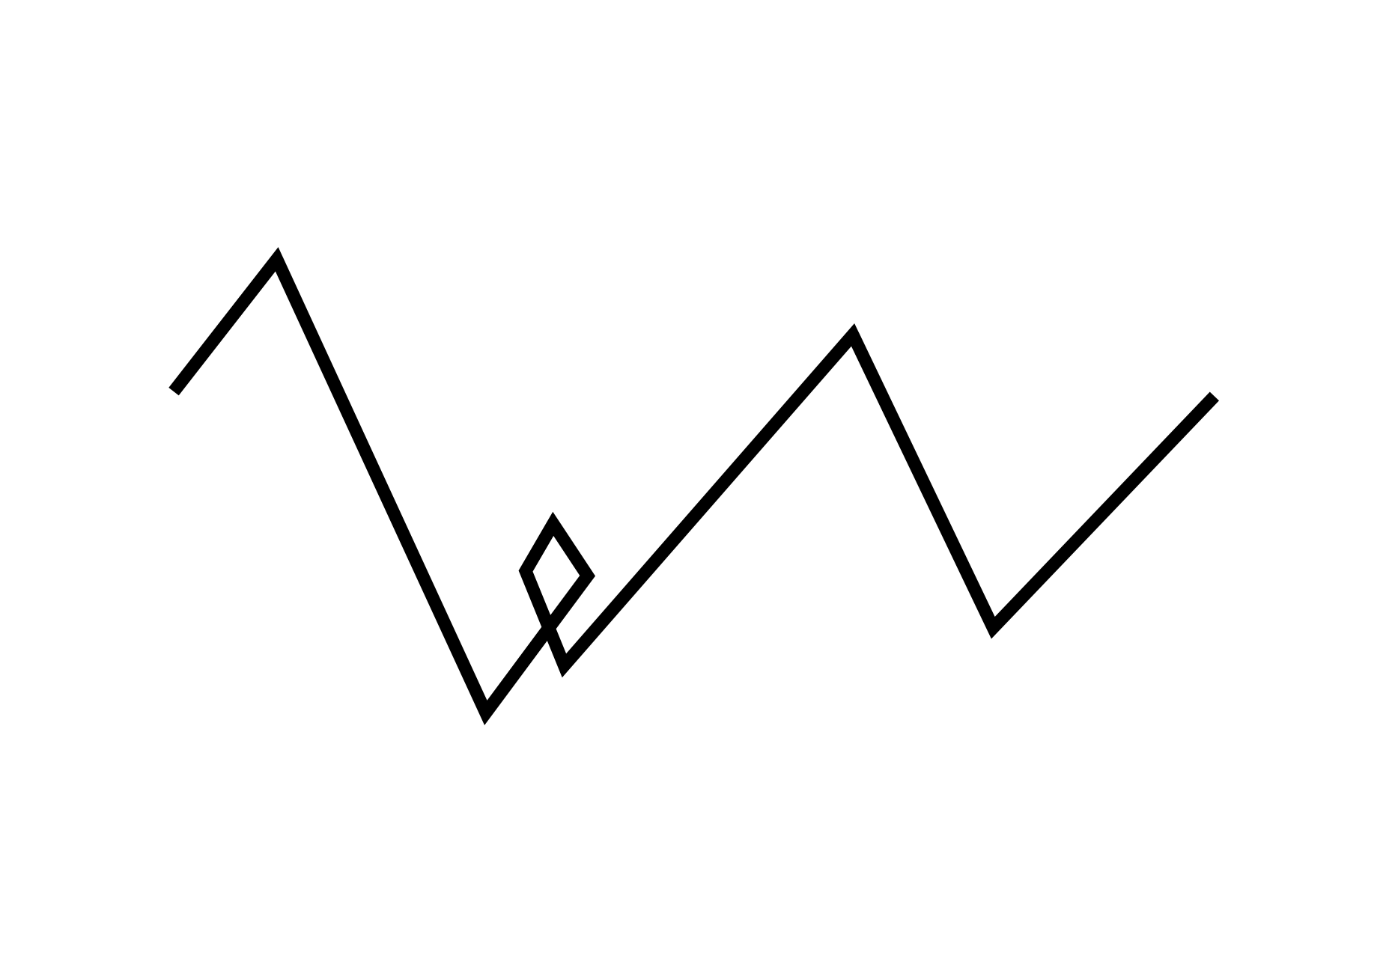

even weight line
FORM
Same width throughout
Same value throughout
Consistent stroke
CONTENT
Cold / mechanical
Rigid / impersonal
Honest, straightforward, matter-of-fact
Notes:
Even weight lines can feel mechanical and impersonal because nothing varies, so the expression is restrained.
Ask: Describe this line personality in 3 adjectives.
Ask: Where is a ‘matter-of-fact’ line useful (infographics, wayfinding, technical diagrams)?

Slide 13
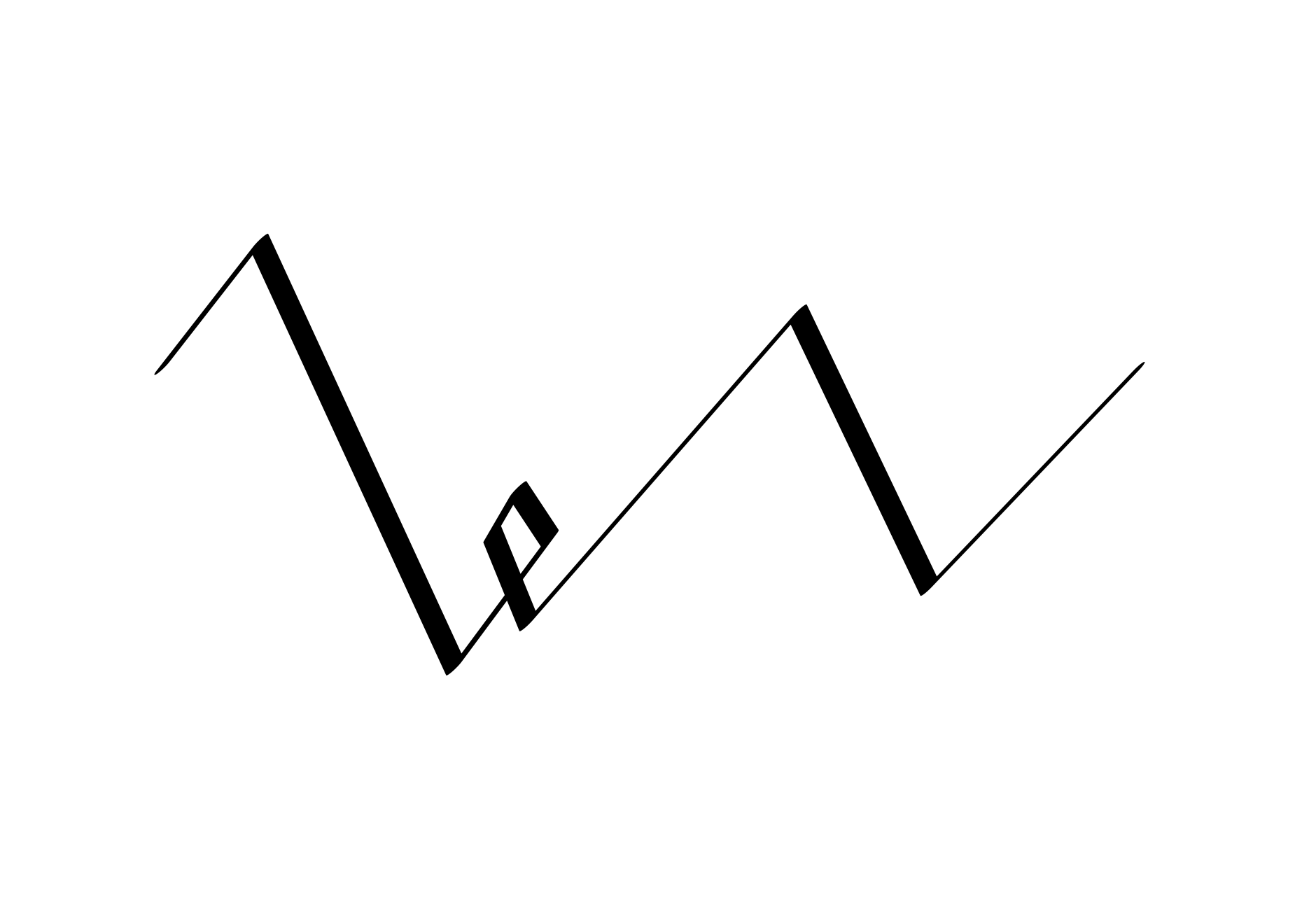

thick-to-thin line
FORM
Width varies
Value stays constant
Tapered stroke
CONTENT
Sophisticated
Elegant / classic
Confident
Notes:
When width varies, the line feels more expressive and intentional, often read as elegant or confident.
Ask: What changed emotionally from even weight to thick-to-thin?
Ask: Where do you see thick-to-thin lines used (fashion illustration, luxury branding, typography)?

Slide 14
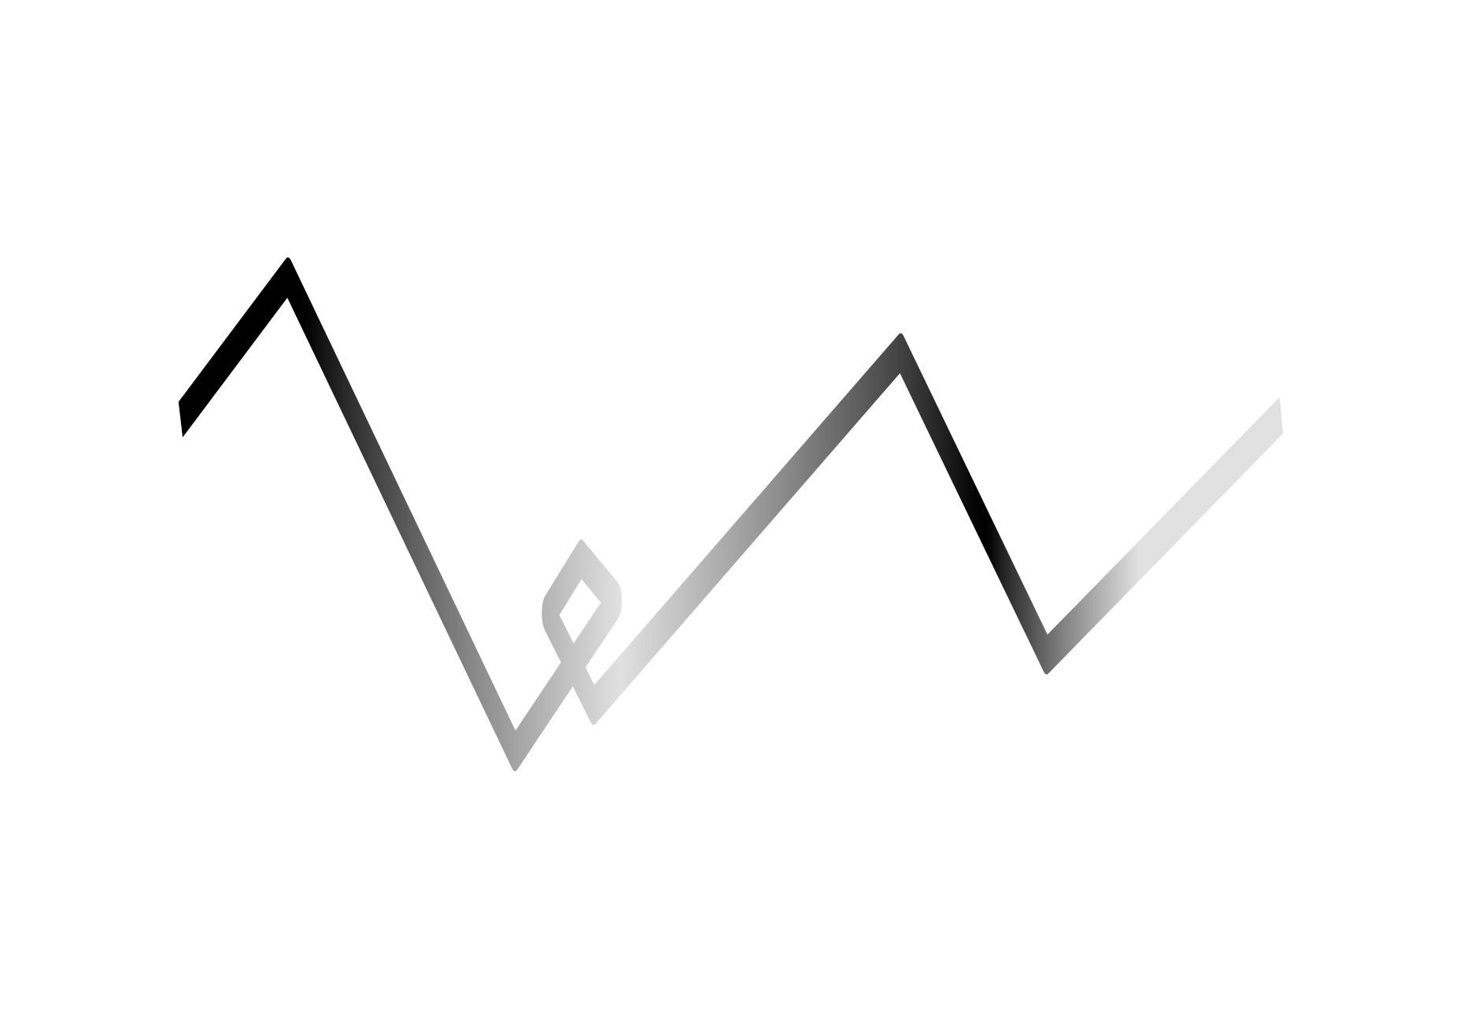

light-to-dark line
FORM
Value varies
Width stays constant
Shifts from light to dark
CONTENT
Messy
Relaxed
Spontaneous
Notes:
Changing value without changing width can feel more relaxed, like a line that isn’t trying to be perfect or controlled.
Ask: Where does the line feel strongest?
Ask: What makes this feel more spontaneous, value variation or uneven emphasis?
Ask: When would “messy/relaxed” be a good design choice?

Slide 15
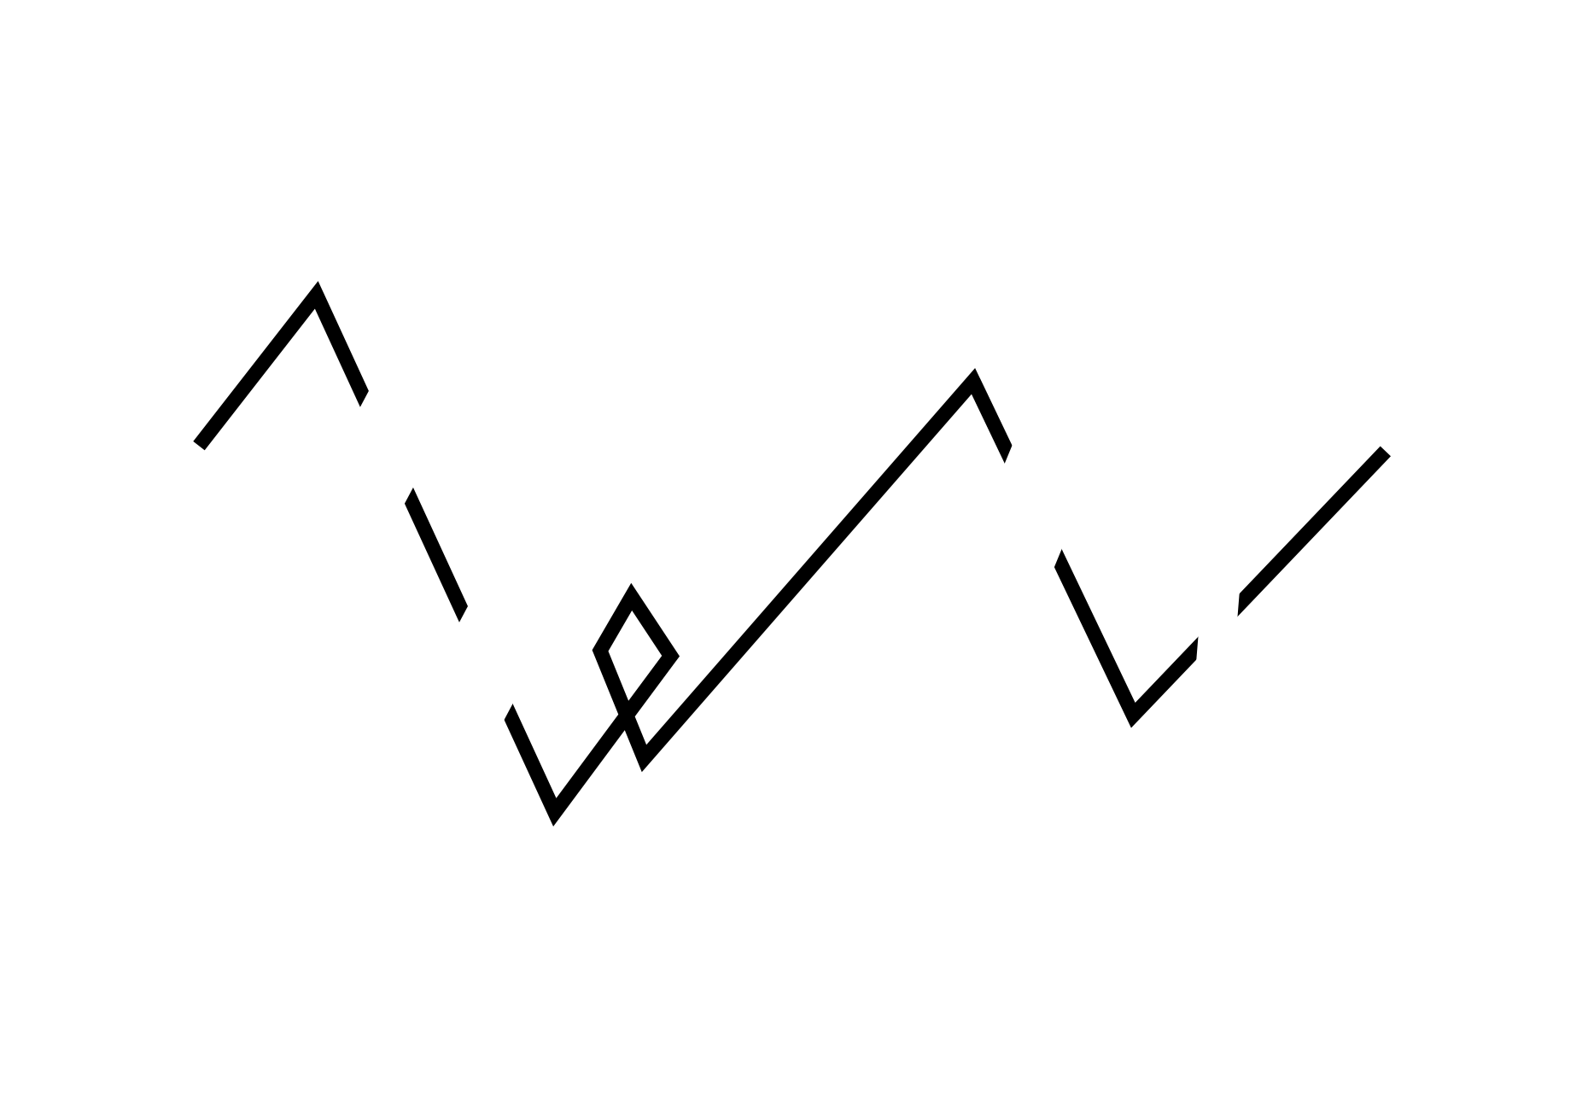
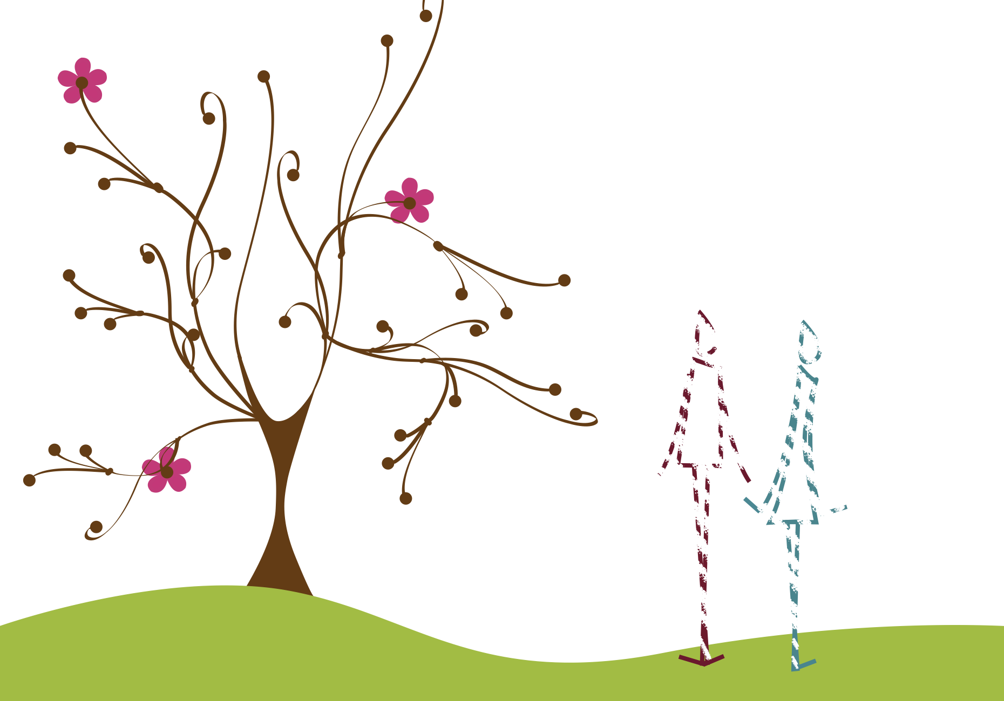
broken line
FORM
Interrupted / fades in and out
Not continuous
Completed in the mind
CONTENT
Delicate
Shy
Quiet
Notes:
When the line disappears, your mind completes it, so the line feels lighter, softer, and more fragile.
Ask: What does the fade-out do to the personality of the figures?
Ask: Where do you see broken line used (sketching, editorial illustration, fashion, animation)?

Slide 16
LINE RELATIONSHIP
parallel lines
opposing lines
radiating lines

Slide 17
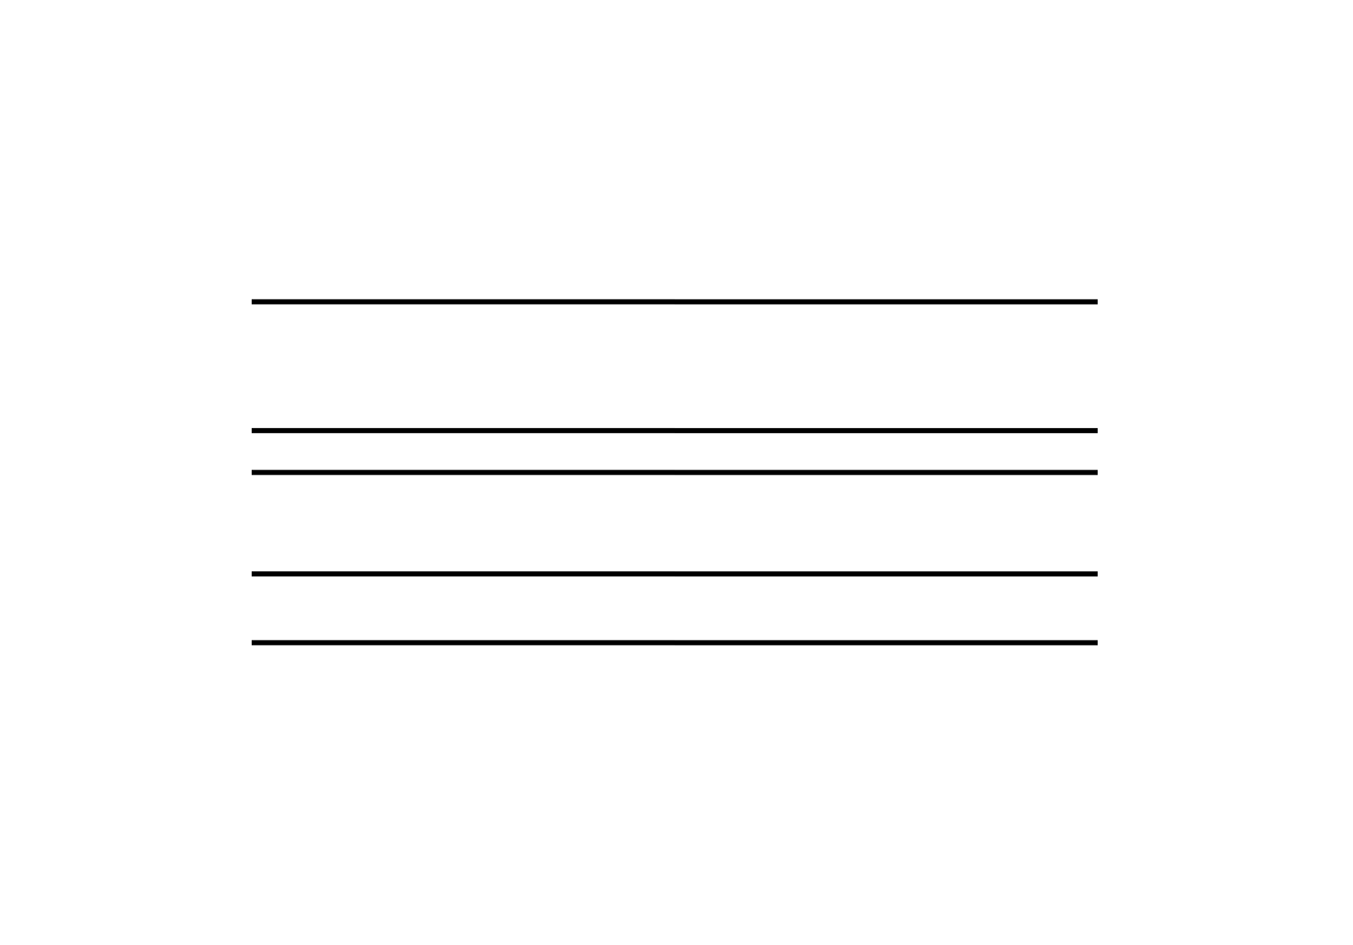

parallel lines
FORM
Lines moving the same direction
Even spacing (often)
Reinforces direction
CONTENT
Strengthens the horizontal feel
Calm / grounded
Stable visual rhythm
Notes:
Parallel lines reinforce whatever direction they share. Here, repeated horizontals make the scene feel more grounded.
Ask: How do parallel horizontals change the mood of the scene?

Slide 18
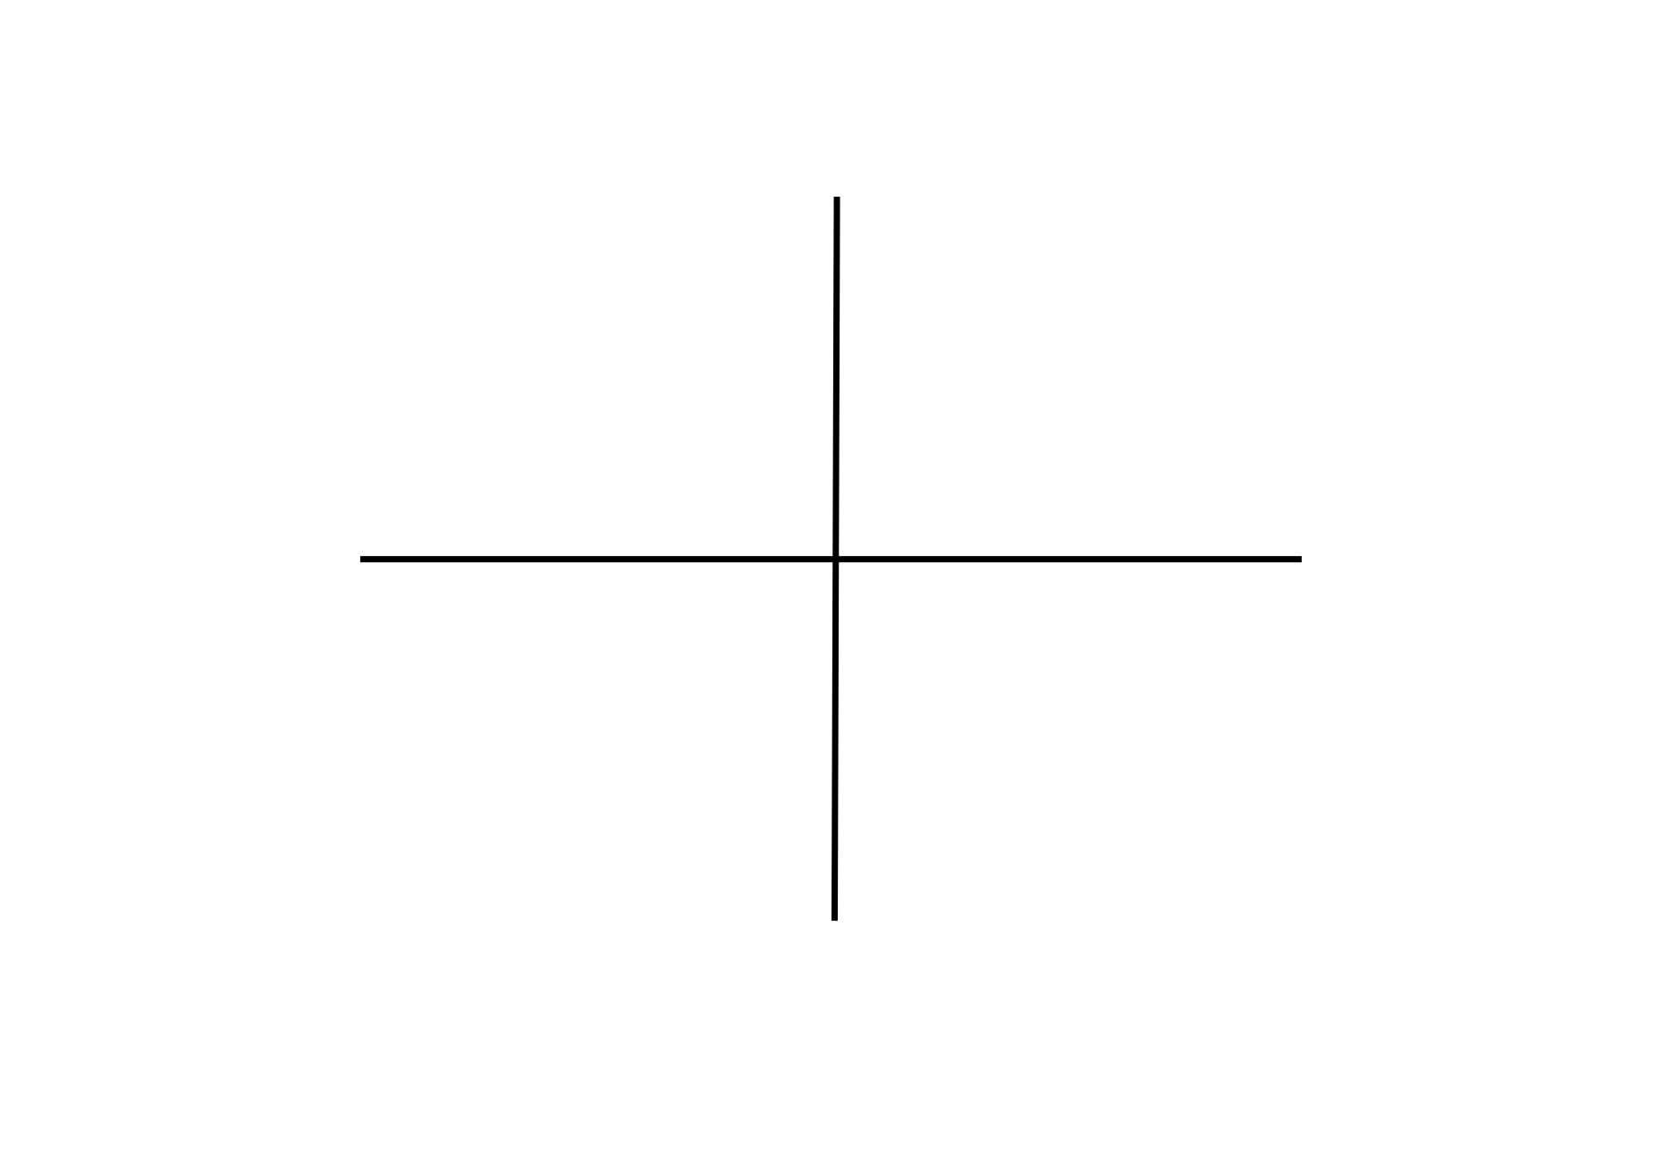
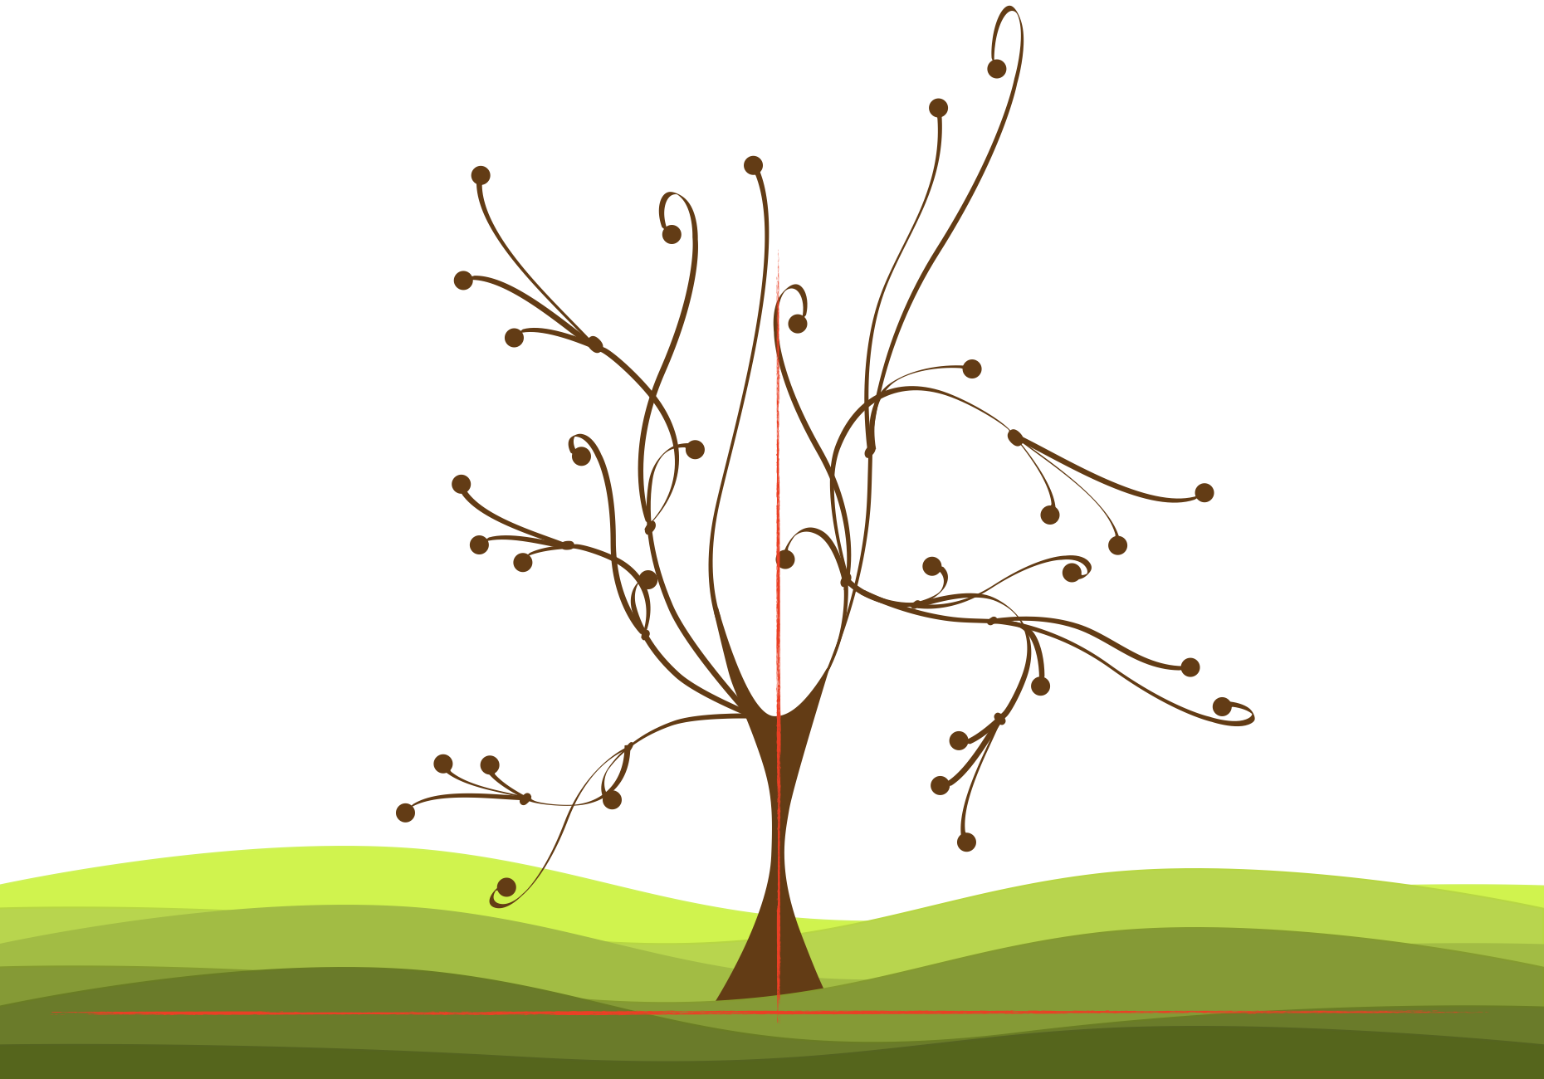
opposing lines
FORM
Lines at right angles or opposite directions
Creates opposition
Strong structural relationship
CONTENT
Stable / anchored
Structural
Strong
Notes:
Opposition often feels structural, like a framework. The vertical tree against horizontal ground makes the tree feel anchored and strong.
Ask: What feels anchored, the tree, the ground, or the whole composition?
Ask: Where do you see opposing lines used for structure (architecture, page layout, furniture)?

Slide 19
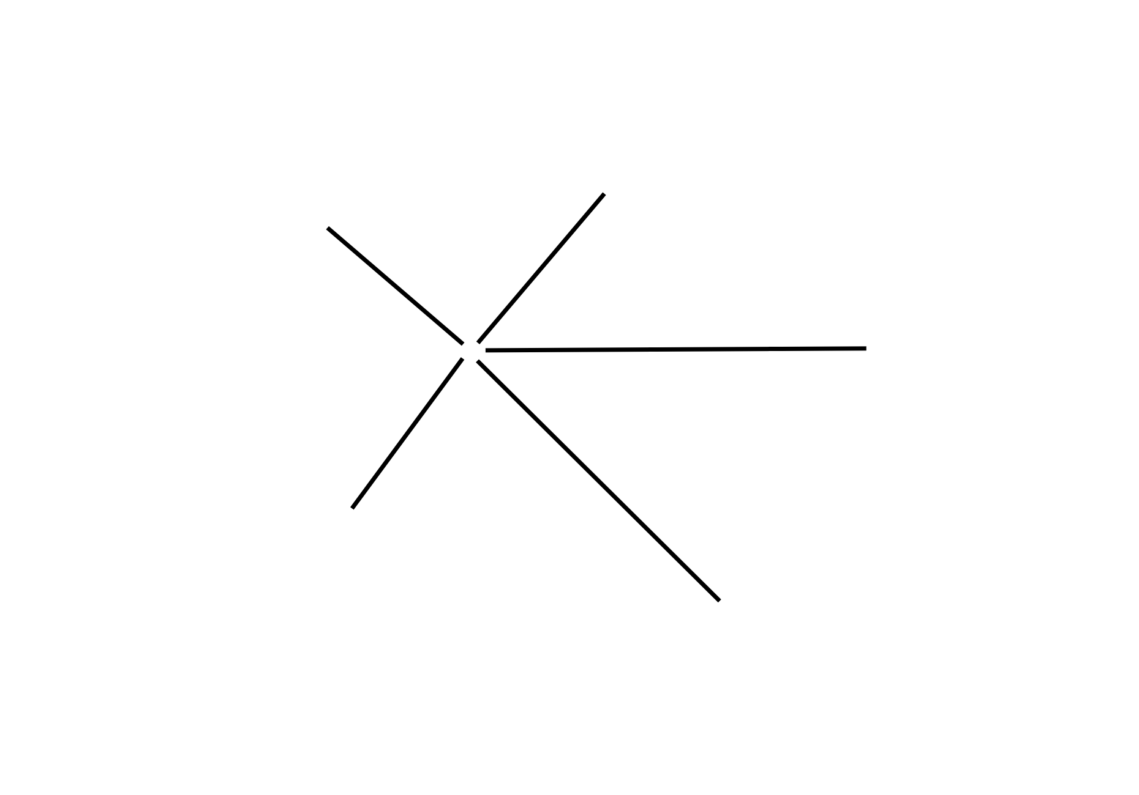

radiating lines
FORM
Starts at a central point
Fans outward
Direction spreads
CONTENT
Motion and movement
Energy / expansion
Dynamic and alive
Notes:
Radiating lines feel active because they expand from a center point, your eye moves outward, which creates motion.
Ask: What feels more active, opposing lines or radiating lines? Why?
Ask: Where do you see radiation used (sunbursts, UI highlights, composition in film posters)?
Transition: Now we’ll apply these concepts to your own design field through Making the Connection and the Commentary on Design examples.

Slide 20
MAKING THE CONNECTION
You now have an understanding of how the element line feels and what it can communicate; now take it a step further, strengthen your comprehension by applying this knowledge to your area of design!
COMMENTARY ON DESIGN
Visit Commentary on Design for inspiration.
You will discover how designers in the real world are employing the elements and principles of design in a variety of design fields!
Notes:
Goal: Turn vocabulary into observation + analysis
Your job is to spot line in the real world and describe it using our terms: type, direction, classification, and relationship, then connect it to mood and meaning.

